Slide 1
Lecture-20
Introduction to HTML

Slide 2
Content
Pseudo-Elements
CSS Image Gallery

Slide 3
What are Pseudo-Elements?
A CSS pseudo-element is used to style specific parts of an element.
For example, it can be used to:
Style the first letter or line, of an element
Insert content before or after an element
Style the markers of list items
Style the viewbox behind a dialog box

Slide 4
The ::first-line Pseudo-element
The ::first-line pseudo-element is used to add a special style to the first line of a text.

Slide 5
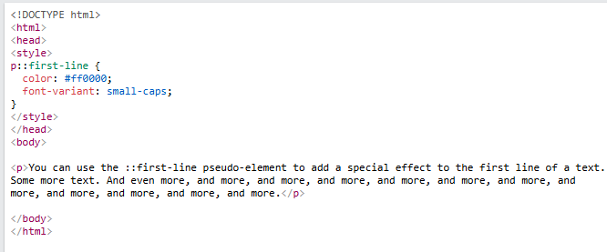

Slide 6
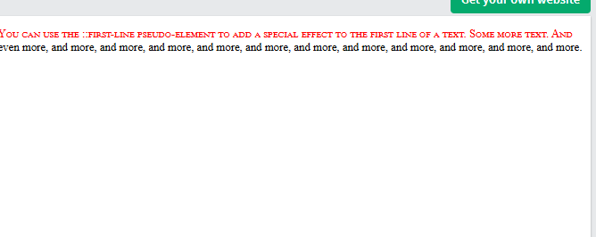

Slide 7
Multiple Pseudo-elements

Slide 8
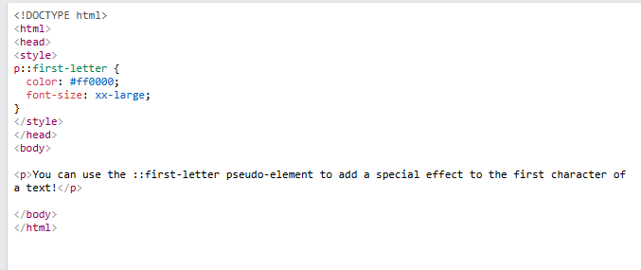

Slide 9
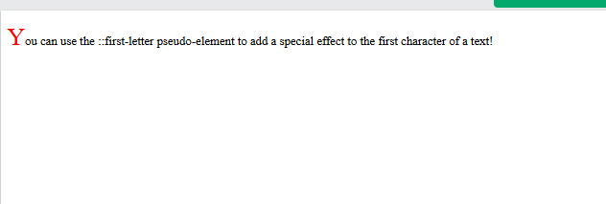

Slide 10
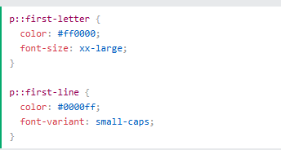

Slide 11
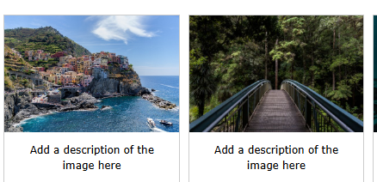
CSS Image Gallery CSS can be used to create an image gallery.

Slide 12
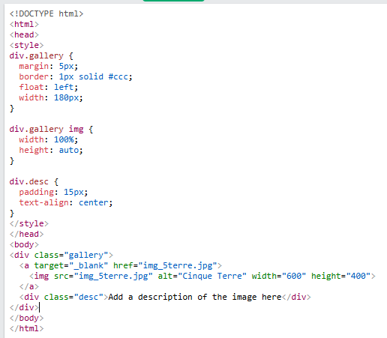

Slide 13


