Slide 1
Lecture-8
Introduction to HTML

Slide 2
Content
CSS
Border
Margin
Padding

Slide 3
External CSS
An external style sheet is used to define the style for many HTML pages.
To use an external style sheet, add a link to it in the <head> section of each HTML page:

Slide 4
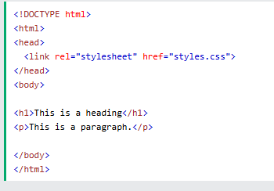

Slide 5
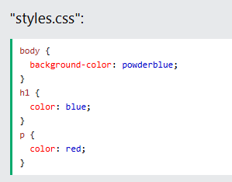

Slide 6
CSS Colors, Fonts and Sizes
Here, we will demonstrate some commonly used CSS properties. You will learn more about them later.
The CSS color property defines the text color to be used.
The CSS font-family property defines the font to be used.
The CSS font-size property defines the text size to be used.

Slide 7
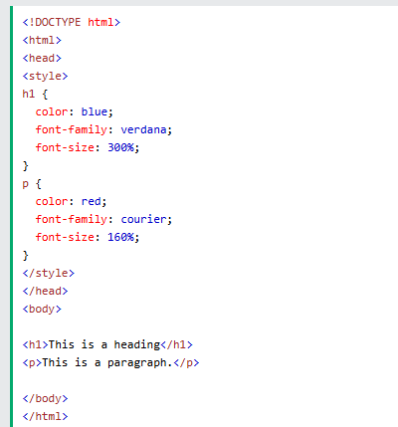

Slide 8
CSS Border
The CSS border property defines a border around an HTML element. CSS Padding
The CSS padding property defines a padding (space) between the text and the border.

Slide 9
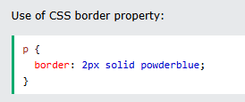

Slide 10
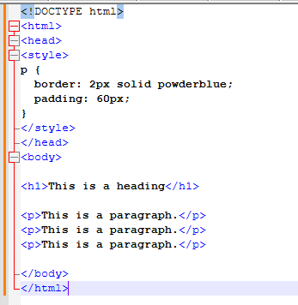

Slide 11
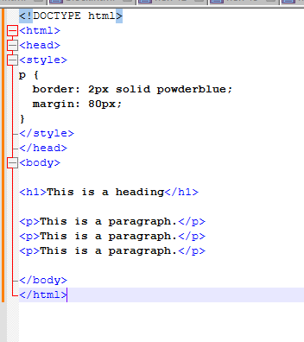
CSS Margin The CSS margin property defines a margin (space) outside the border.

Slide 12
Link to External CSS
External style sheets can be referenced with a full URL or with a path relative to the current web page.
This example uses a full URL to link to a style sheet:
<link rel="stylesheet" href="https://www.w3schools.com/html/styles.css">

Slide 13
This example links to a style sheet located in the html folder on the current web site:
<link rel="stylesheet" href="/html/styles.css">
This example links to a style sheet located in the same folder as the current page:
<link rel="stylesheet" href="styles.css">

Slide 14


