Slide 1
Lecture-9
Introduction to HTML

Slide 2
Content
What is XHTML?
Border
Margin
Padding

Slide 3
What is XHTML?
XHTML stands for EXtensible HyperText Markup Language
XHTML is a stricter, more XML-based version of HTML
XHTML is HTML defined as an XML application
XHTML is supported by all major browsers

Slide 4
Why XHTML?
XML is a markup language where all documents must be marked up correctly (be "well-formed").
XHTML was developed to make HTML more extensible and flexible to work with other data formats (such as XML).

Slide 5
The Most Important Differences from HTML
<!DOCTYPE> is mandatory
The xmlns attribute in <html> is mandatory
<html>, <head>, <title>, and <body> are mandatory
Elements must always be properly nested
Elements must always be closed

Slide 6
Elements must always be in lowercase
Attribute names must always be in lowercase
Attribute values must always be quoted
Attribute minimization is forbidden

Slide 7
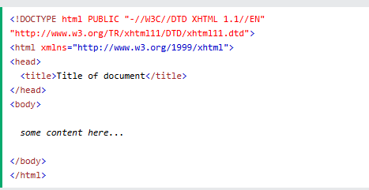

Slide 8
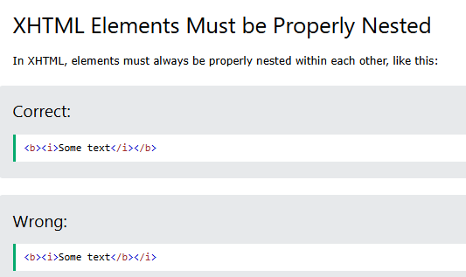

Slide 9
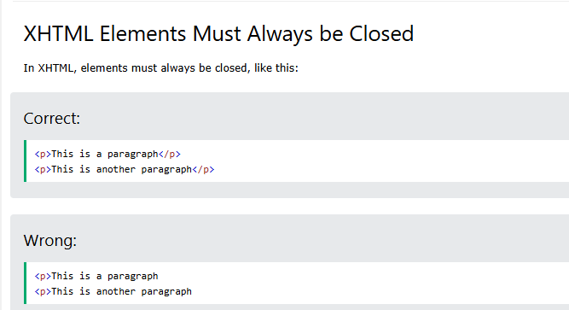

Slide 10
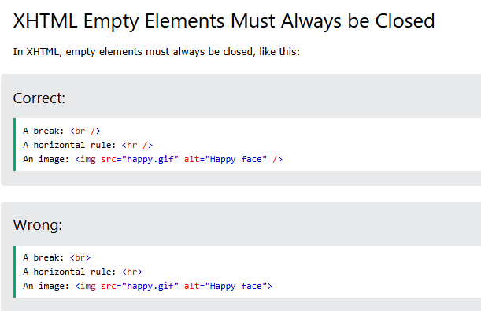

Slide 11
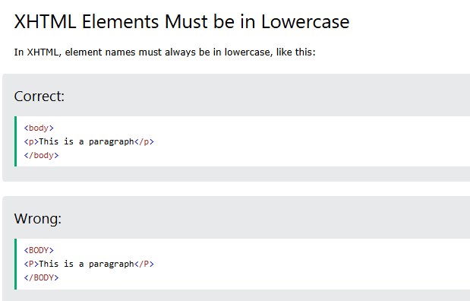

Slide 12
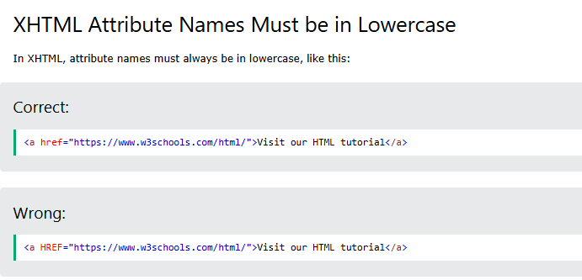

Slide 13
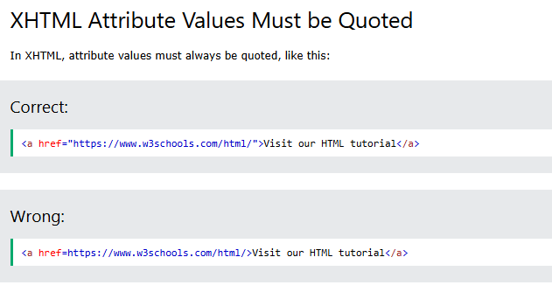

Slide 14
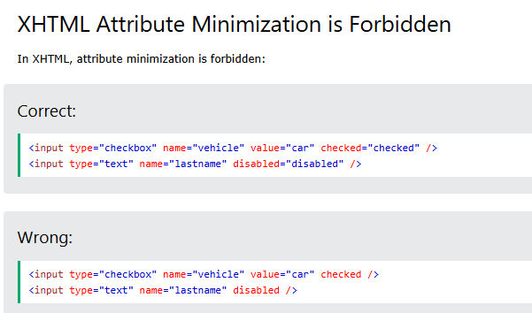

Slide 15


