Slide 1
Lecture-1
Introduction to HTML

Slide 2
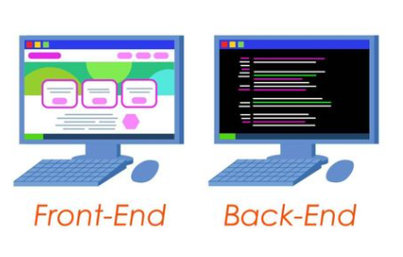
Real Life Example

Slide 3
What is HTML?
HTML is the standard markup language for web pages and web applications.
HTML stands for HYPERTEXT MARKUP LANGUAGE.
With HTML you can create your Own Static Website.
This markup tells a web browser how to display the text, images and other form of multimedia on a webpage.

Slide 4
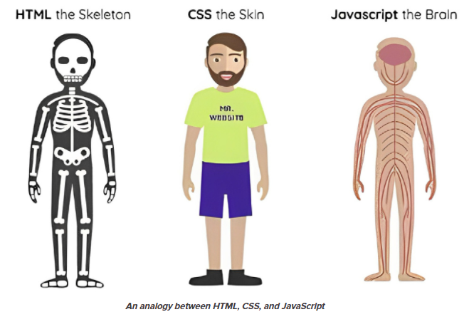

Slide 5
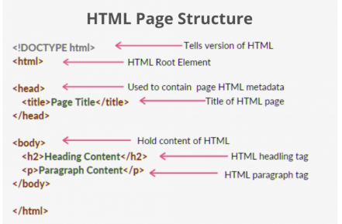

Slide 6
HTML Element
An HTML Tag with attributes and content is called HTML Element..
Basically all HTML Elements are build using html tags.
HTML elements are represented by tags
Container Tag/ Pair Tag:
Start and end tags are also called opening tags and closing tags. For ex <b> and </b>
Empty Tag: Only opening tag is used.
For ex <br> or <hr>

Slide 7
HTML Tags
HTML Tags are used to add content in html, like text, headings, table, list links etc.
Tags along with attributes are core components of HTML.
The latest version of HTML, i.e HTML5 includes 142 tags.
HTML tags are used to build webpage structure, like p, h1, h2, h3, address, b, i, etc.
Tags can have attributes to add extra information.

Slide 8
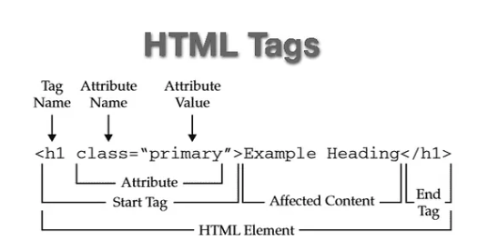

Slide 9
What do I need to create HTML?
Computer
Text or HTML editor:
For ex, HTML editors are Dreamweaver, SeaMonkey, Coffee Cup, Text Pad etc.
The text editors are include Notepad(for windows), Pico(for Linux), or Simple text/ text Edit/Text.
Web Browser. For Ex Internet Explorer of Firefox

Slide 10
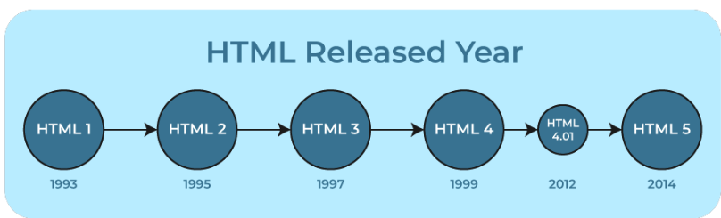

Slide 11
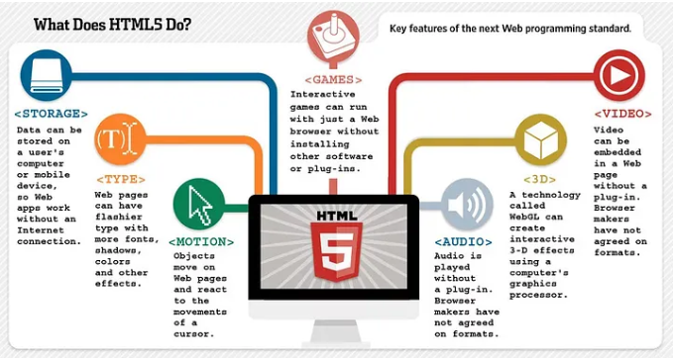

Slide 12
HTML5
The most interesting new API’s in HTML 5 are:
HTML Geolocation
Drag and Drop
Local Storage
Application Cache
Web Workers
Server Sent Events
Audio & Video-
Canvas-

Slide 13
Next lecture
Discussion on different HTML tags…………

Slide 14


