Slide 1
Lecture-4
Introduction to HTML

Slide 2
Content
Table
HTML form

Slide 3
HTML tables
To arrange data into rows and columns.
Define an HTML Table
Each table row is defined with a <tr> tag.
Each table header is defined with a <th> tag. Each table data/cell is defined with a <td> tag.

Slide 4
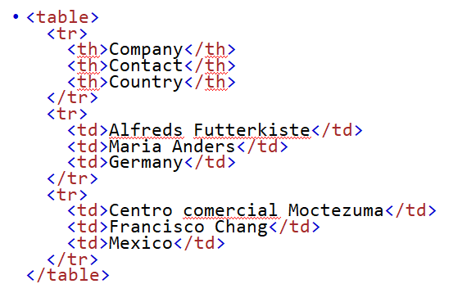

Slide 5

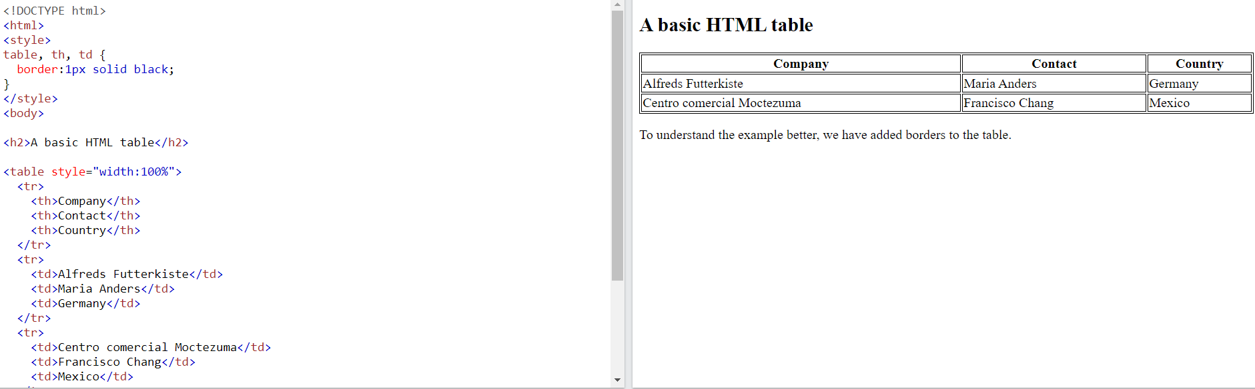
HTML table

Slide 6
Strong tag
An HTML form is used to collect user input. The user input is most often sent to a server for processing.
The HTML <form> element is used to create an HTML form for user input:
<form> . form elements . </form>

Slide 7
The <input> Element
The HTML <input> element is the most used form element.
An <input> element can be displayed in many ways, depending on the type attribute.

Slide 8
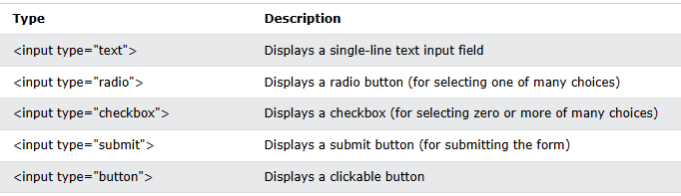

Slide 9
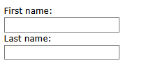
<form> <label for="fname">First name:</label><br> <input type="text" id="fname" name="fname"><br> <label for="lname">Last name:</label><br> <input type="text" id="lname" name="lname"> </form>

Slide 10
The <label> Element
Notice the use of the <label> element in the example above.
The <label> tag defines a label for many form elements.
The for attribute of the <label> tag should be equal to the id attribute of the <input> element to bind them together.

Slide 11
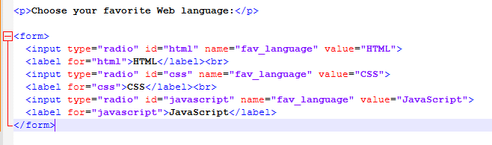
Radio Buttons
The <input type="radio"> defines a radio button.

Slide 12
This is how the HTML code above will be displayed in a browser:
Choose your favorite Web language:
HTML CSS JavaScript

Slide 13
Checkboxes
The <input type="checkbox"> defines a checkbox.
Checkboxes let a user select ZERO or MORE options of a limited number of choices.

Slide 14
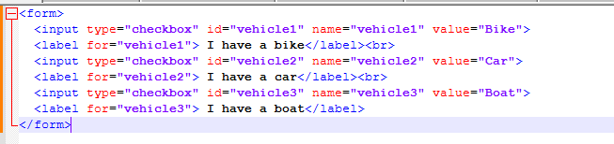

Slide 15
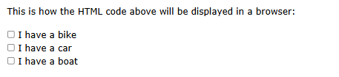

Slide 16
The Submit Button
The <input type="submit"> defines a button for submitting the form data to a form-handler.
The Name Attribute for <input>
Notice that each input field must have a name attribute to be submitted.
If the name attribute is omitted, the value of the input field will not be sent at all.

Slide 17
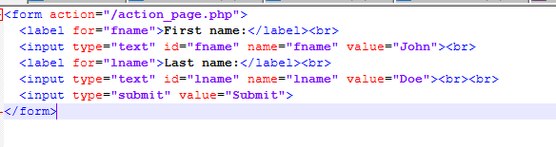

Slide 18
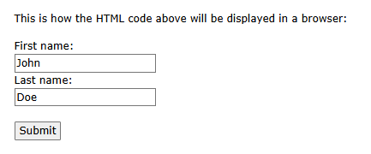

Slide 19
Next lecture
Discussion on different Tables…………

Slide 20


