Slide 1
SQL server schema for Products, Categories and ProductCategory Mappings
CREATE TABLE [dbo].[Product](
[ProductId] BIGINT IDENTITY(1,1) PRIMARY KEY NOT NULL,
[ProductDesc] VARCHAR(450) NOT NULL,
[ProductCurrency] VARCHAR(450) NOT NULL,
[Price] VARCHAR(450) NOT NULL,
[ProductCode] VARCHAR(450) NOT NULL,
[ProductType] VARCHAR(450) NOT NULL,
[UnitsInStock] [bigint] NOT NULL,
[CreatedAt] [datetime] NOT NULL,
[LastModifiedAt] [datetime] NOT NULL)
GO
CREATE TABLE [dbo].[Category](
[CategoryId] BIGINT IDENTITY(1,1) PRIMARY KEY NOT NULL,
[CategoryDesc] VARCHAR(450) NOT NULL,
[CategoryName] VARCHAR(450) NOT NULL,
[ParentCategoryId] [bigint] NOT NULL,
[CreatedAt] [datetime] NOT NULL,
[LastModifiedAt] [datetime] NOT NULL)
GO
CREATE TABLE [dbo].[ProductCategory](
[CategoryId] BIGINT NOT NULL,
[ProductId] BIGINT NOT NULL,
primary key (CategoryId, ProductId))
GO

Slide 2
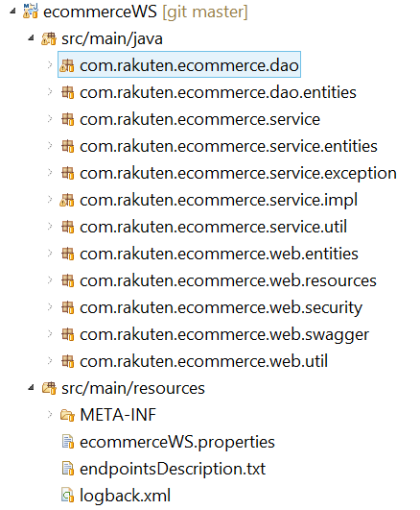
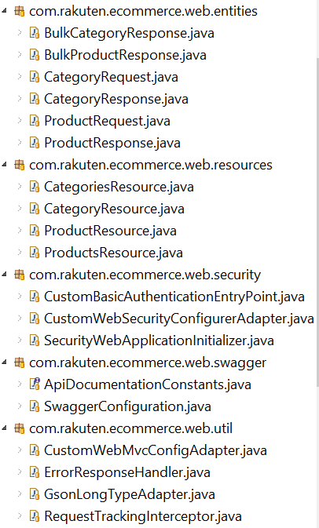
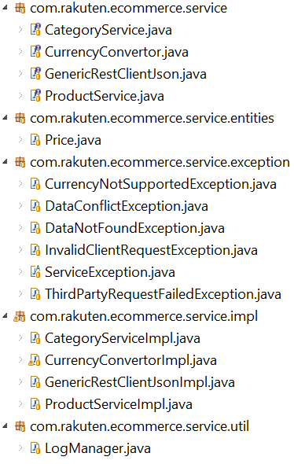
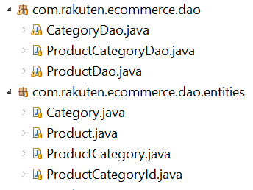
Overall code structure and design
Overall codebase
Web Layer
Service Layer
DAO Layer

Slide 3
Tech stack and open source libraries used
Spring MVC and Jackson for building REST APIs
Spring framework (core, web, beans, aop, context, orm etc) for DI, AOP, ORM, Transaction etc.
Springfox Swagger for REST API documentation
Spring security for basic authentication
Spring Retry for retrying DAO calls
Hibernate with JPA conventions
Logback with SLF4J conventions
Mockito, PowerMockito and Junit for unit testing
SQL server as the database

Slide 4
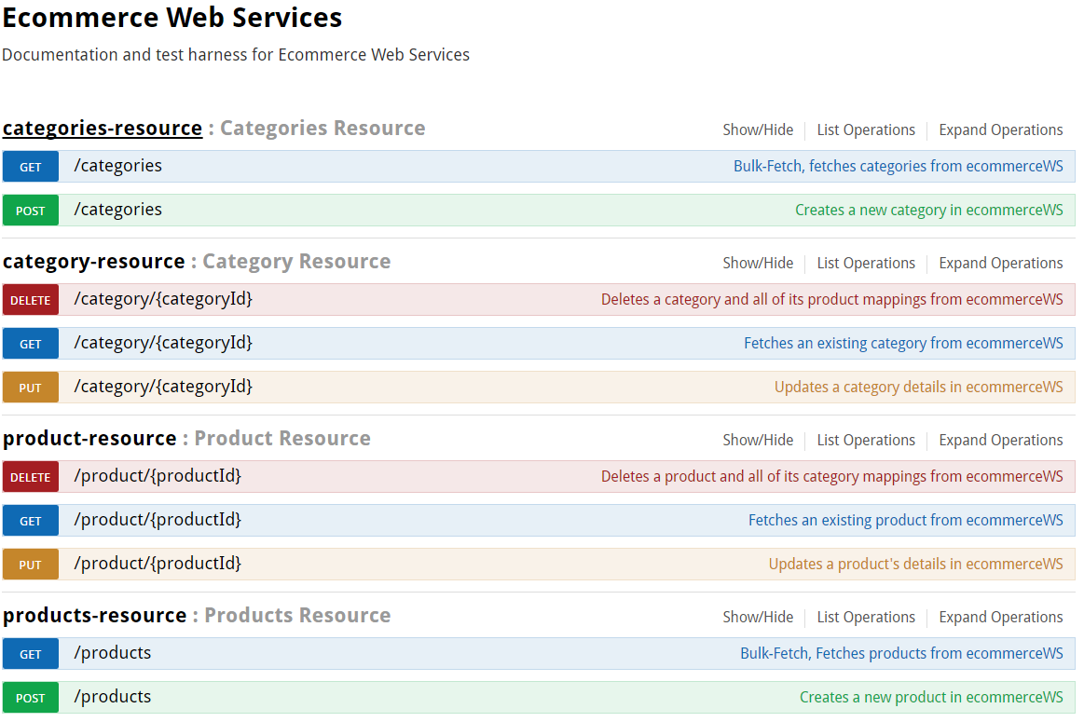
Category and product CRUD operations as captured from swagger

Slide 5
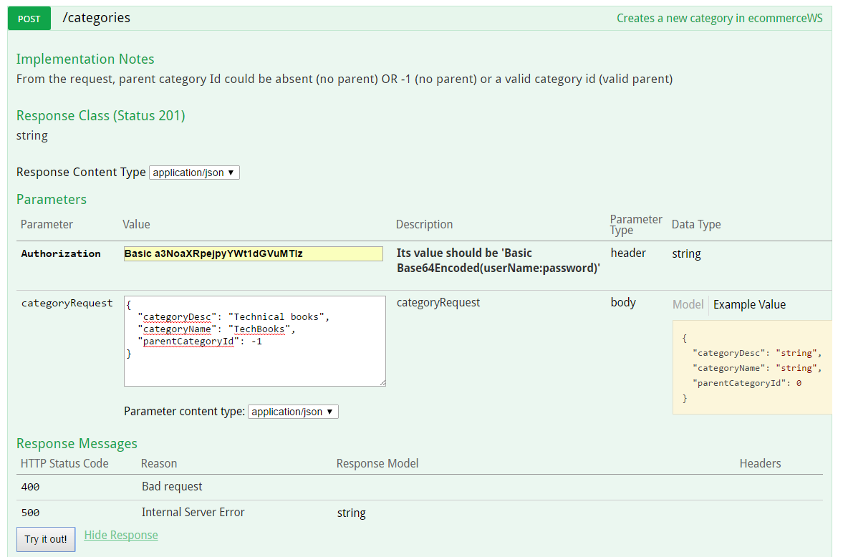
POST on Categories resource

Slide 6
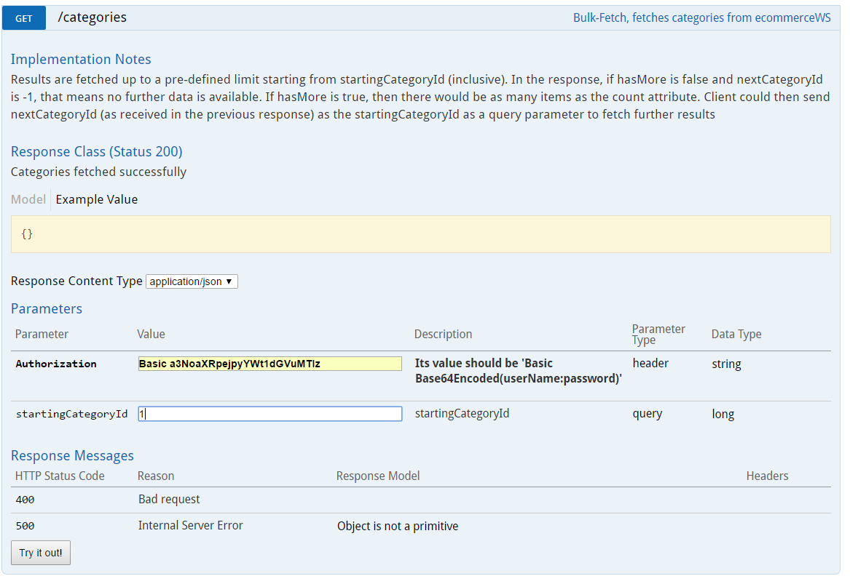
GET on Categories resource (Bulk GET)

Slide 7
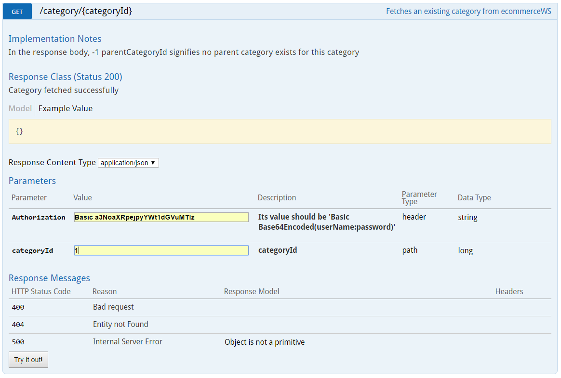
GET on Category resource

Slide 8
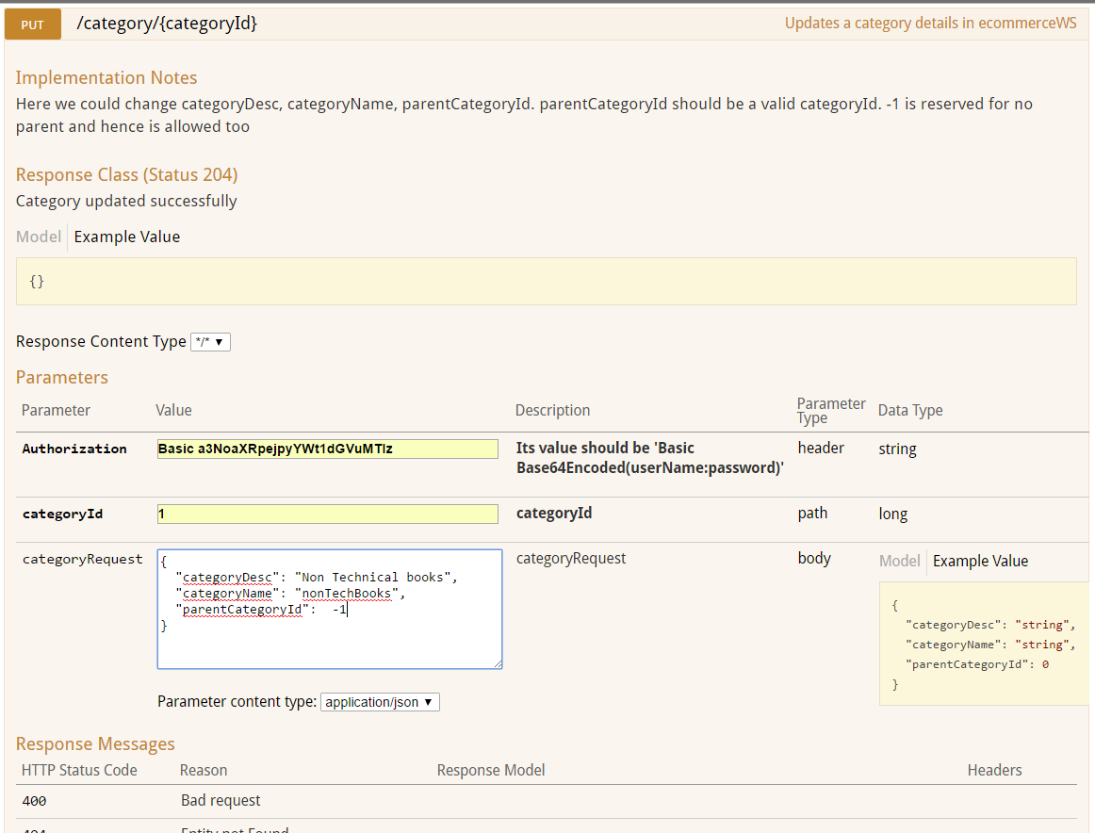
PUT on Category resource

Slide 9
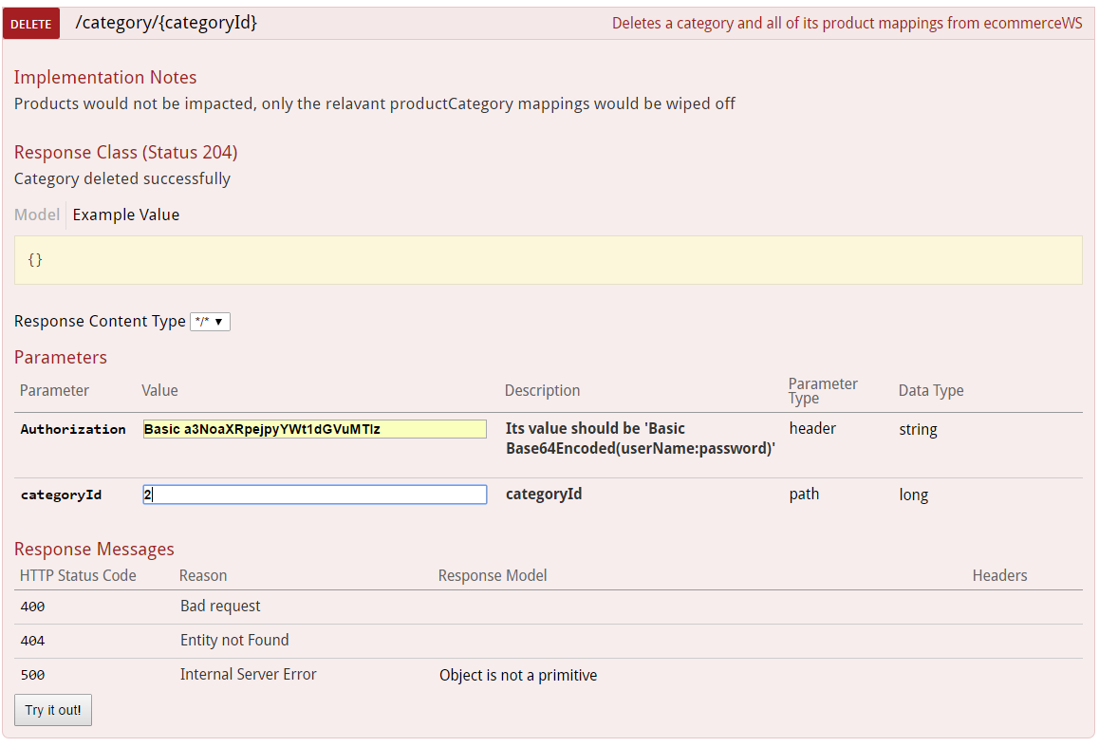
DELETE on Category resource

Slide 10
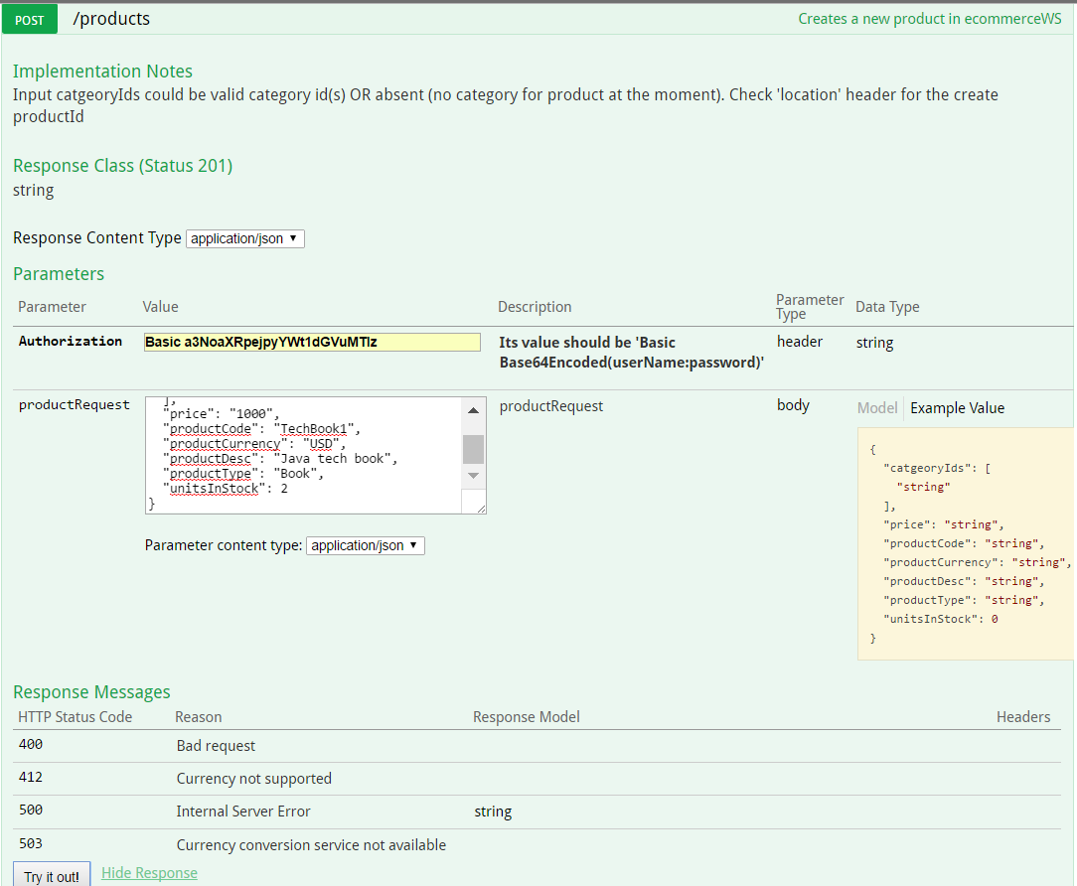
POST on Products resource

Slide 11
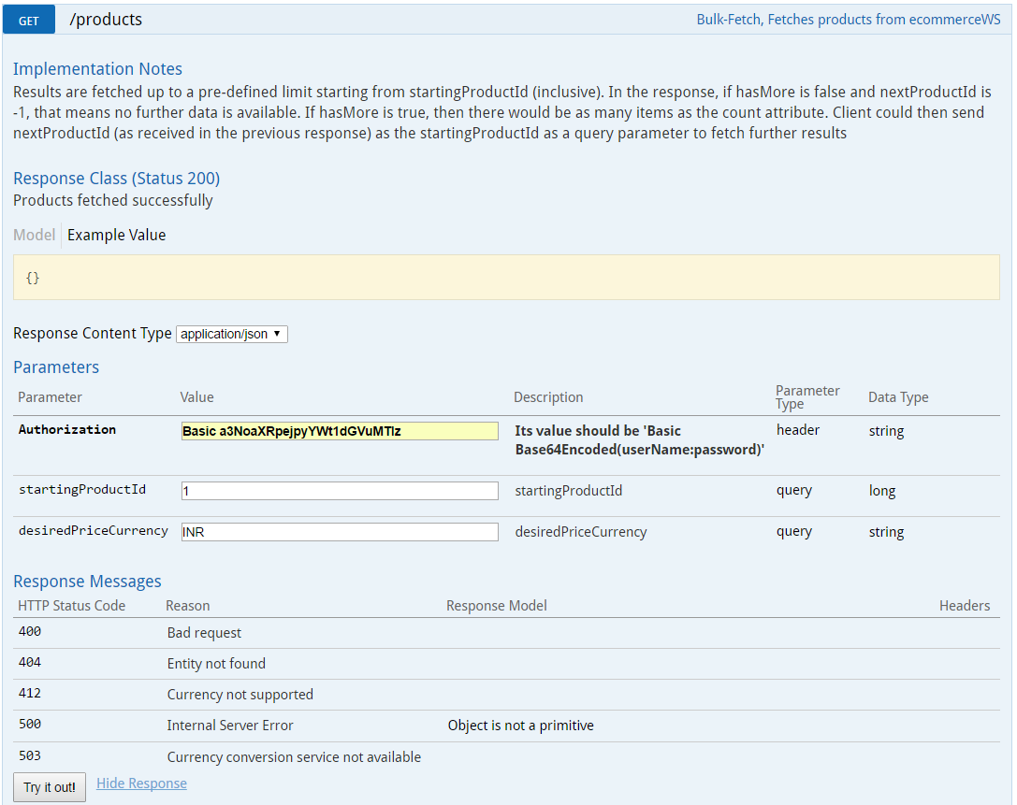
GET on Products resource (Bulk GET)

Slide 12
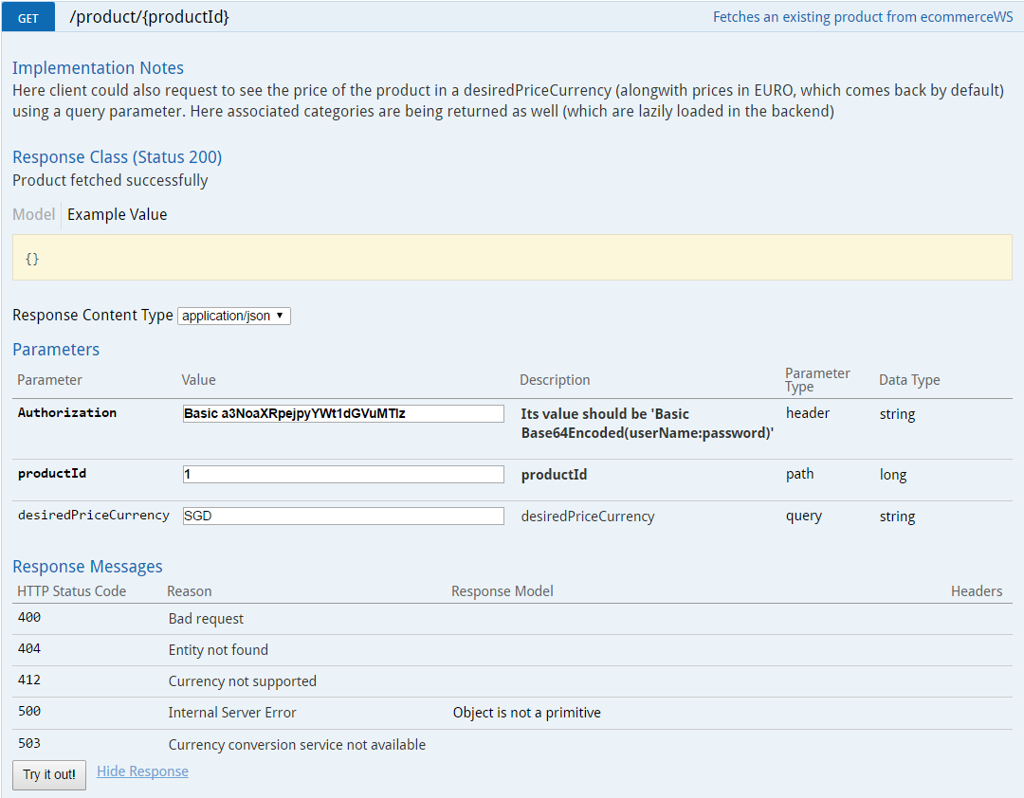
GET on Product resource

Slide 13
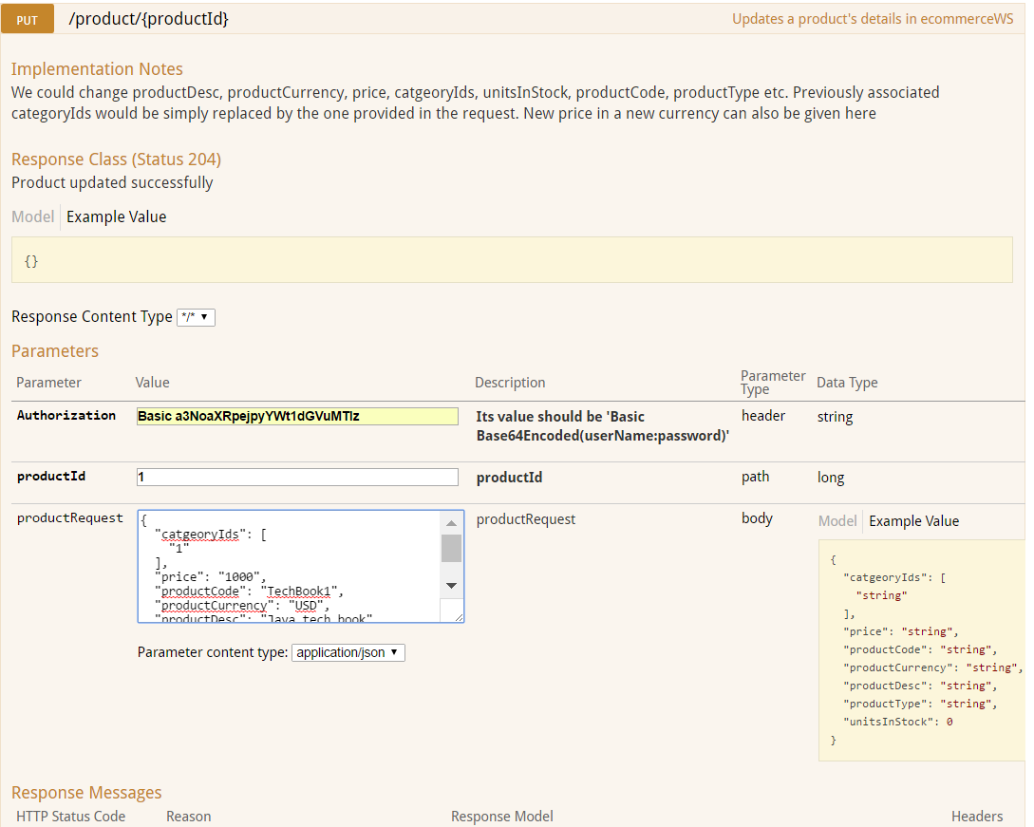
PUT on Product resource

Slide 14
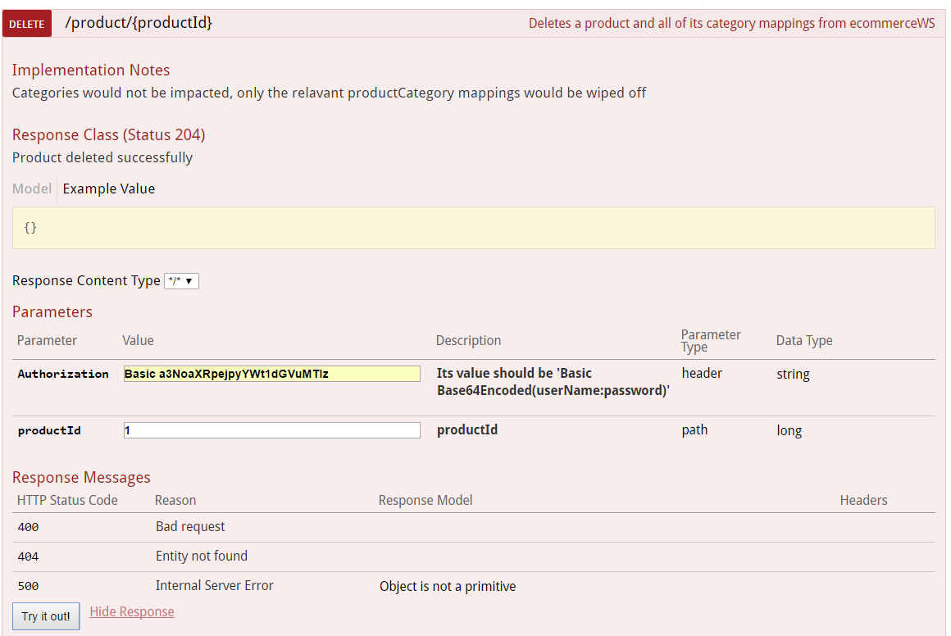
DELETE on Product resource

