Slide 1
Ecommerce SQL server schema
CREATE TABLE [dbo].[Product](
[ProductId] BIGINT IDENTITY(1,1) PRIMARY KEY NOT NULL,
[ProductDesc] VARCHAR(450) NOT NULL,
[ProductCurrency] VARCHAR(450) NOT NULL,
[Price] VARCHAR(450) NOT NULL,
[ProductCode] VARCHAR(450) NOT NULL,
[ProductType] VARCHAR(450) NOT NULL,
[UnitsInStock] [bigint] NOT NULL,
[CreatedAt] [datetime] NOT NULL,
[LastModifiedAt] [datetime] NOT NULL)
GO
CREATE TABLE [dbo].[Category](
[CategoryId] BIGINT IDENTITY(1,1) PRIMARY KEY NOT NULL,
[CategoryDesc] VARCHAR(450) NOT NULL,
[CategoryName] VARCHAR(450) NOT NULL,
[ParentCategoryId] [bigint] NOT NULL,
[CreatedAt] [datetime] NOT NULL,
[LastModifiedAt] [datetime] NOT NULL)
GO
CREATE TABLE [dbo].[ProductCategory](
[CategoryId] BIGINT NOT NULL,
[ProductId] BIGINT NOT NULL,
primary key (CategoryId, ProductId))
GO

Slide 2
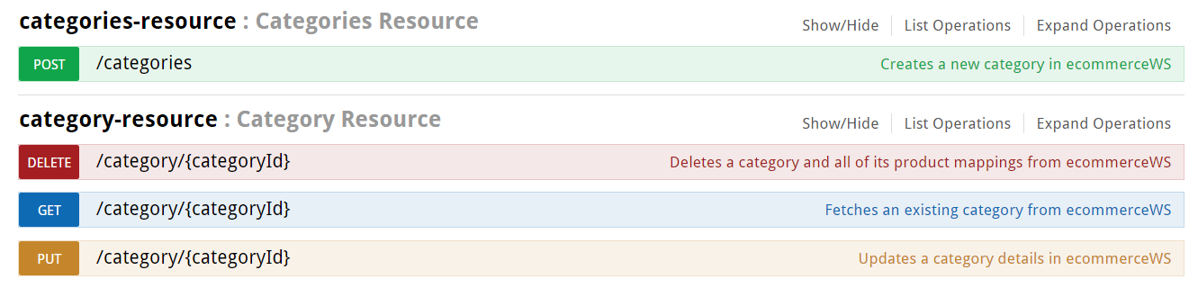
Category CRUD operations

Slide 3
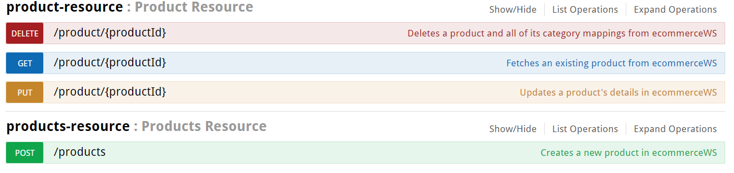
Product CRUD operations

Slide 4
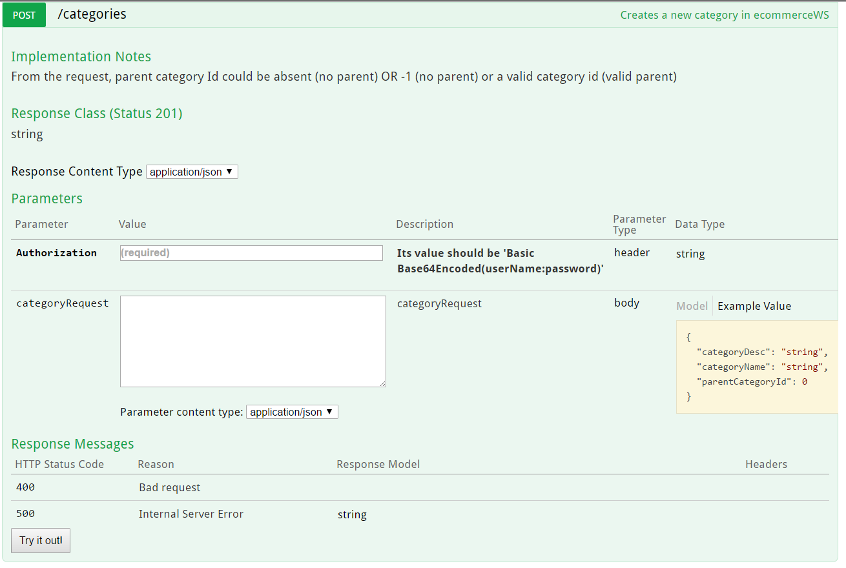
Category POST operation

Slide 5
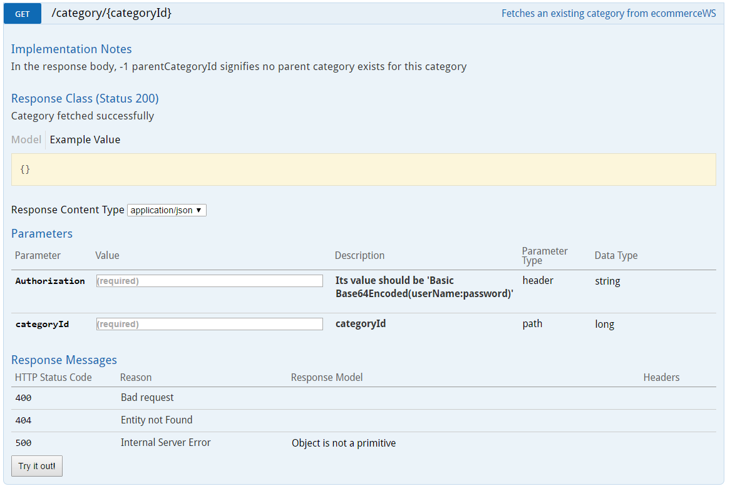
Category GET operation

Slide 6
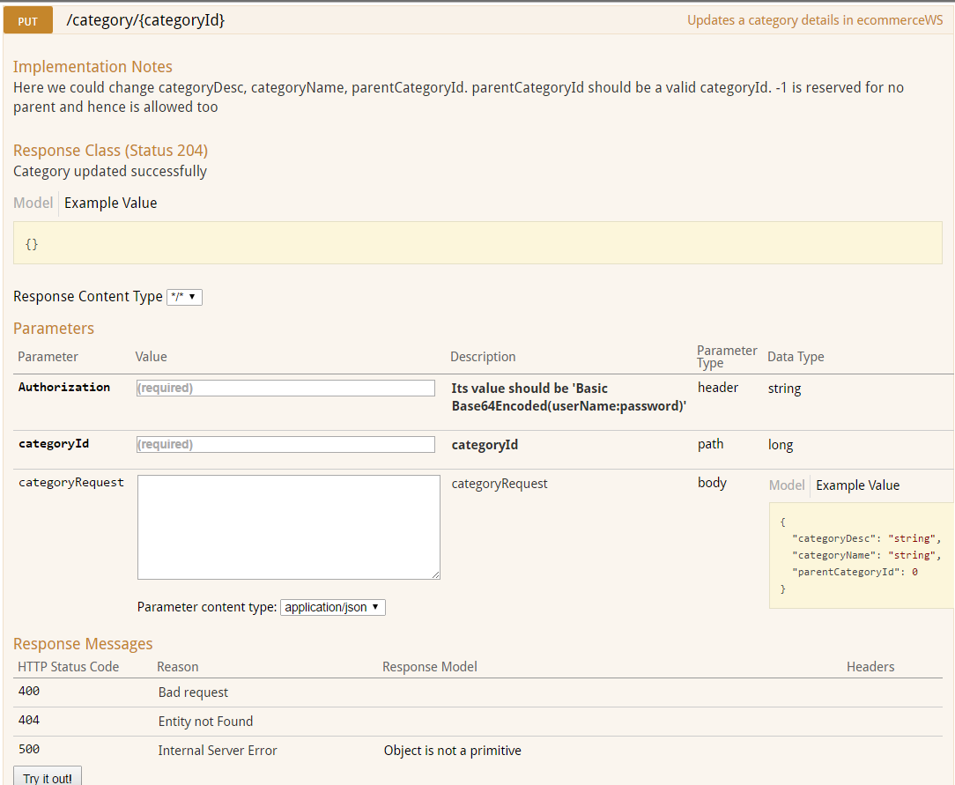
Category PUT operation

Slide 7
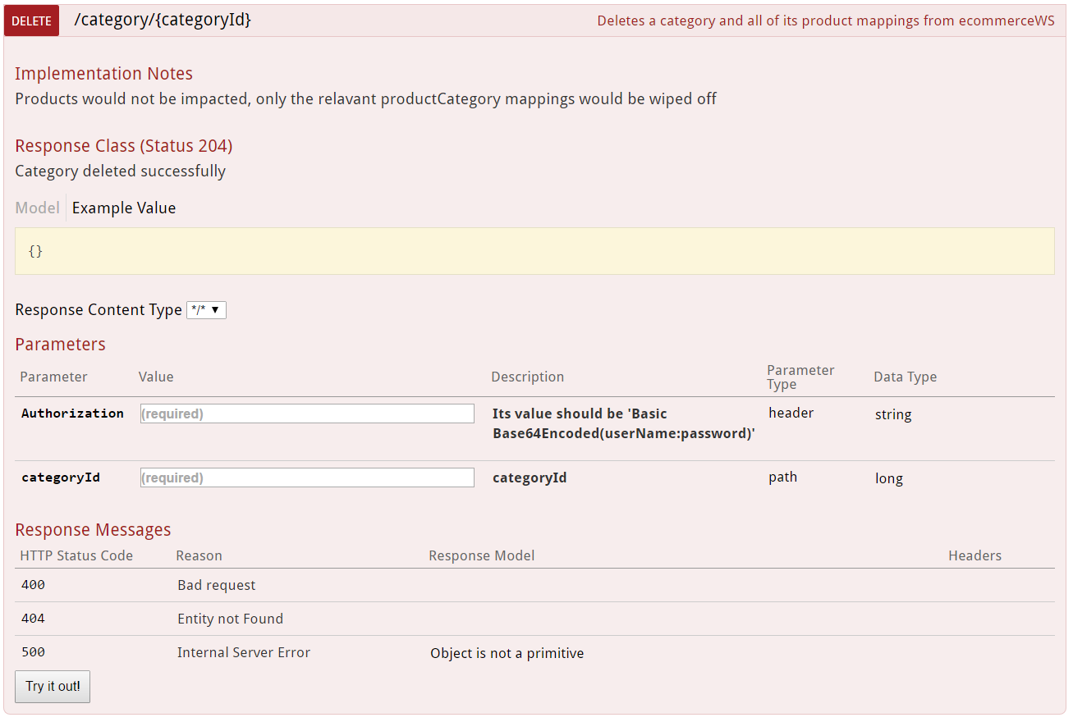
Category DELETE operation

Slide 8
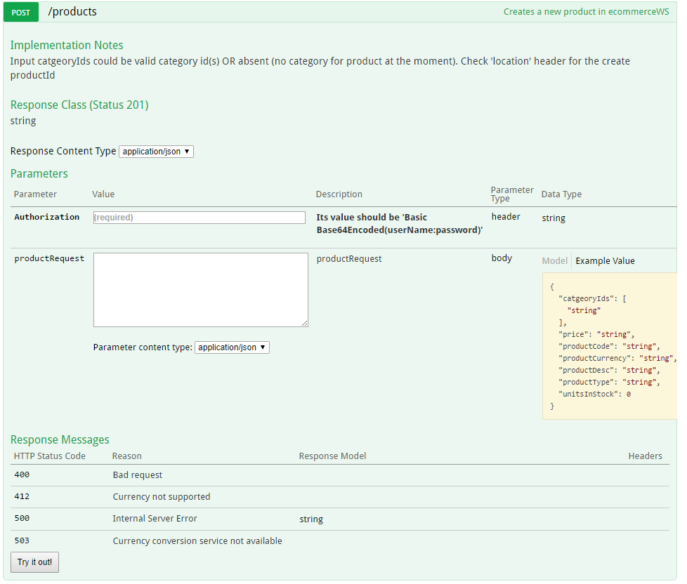
Product POST operation

Slide 9
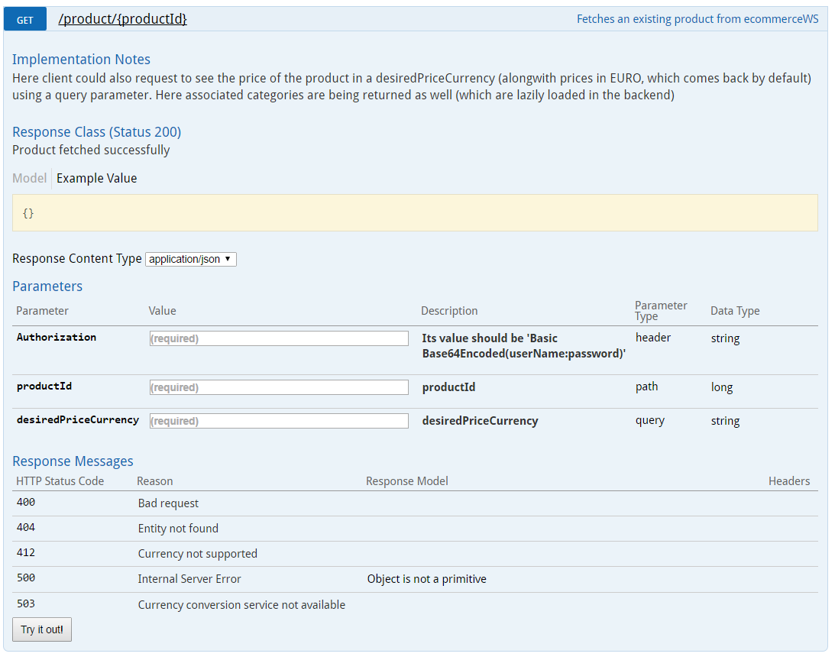
Product GET operation

Slide 10
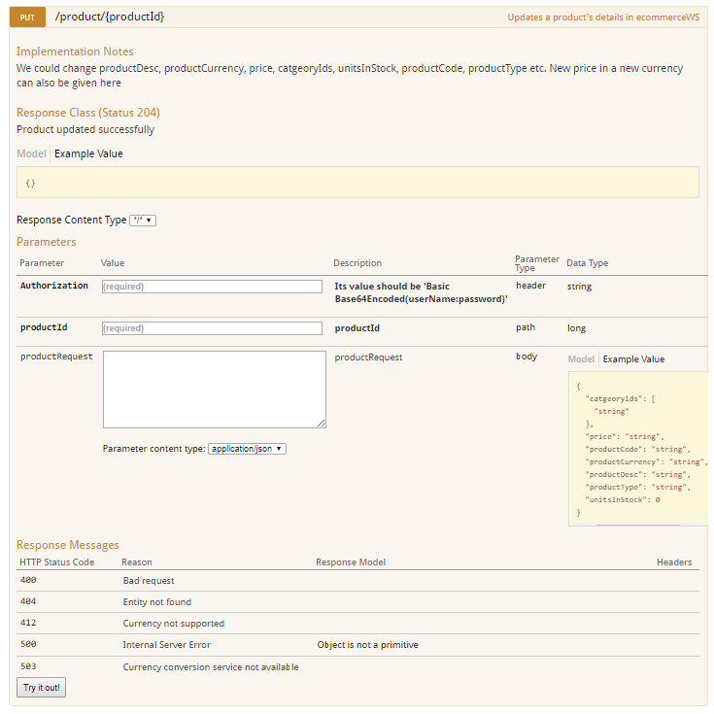
Product PUT operation

Slide 11
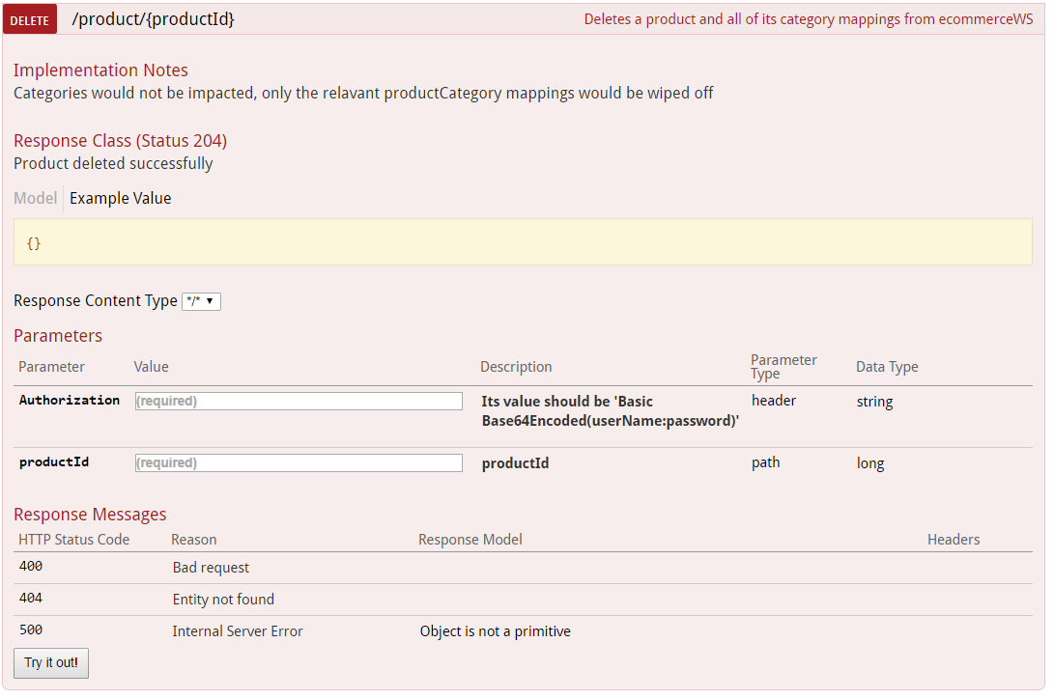
Product DELETE operation

