Slide 1
nush.hack
$ ./lighthouse --event “nush hack”
lighthouse: offline-first cybersecurity checklists
Zhuoxuan, Yiming, Xiaofan
Notes:
Hi everyone. We're Xiaofan, Zhuoxuan and Yiming. And this is Lighthouse: offline-first cybersecurity checklists.

Slide 2
$ our team
Zhuoxuan
Xiaofan
Yiming
Coder
Slides Designer
Debugging
$ problem.txt
Build an app that lets safety personnel keep completing security processes offline and syncs their changes correctly when internet access returns.
nush hack 26
Notes:
Zhuoxuan wrote the code, I designed the slides and Yiming did the debugging.

Slide 3
$ ./lighthouse --solve
1. work offline
2. sync correctly
3. trust the record
Every step is saved to a local SQLite database and queued in an outbox. The app never needs the server to record progress.
Unique event ids make retries safe, a since token pulls only new events, and the outbox clears only after the server confirms.
Completed wins when devices disagree, and a hash-chained audit log shows if anyone tampers with history.
Notes:
We solved it in three steps. First, work offline. Every step is saved to a local SQLite database and queued in an outbox, so the app never needs the server to record progress. Second, sync correctly. Every event has a unique id so retries are safe and the outbox only clears once the server confirms. Third, trust the record. If two devices disagree, "completed" wins and a hash-chained audit log shows if anyone tampers with history.

Slide 4
$ ./lighthouse --features
offline-first
safe sync
tamper-evident log
Every step saves to a local SQLite database and an outbox. No internet needed to keep working.
Unique event ids, a since token and confirmed outbox deletes. No lost or duplicate work.
A hash-chained audit log. /verify shows exactly where history was changed.
admin check
secure accounts
live dashboard
Admins tick a checkbox to verify a step, with the admin password. Verified steps lock.
Salted PBKDF2 passwords, and a 30 second lockout after 5 wrong attempts.
A browser dashboard that refreshes every 2 seconds. Add new checklists with a live preview.
Notes:
Here are Lighthouse's main features. It works offline first, syncs safely, keeps a tamper-evident audit log, lets admins verify steps with a checkbox and a password, protects accounts with salted hashing and lockouts, and shows everything on a live dashboard.

Slide 5
$ ls lighthouse/
processes.py
server.py
app.py
run.py
Shared checklists: the data both sides use.
FastAPI + SQLite sync server and 4-page web dashboard.
PyQt6 desktop client with a local database.
One command to start the server and clients.
app.py <-- sync --> server.py, both importing processes.py
Notes:
The project has four files. processes.py holds the shared checklists, server.py is the sync server and web dashboard, app.py is the desktop client, and run.py starts everything with one command.

Slide 6
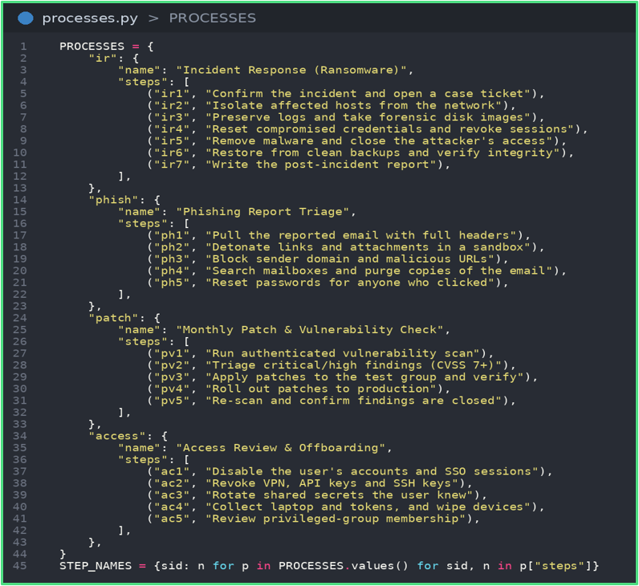
$ processes.py
PROCESSES: 4 built-in checklists (ransomware response, phishing triage, patching, offboarding) with 22 steps in total.
STEP_NAMES: flat lookup from step id to readable name.
Imported by both app.py and server.py, so client and server never disagree.
Step ids are unique, which is what makes syncing safe.
Checklists added on the dashboard are not in this file. They live in server.db.
Notes:
This file holds four built-in checklists with 22 steps in total. Both the client and the server import it, so they never disagree, and its unique step ids are what makes syncing safe.

Slide 7
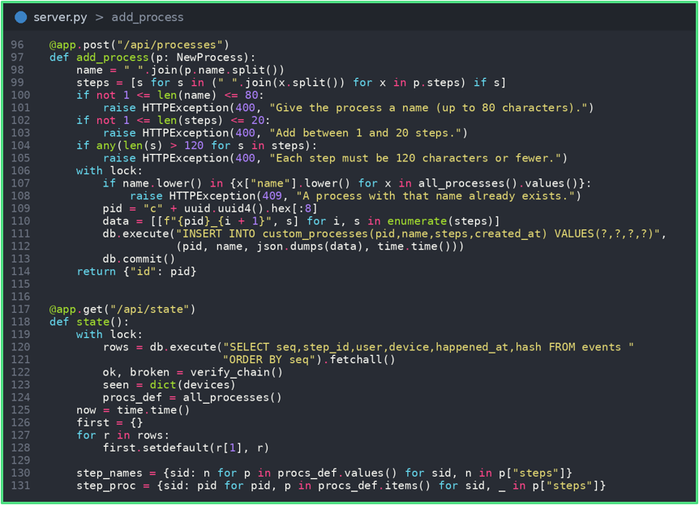
$ cat server.py
POST /sync: accepts events, returns new ones. UNIQUE event_id makes retries harmless.
Each event stores a SHA-256 hash of itself plus the previous hash: a chain.
GET /verify re-checks the chain and reports where it breaks.
POST /api/processes: new. Checks the name and steps, then saves the checklist to custom_processes.
GET /api/state: merges built-in and added checklists, with per-user stats. First completion of a step wins.
Notes:
The main endpoint is POST /sync, which takes in events and returns new ones. Since event ids are unique, retries do not harm. Each event also stores a SHA-256 hash of itself plus the previous one, forming a chain. /verify re-checks it and shows exactly where it breaks.

Slide 8
$ sync flow # POST /sync
1
The client sends its device name, a since token and the events waiting in its outbox.
@app.post("/sync")
def sync(req):
for e in req.events:
if not seen(e.event_id):
insert_event(e) # into the chain
accepted.append(e.event_id)
rows = events_after(req.since)
return {"accepted": accepted,
"locked": locked_steps,
"new_events": rows}
2
Each event_id is checked first. Seen before? It is skipped, so a retry never duplicates.
3
Every id goes into accepted. That tells the client it can delete the matching outbox row.
4
The reply carries locked steps and every event after since. The client merges them in.
# simplified from server.py
Notes:
This is the sync endpoint, step by step. The client sends its device name, a since token and the events in its outbox. For each event the server checks the unique event id first, so a retry is skipped instead of duplicated. Every id goes back in the accepted list so the client can delete that outbox row. The reply also carries locked steps and all events after the since token, and the client merges those in.

Slide 9
$ hash chain # audit log
1
Each hash covers the event's own data plus the hash of the event before it.
def _hash(eid, sid, user, ts, prev):
data = [eid, sid, user, ts, prev]
return sha256(json.dumps(data))
def verify_chain():
prev = "GENESIS"
for ev in events_in_order:
if ev.prev_hash != prev:
return False, ev.seq
if ev.hash != _hash(..., prev):
return False, ev.seq
prev = ev.hash
return True, None
2
The very first event links to a fixed starting value, GENESIS.
3
Edit or delete any old row and every hash after it stops matching.
4
GET /verify replays the chain and returns the seq where it first breaks.
# simplified from server.py
Notes:
This is how the audit log is tamper-evident. Each event's hash covers its own data plus the previous hash, and the first event links to a fixed value called GENESIS. If anyone edits or deletes an old row, every later hash stops matching. The verify endpoint replays the chain and tells us the exact sequence number where it breaks.

Slide 10
$ admin check # verify
1
On the dashboard, ticking the admin checkbox asks for the admin password if you are signed out.
@app.post("/api/admin/review")
def admin_review(r, x_admin_token):
require_admin(x_admin_token) # else 401
ticked, verified = replay_db()
if r.decision == "verify":
if r.step_id not in ticked:
raise 409
if r.step_id in verified:
raise 409
insert_event(r.step_id, "admin",
r.decision) # in the chain
2
Passwords are salted PBKDF2. 5 wrong tries lock login for 30 seconds. A session lasts 8 hours.
3
The verify is saved in the same hash chain, so admin actions are audited too.
4
A verified step is locked. Untick requests are ignored until an admin reopens it.
# simplified from server.py
Notes:
This is the admin check. On the dashboard an admin ticks a checkbox next to a completed step. If they are not signed in, they must enter the admin password first. Passwords are salted PBKDF2, five wrong tries lock login for thirty seconds, and a session lasts eight hours. The verify is written into the same hash chain, and once a step is verified it is locked until an admin reopens it.

Slide 11
$ ls dashboard/
home
processes
add process
accounts
Progress ring, stats, chain status and the audit log.
Open a checklist to see who did each step.
Build a new checklist with a live preview.
Each person’s steps, devices and last activity.
browser -> http://localhost:8000 · refreshes every 2 seconds
Notes:
The web dashboard has four pages: home with progress and the audit log, processes to see who did each step, add process to build a new checklist, and accounts.

Slide 12
$ ./lighthouse --add-process
1. fill the form
2. server checks
3. all see it
On the Add process page, name the checklist and list its steps. A live preview updates as you type.
POST /api/processes trims the text, allows 1 to 20 steps and rejects a duplicate name.
It is saved with a new id, merged into /api/state and tagged Added on the Processes page.
Notes:
On the add process page, you name a checklist and list its steps, with a live preview. The server checks there are one to twenty steps and rejects duplicate names. Then, it is saved, merged and tagged, so everyone can see it.

Slide 13
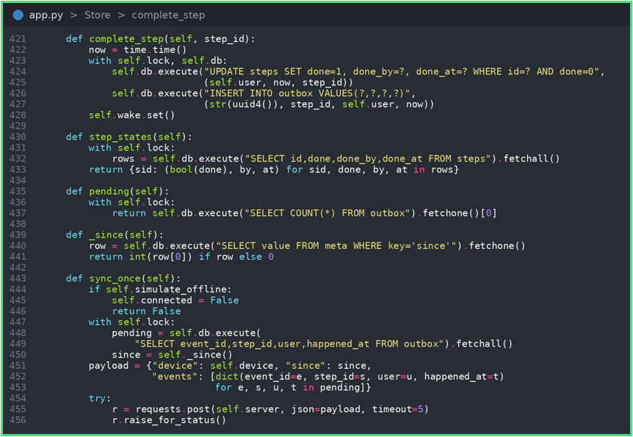
$ app.py # part 1: Store
complete_step updates the step and queues an outbox row in one transaction: both or neither.
sync_once pushes the outbox, then pulls events newer than a saved since token.
Outbox rows are deleted only after the server confirms them.
sync_loop retries with backoff while offline. Merge rule: completed wins.
Notes:
On the client, completing a step updates it and queues an outbox row in one transaction. Both happen or neither does, so nothing is lost. Sync pushes the outbox, then pulls only newer events. Rows are deleted only after the server confirms them and while offline it keeps retrying.

Slide 14
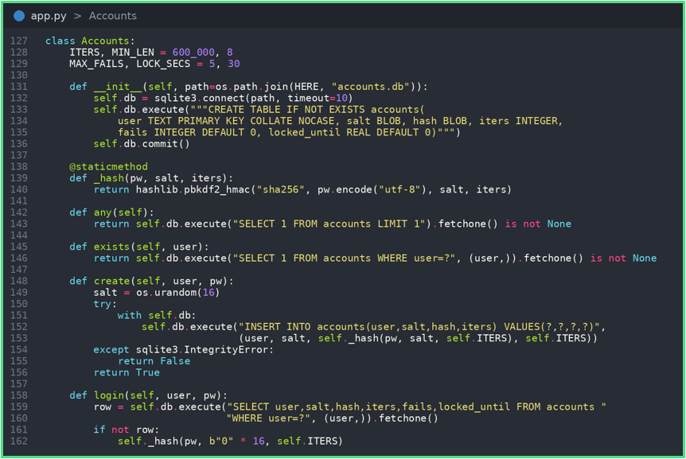
$ app.py # part 2: UI + security
Accounts: random salt, PBKDF2-SHA256 at 600,000 iterations, constant-time compare.
Five wrong passwords lock the account for 30 seconds, and the count survives restarts.
Animated widgets: CheckBox, StepRow, Toast, Pulse status dot.
ServerFeed polls /api/state for the team dashboard. An offline toggle demos the sync.
The desktop client lists the 4 built-in checklists. Added ones show on the web dashboard.
Notes:
For security, passwords use a random salt and PBKDF2 at 600,000 iterations. Five wrong attempts lock the account for 30 seconds and that survives restarts. The client has an offline toggle, which is how we demo syncing. One limit: the desktop app shows the four built-in checklists and added ones appear on the web dashboard.

Slide 15
$ run.py
Starts server.py and waits until /api/state answers (about 12 seconds max). Dashboard: localhost:8000.
Opens one app.py window per name: python run.py Ali Bob shows sync live.
python run.py stop stops a leftover server via server.pid.
Works from VS too: swaps pythonw.exe for python.exe. Logs go to server.log and client logs.
Notes:
run.py starts the server, waits until it's ready and opens one window per name. Running python run.oy Ali Bob shows syncing live.

Slide 16
thank you
$ exit 0
Questions?
Notes:
Thank you for listening. Any questions?

