Slide 1
nush hack
$ ./lighthouse --event "nush hack"
lighthouse: offline-first cybersecurity checklists
Zhuoxuan, Yiming and xiaofan

Slide 2
$ our team
Zhuoxuan
Xiaofan
Yiming
Coder
Slides design
Debugging
nush hack 26

Slide 3
$ problem.txt
Build an app that lets safety personnel keep completing security processes offline and syncs their changes correctly when internet access returns.
The hard parts: no lost work, no duplicates or conflicts on reconnect.

Slide 4
$ ./lighthouse --solve
3. trust the record
1. work offline
2. sync correctly
Every step is saved to a local SQLite database and queued in an outbox. The app never needs the server to record progress.
Unique event ids make retries safe, a since token pulls only new events, and the outbox clears only after the server confirms.
Completed wins when devices disagree, and a hash-chained audit log shows if anyone tampers with history.

Slide 5
$ ls lighthouse/
processes.py
server.py
app.py
run.py
Shared checklists: the data both sides use.
FastAPI + SQLite sync server and 4-page web dashboard.
PyQt6 desktop client with a local database.
One command to start the server and clients.
app.py <-- sync --> server.py, both importing processes.py

Slide 6
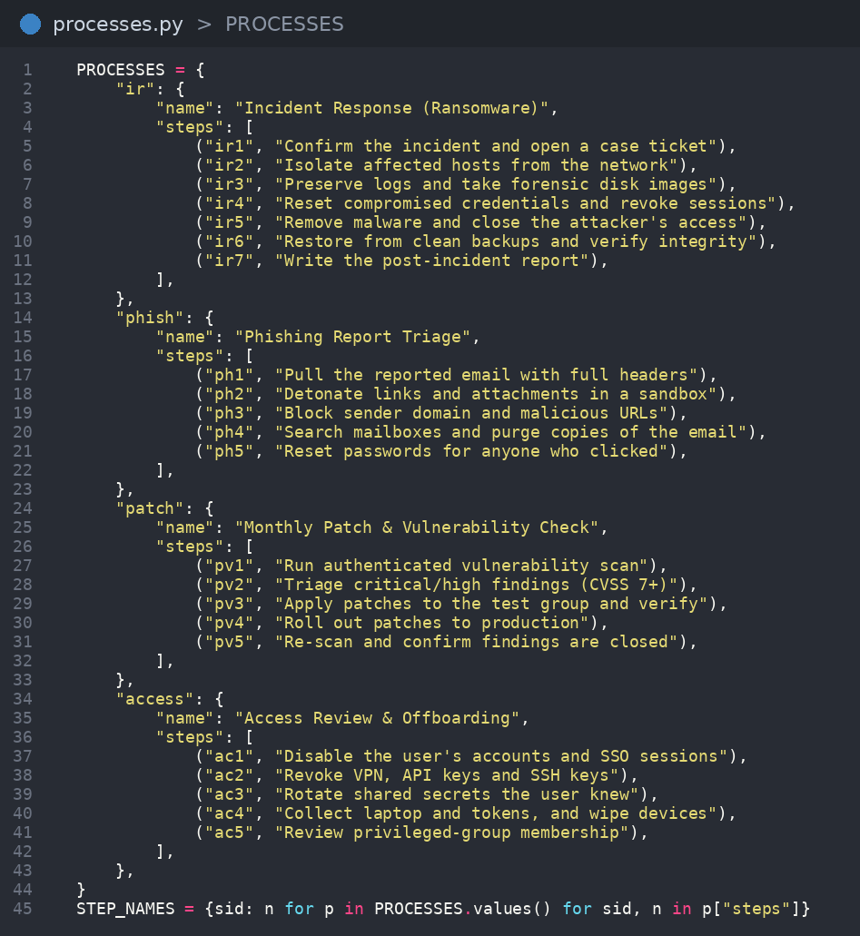
$ processes.py
PROCESSES: 4 built-in checklists (ransomware response, phishing triage, patching, offboarding) with 22 steps in total.
STEP_NAMES: flat lookup from step id to readable name.
Imported by both app.py and server.py, so client and server never disagree.
Step ids are unique, which is what makes syncing safe.
Checklists added on the dashboard are not in this file. They live in server.db.

Slide 7
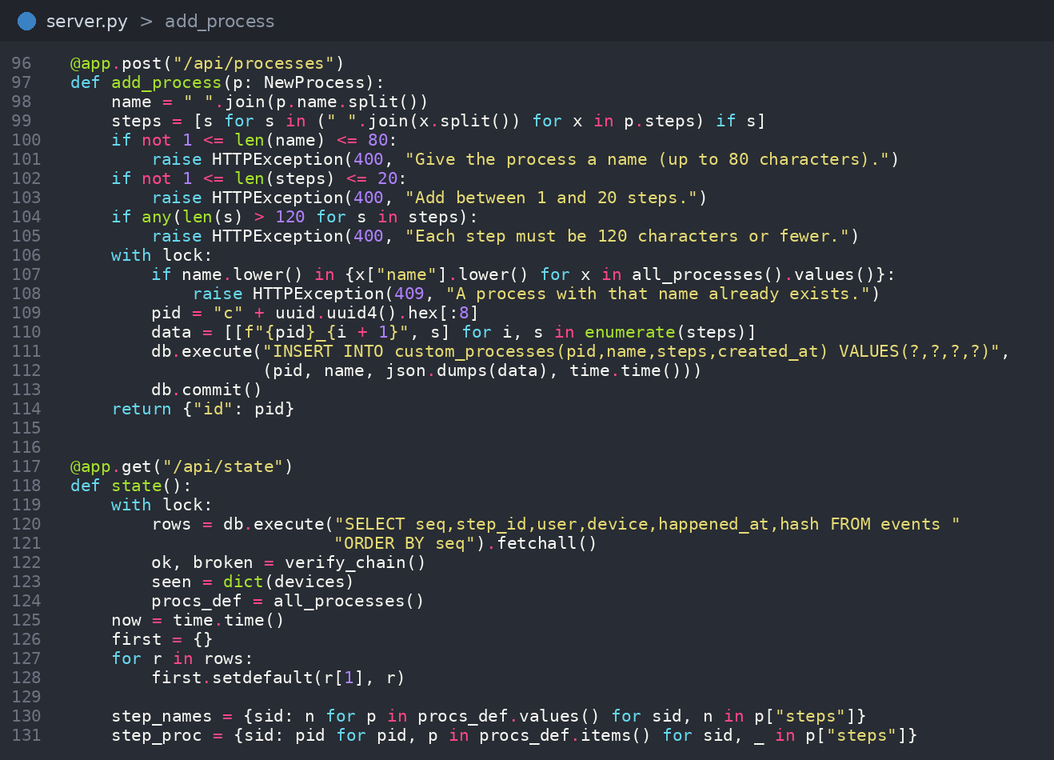
$ cat server.py
POST /sync: accepts events, returns new ones. UNIQUE event_id makes retries harmless.
Each event stores a SHA-256 hash of itself plus the previous hash: a chain.
GET /verify re-checks the chain and reports where it breaks.
POST /api/processes: new. Checks the name and steps, then saves the checklist to custom_processes.
GET /api/state: merges built-in and added checklists, with per-user stats. First completion of a step wins.

Slide 8
$ ls dashboard/
home
processes
add process
accounts
Progress ring, stats, chain status and the audit log.
Open a checklist to see who did each step.
Build a new checklist with a live preview.
Each person's steps, devices and last activity.
browser -> http://localhost:8000 · refreshes every 2 seconds

Slide 9
$ ./lighthouse --add-process
3. all see it
1. fill the form
2. server checks
On the Add process page, name the checklist and list its steps. A live preview updates as you type.
POST /api/processes trims the text, allows 1 to 20 steps and rejects a duplicate name.
It is saved with a new id, merged into /api/state and tagged Added on the Processes page.

Slide 10
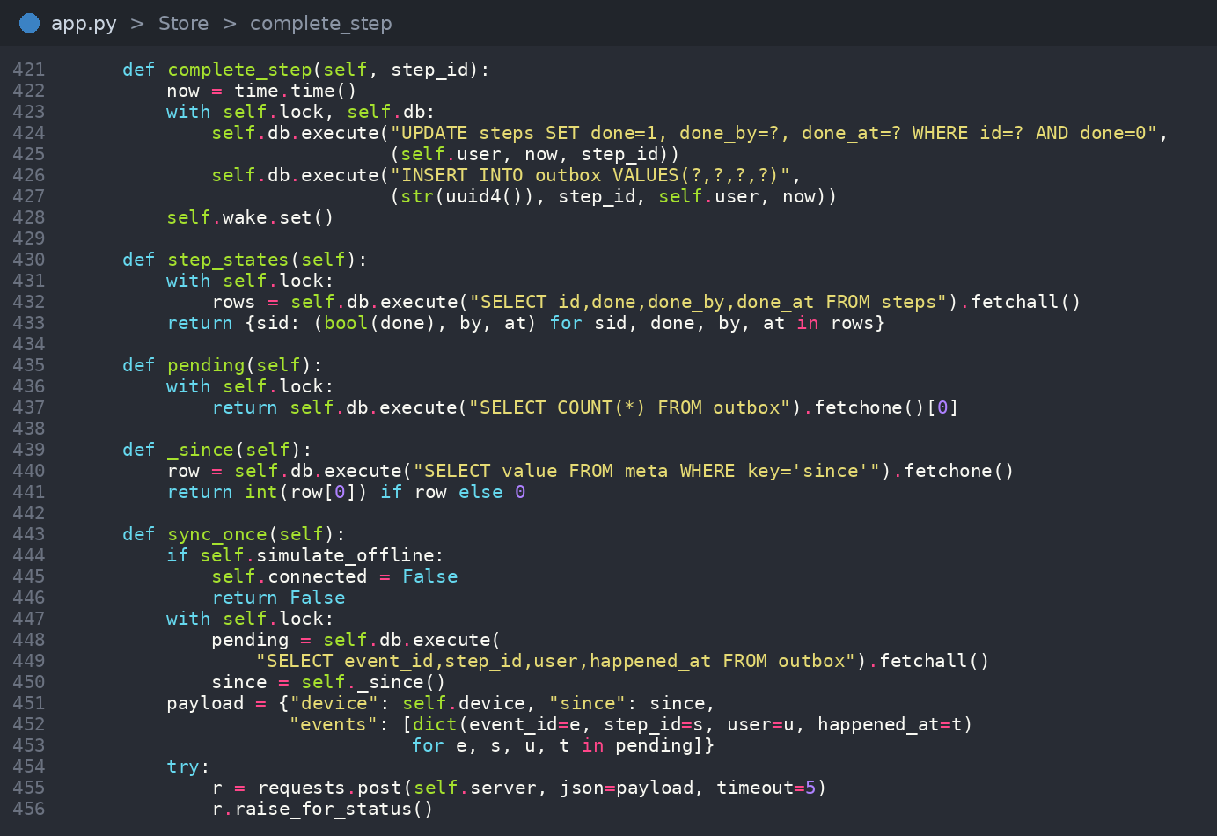
$ app.py # part 1: Store
complete_step updates the step and queues an outbox row in one transaction: both or neither.
sync_once pushes the outbox, then pulls events newer than a saved since token.
Outbox rows are deleted only after the server confirms them.
sync_loop retries with backoff while offline. Merge rule: completed wins.

Slide 11
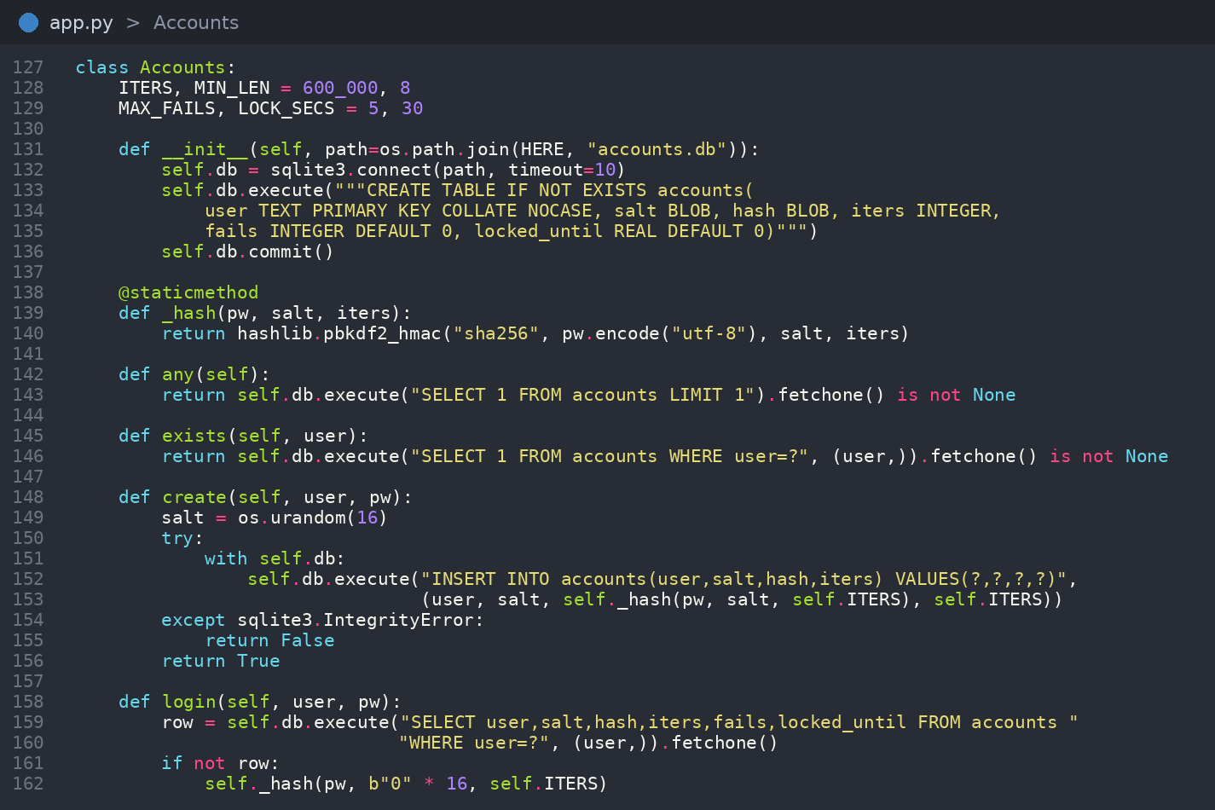
$ app.py # part 2: UI + security
Accounts: random salt, PBKDF2-SHA256 at 600,000 iterations, constant-time compare.
Five wrong passwords lock the account for 30 seconds, and the count survives restarts.
Animated widgets: CheckBox, StepRow, Toast, Pulse status dot.
ServerFeed polls /api/state for the team dashboard. An offline toggle demos the sync.
The desktop client lists the 4 built-in checklists. Added ones show on the web dashboard.

Slide 12
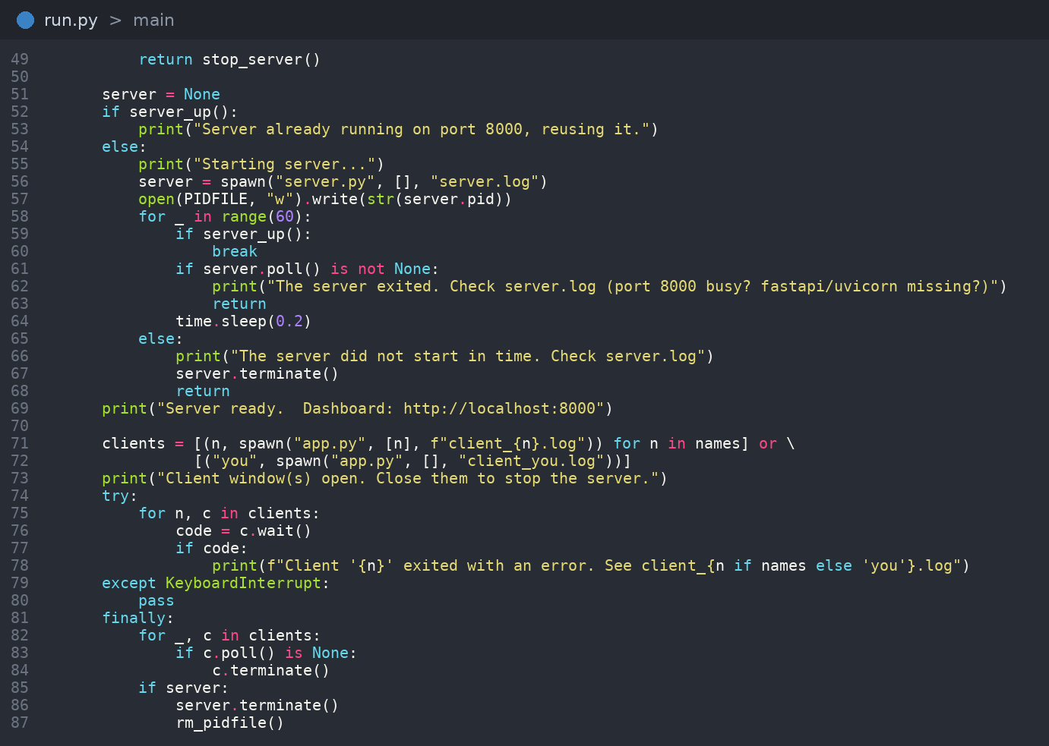
$ run.py
Starts server.py and waits until /api/state answers (about 12 seconds max). Dashboard: localhost:8000.
Opens one app.py window per name: python run.py Ali Bob shows sync live.
python run.py stop stops a leftover server via server.pid.
Works from VS too: swaps pythonw.exe for python.exe. Logs go to server.log and client logs.

Slide 13
thank you
$ exit 0
Questions?

