Slide 1
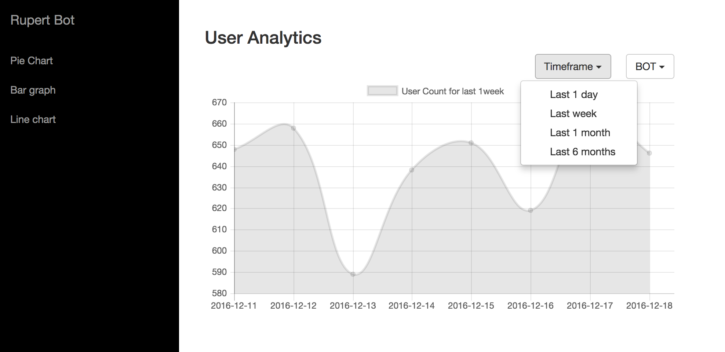
Before
Dropdown to select timeframe

Slide 2
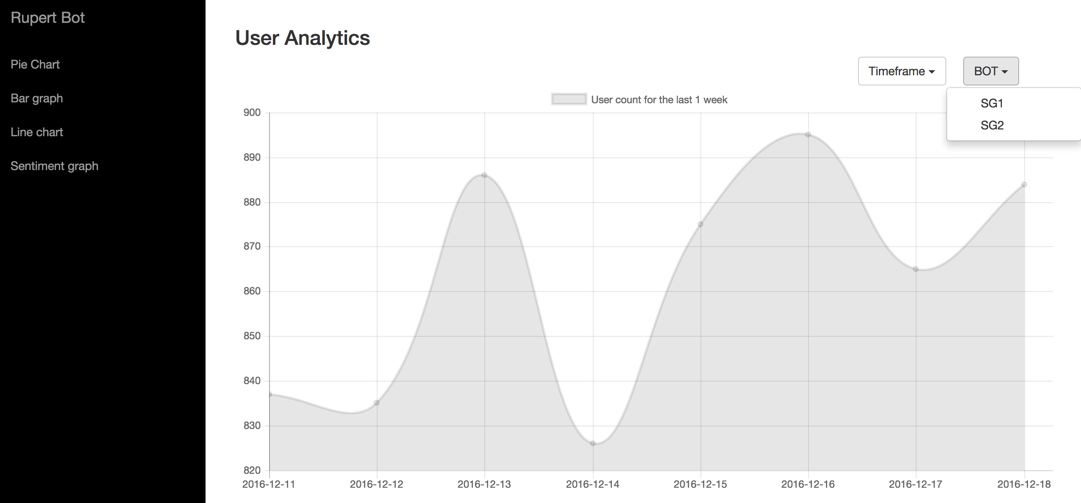
Before
Dropdown to select Bot
This is only available on RupertBot’s dashboard. Kohls, for example,
would only have the option of seeing their own bot.

Slide 3
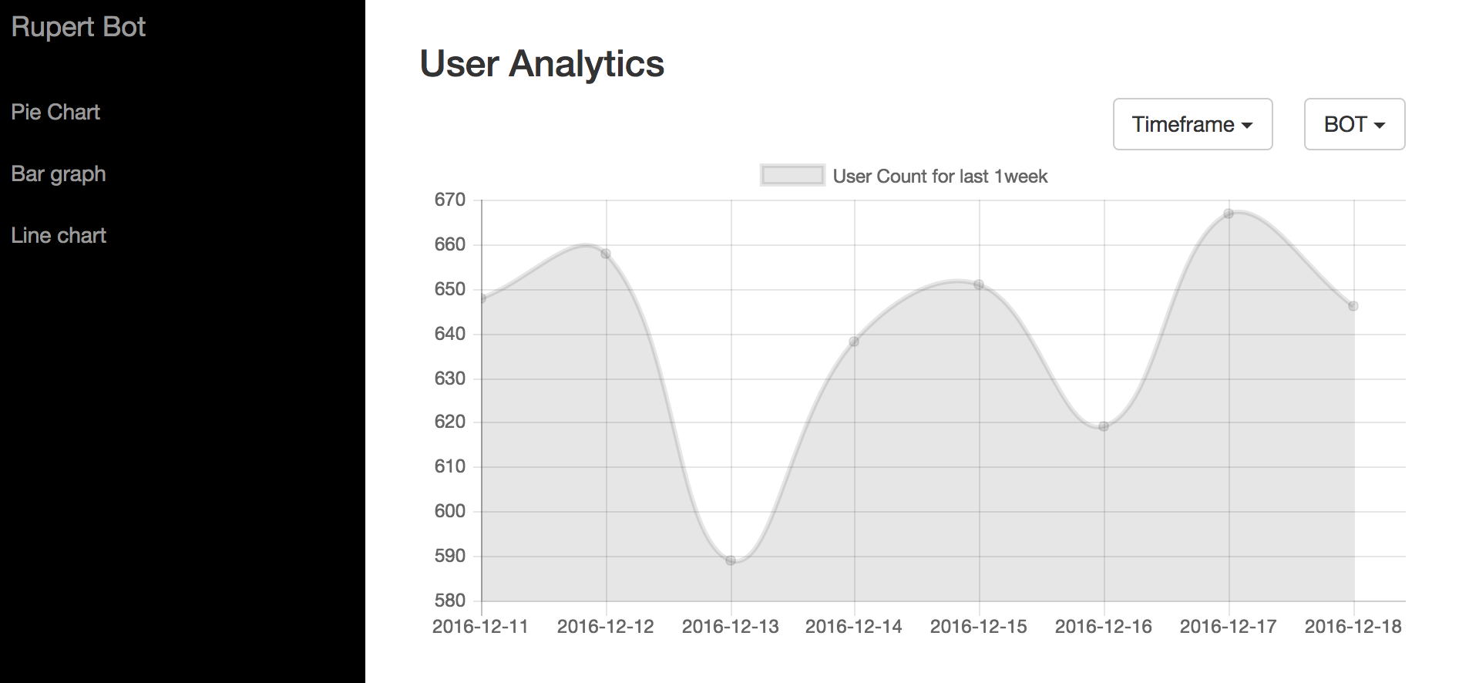
Before
Line Chart view

Slide 4
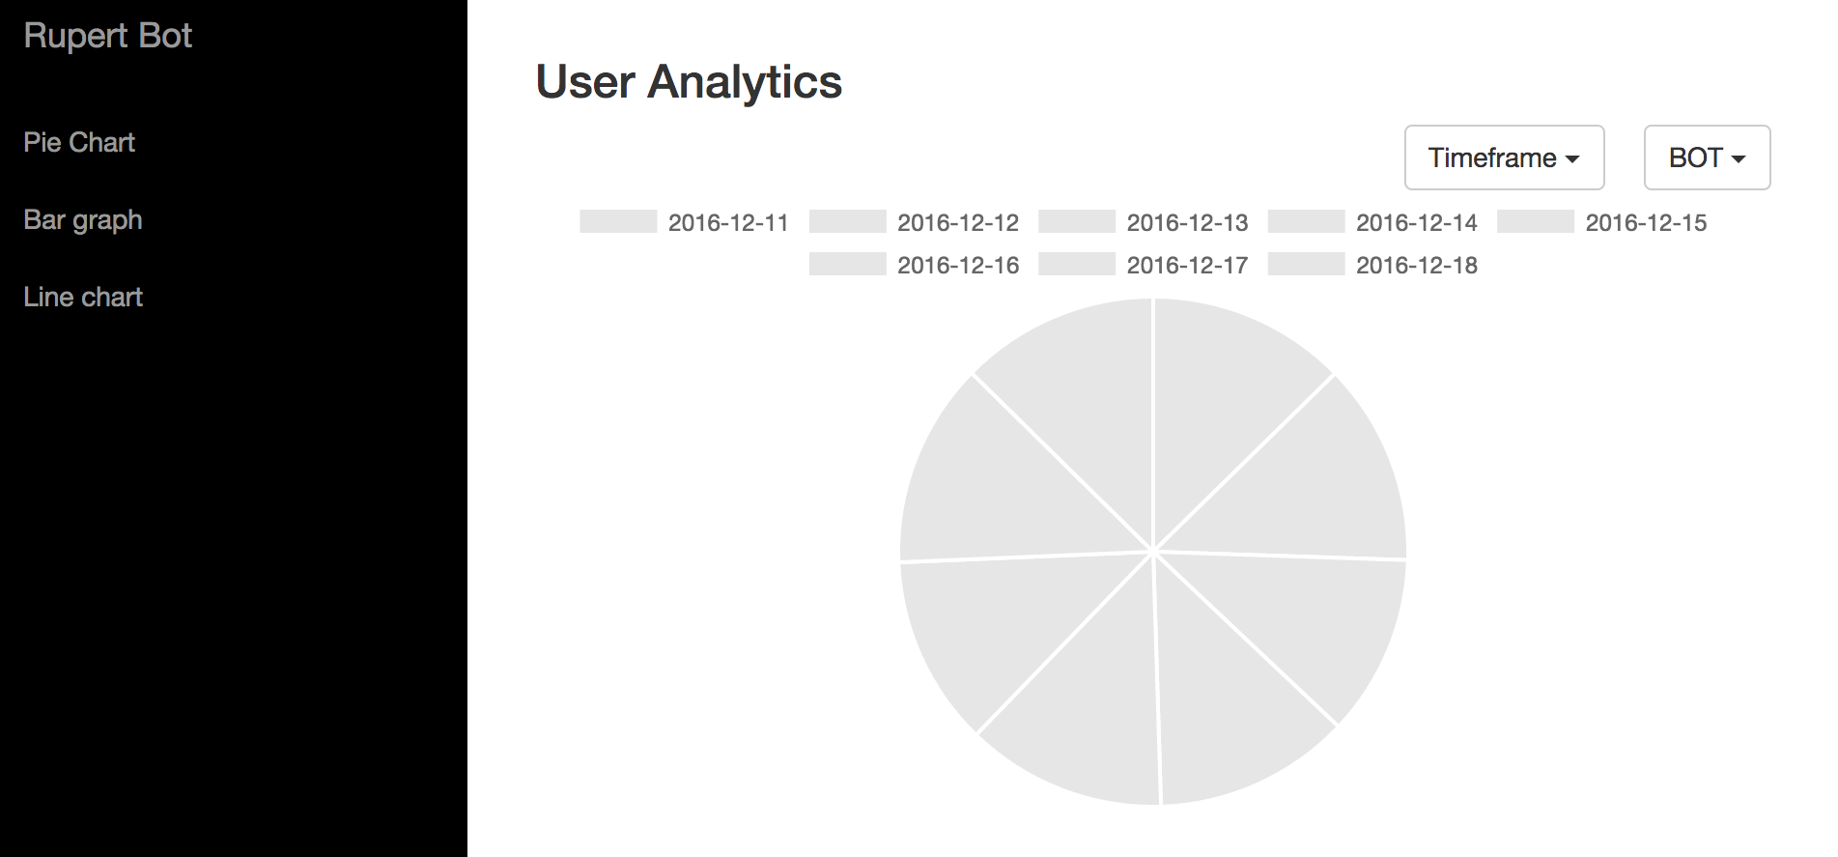
Before
Pie Chart view

Slide 5
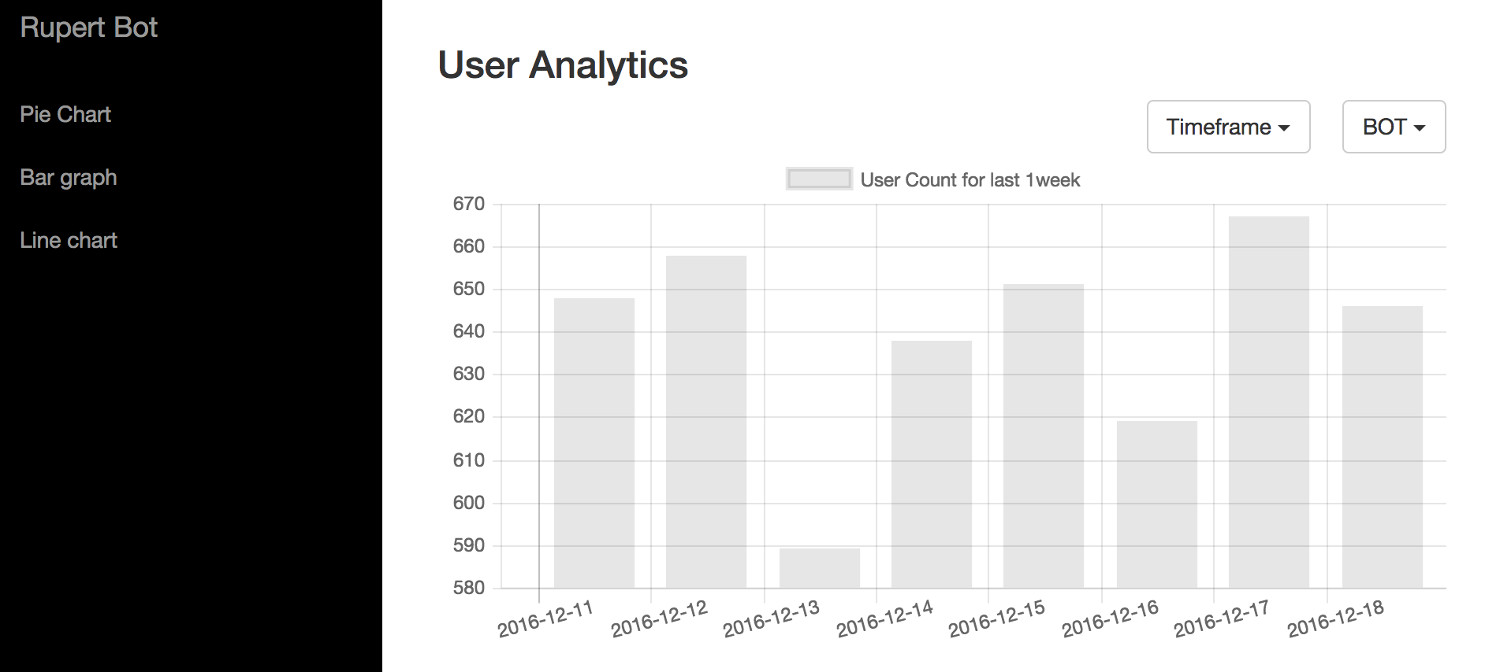
Before
Bar Graph view

Slide 6
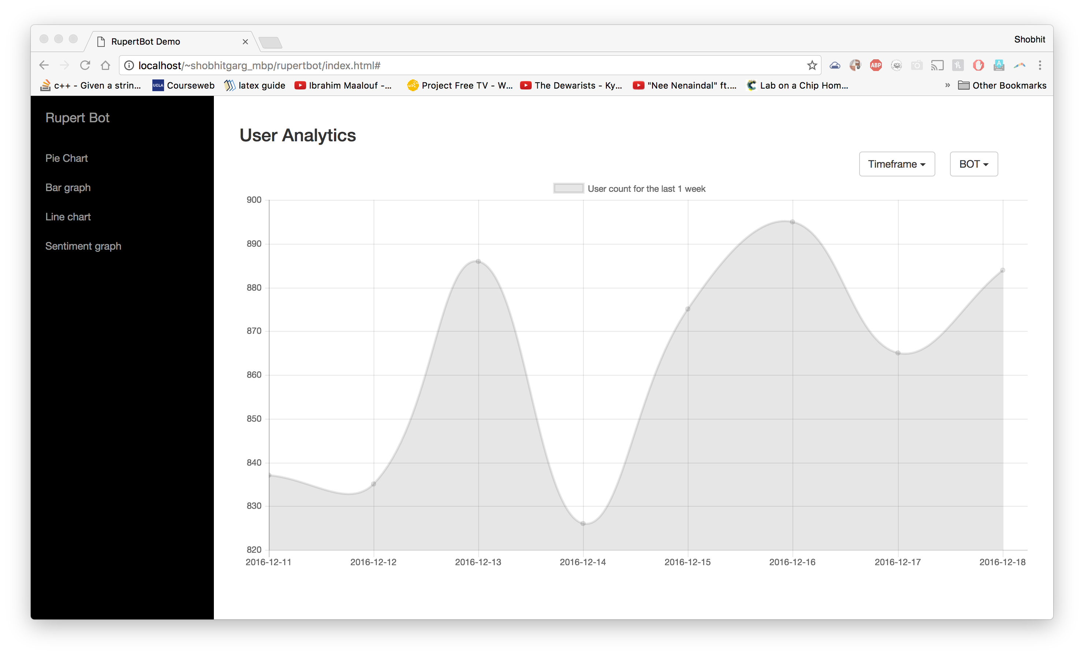
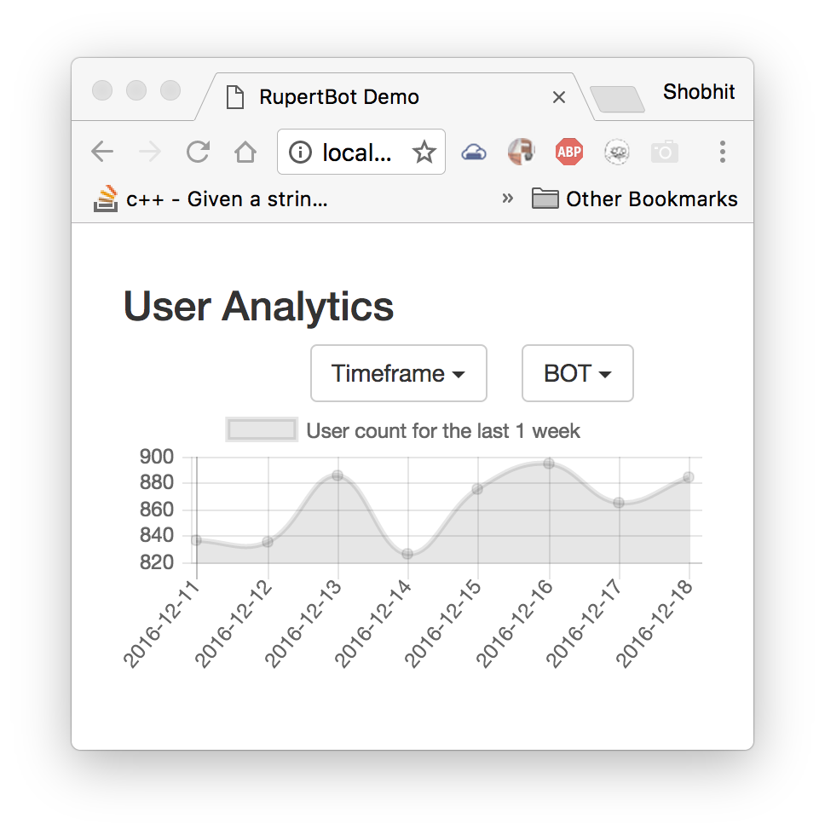
After
Responsive charts

Slide 7
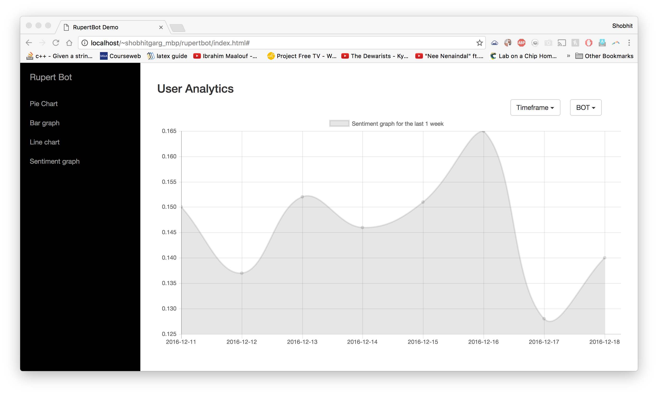
After
Sentiment graph – 1 week timeframe
Value of 1 means user action == expected action
Value shown on this graph is average across all users

Slide 8
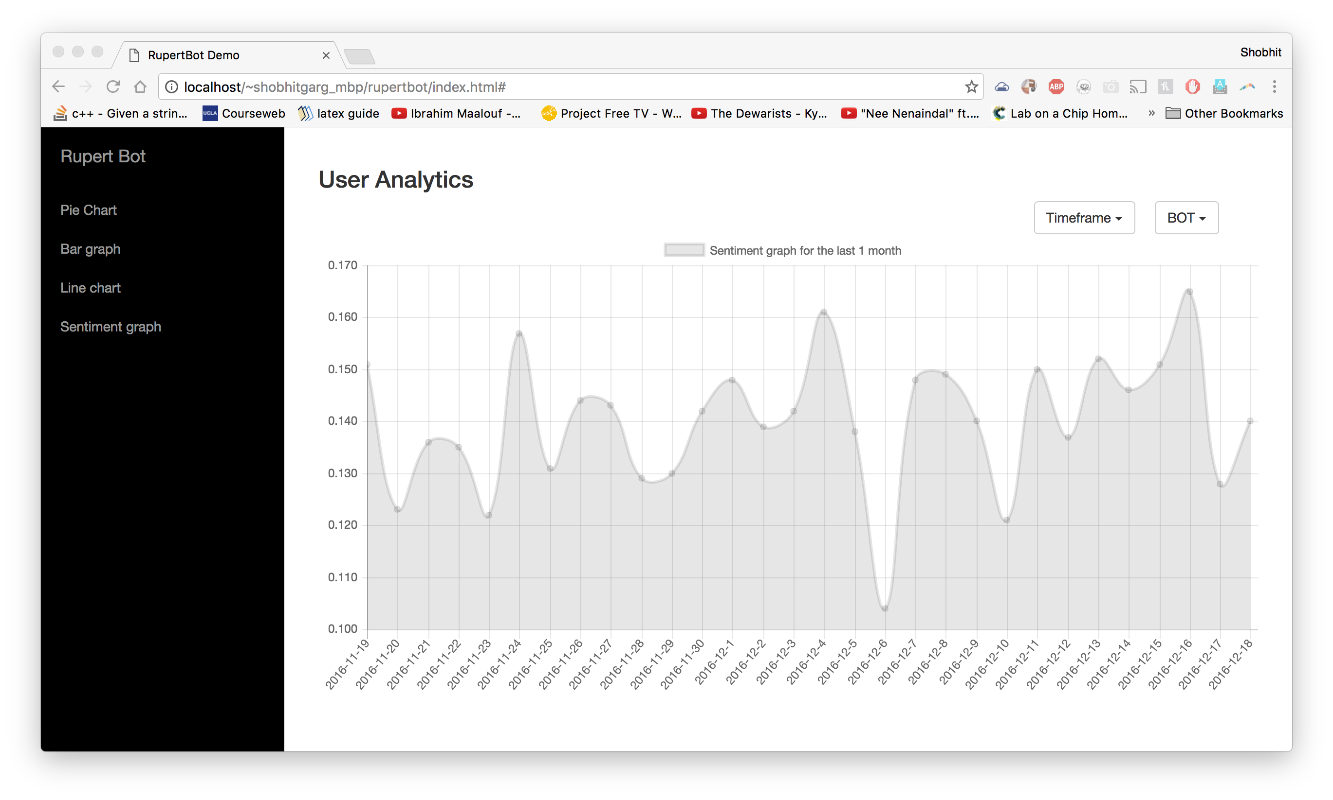
After
Sentiment graph – 1 month timeframe
Value of 1 means user action == expected action
Value shown on this graph is average across all users

Slide 9
TODO:
* Add to line chart: # actions
** Modify SQL query to get Count(UserAction) in addition to other counts
* SQL queries in data.php
** lots of redundant code: make functions
** date range hard coded: use GETDATE() and use math eq.

