Slide 1
Snapshot of filesystem
Group name: Oscillator
Mentor: Juhi Gupta
Team Members:
Chittaranjan Rath (2018201007)
Prakash Nath Jha (2018201013)
Nitish Srivastava (2018201012)
Suraj Garg (2018202003)

Slide 2
Overview
Introduction:
In computer systems, a snapshot is the state of a system at a particular point in time. It refers to an actual copy of the state of a system or to a capability provided by certain systems.
Other ways to achieve is backing up of whole data but here we are optimizing this approach using concept of Rsync algorithm
Features
Following are the features that our implementation provide
Create Snapshot
Restore Snapshot
Remove Snapshot
Start scheduler
Stop scheduler

Slide 3
Overview
Specification
Along with snapshot creation, system has a functionality of scheduler which will run as a background process.
The responsibility of a scheduler is to make snapshot of the filesystem consistent with the directory of which the snapshot is taken.
Activity of maintaining a snapshot is performed by scheduler for every predefined time interval

Slide 4
Functionality
Execution commands
Start Scheduler
command: “startScheduler ”
The command will start scheduler which will take snapshot periodically. This will take snapshots of the registered directories of which snapshots are already created.
Create Snapshot
command: “createSnapShot [source path] [backup path]”
Above command will be responsible for creating initial snapshot of the source path provided. The path provided by user should be absolute path.
The above source path will be marked as a registered directory to make further snapshots.
Restore Snapshot
command: “restoreSnapShot [source path]”
Above command will be executed whenever at any point of time user needs to restore the original contents by its last updated preserved snapshot,

Slide 5
Functionality
Execution commands
Remove Snapshot
command: “removeSnapShot [source path]”
Above command will be executed whenever at any point of time user wants to stop taking snapshot for any registered directory on which.
Prerequisite: The above source path provided in the should be a valid registered directory path.
Stop Scheduler
command: “stopScheduler ”
The command will stop scheduler from taking snapshots periodically.

Slide 6
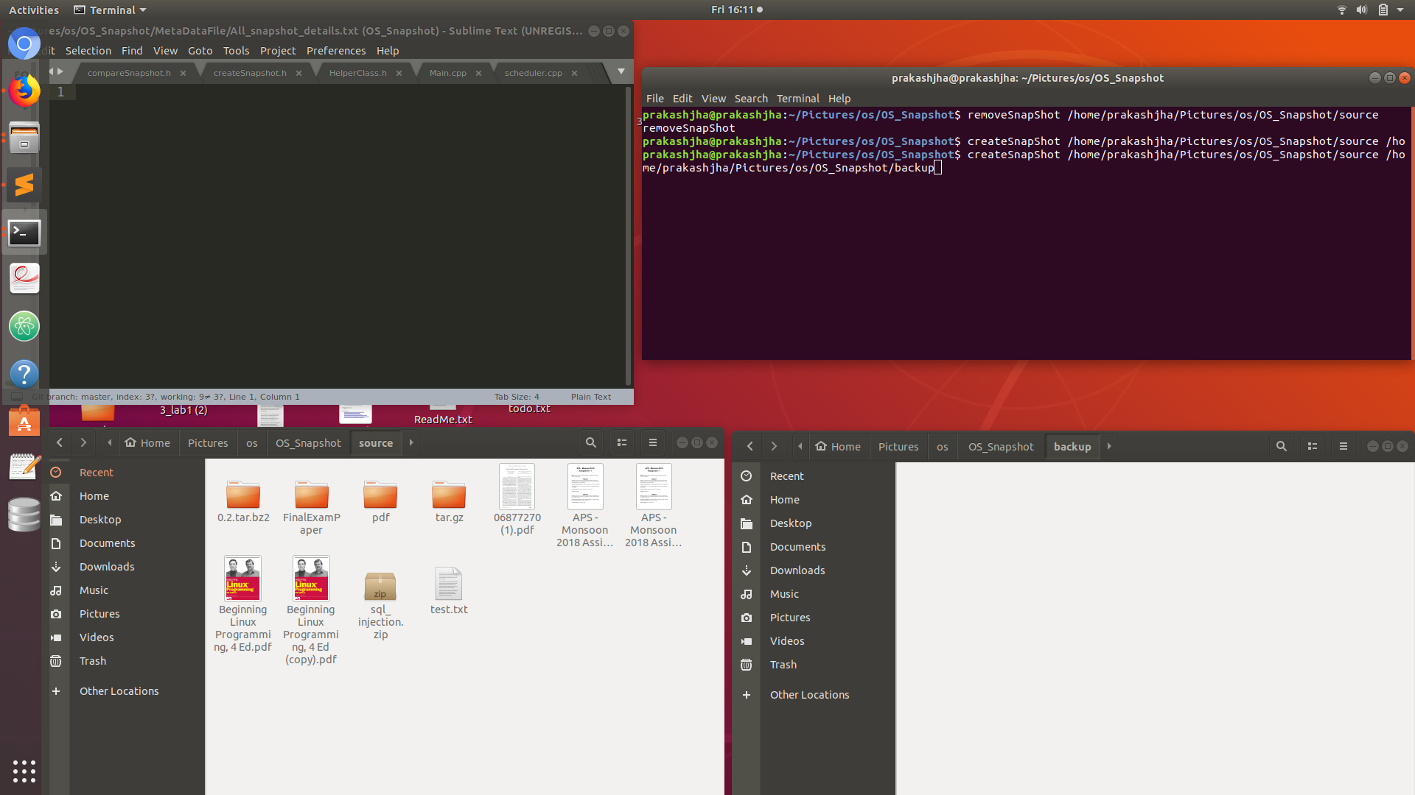
Create Snapshot
Pre command Execution

Slide 7
Snapshot metadata

Slide 8
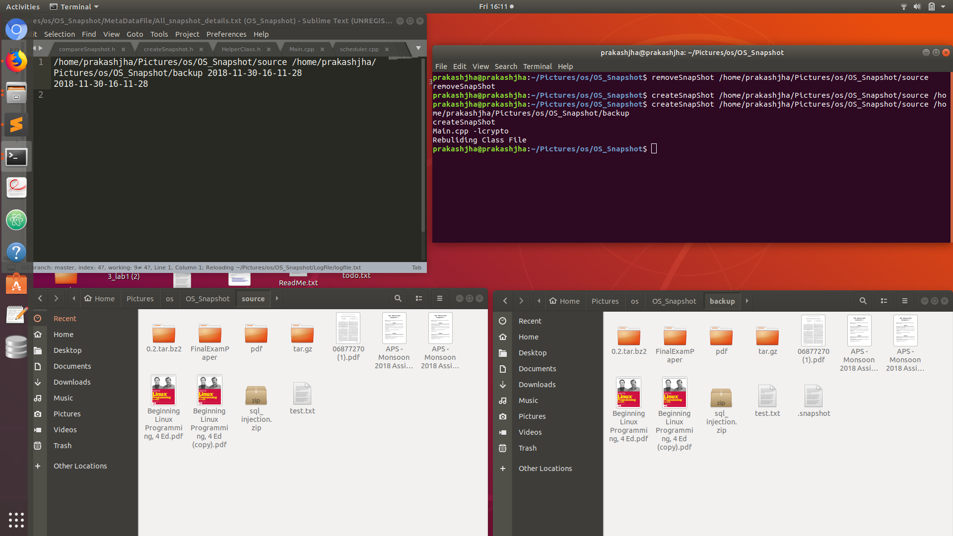
Create Snapshot
POST command Execution

Slide 9
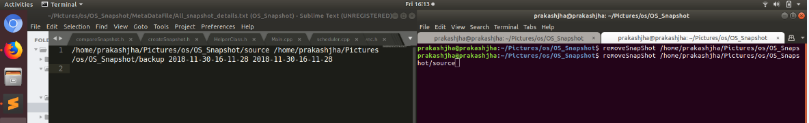
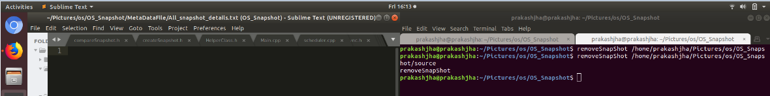
Remove Snapshot
Pre command Execution
POST command Execution

Slide 10
Operation Description
Execution flow :
Initial Snapshot:
Creation of snapshot metadata entry ; For the source directory in case the snapshot already exits then no action will be performed.
Copy entire source directory content at backup location.
Creation of “.snapshot” file at backup location; “.snapshot” file will be later used by scheduler for synchronization.
Scheduler:
Reading of snapshot metadata entry (after creation of snapshot metadata entry via “createSnapShot” command)
Creation of “.snapshot” file at backup location
Creation of temporary “.snapshot” file at source location
Comparison of “.snapshot” files at source and backup location for finding delta changes w.r.t. source directory ( In depth analysis will be presented in the next slide under “Synchronization mechanism ”)
Creation of “.snapshot” file at backup location

Slide 11
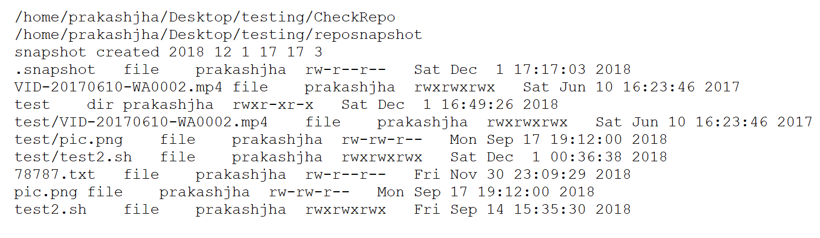
.snapshot sample

Slide 12
Operation Description
Execution flow :
Synchronization mechanism :
Operation Types:
Create: User has created a new file or directory i.e. a file or directory is present at source but not at backup
Modify: If the file at source is modified at with respect to backup location (based on timestamp comparison).
Delete: User has removed a file or directory i.e. a file or directory is present at source but not at backup.
For the “create” operation type content will be replicated at backup location.
For the “delete” operation type content will be removed from backup location.
For the “modify” operation type file will be updated using “rsync” algorithm.
Remove Snapshot:
Remove snapshot metadata entry for the source directory. For the source directory no further snapshot will be performed.
This operation can be performed only on the registered directories.

Slide 13
RSYNC Algorithm
Introduction:
Rsync is a utility for efficiently transferring and synchronizing files across computer systems, by checking the timestamp and size of files
Commonly used for both file transfer and file synchronization
Why Rsync:
The rsync algorithm efficiently computes which parts of a source file match some part of an existing destination file
Only parts of the source file which are not matched need to be copied

Slide 14
RSYNC Working
With source file as S and destination file as D then Rsync consist of following steps:
Destination file will be splitted into non-overlapping fixed size blocks (say N Bytes)
For each destination file block two checksums are calculated:
Weak checksum using Mark Adler's 32-bit hash
Strong128-bit MD-5 checksum
These checksums are sent to source.

Slide 15
RSYNC Working CONTd ...
At source file S is searched to find all blocks that have the same weak and strong checksum as one of the blocks of D
For the matched blocks corresponding block number and unmatched characters are sent to destination
At destination using the sequence of block numbers and unmatched characters updated copy of file S is constructed.
Benefit:
The end result is that D gets a copy of S, but only the pieces of S that are not found in D (plus a small amount of data for checksums and block indexes) are sent to the destination

Slide 16
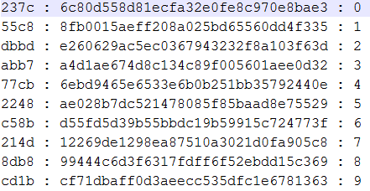
.INDEX FILE
Weak and Strong checksum generation of destination file:

Slide 17
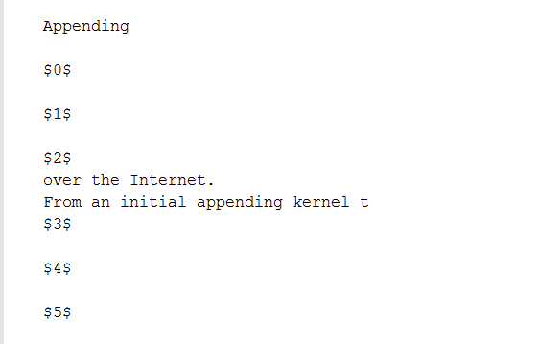
.updateindex FILE
.updateIndex file generation of source file using .index file:

Slide 18
CONCLUSION
Our snapshot implementation provides a mechanism to the user to securely maintain a backup of filesystem which gets updated after every fixed time interval in minimum amount of time possible as only incremental changes are reflected at backup rather than taking full backup every single time.
Our implementation also provides restore functionality using which user can restore files from backup location any time.
Using Rsync algorithm we have ensured that in case of file modification we only update the changed portion of file at the backup rather than copying the entire file.

Slide 19
Thank you

