Slide 1
Data Compression Techniques
Vivek garg
12100EN009

Slide 2
What is Data Compression
Converting an input data stream or the source stream or the original data into another data stream which is shorter in length.
There are many ideas but all are based on the single fact that “remove redundancy of source data”.

Slide 3
Metric
A good metric for compression is compression factor and is given by :
C.f. =
1-(compressed_size/uncompressed_size) *100
If we have a 100KB file that we compress to 40KB, we have a compression factor of:
1-(40/100) = 0.6 or 60%

Slide 4
Need of data compression
People like to accumulate data and hate to delete it. So they can store it in their hard drive or any other memory based device even in lesser space.
People hate to wait for long time to transfer data. So if total size of data is less then it will transfer in lesser amount of time.

Slide 5
Data Compression- Entropy
Ref: http://www.csie.kuas.edu.tw/course/cs/english/ch-15.ppt
Entroy is the measure of information content in a message.
Higher Entropy, means carry more information
How to determine the entropy
Find the probability p(x) of symbol x in the message
The entropy H(x) of the symbol x is:
H(x) = - p(x) • log₂p(x)

Slide 6
Data Compression- Entropy
The entropy of the entire message is the sum of the individual symbol entropies.
∑ -P(x) × log₂P(x_{i})
The average redundancy for each character in a message of length l is given by:
∑ P(x) × l_{i} - ∑ -P(x) × log₂P(x_{i})

Slide 7
Example
Consider Message String = “Hello World”
Probability of char 'l' is given by
p(l) = 3/12 or 1/4
So number of bits required to encode this is -log(1/4) or 2.
If we do sum for whole string using previous formula then we will get 3.022
So no of bits required to encode whole string is approx 12*3.022

Slide 8
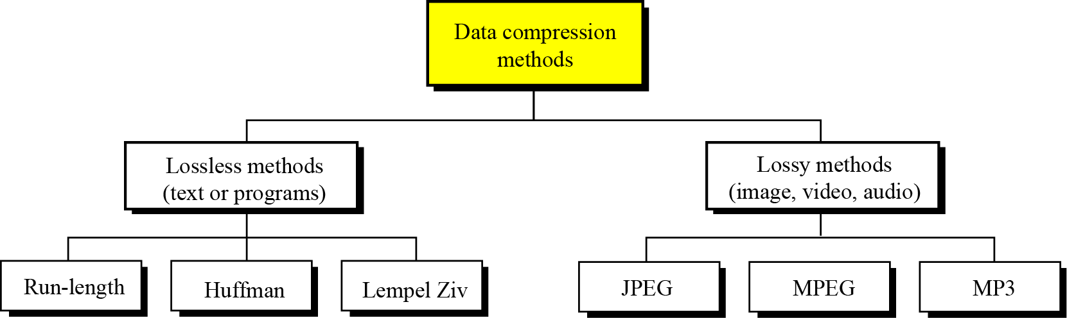
Methods

Slide 9
Lossless Compression
In this type, there is no loss of original data source during processing.
This type of compression is used when we can't compromise with the loss of data, not even a single bit. For example: Legal Documents
Compression and Decompression algorithms are excat inverse of each other.

Slide 10
Run Length Encoding
Reference- http://rosettacode.org/wiki/Run-length_encoding
It is the simplest technique.
Represent data value using value and run length.
Runlength is the number of continuous occurance of value.

Slide 11
Run Length Encoding
Useful when there is repeated values.
Reversible(Lossless Compression)
Decompression is very easy.
We must have consecutive runs in order of maximize compression
Best Case: All Values Same
Example: AAAAAAAAAAAA
Worst Case: No repeating values
Example: abcdabcd

Slide 12
Encoding Algorithm
Ref: http://www.geeksforgeeks.org/run-length-encoding/
Start on the first element of input
Examine next value
If same as previous value
Keep a counter of consecutive values
Keep examining the next value until a different value or end of input then output the value followed by the counter. Repeat
If not same as previous value
Output the previous value followed by ‘1’ (run length. Repeat

Slide 13
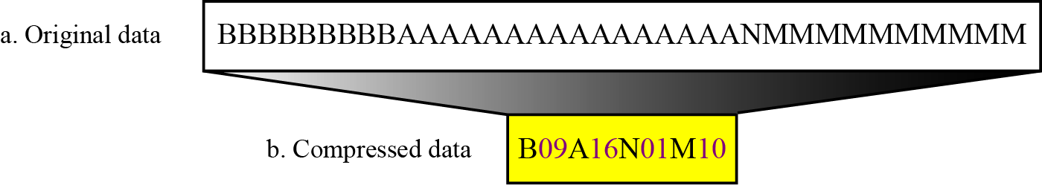
RLE Example

Slide 14
Huffman Coding
Ref: https://en.wikipedia.org/wiki/Huffman_coding
Developed by “David A. Huffman” while he was a Ph.D. student at MIT, and published in the 1952 paper "A Method for the Construction of Minimum-Redundancy Codes”.
This method assign bits to each char according to its frequency.
Higher the frequency, lesser the number of assigned bits.

Slide 15
Huffman Coding Procedure
Ref: https://www.cs.cf.ac.uk/Dave/Multimedia/node210.html
1. Initialization: Put all nodes in an OPEN list, keep it sorted at all times (e.g., ABCDE).
2. Repeat until the OPEN list has only one node left:
(a) From OPEN pick two nodes having the lowest frequencies/probabilities, create a parent node of them.
(b) Assign the sum of the children's frequencies/probabilities to the parent node and insert it into OPEN.
(c) Assign code 0, 1 to the two branches of the tree, and delete the children from OPEN.

Slide 16
Example
Consider a string having 5 different types of char.
Frequency table for above string

Slide 17
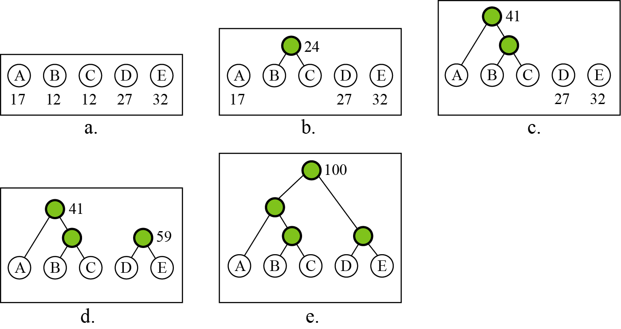
Figure: Huffman coding

Slide 18
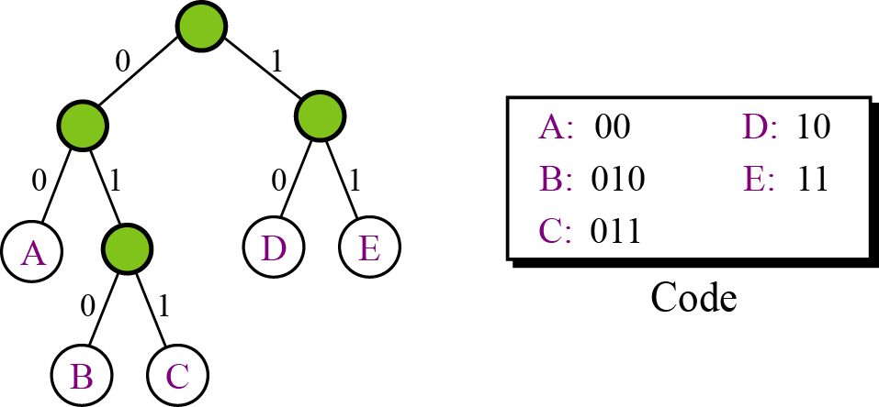
A character’s code is found by starting at the root and following the branches that lead to that character. The code itself is the bit value of each branch on the path, taken in sequence.
Figure: Final tree and code

Slide 19
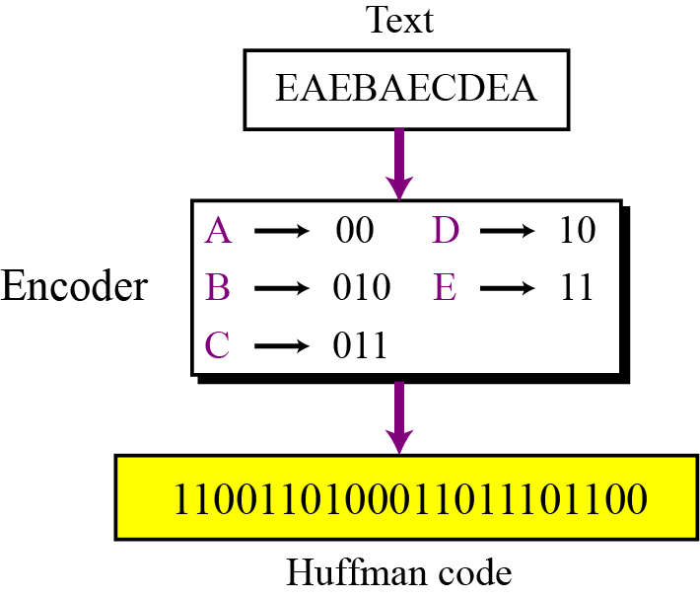
Encoding
Let us see how to encode text using the code for our five characters. Figure shows the original and the encoded text.
Figure 15.6 Huffman encoding

Slide 20
C.R.
Total no of bits required before compression =
10*8= 80
After Compression = 22
C.R. = (1-(22/80))*100
= 72.5 %

Slide 21
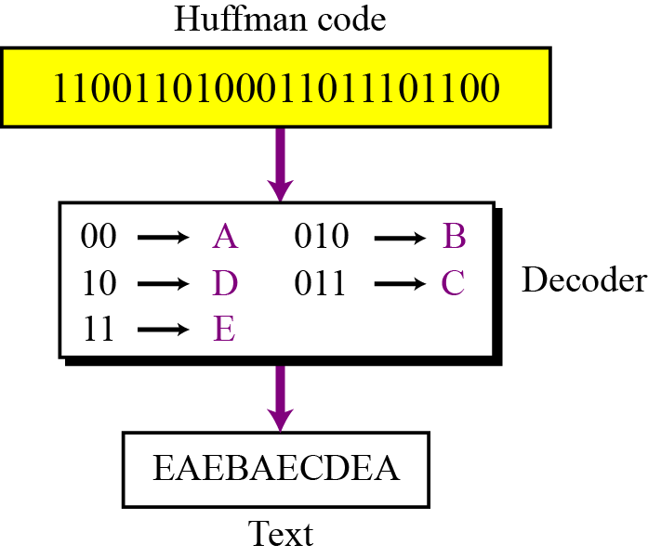
Decoding
The recipient has a very easy job in decoding the data it receives. Figure shows how decoding takes place.
Figure Huffman decoding

Slide 22
Lempel-Ziv(LZ) Method
Ref: https://en.wikipedia.org/wiki/LZCompressionMethod
Till late 1970's, data compression was mainly inclined towards to creating better methodologies for huffman coding
In 1977, an innovative and different method is proposed by “Abraham Lempel” and “Jacob ziv”.
This techniques consists of two different algorithms, LZ77 and LZ78.

Slide 23
LZ78
Ref 1: se.csie.dyu.edu.tw/lairrol/files/DC/chap5.pdf
Ref2: http://michael.dipperstein.com/lzss/
Ref3: https://en.wikipedia.org/wiki/LZ78
It is dictionary based encoding.
It will basically creates a dictionary of strings used during communication.
It inserts one or multi character, non-overlapping, distinct patterns in the dictionary.
The multi-character patterns are of the form C0C1C2...Cn-1Cn. The prefix of pattern consists of all the pattern characters except the last C0C1C2...Cn-1.

Slide 24
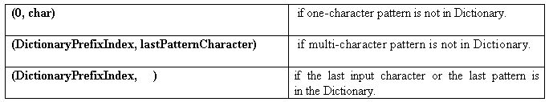
LZ78
LZ78 Output:
Note: The dictionary is usually implemented as a hash table.

Slide 25
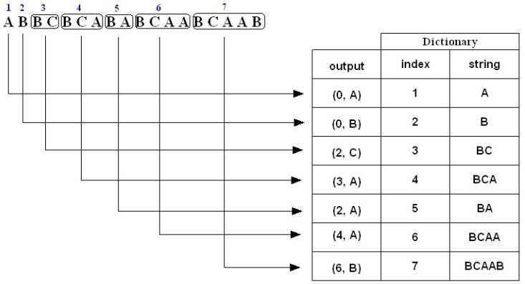
Example 1: LZ78 Compression
The compressed message is: (0,A)(0,B)(2,C)(3,A)(2,A)(4,A)(6,B)
Note: The above is just a representation, the commas and parentheses are not transmitted; we will discuss the actual form of the compressed message later on .

Slide 26
Example 1: LZ78 Compression (cont’d)
1. A is not in the Dictionary; insert it
2. B is not in the Dictionary; insert it
3. B is in the Dictionary.
BC is not in the Dictionary; insert it.
4. B is in the Dictionary.
BC is in the Dictionary.
BCA is not in the Dictionary; insert it.
5. B is in the Dictionary.
BA is not in the Dictionary; insert it.
6. B is in the Dictionary.
BC is in the Dictionary.
BCA is in the Dictionary.
BCAA is not in the Dictionary; insert it.
7. B is in the Dictionary.
BC is in the Dictionary.
BCA is in the Dictionary.
BCAA is in the Dictionary.
BCAAB is not in the Dictionary; insert it.

Slide 27
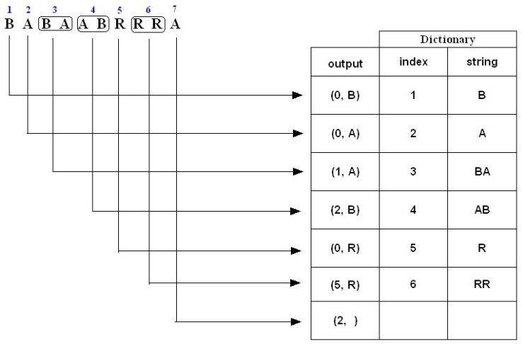
Example 2: LZ78 Compression
Encode (i.e., compress) the string BABAABRRRA using the LZ78 algorithm.
The compressed message is: (0,B)(0,A)(1,A)(2,B)(0,R)(5,R)(2, )

Slide 28
Example 2: LZ78 Compression (cont’d)
1. B is not in the Dictionary; insert it
2. A is not in the Dictionary; insert it
3. B is in the Dictionary.
BA is not in the Dictionary; insert it.
4. A is in the Dictionary.
AB is not in the Dictionary; insert it.
5. R is not in the Dictionary; insert it.
6. R is in the Dictionary.
RR is not in the Dictionary; insert it.
7. A is in the Dictionary and it is the last input character; output a pair
containing its index: (2, )

Slide 29
Example: Uncompressed String: ABBCBCABABCAABCAAB
Number of bits = Total number of characters * 8
= 18 * 8
= 144 bits
Suppose the codewords are indexed starting from 1:
Compressed string( codewords): (0, A) (0, B) (2, C) (3, A) (2, A) (4, A) (6, B)
Codeword index 1 2 3 4 5 6 7
LZ78 Compression: Number of bits transmitted

Slide 30
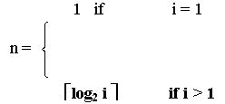
LZ78 Compression: Number of bits transmitted
Each code word consists of an integer and a character:
The character is represented by 8 bits.
The number of bits n required to represent the integer part of the codeword with index i is given by:

Slide 31
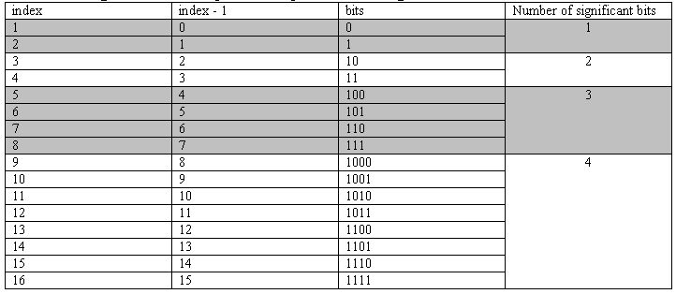
LZ78 Compression: Number of bits transmitted (cont’d)
Codeword (0, A) (0, B) (2, C) (3, A) (2, A) (4, A) (6, B)
index 1 2 3 4 5 6 7
Bits: (1 + 8) + (1 + 8) + (2 + 8) + (2 + 8) + (3 + 8) + (3 + 8) + (3 + 8) = 71 bits
The actual compressed message is: 0A0B10C11A010A100A110B
where each character is replaced by its binary 8-bit ASCII code.

Slide 32
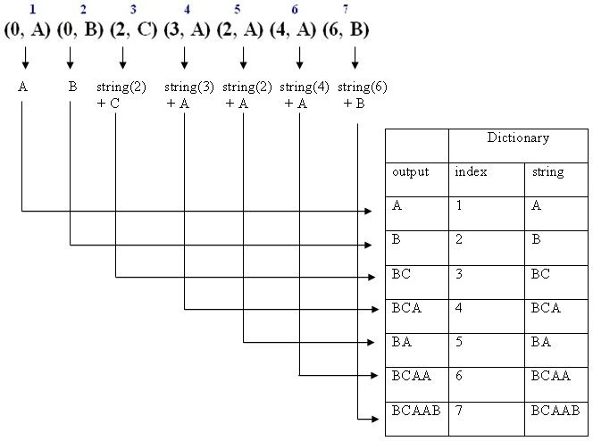
Example 1: LZ78 Decompression
Decode (i.e., decompress) the sequence (0, A) (0, B) (2, C) (3, A) (2, A) (4, A) (6, B)
The decompressed message is: ABBCBCABABCAABCAAB

Slide 33
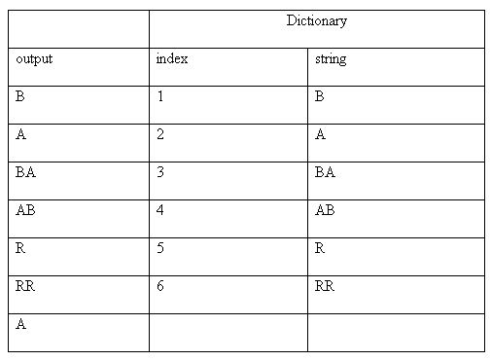
Example 2: LZ78 Decompression
Decode (i.e., decompress) the sequence (0, B) (0, A) (1, A) (2, B) (0, R) (5, R) (2, )
The decompressed message is: BABAABRRRA

Slide 34
LZ78 Decompression Algorithm
Dictionary  empty ; DictionaryIndex  1 ;
while(there are more (CodeWord, Char) pairs in codestream){
CodeWord  next CodeWord in codestream ;
Char  character corresponding to CodeWord ;
if(CodeWord = = 0)
String  empty ;
else
String  string at index CodeWord in Dictionary ;
Output: String + Char ;
insertInDictionary( (DictionaryIndex , String + Char) ) ;
DictionaryIndex++;
}

Slide 35
LZ77
Ref: http://michael.dipperstein.com/lzss/
This method, try to replace the redundant data with “Metadata”.
No external dictionary is used to check redundant data like LZ78 method.
Basically, a section of data(which is repeated) is replaced by pointer.

Slide 36
LZ77 terminology
Ref: https://msdn.microsoft.com/en-us/library/ee916854.aspx
Input stream: Given byte of sequence is to be compressed.
Byte: basic data element in the input stream
Coding position: position of the byte which is currently being coded.
Lookahead buffer: buffer from coding postion to end of input stream
Window: buffer from starting of input stream to coding position
Pointer: <B,L>
Where B indicates how many bytes we have to go backward in sliding window and L is the length of longest match.

Slide 37
LZ77 Encoding Algorithm
Set the coding position to the beginning of the input stream.
Find the longest match in the window for the lookahead buffer.
If a match is found, output the pointer P. Move the coding position (and the window) L bytes forward.
If a match is not found, output a null pointer and the first byte in the lookahead buffer. Move the coding position (and the window) one byte forward.
If the lookahead buffer is not empty, return to step 2.

Slide 38
Compression Process Example
Input Stream : “AABCBBABC”
Position 1 2 3 4 5 6 7 8 9
Byte A A B C B B A B C

Slide 39
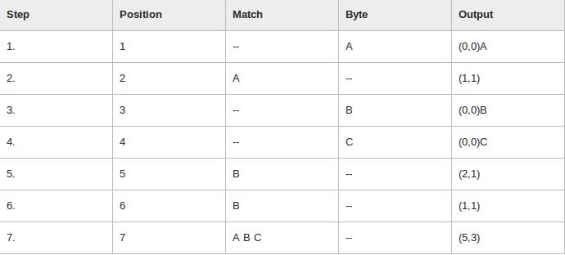
Compression Process Example

Slide 40
Compression Process Example
Step: Number of encoding step
Position: Number of coding position.
Match: Show the longest match found.
Byte: First byte in the lookahead buffer after match.
Output: Final Output pattern.

Slide 41
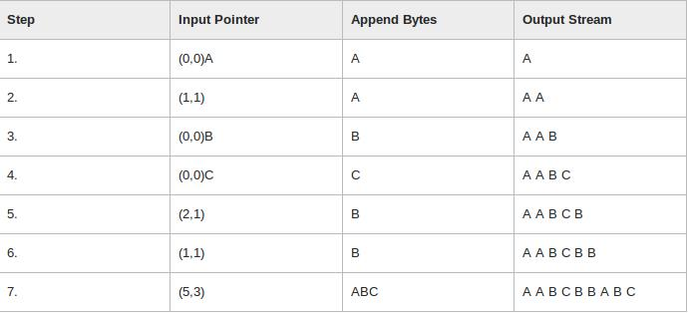
Decompression LZ77

Slide 42
Decompression LZ77
Step: Indicates the number of the decoding step.
Input Pointer: The next pointer from the input stream.
Append Bytes: The bytes that the pointer identifies to be appended to the output stream.
Output Stream: The output stream as it looks at the end of each step.

Slide 43
Applications LZ77
This algorithm is open source and used in what is widely known as ZIP, and by the formats PNG, TIFF, PDF and many others. LZ77 is used in gzip, Squeeze, LHA, PKZIP, and ZOO.
For more details please visit
http://www.ijesit.com/Volume%204/Issue%203/IJESIT201503_06.pdf

Slide 44
Lossy Compression
As the name suggests, some of the original data source may lost during processing.
But this loss is so small that can't be visible to eyes so it can be ignored.
These methods are cheaper – they take less time and space when it comes to sending millions of bits per second for images and videos.

Slide 45
Lossy Compression
Image Compression
Video Compression
Audio Compression

Slide 46
Image compression – JPEG encoding
Ref: https://en.wikipedia.org/wiki/JPEG
JPEG compression is used with .jpg and can be embedded in .tiff and .eps files.
Used on 24-bit color files.
Works well on photographic images.
Although it is a lossy compression technique, it yields an excellent quality image with high compression rates.

Slide 47
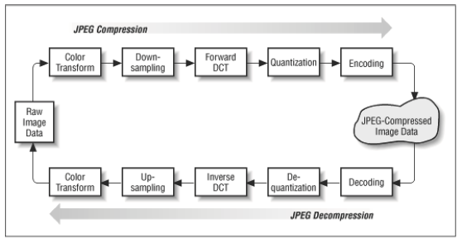
JPEG METHOD
Ref: www.cs.cf.ac.uk/Dave/Multimedia_CM0340/.../10_CM0340_JPEG.pdf

Slide 48
STEPS
1. (Optionally) If the color is represented in RGB mode, translate it to YUV.
2. Divide the file into 8 X 8 blocks.
3. Transform the pixel information from the spatial domain to the frequency domain with the Discrete Cosine Transform.
4. Quantize the resulting values by dividing each coefficient by an integer value and rounding off to the nearest integer.
5. Look at the resulting coefficients in a zigzag order. Do a run-length encoding of the coefficients ordered in this manner. Follow by Huffman coding.

Slide 49
1. Color Transform
src: https://en.wikipedia.org/wiki/YUV
http://www.shmo.de/mlab/downsample
This step is optional but using it gives better compression rate.
(a) translate from RGB to YC_{b}C_{r}

Slide 50
1. Color Transform
(b) translate from YC_{b}C_{r} to RGB

Slide 51
2. Downsampling
Y
Y
Y
H
H
H
W
W
W
W
W
W
C_{b}
C_{b}
C_{b}
H
H
H
W
W
W
C_{r}
C_{r}
C_{r}
H
H
H
(a) 4:4:4
(b) 4:2:2
(c) 4:2:0
The ratios at which the downsampling is ordinarily done for JPEG images are 4:4:4 (no downsampling), 4:2:2 (reduction by a factor of 2 in the horizontal direction), or (most commonly) 4:2:0 (reduction by a factor of 2 in both the horizontal and vertical directions)

Slide 52
3. Discrete Cosine Transform
Ref: vision.arc.nasa.gov/publications/mathjournal94.pdf
It Convets information contained in a block from spatial domain to frequency domain.
Consider a unsorted list of 12 numbers between 0 and 3 -> (2, 3, 1, 2, 2, 0, 1, 1, 0, 1, 0, 0). Consider a transformation of the list involving two steps (1.) sort the list (2.) Count the frequency of occurrence of each of the numbers ->(4,4,3,1 ). : Through this transformation we lost the spatial information but captured the frequency information.
There are other methods available by which information of spatial space can be retained. Example DCT, Fourier transform

Slide 53
3. Discrete Cosine Transform
Forward DCT:
Inverse DCT:

Slide 54
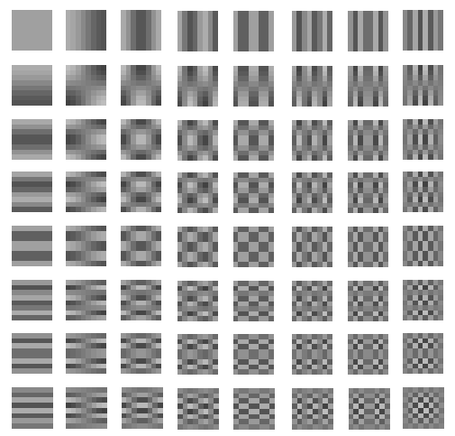
3. Discrete Cosine Transform
0 1 2 3 4 5 6 7
0 1 2 3 4 5 6 7
v
The 8x8 DCT basis

Slide 55
3. Discrete Cosine Transform
48 | 39 | 40 | 68 | 60 | 38 | 50 | 121
149 | 82 | 79 | 101 | 113 | 106 | 27 | 62
58 | 63 | 77 | 69 | 124 | 107 | 74 | 125
80 | 97 | 74 | 54 | 59 | 71 | 91 | 66
18 | 34 | 33 | 46 | 64 | 61 | 32 | 37
149 | 108 | 80 | 106 | 116 | 61 | 73 | 92
211 | 233 | 159 | 88 | 107 | 158 | 161 | 109
212 | 104 | 40 | 44 | 71 | 136 | 113 | 66
W
Y
H
8x8 values of luminance
DCT
699.25 | 43.18 | 55.25 | 72.11 | 24.00 | -25.51 | 11.21 | -4.14
-129.78 | -71.50 | -70.26 | -73.35 | 59.43 | -24.02 | 22.61 | -2.05
85.71 | 30.32 | 61.78 | 44.87 | 14.84 | 17.35 | 15.51 | -13.19
-40.81 | 10.17 | -17.53 | -55.81 | 30.50 | -2.28 | -21.00 | -1.26
-157.50 | -49.39 | 13.27 | -1.78 | -8.75 | 22.47 | -8.47 | -9.23
92.49 | -9.03 | 45.72 | -48.13 | -58.51 | -9.01 | -28.54 | 10.38
-53.09 | -62.97 | -3.49 | -19.62 | 56.09 | -2.25 | -3.28 | 11.91
-20.54 | -55.90 | -20.59 | -18.19 | -26.58 | -27.07 | 8.47 | 0.31
8x8 DCT coefficiences

Slide 56
4. Quantization
Ref: www.site.uottawa.ca/.../Image_Quantization/image_quantization.html
16 | 11 | 10 | 16 | 24 | 40 | 51 | 61
12 | 12 | 14 | 19 | 26 | 58 | 60 | 55
14 | 13 | 16 | 24 | 40 | 57 | 69 | 56
14 | 17 | 22 | 29 | 51 | 87 | 80 | 62
18 | 22 | 37 | 56 | 68 | 109 | 103 | 77
24 | 35 | 55 | 64 | 81 | 104 | 113 | 92
49 | 64 | 78 | 87 | 103 | 121 | 120 | 101
72 | 92 | 95 | 98 | 112 | 100 | 103 | 99
17 | 18 | 24 | 47 | 99 | 99 | 99 | 99
18 | 21 | 26 | 66 | 99 | 99 | 99 | 99
24 | 26 | 56 | 99 | 99 | 99 | 99 | 99
47 | 66 | 99 | 99 | 99 | 99 | 99 | 99
99 | 99 | 99 | 99 | 99 | 99 | 99 | 99
99 | 99 | 99 | 99 | 99 | 99 | 99 | 99
99 | 99 | 99 | 99 | 99 | 99 | 99 | 99
99 | 99 | 99 | 99 | 99 | 99 | 99 | 99
Figure 3. Luminance and Chrominance quantization matrix

Slide 57
4. Quantization
699.25 | 43.18 | 55.25 | 72.11 | 24.00 | -25.51 | 11.21 | -4.14
-129.78 | -71.50 | -70.26 | -73.35 | 59.43 | -24.02 | 22.61 | -2.05
85.71 | 30.32 | 61.78 | 44.87 | 14.84 | 17.35 | 15.51 | -13.19
-40.81 | 10.17 | -17.53 | -55.81 | 30.50 | -2.28 | -21.00 | -1.26
-157.50 | -49.39 | 13.27 | -1.78 | -8.75 | 22.47 | -8.47 | -9.23
92.49 | -9.03 | 45.72 | -48.13 | -58.51 | -9.01 | -28.54 | 10.38
-53.09 | -62.97 | -3.49 | -19.62 | 56.09 | -2.25 | -3.28 | 11.91
-20.54 | -55.90 | -20.59 | -18.19 | -26.58 | -27.07 | 8.47 | 0.31
F(u,v)
8x8 DCT coefficiences
Q(u,v)
Quantization matrix
16 | 11 | 10 | 16 | 24 | 40 | 51 | 61
12 | 12 | 14 | 19 | 26 | 58 | 60 | 55
14 | 13 | 16 | 24 | 40 | 57 | 69 | 56
14 | 17 | 22 | 29 | 51 | 87 | 80 | 62
18 | 22 | 37 | 56 | 68 | 109 | 103 | 77
24 | 35 | 55 | 64 | 81 | 104 | 113 | 92
49 | 64 | 78 | 87 | 103 | 121 | 120 | 101
72 | 92 | 95 | 98 | 112 | 100 | 103 | 99

Slide 58
4. Quantization
Example :
43.70 | 3.93 | 5.52 | 4.51 | 1.00 | -0.64 | 0.22 | -0.07
-10.82 | -5.96 | -5.02 | -3.86 | 2.29 | -0.41 | 0.38 | -0.04
6.12 | 2.33 | 3.86 | 1.87 | 0.37 | 0.30 | 0.22 | -0.24
-2.91 | 0.60 | -0.80 | -1.92 | 0.60 | -0.03 | -0.26 | -0.02
-8.75 | -2.25 | 0.36 | -0.03 | -0.13 | 0.21 | -0.08 | -0.12
3.85 | -0.26 | 0.83 | -0.75 | -0.72 | -0.09 | -0.25 | 0.11
-1.08 | -0.98 | -0.04 | -0.23 | 0.54 | -0.02 | -0.03 | 0.12
-0.29 | -0.61 | -0.22 | -0.19 | -0.24 | -0.27 | 0.08 | 0.00
44 | 4 | 6 | 5 | 1 | -1 | 0 | 0
-11 | -6 | -5 | -4 | 2 | 0 | 0 | 0
6 | 2 | 4 | 2 | 0 | 0 | 0 | 0
-3 | 1 | -1 | -2 | 1 | 0 | 0 | 0
-9 | -2 | 0 | 0 | 0 | 0 | 0 | 0
4 | 0 | 1 | -1 | -1 | 0 | 0 | 0
-1 | -1 | 0 | 0 | 1 | 0 | 0 | 0
0 | -1 | 0 | 0 | 0 | 0 | 0 | 0

Slide 59
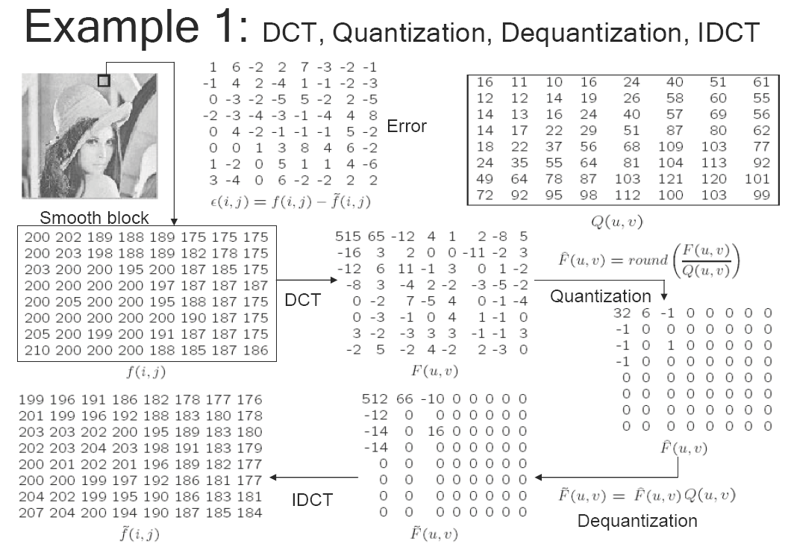

Slide 60
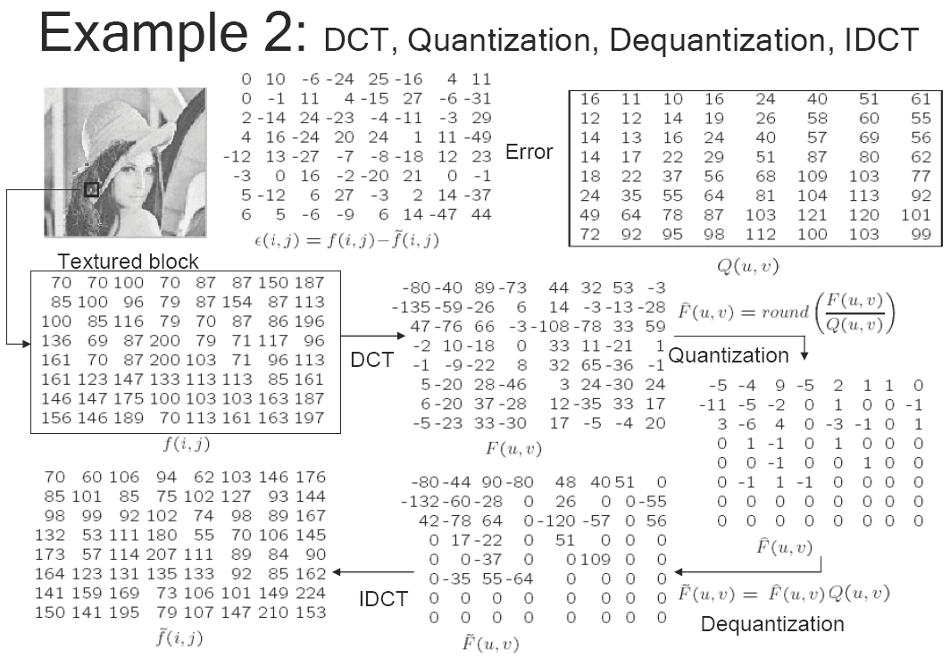

Slide 61
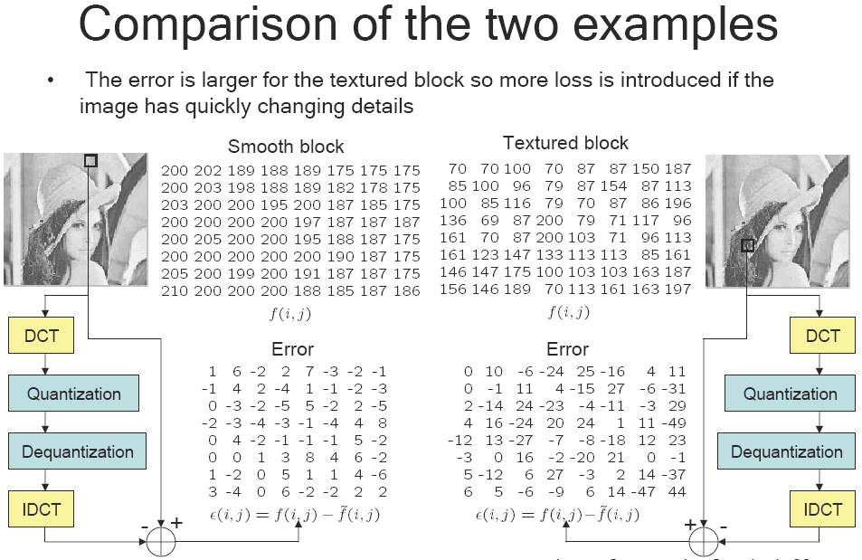

Slide 62
5. Zig-Zag reordering
Ref: www.sciencedirect.com/science/article/pii/0262885694900388
This is done so that the coefficients are in order of increasing frequency.
The higher frequency coefficients are more likely to be 0 after quantization.
This improves the compression of run-length encoding.
Do run-length encoding and Huffman coding
It is used to group low frequency coefficients in top of vector and high frequency coefficients at the bottom.

Slide 63
5. Zig-Zag reordering
0 | 1 | 5 | 6 | 14 | 15 | 27 | 28
2 | 4 | 7 | 13 | 16 | 26 | 29 | 42
3 | 8 | 12 | 17 | 25 | 30 | 41 | 43
9 | 11 | 18 | 24 | 31 | 40 | 44 | 53
10 | 19 | 23 | 32 | 39 | 45 | 52 | 54
20 | 22 | 33 | 38 | 46 | 51 | 55 | 60
21 | 34 | 37 | 47 | 50 | 56 | 59 | 61
35 | 36 | 48 | 49 | 57 | 58 | 62 | 63
Figure 4. Zig-Zag reordering matrix

Slide 64
5. Zig-Zag reordering
Example :
44 | 4 | 6 | 5 | 1 | -1 | 0 | 0
-11 | -6 | -5 | -4 | 2 | 0 | 0 | 0
6 | 2 | 4 | 2 | 0 | 0 | 0 | 0
-3 | 1 | -1 | -2 | 1 | 0 | 0 | 0
-9 | -2 | 0 | 0 | 0 | 0 | 0 | 0
4 | 0 | 1 | -1 | -1 | 0 | 0 | 0
-1 | -1 | 0 | 0 | 1 | 0 | 0 | 0
0 | -1 | 0 | 0 | 0 | 0 | 0 | 0
Zig-Zag Reordering :
44,
4,-11,
6,-6,6,
5,-5,2,-3,
-9,1,4,-4,1,
-1,2,2,-1,-2,4,
-1,0,0,-2,0,0,0,
0,0,0,1,0,1,-1,0,
-1,0,-1,0,0,0,0,
0,0,0,-1,0,0,
0,1,0,0,0,
0,0,0,0,
0,0,0,
0,0,
0

Slide 65
Video Compression- MPEG Encoding
Ref: http://www.bretl.com/mpeghtml/mpeg2vc1.HTM
http://homepages.inf.ed.ac.uk/rbf/CVonline/LOCAL_COPIES/AV0506/s0561282.pdf
Each video is a rapid sequence of a set of frames. Each frame is a spatial combination of pixels, or a picture.
Compressing video =
spatially compressing each frame
+
temporally compressing a set of frames.

Slide 66
Video Compression- MPEG Encoding
Spatial Compression
Each frame is spatially compressed by JPEG.
Temporal Compression
Redundant frames are removed.
For example, in a static scene in which someone is talking, most frames are the same except for the segment around the speaker’s lips, which changes from one frame to the next.

Slide 67
Video Compression- MPEG Encoding
Generally three types of frames are used.
I-frame(intra): These are key frames.It is a type of absolute frame and Have No reference to other frame. Compression is not that high for these.
P-frame(predicated): Can be constructed by previouse P-frame or I-frame. These cannot be constructed without without any reference frame

Slide 68
Video Compression- MPEG Encoding
B-frame(bi-directional): It is two directional version of P-frame referring both direction( one forward frame and one backward frame). These cannot be referenced by other P or B-frames.
For more detail about how excatly compression happen then please visit below link:
http://homepages.inf.ed.ac.uk/rbf/CVonline/LOCAL_COPIES/AV0506/s0561282.pdf

Slide 69
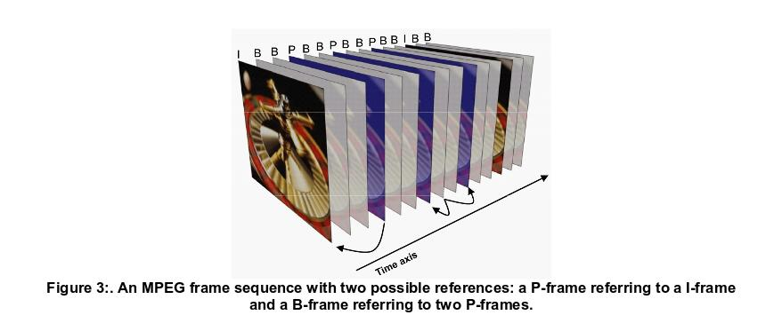
Video Compression- MPEG Encoding

Slide 70
Audio Compression
Ref: http://www.mpi.nl/corpus/a4guides/a4-guide-audio-compression.pdf
Input signal in digital form (sampled).
Split signal into separate frequency bands corresponding to the ear’s critical bands.
Separately calculate the ear’s response to ear band.
Increase the quantisation step in bands were we can mask quantisation noise
Code resultant bit stream using Huffman coding.
Output the result.

Slide 71
Thank you !

