Slide 1
Week 14 Team IIP Reflection Video
D2
Afsheen Shakoor
Lokesh Garg
Ryoma Machida
Victoria Tan Zhaozhi
Xie Yunfeng
Notes:
Welcome to our reflection video.

Slide 2

Tackling Mental Health Challenges
Addressing stress through accessible mental health tools for high school students.
“Students in an academic setting” by Chat GPT image
Notes:
Our project addresses the mental health challenges faced by high school students under academic pressure. We aimed to provide affordable, accessible mental health tools that empower students to manage stress and improve well-being. In this video, we’ll reflect on five significant learning moments and how the DD+ framework guided our journey, using insights captured on our Miro board.

Slide 3
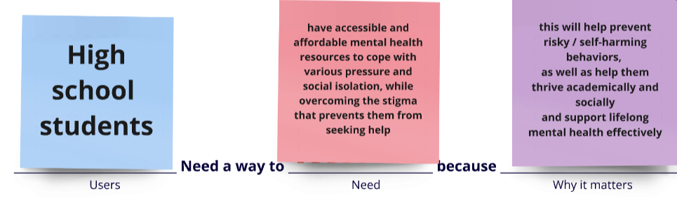
Learning Moment 1: Reframing POV to HMW
Initial POV targeted all students; debates led to narrowing the focus to high school students.
Tradeoff: Broader reach vs. tailored feasibility
Decision: Target high school students for relevance and practicality.
POV Statement
Notes:
"Our first learning moment was reframing our initial POV statement into a focused HMW question. Initially, our POV targeted all students, but critical debates led us to narrow it down to high school students. The debate weighed reach against depth. Some advocated for broader impact, while others emphasized the feasibility of targeting a specific group."
" We chose high school students for greater relevance and feasibility. This key decision reflected a tradeoff between addressing a broader audience and creating tailored solutions

Slide 4
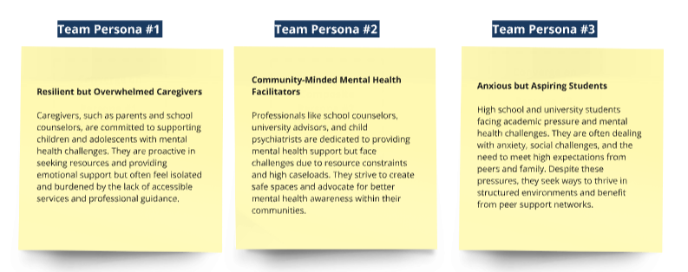
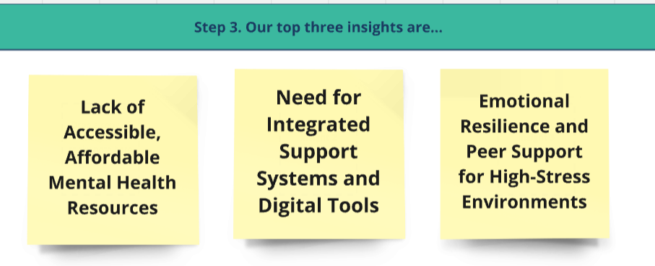
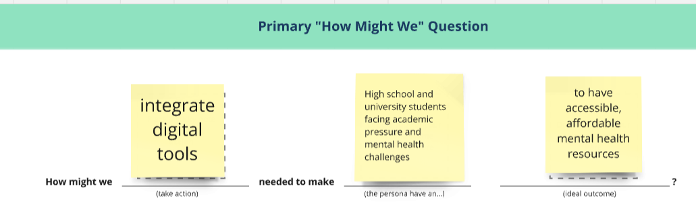
DD+ Framework Application
Divergence: Explored multiple personas and contexts.
Convergence: Refined the HMW question based on our top three insights to focus on high school students and their specific challenges.
Notes:
. Guided by the DD+ framework, we transitioned from divergence—exploring multiple personas—to convergence—refining our target group. This process led us to craft our final HMW question: ‘How might we integrate digital tools that enable high school students facing academic pressure and mental health challenges to access affordable resources for managing stress effectively and improving their well-being?’"

Slide 5
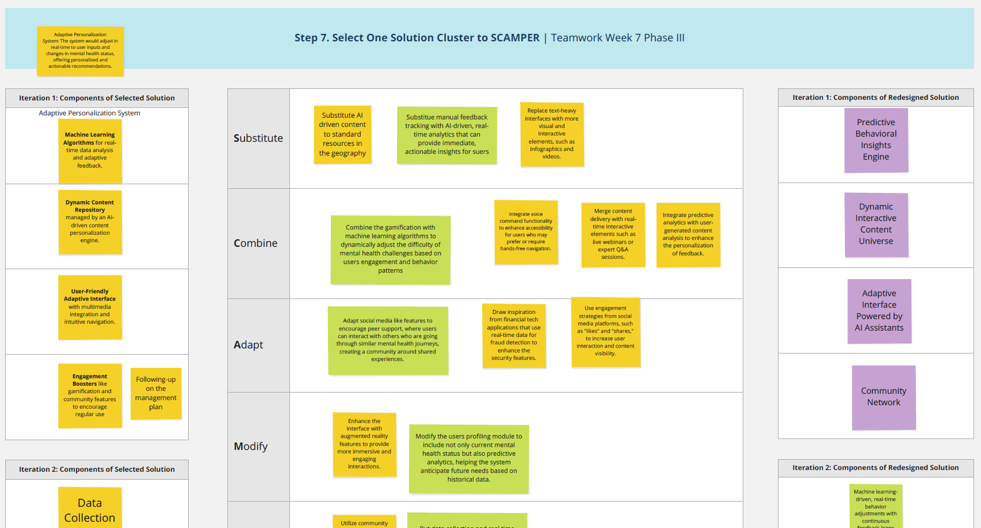
Learning Moment 2: Prioritizing Platform Features
Process Element: Critical Debates, Key Decisions, and Tradeoffs
Key Highlights: Debate between gamification (to drive engagement) and AI personalization (for tailored insights).
Tradeoff: Immediate engagement vs. long-term personalization benefits.
AI
Personalization
Gamification

Slide 6
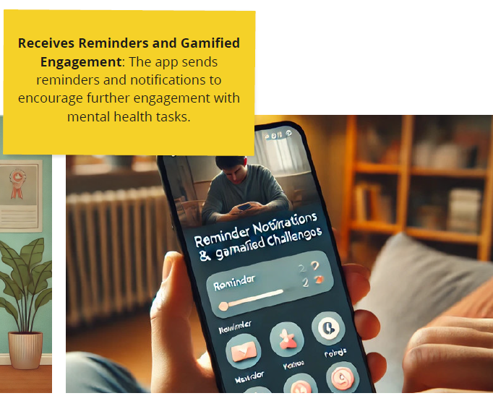
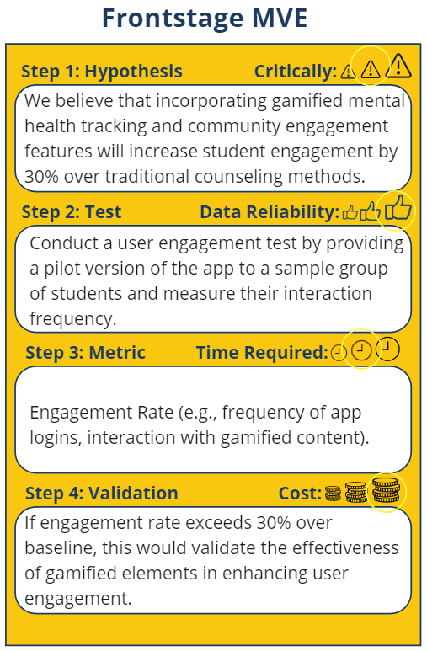
DD+ Framework Application
Decision: Prioritize gamification initially for user engagement; plan AI features for future iterations.
DD+ Framework Application:
Iterative testing and feedback validated desirability of gamification (e.g., reminders and interactive tasks).

Slide 7
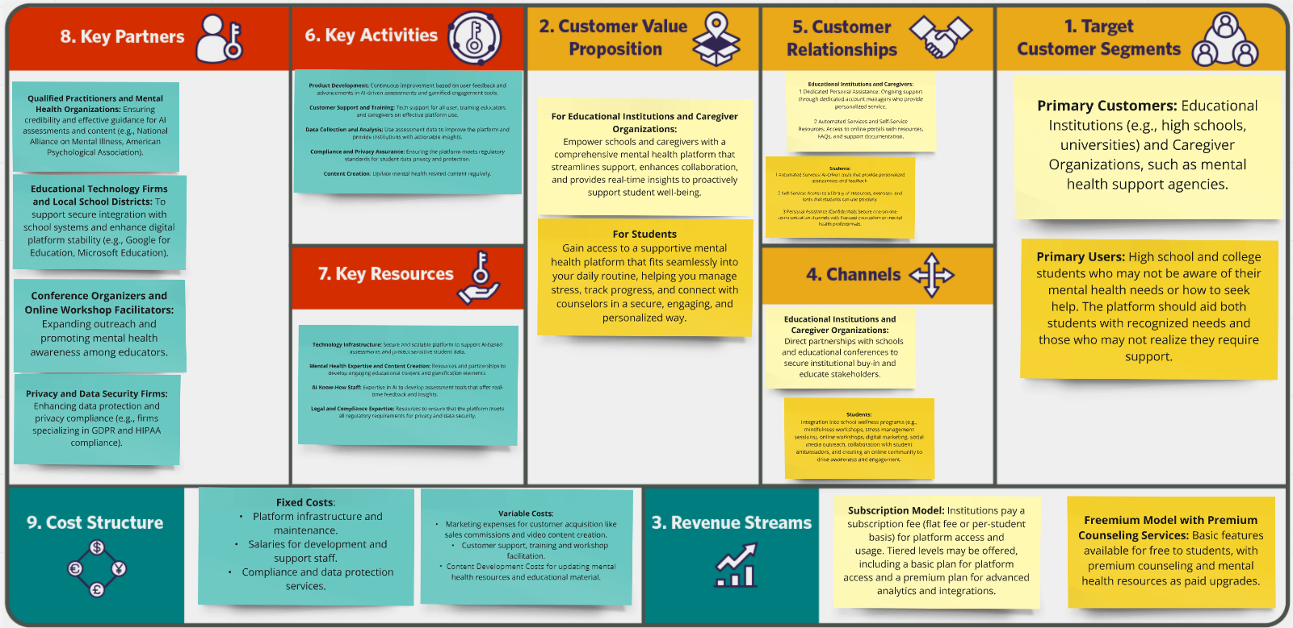
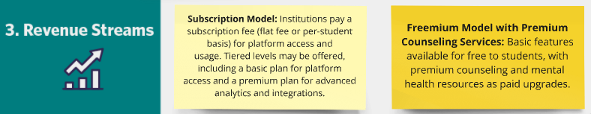
Learning Moment 3: Business Model Development
Debate: Freemium Vs. Subscription Model
Tradeoff: Accessibility vs. operational viability.
Pivot: Tiered subscription model targeting institutions while offering free basic features for students.
Notes:
"Another critical moment was developing our business model. We debated adopting a freemium model or a subscription-based approach targeting institutions. The freemium model increased accessibility but limited revenue, whereas subscriptions sustained operations but reduced adoption."

Slide 8
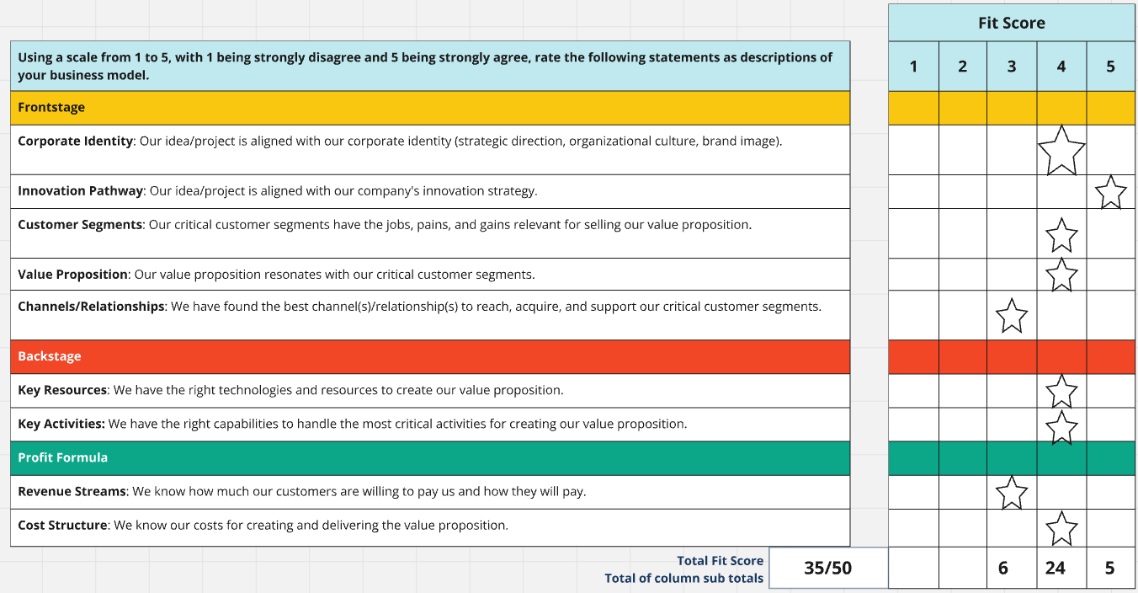
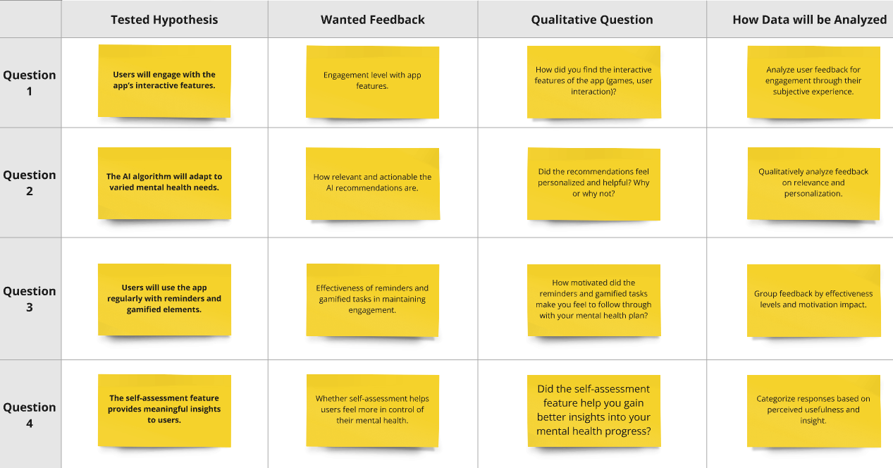
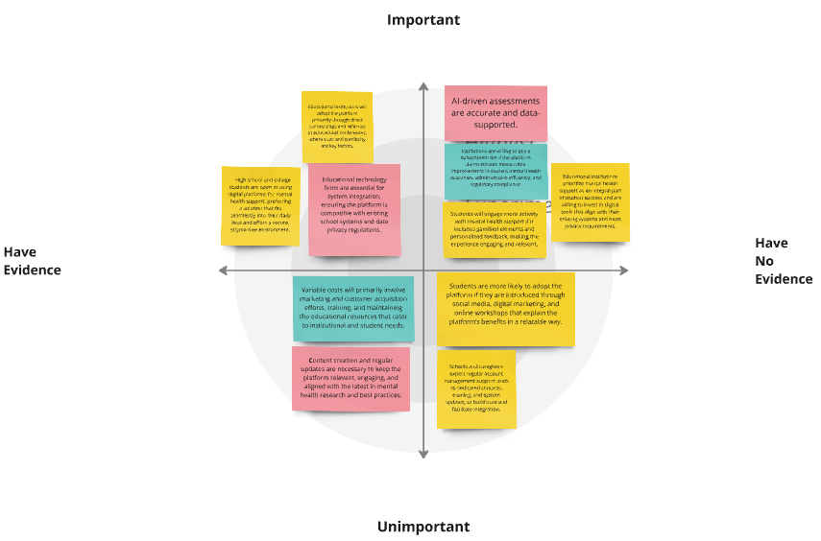
DD+ Framework Application
Divergence: Explored multiple pricing models.
Convergence: Refined a sustainable strategy through feedback loops.
Notes:
"We decided on a tiered subscription model targeting institutions while offering free basic features for students. This pivot expanded our target audience to include caregivers and schools. Applying the DD+ framework, we explored various pricing models through divergence and refined a sustainable revenue strategy during convergence. Iterative feedback from stakeholders ensures alignment with user needs while maintaining financial viability."

Slide 9
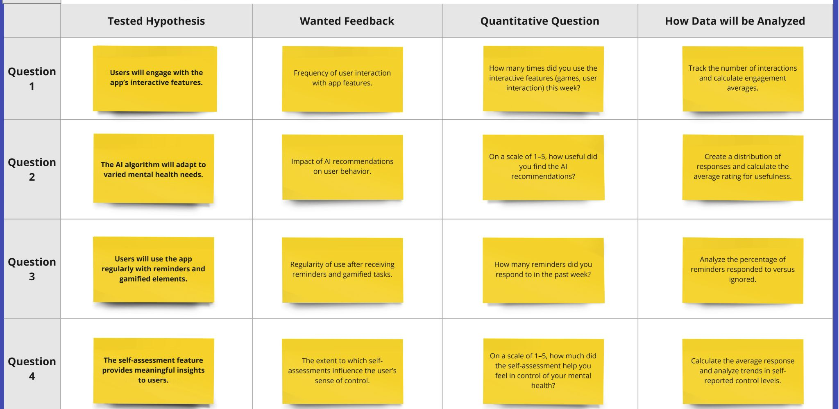
Learning Moment 4: Testing Assumptions with MVEs
Tested gamified engagement features (e.g., reminders, interactive tasks).
Debate: Prioritize engagement metrics or mental health outcomes.
Decision: Validate desirability first by focusing on engagement metrics; address broader outcomes in future iterations.

Slide 10
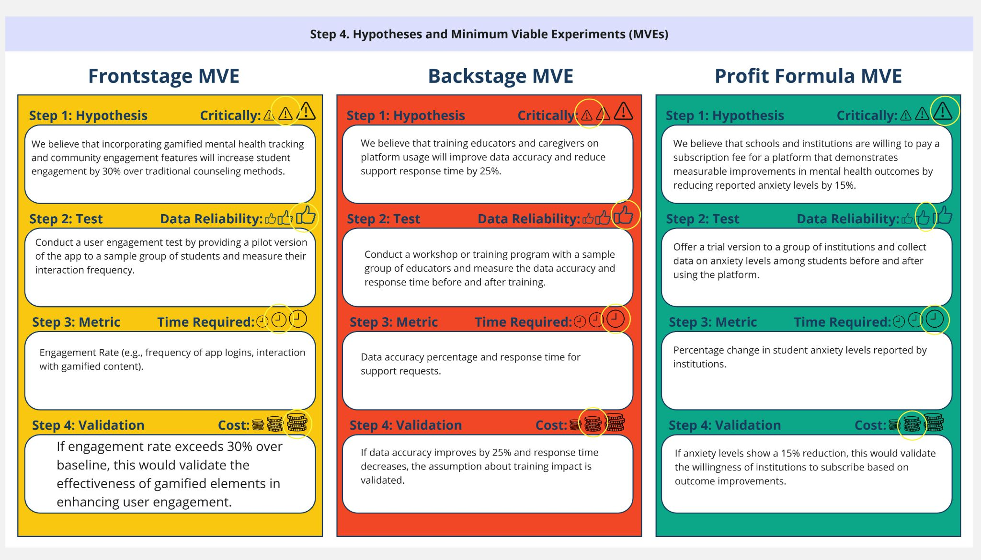
DD+ Framework Application
Iterative refinement of experiments aligned desirability with feasibility.

Slide 11
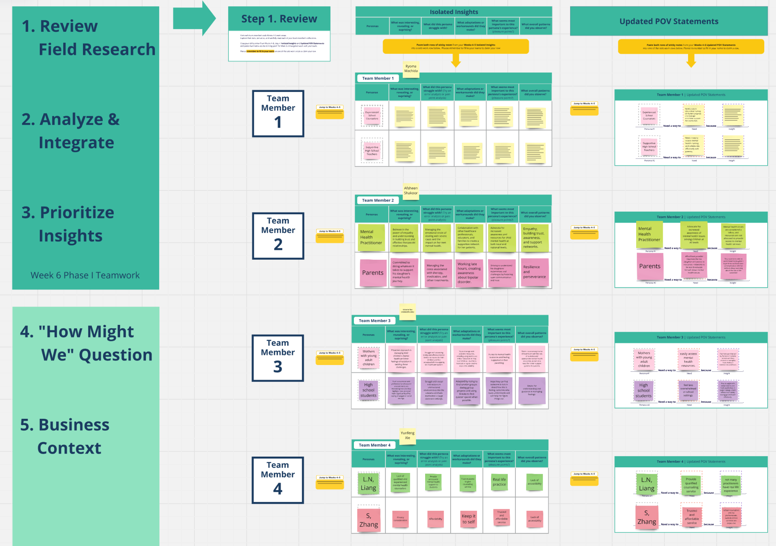
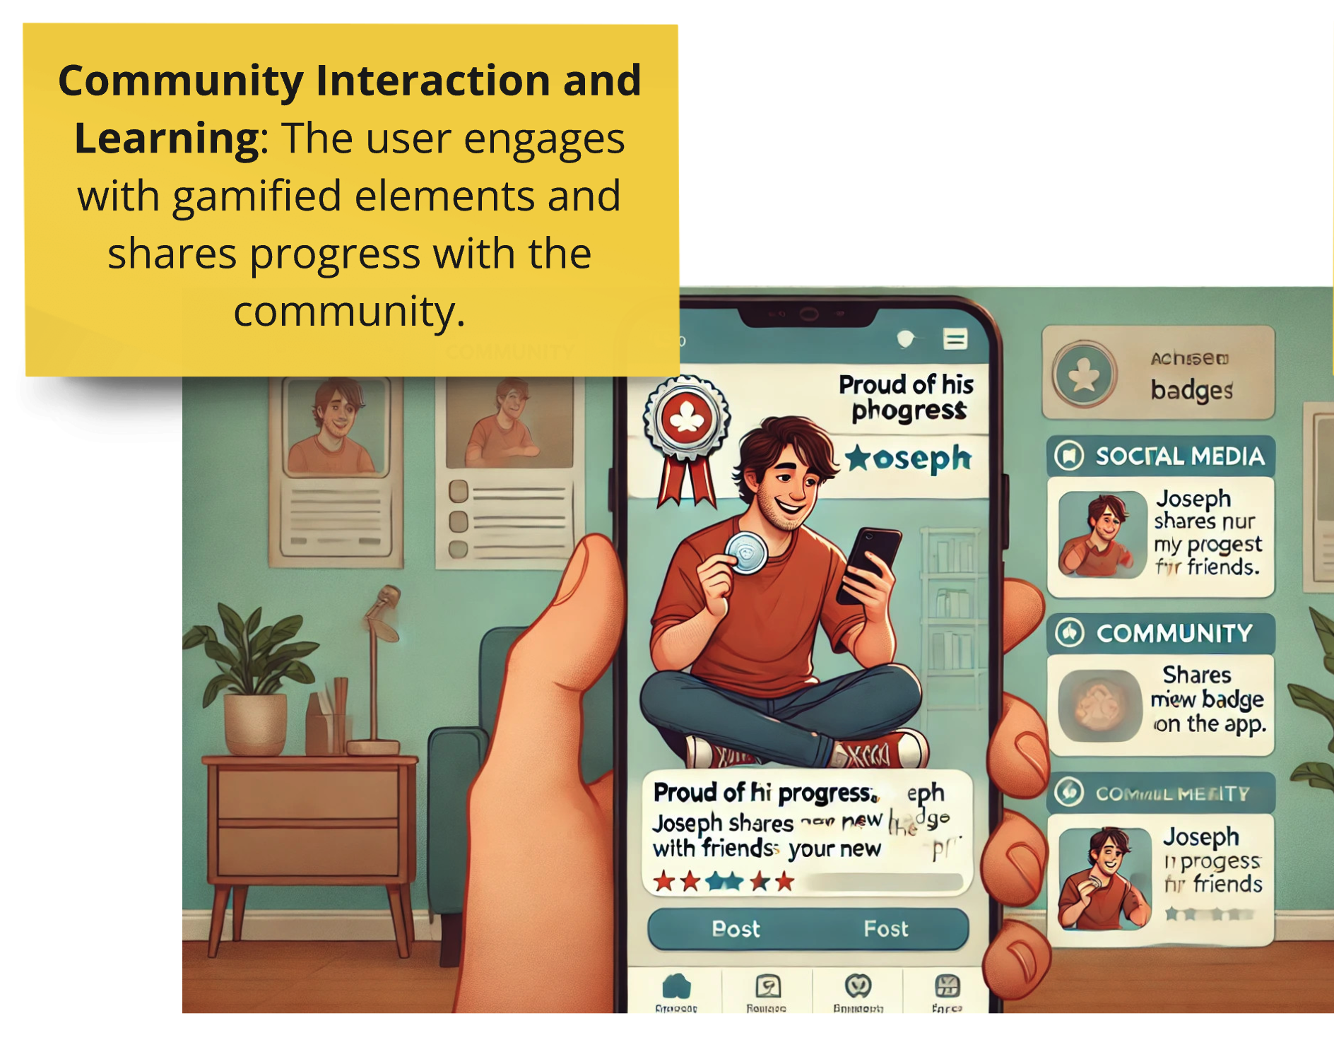
Learning Moment 5: Iteration and Feedback Integration
Stakeholder Feedback:
Stakeholders emphasized the need for community-driven features like shared stress management challenges.
Minor Pivot:
Enhanced engagement without overcomplicating the platform.
Iterative Process:
Cycles of divergence (gathering inputs) and convergence (prioritizing improvements) refined the prototype.
Framework Applied:
Adaptability in innovation achieved using the DD+ framework.
Notes:
Our final significant moment involved integrating stakeholder feedback through iterative refinement.
Stakeholders highlighted the need for community-driven features, leading us to add shared stress management challenges.
This was a minor pivot that enhanced engagement without overcomplicating the platform.
Using the DD+ framework, we moved through cycles of divergence—gathering diverse inputs—and convergence—prioritizing actionable improvements.
This iterative process refined our prototype, ensured alignment with user needs, and highlighted the value of adaptability in innovation.

Slide 12
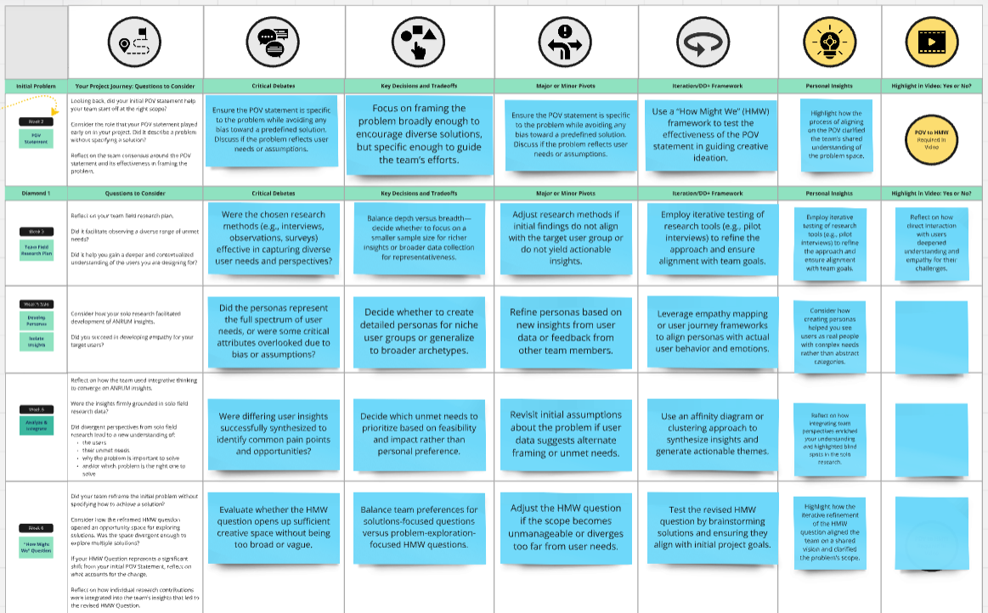
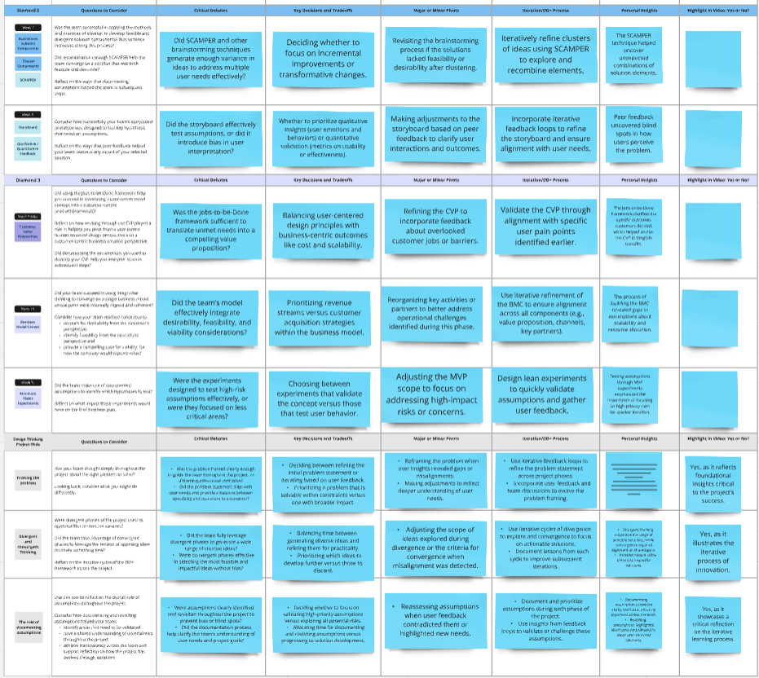
Key Takeaways
Our journey highlighted constructive debates, tradeoffs, and iterative refinements as key to impactful solutions.
Through pivots and iterations, we balanced desirability, feasibility, and viability to create a meaningful and sustainable solution.
Notes:
"In summary, our journey highlighted constructive debates, tradeoffs, and iterative refinements as key to impactful solutions. By applying the DD+ framework, we transformed challenges into opportunities and created a platform tailored to high school students' mental health needs." "This project demonstrated the value of collaboration, adaptability, and stakeholder engagement. Through pivots and iterations, we balanced desirability, feasibility, and viability to create a meaningful and sustainable solution."

