Slide 1

ion focusing lens
(einzel lens)
FIL1
⑦
⑧
Q-
FIL1_V
ION
BOX
⑥
⑨
ION
BOX
①
IB_OS
Q+
FC/SEM
⑤
BODY
EL3
FIL_GND
②
LENS_DC
④
FIL2_V
③
FIL2
Extracting Lens
Focusing Lens
Accelerating Lens
FIL1_V
FIL2_V
FET
FET
??? V
(positive ???)
SEM : -1000V
Filament current measure
0.5V/A
meas : max 6A
0.005
A
-70V
??? V
(negative ???)
FIL_3V
-
+
1K
+
AD8236
Emission
current
50
REF
-
RF
+
1K
-
FIL_OS
-
+
-
+
IB_OS
-
+
LENS_DC
-
+
Q_DC-
-
+
Q_DC+
-105..+105V
0..+105V
0..+105V
-105..+105V
0..+210V
FIL_OS = IB_OS – 70V

Slide 2
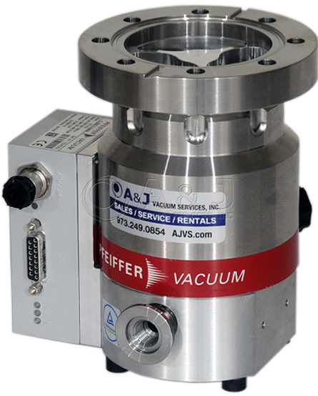
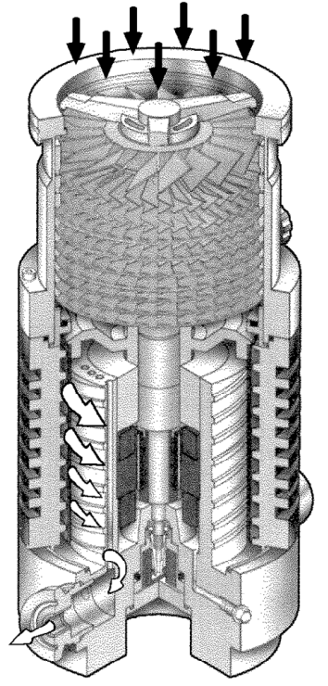
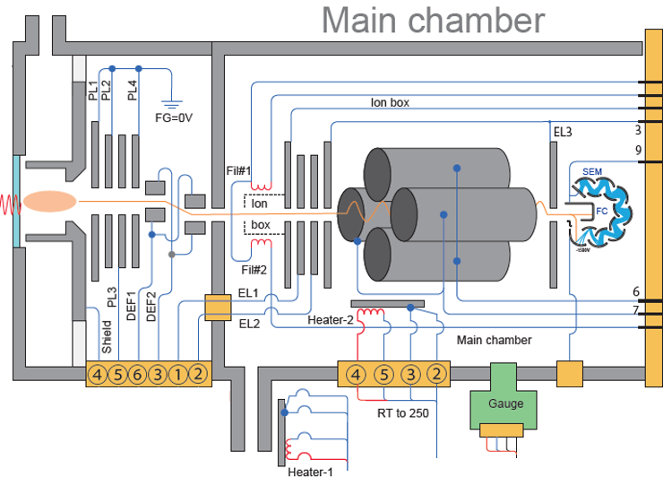
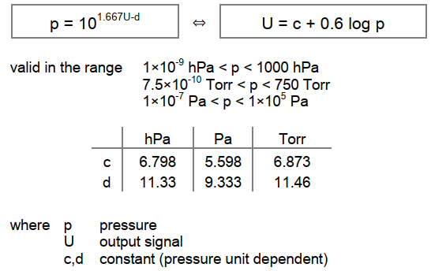
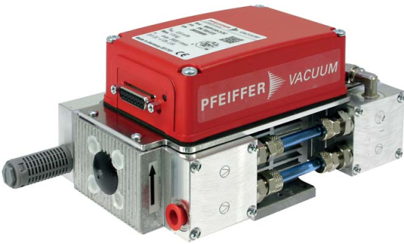
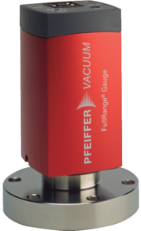

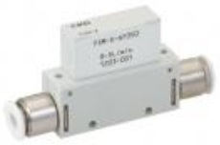
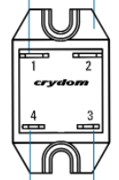
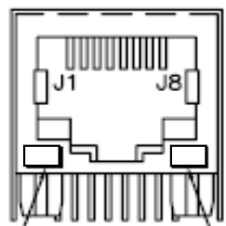
Drive Board(plasma) Block Diagram
PKR361 pressure calculation
NTC
24VIN
DI PRI.
8
7
6
5
4
3
2
1
15
14
13
12
11
10
DP (female)
Pump on
9
TMP
(Turbo Molecular Pump)
DP (Diaphragm Pump)
Standby
24VOUT
GND
vacuum
exhaust
vacuum
exhaust
RS-485
(9600, N, 8, 1)
not connected
Pfeiffer : PKR361
- Pressure gauge
(1x10⁻⁸ ~ 1000 hPa)
- out : 2~8.6V log scale
(0.6V/decade)
P24V
Remote OUT
(female)
connection check required
J11
AUX3
J26
4
5,6
3
2
BL
YL
WH
AUX1
GR
1
6
out : 1~5V
- no flow : 3V
- pos. flow : 3~5V
- neg. flow : 1~3V
GR
2A Fuse
WH
BL
2
7
RD
YL
DO (Digital Out)
J27
OR
3
8
BK
WH
YL
4
9
BK
PKR361
MAX14915
RD
5
Flow meter
FSM-V-AH3-R0005-M5
J18
Front panel
J14
J12
P24V
Vdd
OUT1
SEM_ONOFF
2.2K
P24V
P24V
P5V
J13
P24V
J22
P24V
J23
SEM
OUT2
J1 #21
Back panel
CB PWR
BYH05-200S01
Lens
SSR
Heater-1
SSR
Heater-2
P3V3
Va
OUT3
J1 #22
J17
Plasma PWR
2.2K
J15
Flow meter
Vin
Vo+
HTR1
HTR2
OUT4
CB to PC conn.
2.2K
GR
P24V
AD7682(7689)
+200V
OUT5
2.2K
BL
x0.8
IN0
Vc
Vo-
SPI
OUT6
PC to CB conn.
BK
x0.4
IN1
Vdd
P5V
BYH05-200S01
MAX31855
MAX31855
A0
OUT7
2.2K
x0.8
IN2
P3V3
Vdd
TC+
P3V3
Vdd
TC+
OUT8
x0.4
IN3
Vio
P3V3
Vin
-200V
Vo+
SPI
TC-
SPI
TC-
24V high side SW
SSR : EL100D10-24N
J16
AUX2
IN4
int REF
=4.096V
Vc
Vo-
MAX14915
IN5
OUT1
CB2.0
J19
J6
Door SW
IN6
SPI
Vdd
OUT2
P24V
P24V
IN7
C11152-01
OUT3
SSR
CB power
Remote IN
(male)
4ch(8ch) ADC
P12V
Vcc
HV_OUT
Va
OUT4
HTR2
MAX31913
SEM_ONOFF
ON/OFF
-1000V
OUT5
HTR1
J1#14
IN0
HV_MON
SPI
OUT6
J20
AVC
(RS-485)
1
GR
J1#15
IN1
Vdd
150
P24V
Vcont
P3V3
A0
OUT7
6
IN2
12V → -1500V
OUT8
SSR
2
BL
IN3
24V high side SW
DP
1
7
OR
IN4
6
3
J5
DI
IN5
25MHz
CLK
2
BK
8
4
VL
TP5
IN6
SPI
J21
7
9
J1 #6
TP6
IN7
RZ/T1
3
5
RD
J1 #12
HV DI → SPI
J1#2
4
8
J1 #28
DAC80504
Renesas MCU
RS-485
9
J1 #29
MX25L6433
P3V3
ISO1430
J1#3
5
J1 #16
P5V
Vdd
OUT0
SPI
SPI
Plasma PS
J1 #17
OUT1
ENET0
ENET1
ENET2
V1
V2
P5V
AVC
J24
IO
OUT2
TX
A
J7
Chassis
Serial FLASH
isolation
SPI
OUT3
LAN8710
LAN8710
LAN8710
RX
RS485
P24V
16bit DAC
RMII
RMII
B
120
RD
J10
FAN2
P24V
R7812-0.5
(DCDC module)
inductor + FET
RMII
TX RX
TX RX
MRSSV1DR16SM
TX RX
10/100M PHY
10/100M PHY
P24V
TMP
J8
J9
FAN1
P12V
10/100M PHY
1
1
1
ISO1430
8
7
6
5
4
3
2
1
7A Fuse
LMZ10501
(DCDC module)
inductor + FET
2
2
2
V1
V2
TP1
15
GR
TMP (female)
BNX022
LMZM33603
(DCDC module)
inductor + FET
P3V3
4
4
4
TX
A
120
14
13
12
11
10
9
EMI
FILTER
8
8
8
isolation
RX
RS485
WH
0154007.0DR
P5V/3A
C
C
C
B
SW : TMP test ON
(#2,#5,#7 short)
YL
J25
Power
ECAT IN
ECAT OUT
ETHERNET
rotary selector
BL
220Vac
AC/DC
24Vdc
BK

Slide 3
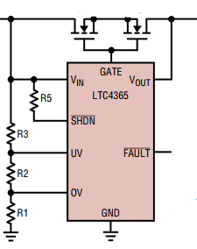

CB3 PS(power supply) rev 03 Block Diagram
LTM8065
(DCDC module)
inductor + FET
-7.5V
2.5A
LTC7149
(DCDC)
+ FET
-20V
4A
Si7370
N ch MOSFET(60V)
24VIN
+24V
LTM8065
(DCDC module)
inductor + FET
-10V
2.5A
S+
S-
R divide
MIC2774L-46YM5
power supervisor
1) +5V > 4.68V
2) +20V > 17V
+20V
+5VIN
use PGOOD signal + pull-up
damping : 100 ohm
pull-up : 10K
VIN
ADIN
464K
MIC2774
J2 : to IDBB
I2C
Vcc
1 : Power Good
0 : Power fail
IN
1
41
8.25K
MR
RST
I2C_SCL
2
42
I2C_SDA
3
43
U3
(N/A)
TPSM53603
(DCDC module)
inductor + FET
GND
LED
4
44
LTC4365
power protection
+3.6V
3A
+3.6V
5
45
LT4151
I2C addr : 1101_001
Voltage, Current monitor
1) Sense voltage (for current)
2) VIN voltage
3) ADIN voltage
6
46
7
47
8
48
LTM8065
(DCDC module)
inductor + FET
+10V
2.5A
+10V
9
49
-10V
10
50
11
51
12
52
13
53
14
54
15
55
LTM8026
(DCDC module)
inductor + FET
+20V
5A
+20V
16
56
-20V
17
57
18
58
19
59
20
60
21
61
LTM8065
(DCDC module)
inductor + FET
22
62
+7.5V
2.5A
+7.5V
23
63
-7.5V
24
64
25
65
26
66
27
67
28
68
+3.3VIN
+3.3VIN
29
69
+5VIN
30
70
AT24C256
31
71
32
72
Vcc
I2C
I2C_SCL
FAN_ALERT-
33
73
I2C_SDA
+24V
34
74
(32Kbyte)
35
75
I2C addr : 1010_000
36
76
37
77
+24V
Filament Power (Isolated)
38
78
EMC2103
Fan (24V)
GND
39
79
I2C
IRS-5/10-Q12
(isolated DCDC)
ISO_5V
10A
LT8612
(DCDC)
+ FET
FIL_3V, 6A
FIL_3V
40
80
Vcc
ALERT
TACH
PG
PWM
LED
FIL_GND
FIL_GND
(FAN controller)
GND
I2C addr : 0101_110
J4
(FAN connector)

Slide 4
ATIK IDBB rev0.1 Block Diagram (1/3)
J18 : to PS
J9 : to FP
J33 : to RFB
1
41
+3.3VIN
1
41
GND
LENS_DC
1
51
IONBOX
PGOOD
2
42
FAN_ALERT-
2
42
2
52
I2C1_SCL
3
43
J18_42
U3
(N/A)
3
43
3
53
I2C1_SDA
4
44
J18_43
4
44
4
54
LED
5
45
J18_44
5
45
5
55
+3.6V
6
46
J18_45
6
46
6
56
7
47
7
47
FP_01
7
57
SCL_1
8
48
8
48
FP_02
8
58
SDA_1
9
49
9
49
9
59
+10V
10
50
-10V
10
50
FP_03
10
60
FP_08
11
51
11
51
WP
11
61
FP_09
12
52
12
52
RESET-
12
62
T_alert-
13
53
13
53
DAC1_SYNC
FP_04
13
63
FP_10
14
54
14
54
DAC1_SCLK
FP_05
14
64
FP_11
15
55
I2C1_SCL
15
55
DAC1_SDO
FP_06
15
65
FP_12
16
56
I2C1_SDA
16
56
DAC1_SDI
FP_07
16
66
FP_13
+20V
17
57
-20V
17
57
17
67
FP_14
18
58
J18_42
18
58
I2C2_SDA
18
68
FP_15
19
59
19
59
I2C2_SCL
19
69
20
60
20
60
20
70
21
61
21
61
+3.6V
21
71
22
62
22
62
22
72
23
63
23
63
23
73
+7.5V
24
64
-7.5V
24
64
24
74
25
65
25
65
25
75
26
66
26
66
26
76
27
67
27
67
27
77
28
68
28
68
FAN_ALERT-
28
78
29
69
29
69
-20V
29
79
+20V
+3.3VIN
30
70
+5VIN
30
70
30
80
31
71
31
71
31
81
32
72
32
72
32
82
33
73
33
73
33
83
34
74
34
74
34
84
+24V
35
75
35
75
+5VIN
-7.5V
35
85
+7.5V
36
76
+10V
36
76
36
86
37
77
37
77
37
87
38
78
38
78
38
88
39
79
-10V
39
79
+3.6V
39
89
GND
40
80
40
80
40
90
FIL_3V
???
GND
41
91
FIL2_V
42
92
FIL1_V
43
93
44
94
GND
45
95
46
96
FIL_GND
47
97
FIL_GND
= FIL_OS
48
98
49
99
50
100
GND

Slide 5
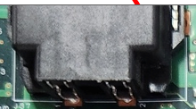

ATIK IDBB rev0.1 Block Diagram (2/3)
ADC required items
1) Q_DC+
2) Q_DC-
3) +215V
4) +110V
5) -110V
6) FIL_OS
7) IONBOX_OS
8) LENS_DC
F_P9V
LT3062
(LDO)
Filament Block
+24V
MEV1D2409SC
(isolated DCDC)
F_N9V
(unused)
½
2.5V
F_P5V
+24V
LT8365
(DCDC)
+FET
+215V
+10V
LT3062
(LDO)
9V
MAX6341
4.096Vref
VREF_4096
MAX6341
4.096Vref
FREF_4096
EN
LT3062
(LDO)
5VA
LED
1/2
5V
FIL_3V
½
FREF_2048
LT8365
(DCDC)
+FET
+7.5V
-
VREF_2048
FIL_3V
F_P5V
+110V
OP2177
FIL_GND
EN
-10V
LM337
(LDO)
-5V
+
0V
+
AD8236
LT8365
(DCDC)
+FET
-110V
5V
-2.048V~+2.048V, 18-bit ADC
: R divide
FIL_GND
-
REF
G=100
5m
EN
MC33161
+3.3V
PCA9306
MCP3424(4ch ADC)
Q_DC+
FREF_2048
FIL_GND
(207V)
V1
V2
Vdd
CH1
unused
ratio=0.008, 0~+256V
IN1
OUT1
+3.3V
CH2
VREF(4.096V)
ratio=0.332, 0~+6V
F_CURRENT
(1A → 0.5V)
I2C2
I2C1
I2C2
I2C
CH3
+215V
FIL_3V
(105V)
IN2
OUT2
CH4
ratio=0.008, 0~+265V
F_P5V
MCP4728
(4ch 12-bit DAC)
-
+3.3V
Vcc
AT24C256
I2C:1101_000
ISC1540
AD8572
MC33161
HV_FAIL
MCP3424(4ch ADC)
Q_DC-
+3.3V
V1
V2
Vdd
VoutA
x1
+
Vcc
Vdd
CH1
FIL_OS
ratio=0.0175, -115~+115V
isolation
VoutB
FIL1_V
(-105V)
IN1
OUT1
I2C
CH2
VREF(4.096V)
ratio=0.0175, -115~+115V
I2C_FDAC
x100
I2C
CH3
+110V
ratio=0.332, 0~+6V
I2C3
I2C1
I2C2
I2C
VoutC
Filament
1 (#8)
IN2
OUT2
(32Kbyte)
CH4
ratio=0.008, 0~+256V
U136
BUSY
VoutD
5V
Vcc
I2C:1010_xxx
I2C:1101_001
Possible to use one I2C isolator
I2C:1100_000
-
under voltage
monitor
MCP3424(4ch ADC)
IONBOX_OS
ratio=0.0175, 0~+115V
int. ref=2.048V
Gain=x1/x2
AD8572
Vdd
CH1
LENS_DC
ratio=0.0175, 0~+115V
x1
+
CH2
VREF(4.096V)
ratio=0.25, 0~+8V
x100
FIL2_V
+5V
I2C
CH3
-110V
ratio=0.0175, -115~+115V
from FP
+3.3V
CH4
ISC1540
Filament
2 (#3)
I2C:1101_010
V1
V2
MCP3424(4ch ADC)
FIL1_V
ratio=0.5
AD5676
out range : 0 ~ 4.096V
Vdd
CH1
F_CURRENT
ratio=1.0
LTM8024
(DCDC module)
+FET +inductor
QDCC+
ADHV4702
+215V
isolation
CH2
FREF_4096
ratio=0.33
+5V
RESET
Vout0
+
Q_DC+
I2C2
I2C1
I2C2
I2C_FADC
I2C
CH3
unused
+3.3V
Vlogic
Vout1
FILN_REF
Vo=51$∙$V1
-
(0~+208.9V)
CH4
+3.3V
5VA
Vdd
Vout2
IONBOX_DCC
-5V
U16
I2C:1101_011
FIL_GND
Vref
Vout3
LENS_DCC
ADC required items
1) FIL1_V
2) FIL2_V
3) F_CURRENT
4) FIL_3V
MCP3424(4ch ADC)
FIL2_V
ratio=0.5
FIL_OFFSETC
2K
100K
Vdd
CH1
FIL_3V
ratio=0.5
Vout4
5V
CH2
FREF_4096
ratio=0.33
0V
GAIN
Vout5
QDCC-
VREF_2048 or QDCN_REF
-
ADHV4702
+110V
I2C
CH3
unused
F_P5V
QDCN_REF
OP2177
+
Q_DC-
CH4
DAC1_SPI
SPI
Vout6
+
0V
Vo=51(2.048-V1)
-
(-100.35V~
+104.45V)
I2C:1101_100
Vout7
-110V
MEV1D2409SC
(isolated DCDC)
VB_P9V
LT3062
(LDO)
IONBOX Block
PS connector
(8ch, 16-bit DAC)
5V
2K
100K
+24V
VB_N9V
VB_P5V
+24V
-
ADHV4702
+110V
LT3062
(LDO)
VB_P1.4V
+20V
OP2177
+
FIL_OS
-20V
VREF_2048or FILN_REF
+
0V
Vo=51(2.048-V1)
-
(-100.35V~
+104.45V)
LM337
(LDO)
VB_N3.6V
+10V
differential amp
-110V
VB_GND
MAX6341
4.096Vref
VBREF_0496
-10V
5V
DAC_VREF_ADJ
2K
100K
ISC1540
VB_P5V
MCP3424(ADC)
+7.5V
DAC1_VREF
-
+3.3V
V1
V2
Vdd
CH1
EMISSION_CUR
ratio=0.5
-7.5V
OP2177
ADHV4702
+110V
J33
CH2
VB_P5V
ratio=0.33
+3.6V
VREF_4096
+
0V
+
IONBOX_OS
isolation
CH3
VBREF_0496
ratio=0.33
GND
Vo=26$∙$V1
-
-5V
(0~+106.5V)
I2C1
I2C1
I2C2
I2C
CH4
VB_N3.6V
ratio=0.5
VB_P5V, N3.6V
+3.3V
U18
(18 bit, 2.048Vref)
4K
100K
ISC1540(U137)
I2C:1101_101
+5V
V1
V2
ADS1115(ADC)
EMISSION_CUR
ratio=0.5
I2C_PS
ADHV4702
+110V
Vdd
CH1
PGOOD/FAN_ALERT-
+
LENS_DC
isolation
RDY
CH2
VBREF_0496
ratio=0.33
Vo=26$∙$V1
I2C1
I2C2
I2C
CH3
LED
-
-5V
(0~+106.5V)
CH4
what’s the purpose of this block ?
same measurement with MCP3424
ISC1540(U101)
(16 bit ΔΣ)
FIL_3V
4K
100K
V1
V2
I2C:1001_011
FIL_GND
isolation
DAC1_VREF (4.096V)
I2C1
I2C2
VB_P1.4V
IONBOX
J33 (side 51)
+
AD8236
EMISSION_CUR
50
G=5
-
REF
VB_GND
VB_GND
VB_N3.6V

Slide 6
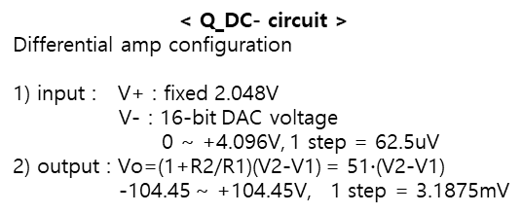
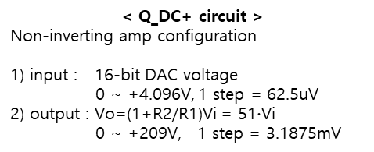
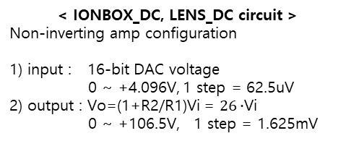
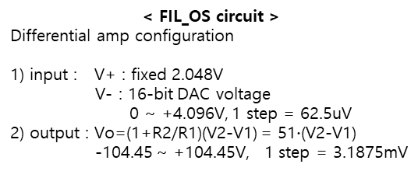
ATIK IDBB rev0.1 Block Diagram (3/3)
< Q_DC+ circuit >
Non-inverting amp configuration
1) input : 16-bit DAC voltage
0 ~ +4.096V, 1 step = 62.5uV
2) output : Vo=(1+R2/R1)Vi = 51$∙$Vi
0 ~ +209V, 1 step = 3.1875mV
< Q_DC- circuit >
Differential amp configuration
1) input : V+ : fixed 2.048V
V- : 16-bit DAC voltage
0 ~ +4.096V, 1 step = 62.5uV
2) output : Vo=(1+R2/R1)(V2-V1) = 51$∙$(V2-V1)
-104.45 ~ +104.45V, 1 step = 3.1875mV
Non-inverting Amp
Va=Vb=V1, i1 = Va/R1
Vo = i1*R2 + Va
= Va*R2/R1 + Va
= (1+R2/R1) V1
= 51 V1
Differential Amp
Va=Vb=V2=2.048V
i1 = (Va-V1)/R1
Vo = i1*R2 + (Va-V1)
= (Va-V1)*R2/R1 + (Va-V1)
= (1+R2/R1) (Va-V1)
= 51 (2.048 – V1)
ADHV4702
Vo
ADHV4702
Vo
DAC OUT0
(0~4.096V)
V1
1K
Vb
12K
+
+215V
+210
VREF / 2
= 2.048V
V2
1K
Vb
12K
+110V
+110
12K
Vo
Q_DC+
(0~+209V)
+
Vo
Q_DC-
(-104.45 ~
+104.45V)
Va
-
-5V
Va
12K
-
R1
2K
100K
2K
-110V
DAC OUT5
(0~4.096V)
V1
R1
100K
0
Vi
i1
R2
0
Vi
i1
R2
1
2
3
4
1
2
3
4
-110
< FIL_OS circuit >
Differential amp configuration
1) input : V+ : fixed 2.048V
V- : 16-bit DAC voltage
0 ~ +4.096V, 1 step = 62.5uV
2) output : Vo=(1+R2/R1)(V2-V1) = 51$∙$(V2-V1)
-104.45 ~ +104.45V, 1 step = 3.1875mV
< IONBOX_DC, LENS_DC circuit >
Non-inverting amp configuration
1) input : 16-bit DAC voltage
0 ~ +4.096V, 1 step = 62.5uV
2) output : Vo=(1+R2/R1)Vi = $26∙$Vi
0 ~ +106.5V, 1 step = 1.625mV
Differential Amp
Va=Vb=V2=2.048V
i1 = (Va-V1)/R1
Vo = i1*R2 + (Va-V1)
= (Va-V1)*R2/R1 + (Va-V1)
= (1+R2/R1) (Va-V1)
= 51 (2.048 – V1)
Non-inverting Amp
Va=Vb=V1, i1 = Va/R1
Vo = i1*R2 + Va
= Va*R2/R1 + Va
= (1+R2/R1) V1
= 26 V1
ADHV4702
Vo
ADHV4702
Vo
VREF / 2
= 2.048V
V2
1K
Vb
12K
+
+110V
+110
DAC OUT2
DAC OUT3
(0~4.096V)
V1
1K
Vb
12K
+
+110V
Vo
+110
12K
Vo
FIL_OS
(-104.45 ~
+104.45V)
12K
IONBOX_DC
LENS_DC
(0~+106.5V)
Va
-
-110V
Va
-
-5V
DAC OUT4
(0~4.096V)
V1
R1
2K
100K
R1
4K
100K
i1
R2
0
1
2
3
4
Vi
i1
R2
0
1
2
3
4
Vi
-110

Slide 7

CB3 RFD rev0.2 Block Diagram (1/2)
⑦
⑧
FIL1_V
LT3045
(LDO)
Q_pole-
FIL_1
+3.6V
J5
1.0V, 500mA
Quadrupole
capacitance
VC
40pF
LT3029 U15
⑥
①
+7.5V
J1
TPS7A4701
(LDO)
+7V, 1A
OUT1
3.3V1, 500mA
Q_pole+
EL0
IONBOX
3.3V2, 500mA
EL3
TPS7A33
(LDO)
OUT2
LC resonant frequency = $\frac{1}{2π\sqrt{LC}}$
⑤
②
-7.5V
J2
-7V, 1A
LT3029 U18
1.8V1, 500mA
FIL_GND
FIL_2
OUT1
④
③
LT3032-5
(dual LDO)
+5V, 150mA
OUT2
3.3V3, 500mA
LENS_DC
-5V, 150mA
LT3029 U21
1.8V2, 500mA
RESET-
OUT1
MAX16025
OUT2
3.3V4, 500mA
J33 : to IDBB
Vcc
FIL2_V
+20V
J3
20m
IN1
OUT1
3.3V3
IN2
OUT2
1
51
SENSE+
SENSE-
MR-
RESET-
Q_DC+
2
52
-20V
J4
power mon
3
53
Vin
ADIN
4
54
I2C
Q_DC-
5
55
I2C1
(3.3V1 pull-up)
max 1Vpp differential
max gain = x7(LG), x50(HG)
used gain range = 0~x4
6
56
LTC4151
I2C addr : 1101_001
Voltage, Current monitor
1) Sense voltage (for current)
2) VIN voltage
3) ADIN voltage
0~+18V
FP_01
7
57
SCL_1
FP_01 ~ FP_15
ADA4870
FP_02
8
58
SDA_1
FP_03
9
59
+7V
0~+4V
+20V
10
60
FP_08
3.3V2
-7V
G = 5
+
WP
11
61
FP_09
+5V
0~+1V
RESET-
12
62
T_alert-
0~0.5V
@50Ω
0~+0.25V
ON
-
N=4.12
FP_04
13
63
FP_10
RF=3.5MHz
AD8370 (VGA)
+
SD
FP_05
14
64
FP_11
+1.0V, +1.8V1, 3.3V3
-
TFL
-20V
FP_06
15
65
FP_12
AVdd
DVdd
FP_07
16
66
FP_13
5P49V5901
LC
Filter
17T
17
67
FP_14
FPGA
Artix 7
XC7A35T
DDS
IOUT+
PRE
AMP
OUT
AMP
G = 10
300
1.2K
70T
18
68
FP_15
3.3V4
Vdd
CLK1
D[15:0]
ADA4870
19
69
X-tal
(25MHz)
CLK
CLK2
20
70
CLK
IOUT-
-
+20V
+3.6V
21
71
CLK3
where ???
SER
G = 5
+
22
72
3.3V3
J10 conn.
I2C
TP31,32
23
73
CLK4
MAX5885
16-bit DAC, 200M
FS current : 10mA
@50Ω : 0.5Vpp
+
ON
-
24
74
NA
clock generator
50MHz ↑
50M : 14.3 step
70M : 20 step
100M : 28.6 step
140M : 40 step
200M : 57 step
Vcc/2
biased
Vcc/2
biased
SD
25
75
I2C:1101_010
3.3V1
MT25QL128
THS6212
Line Driver
TFL
-20V
26
76
27
77
Vcc
DQ
0~-0.25V
0~-1V
0~-4V
300
1.2K
28
78
-20V
29
79
+20V
serial FLASH
DATA, CLK, LATCH
-20V
30
80
0~-18V
31
81
AT24C256
32
82
I2C
I2C_1
33
83
Vcc
WP
WP
34
84
For 2V input range
VCM(0.9V)±0.5V
= 0.4 ~ 1.4V
-7.5V
35
85
+7.5V
EEPROM 32K
I2C: 1010_001
+1.8V2
36
86
+5V
-5V
37
87
AC divider
38
88
TCN75A
1.25V ref
39
89
I2C
LTC6655
40
90
Vcc
Alert
OVdd
Vdd
IN+
+
FIL2_V
41
91
FIL1_V
T_alert-
+5V
Vcc
1.25V
NA
SENSE
-
42
92
temp. sensor
I2C: 1001_010
ADC control signal
-1 ~ +1V range
43
93
SPI
G = 2
44
94
D[15:0], OF
+
45
95
100M_ADC
IN-
46
96
CLK
-
FIL_GND
47
97
48
98
LTC2165
16-bit ADC
(100 M)
49
99
LT6411
ADC driver
50
100
GND

Slide 8
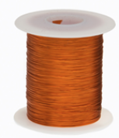
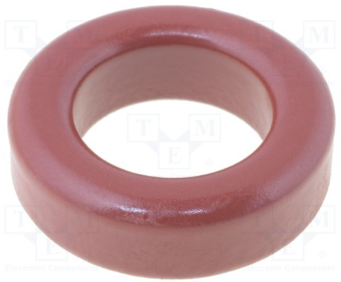
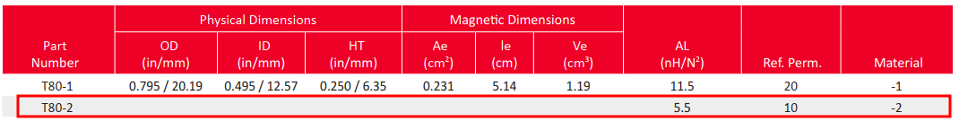
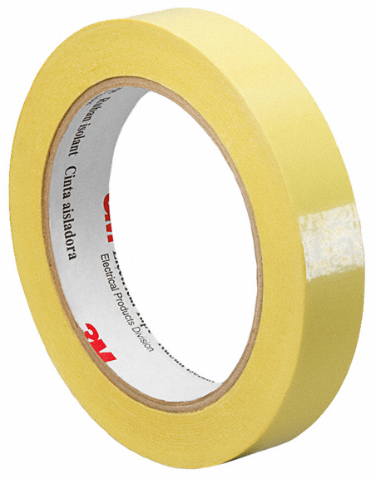
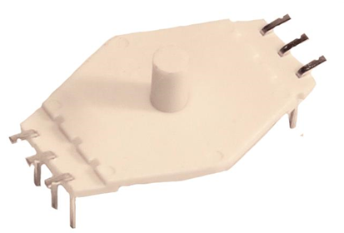
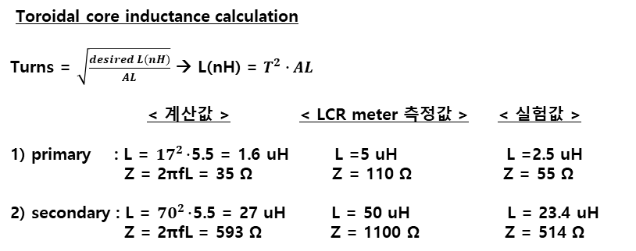
CB3 RFD rev0.2 Block Diagram (2/2)
Note :
1) Toroidal ferrite core 는 size 와 color 를 기준으로 검색 (다를 수 있음).
2) Toroidal core 의 bobbin(case, holder) 은 유사 제품 찾을 수 없음.
자체 제작시 bobbin 없이 절연 taping 후 wire 를 감아서 제작.
3) transformer 의 1차, 2차 측 inductance 계산 값이 LCR meter 측정값과 다름.
- 계산값, LCR meter측정값, 실험값은 아래 내용 참조
1) 계산값은 ideal 한 상태의 값이므로 실제 측정치와 차이가 발생함
2) LCR meter 측정값은 freq. = 100KHz 에서의 측정치
3) 실험값은 실 사용 조건과 가장 유사한 상태에서 측정.
(freq. = 3.5 MHz, signal = 1Vpp sinewave)
RF transformer
primary : 17T, AWG27(Ø0.36)
secondary : 70T, AWG27(Ø0.36)
N = 70T / 17T = 4.12
N=4.12
17T
70T
1차측 inductance 실험
2차측 inductance 실험
1Vpp @3.5MHz
(sinewave)
V1
17T
70T
1Vpp @3.5MHz
(sinewave)
-
+
-
+
V1
70T
17T
AWG28 enamel coated wire
- 28H200P.125 (Digikey)
(AWG28 enamel coated wire)
V2
55Ω
V1 = V2
V2
514Ω
V1 = V2
Toroidal Ferrite Core
- Micrometals : T80-2 (레오콤)
- size : 20.2 x 12.6 x 6.35
Toroidal split holder
- Can’t find similar model
- make RF transformer
without this holder
3M insulation tape 로 대치
- 3M159698-ND (Digikey)
- width : 6.35mm
- core 에 절반씩 겹치도록 taping
Toroidal core inductance calculation
Turns = $\sqrt{\frac{desired L(nH)}{AL}}$ → L(nH) = $T^{2}∙AL$
< 계산값 > < LCR meter 측정값 > < 실험값 >
1) primary : L = ${17}^{2}∙$5.5 = 1.6 uH L =5 uH L =2.5 uH
Z = 2πfL = 35 Ω Z = 110 Ω Z = 55 Ω
2) secondary : L = ${70}^{2}∙$5.5 = 27 uH L = 50 uH L = 23.4 uH
Z = 2πfL = 593 Ω Z = 1100 Ω Z = 514 Ω
Lodestone Pacific
- HTM851-6 (Digikey)
(Horizontal Toroid Mount)
- 4 pin 짜리는 찾지 못 함

Slide 9
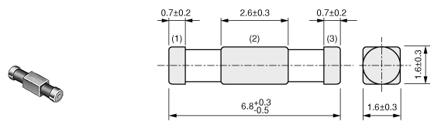
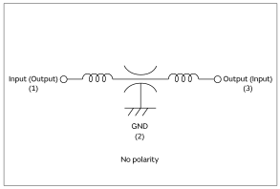

CB2.0 Ion Detector Board : rev A
Murata : NFE61HT102
- LC Filter
LT3045
U51
(LDO)
LTC6655
(5V ref.)
Ref5V
-
5.6V
+
unused
3.3V1
LT3045
U19
(LDO)
10K
-
Ref2.5V
5V
+
TCN75A
(temp. sensor)
10K
10K
AD8066
LT3045
U50
(LDO)
GND2
3.3V1
Vcc
I2C
I2C_AD : 100_1000
3.3V2
24AA512
(64Kbyte)
U21
LT3045
U49
(LDO)
3.3V1
Vcc
WP
I2C_AD : 101_0000
6.7V
LC filter
2.5V
I2C
J1
GND1
GND2
GND1
power (???)
1
2
3
4
5
6
7
8
9
R11, 0
3.3V1
C282
5p
ISO7341
(isolator)
6.7V
100p
I2C_SDA
two pole compensation
R958
1M
R967
100M
R959
0
3.3V2
Vdd2
Vdd1
3.3V1
I2C_SCL
C72
390p
C283
680p
R59, 33
EE_WP
10
11
12
13
14
15
16
17
18
19
390p//680p
= 250p
ADG1613
GND2
isolation
R28, 33
GND1
TP139
to FP board
R206
51K
R58, 33
TP138
GND2
TP137
C71
100p
2.5V
3.3V2
Si8652
(isolator)
TP136
FC / SEM
-
5V
5V
C271
10n
GND2
ADC_SCK
+
ADA4530
R203
51K
-
R205
10K
R20
499
IN+
Vdd
OVdd
Vdd2
Vdd1
3.3V1
ADC_SDI
GND2
+
R204
10K
C272
100n
CNV
ADC_CNV
ADC_CNV
20
21
22
23
24
AD8066
SPI
SCK
isolation
ADC_SCK
ADC_SDO
-
R21
499
SDI
ADC_SDI
Ref2.5V
+
IN-
REF
SDO
ADC_SDO
ADC_BUSY
C270
10n
BUSY
ADC_BUSY
Ref5V
LTC2380-24
24bit ADC
GND2
GND1
Tow-Thomas Biquad Filter (Low Pass Filter)
- Fc = 4.5 KHz
Low Pass Filter
- Fdiff = 1 / 2πR$∙$2Cdiff = 1.6 KHz
- Fcmn = 1 / 2πR$∙$Ccmn = 32 KHz
FC : Faraday Cup
SEM : Secondary Electron Multiplier
Notes:
Femto : 10^(-15) ,, Mili → Micro → Nano → Pico → Femto
250fA → 250uA ( 10^(9)) 10억배

Slide 10
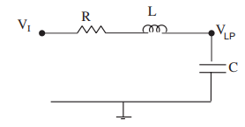
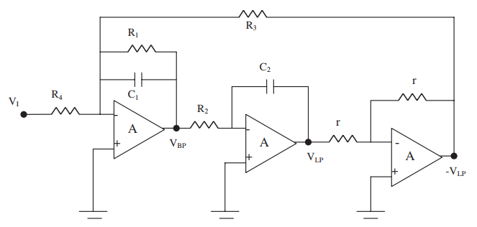



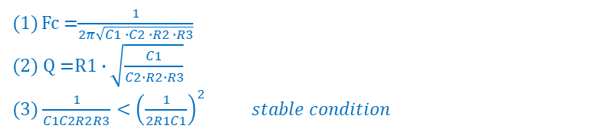



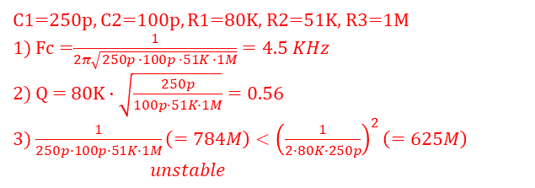
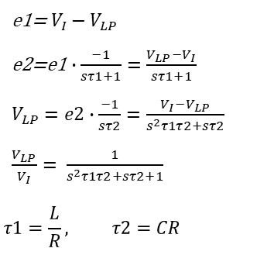





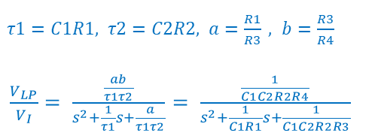



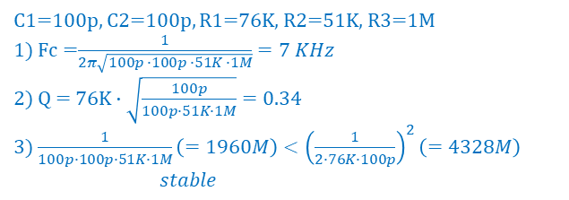
Tow-Thomas Biquad Filter
- reference : History and progress of the Tow–Thomas bi-quadratic filter. by Ahmed M. Soliman
Derivation of loop gain and stability test for low-pass Tow-Thomas biquad filter by Minh Tri Tran
- derivation of 2nd order active biquad filter, 2 filter outputs (LowPass, BandPass)
1. Basic Form Generation : using passive RLC low pass filter
lossy integrator
lossless integrator
e1=$V_{I}−V_{LP}$
e2=e1$∙\frac{−1}{sτ1+1}=\frac{V_{LP}−V_{I}}{sτ1+1}$
$V_{LP}=e2∙\frac{−1}{sτ2}=\frac{V_{I}−V_{LP}}{s^{2}τ1τ2+sτ2}$
$\frac{V_{LP}}{V_{I}}= \frac{1}{s^{2}τ1τ2+sτ2+1}$
$$τ1=\frac{L}{R}, τ2=CR$$
V_{I}
₊
$$Σ$$
$$\frac{1}{s^{2}LC+sCR}$$
V_{LP}
V_{I}
₊
$$Σ$$
e1
$$\frac{−1}{sτ1+1}$$
e2
$$\frac{−1}{sτ2}$$
V_{LP}
$X_{L}=$ sL
₊
$X_{C}=$ $\frac{1}{sC}$
₋
-1
$\frac{ V_{LP}}{V_{I}}=\frac{X_{C}}{R+X_{L}+X_{C}}$ $=\frac{1}{s^{2}LC+sCR+1}$
$\frac{ V_{LP}}{V_{I}}=\frac{1}{s^{2}LC+sCR+1}$
$τ1=C1R1, τ2=C2R2, a=\frac{R1}{R3} , b=\frac{R3}{R4}$
$\frac{V_{LP}}{V_{I}}= \frac{\frac{ab}{τ1τ2}}{s^{2}+\frac{1}{τ1}s+\frac{a}{τ1τ2}}$ $= \frac{\frac{1}{C1C2R2R4}}{s^{2}+\frac{1}{C1R1}s+\frac{1}{C1C2R2R3}}$
2. Add Parameters : basic form + gain/Q control parameter
- a : Q factor control
- b : gain control
Q control
V_{I}
b
₊
$$Σ$$
$$\frac{−a}{sτ1+1}$$
$$\frac{−1}{sτ2}$$
V_{LP}
gain control
₊
Fc =$\frac{1}{2π\sqrt{C1 ∙C2 ∙R2 ∙R3}}$
(2) Q =$R1∙\sqrt{\frac{C1}{C2∙R2∙R3}}$
(3) $\frac{1}{C1C2R2R3}<{\left(\frac{1}{2R1C1}\right)}^{2} stable condition$
-1
(Q adj.)
1M
100p
C1=250p, C2=100p, R1=80K, R2=51K, R3=1M
1) Fc =$\frac{1}{2π\sqrt{250p ∙100p ∙51K ∙1M}}=4.5 KHz$
2) Q = $80K∙\sqrt{\frac{250p}{100p∙51K∙1M}}=0.$56
3) $\frac{1}{250p∙100p∙51K∙1M}\left(=784M\right)<{\left(\frac{1}{2∙80K∙250p}\right)}^{2}\left(=625M\right)$
$unstable$
C1=100p, C2=100p, R1=76K, R2=51K, R3=1M
1) Fc =$\frac{1}{2π\sqrt{100p ∙100p ∙51K ∙1M}}=7 KHz$
2) Q = $76K∙\sqrt{\frac{100p}{100p∙51K∙1M}}=0.$34
3) $\frac{1}{100p∙100p∙51K∙1M}\left(=1960M\right)<{\left(\frac{1}{2∙76K∙100p}\right)}^{2}\left(=4328M\right)$
$stable$
250p
10K
51K
Fc adj.
10K
Notes:
Femto : 10^(-15) ,, Mili → Micro → Nano → Pico → Femto
250fA → 250uA ( 10^(9)) 10억배

Slide 11
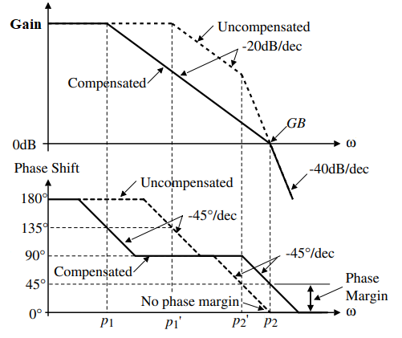

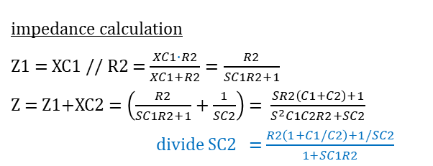

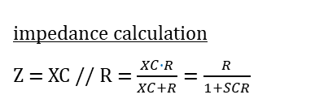
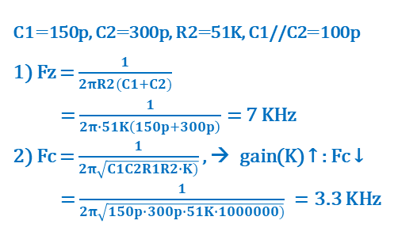
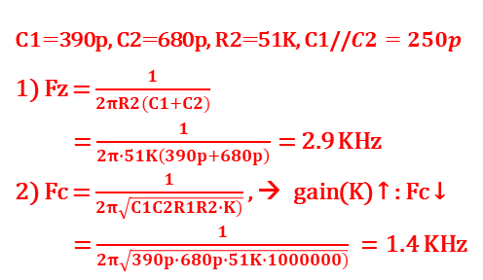
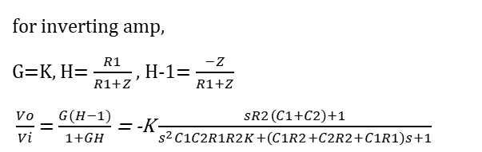
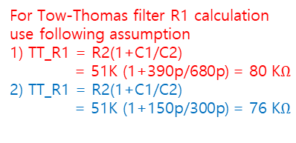
OP-Amp frequency compensation : 2-pole compensation
- reference : Dynamic Circuit Response. by Dennis L. Feucht
- OP-amp compensation required to prevent oscillation at high frequency
1) dominant pole compensation : commonly used, loop gain rolls off(-20dB/dec) at low freq. and reduces loop gain at higher freq.
2) 2-pole compensation : rarely used, loop gain rolls off (-40dB/dec) at higher freq. and then revert to -20dB/dec at Fzero freq.
For Tow-Thomas filter R1 calculation
use following assumption
1) TT_R1 = R2(1+C1/C2)
= 51K (1+390p/680p) = 80 K$Ω$
2) TT_R1 = R2(1+C1/C2)
= 51K (1+150p/300p) = 76 K$Ω$
impedance calculation
Z = XC // R = $\frac{XC∙R}{XC+R}=\frac{R}{1+SCR}$
C
R
impedance calculation
Z1 = XC1 // R2 = $\frac{XC1∙R2}{XC1+R2}=\frac{R2}{SC1R2+1}$
Z = Z1+XC2 = $\left(\frac{R2}{SC1R2+1}+\frac{1}{SC2}\right)$ = $\frac{SR2\left(C1+C2\right)+1}{S^{2}C1C2R2+SC2}$
divide SC2 = $\frac{R2\left(1+C1/C2\right)+1/SC2}{1+SC1R2}$
C1
C2
Vi
390p
680p
51K
R2
Z
for inverting amp,
G=K, H= $\frac{R1}{R1+Z}$ , H-1= $\frac{−Z}{R1+Z}$
$\frac{Vo}{Vi}$ = $\frac{G(H−1)}{1+GH}$ = -K $\frac{sR2\left(C1+C2\right)+1}{s^{2}C1C2R1R2K+\left(C1R2+C2R2+C1R1\right)s+1}$
C1
V1
C2
dominant pole compensation
R2
Gain
dominant pole
compensation
(-20dB/dec)
Vi
R1
5V
-
Vo
+
ADA4530
C1=390p, C2=680p, R2=51K, C1//$C2=250p$
1) Fz = $\frac{1}{2πR2(C1+C2)}$
= $\frac{1}{2π∙51K\left(390p+680p\right)}$ = 2.9 KHz
2) Fc = $\frac{1}{2π\sqrt{C1C2R1R2∙K)}}$ , → gain(K) ↑ : Fc ↓
= $\frac{1}{2π\sqrt{390p∙680p∙51K∙1000000)}} =$1.4 KHz
C1=150p, C2=300p, R2=51K, C1//C2=100p
1) Fz = $\frac{1}{2πR2(C1+C2)}$
= $\frac{1}{2π∙51K\left(150p+300p\right)}$ = 7 KHz
2) Fc = $\frac{1}{2π\sqrt{C1C2R1R2∙K)}}$ , → gain(K) ↑ : Fc ↓
= $\frac{1}{2π\sqrt{150p∙300p∙51K∙1000000)}} =$3.3 KHz
K
two pole
compensation
(-40dB/dec)
Fz $≪$ Fu preferable
Fz $≪$ Fu / 50 = 2MHz / 50 = 40 KHz
Fd
Fc
Fz
Fu
$$ω$$
two pole compensation
Notes:
Femto : 10^(-15) ,, Mili → Micro → Nano → Pico → Femto
250fA → 250uA ( 10^(9)) 10억배

