Slide 1
Movie Ticketing DB
Giacomo Aris
00.00.00

Slide 2
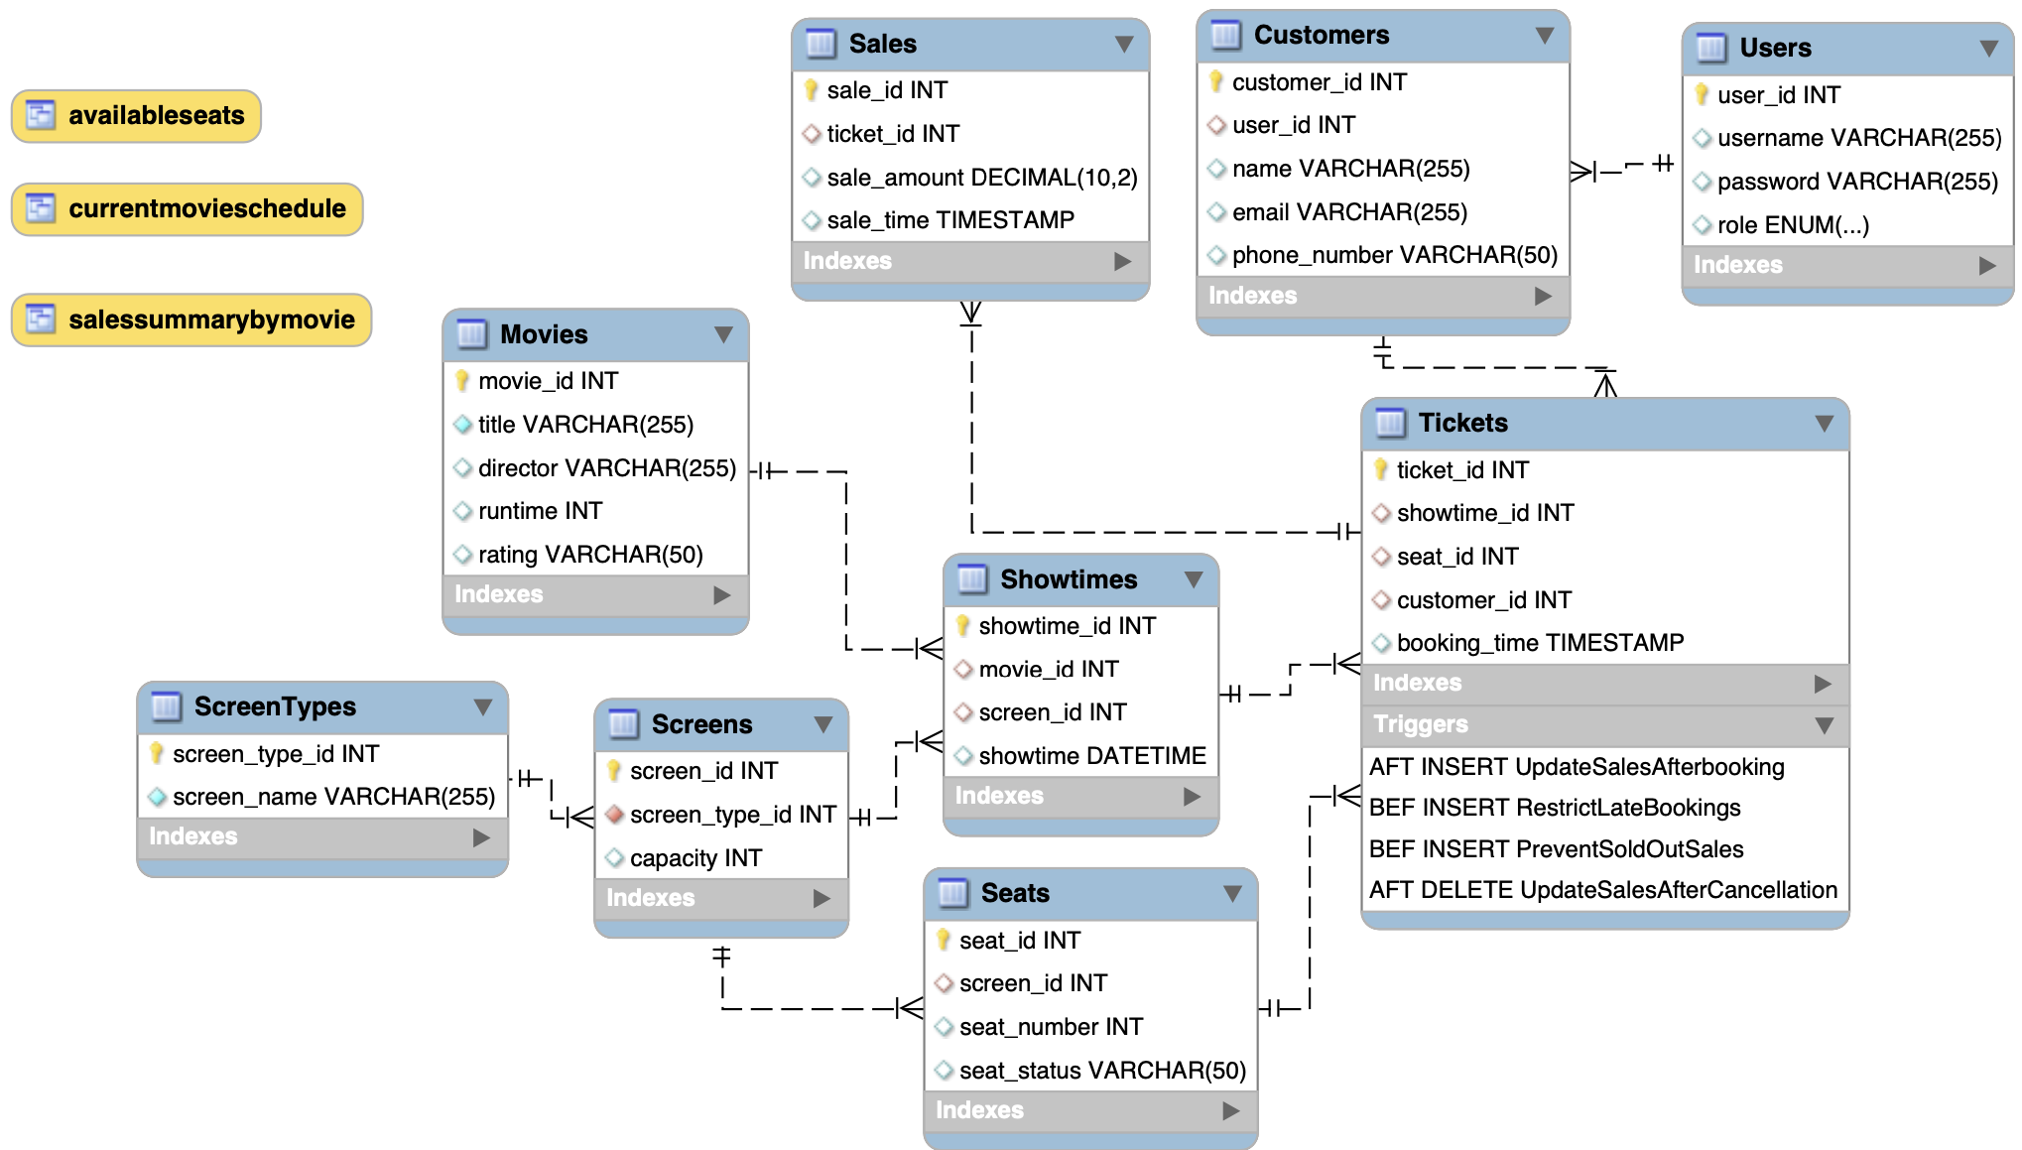
Database Design
Notes:
Tables:
Users: Stores user account information, including a unique ID, username, password, and role (either customer or admin).
Customers: Contains customer details linked to users, name, email, and phone number. It relates to the Users table through user_id.
Movies: Holds movie information, such as title, director, runtime, and rating.
ScreenTypes: Defines types of screens available in the theater, each with a unique name.
Screens: Details on individual screens, including their type and capacity, linked to ScreenTypes via screen_type_id.
Showtimes: Lists showtimes for movies, including the movie ID, screen ID, and the datetime of the show.
Seats: Keeps track of seats for each screen, their number, and status (e.g., available, booked).
Tickets: Represents tickets sold, linking showtimes, seats, and customers, with a timestamp for the booking time.
Sales: Records sales transactions, including the ticket sold and the sale amount, along with a timestamp.
Views:
availableseats: Shows available seats for each showtime and movie.
currentmovieschedule: Displays the current movie schedule, including titles, showtimes, and screen names.
salessummarybymovie: Provides a summary of sales by movie, including the number of tickets sold and total sales amount.
Procedures:
BookTicket: Books a ticket for a customer, marking the seat as booked if available.
CancelTicket: Cancels a ticket, freeing up the seat and deleting the ticket record.
CheckSeatAvailability: Checks seat availability for a specific showtime.
GenerateSeatsForScreen: Generates seats for a given screen based on its capacity.
Functions:
IsShowtimeSoldOut: Determines if a showtime is sold out based on ticket sales and screen capacity.
TicketsSoldForShowtime: Counts the number of tickets sold for a specific showtime.
TotalSalesForMovie: Calculates the total sales for a particular movie.
Triggers:
PreventSoldOutSales: Prevents ticket sales for sold-out showtimes.
RestrictLateBookings: Restricts ticket bookings beyond a specified time after the showtime begins.
UpdateSalesAfterCancellation: Deletes sales records corresponding to a canceled ticket.
UpdateSalesAfterBooking: Inserts a sales record after a ticket is booked.

Slide 3
Normalization & Integrity
BCNF – Dependencies are all primary keys
Unique constraints prevent duplicate entries in username in the Users table and email in the Customers table. This maintains uniqueness and data accuracy.
Tables have default values
Foreign keys are used extensively to create relationships between tables
Notes:
Based on the provided SQL DDL statements for your database schema, here's the analysis regarding normalization:
First Normal Form (1NF)
Achieved. Each table has a primary key defined (e.g., user_id for Users, movie_id for Movies). There are no repeating groups or arrays, and all column entries in each table are of the same type.
Second Normal Form (2NF)
Achieved. All non-key attributes are fully dependent on the primary key. For example, in the Customers table, attributes like name, email, and phone_number are dependent on customer_id. This is also the case with other tables where all attributes are dependent on their respective primary keys.
Third Normal Form (3NF)
Likely Achieved. There are no transitive dependencies where non-key attributes depend on other non-key attributes. For instance, in the Tickets table, showtime_id, seat_id, and customer_id are all dependent on the primary key ticket_id and not on each other.
Your schema does not exhibit signs of unnecessary redundancy, and it maintains dependencies that ensure data integrity. Each foreign key reference establishes a clear relationship between the tables, supporting proper data integrity rules.
For Boyce-Codd Normal Form (BCNF), where every determinant must be a candidate key, your schema likely adheres to this as well, given that most dependencies are on primary keys, which are candidate keys. Without more complex business rules that might lead to other candidate keys not being primary keys, it's reasonable to conclude your schema is also in BCNF.
This level of normalization is excellent for reducing data redundancy and promoting data integrity. If you have any specific rules or business logics that might affect these interpretations (like calculated fields or multi-attribute dependencies not evident in the DDL), it would be important to consider them as well. Otherwise, your database design looks robust and well-structured!

Slide 4
Isolation & Transactional Controls
Triggers:
PreventSoldOutSales: Ensures that no tickets are sold beyond the capacity of a show (transaction integrity).
RestrictLateBookings: Prevents booking tickets after a certain time relative to the showtime, thus ensuring that data reflects real-world constraints.
UpdateSalesAfterBooking and UpdateSalesAfterCancellation: Manage sales records in response to ticket bookings and cancellations, ensuring that sales data is consistent with ticketing actions.
Procedures:
BookTicket and CancelTicket: updating seat status and managing corresponding tickets and sales records
Functions
IsShowtimeSoldOut: decision-making processes in transactions, such as allowing or disallowing further ticket sales
Notes:
Triggers:
PreventSoldOutSales: Ensures that no tickets are sold beyond the capacity of a show (transaction integrity).
RestrictLateBookings: Prevents booking tickets after a certain time relative to the showtime, thus ensuring that data reflects real-world constraints.
UpdateSalesAfterBooking and UpdateSalesAfterCancellation: These triggers manage sales records in response to ticket bookings and cancellations, ensuring that sales data is consistent with ticketing actions.
Procedures:
Procedures like BookTicket and CancelTicket encapsulate data operations that need to maintain consistency (e.g., updating seat status and managing corresponding tickets and sales records). These are critical in scenarios where multiple steps are involved in a transaction, and each step must be completed successfully to maintain database consistency.
Functions:
Functions like IsShowtimeSoldOut calculate critical business metrics (show capacity vs. tickets sold). These contribute to decision-making processes in transactions, such as allowing or disallowing further ticket sales.

