Slide 1
SDXL
SDXL Turbo
LCM LoRA

Slide 2
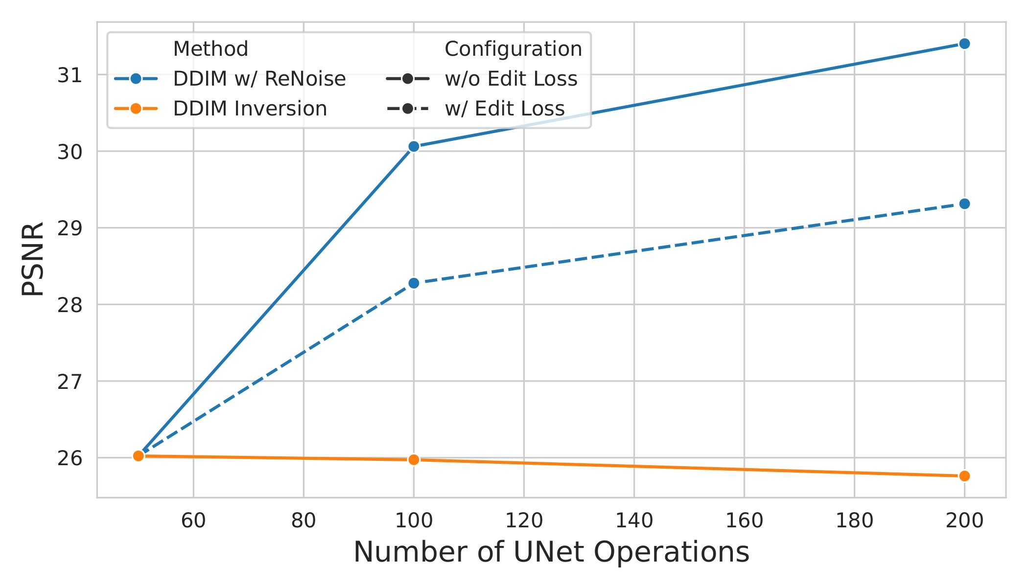
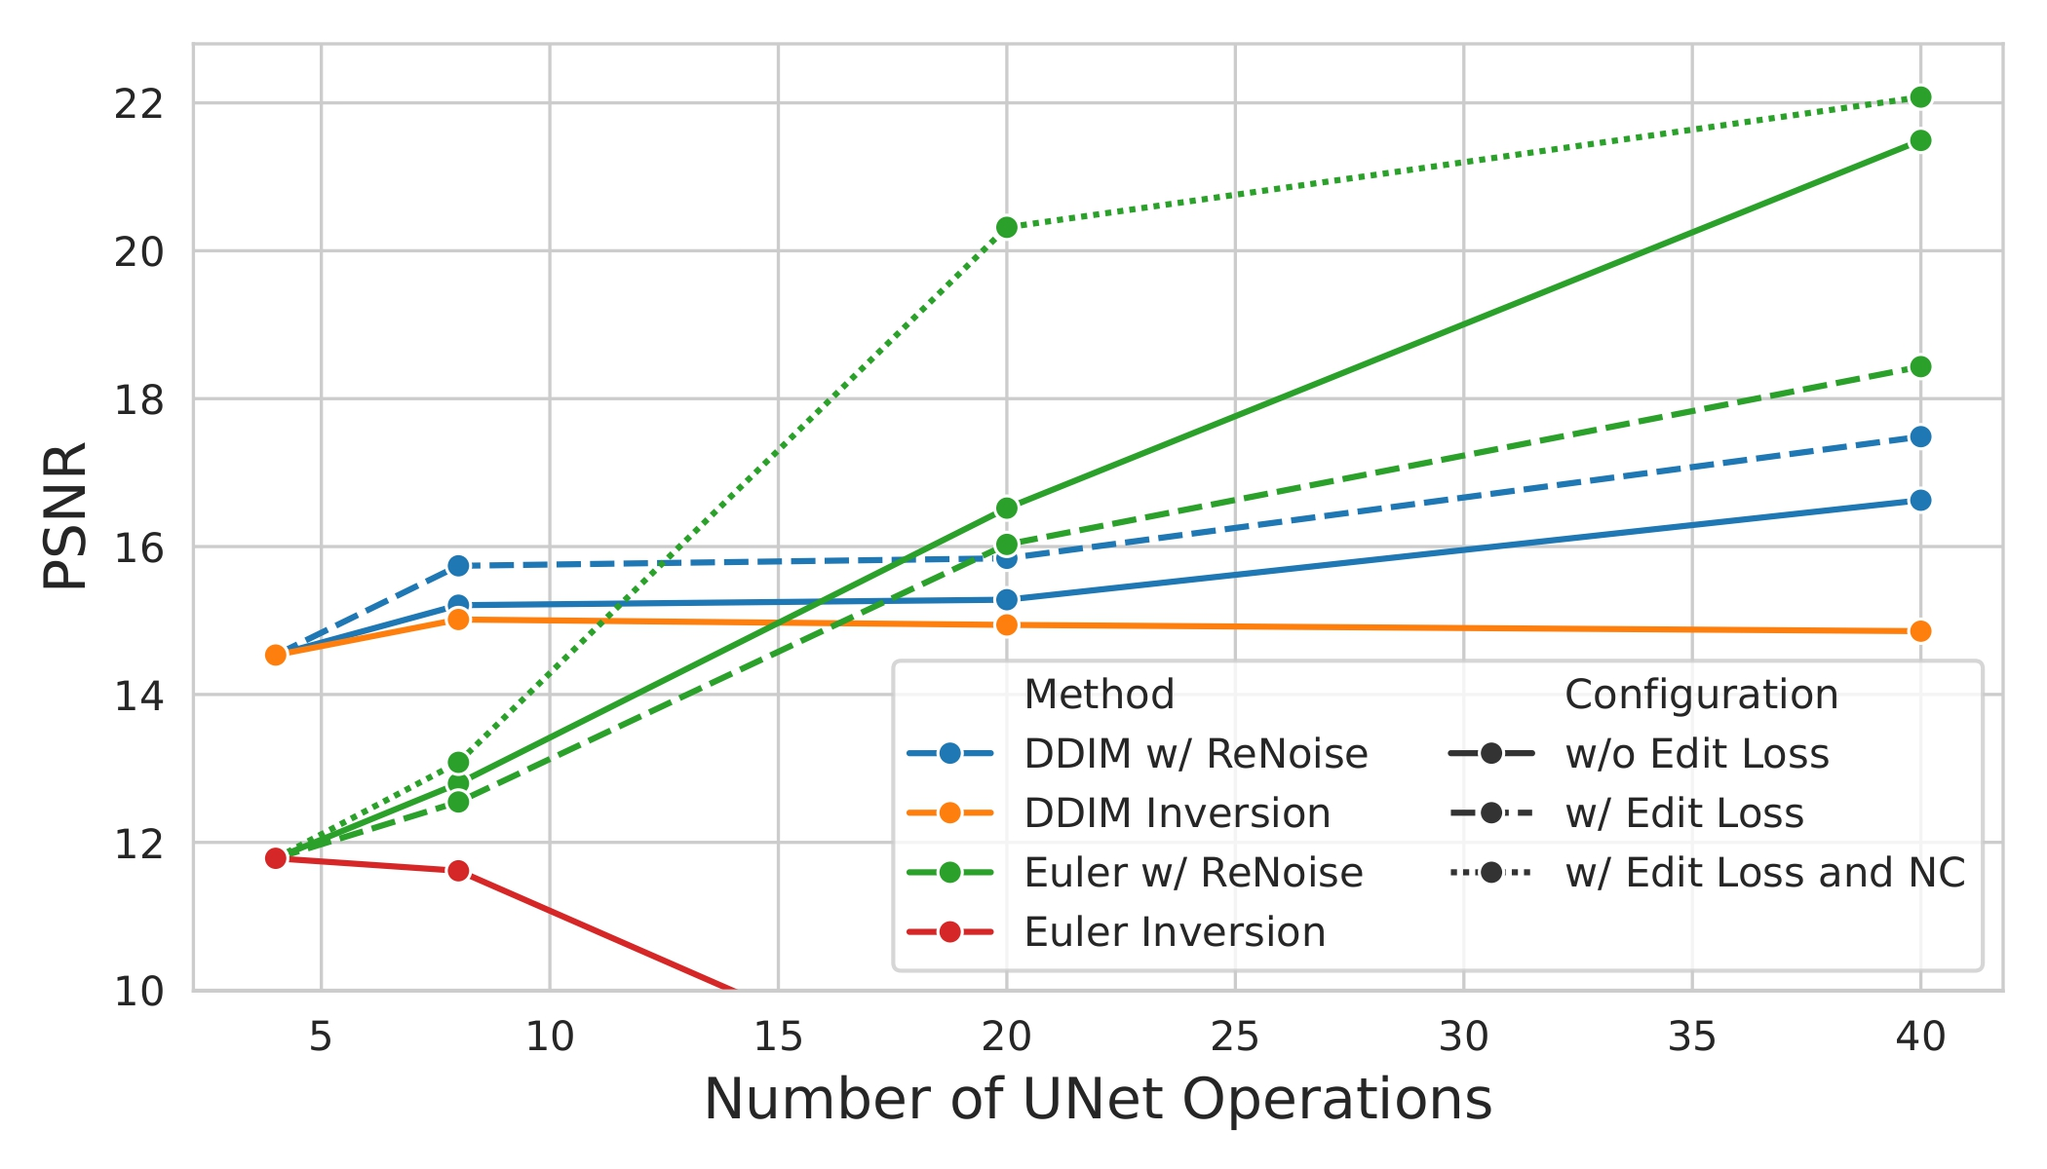
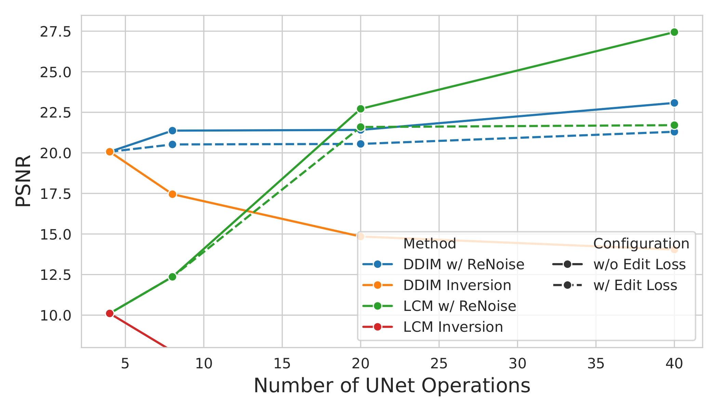
SDXL
SDXL Turbo
LCM LoRA

