Slide 1
Theoretical basis for GAN training problems
Reference:- arXiv: 1701.04862, 2017

Slide 2


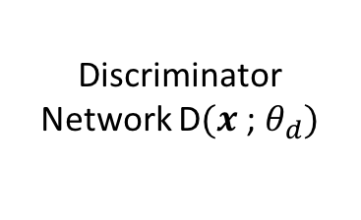

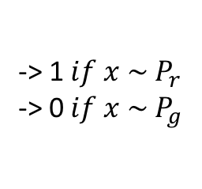
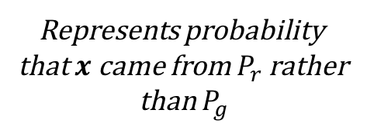
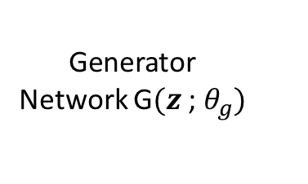
Generator Network G$(z$; $θ_{g})$
$$z\sim P_{z}$$
$x$
Represents probability
that $x$ came from $P_{r}$ rather
than $P_{g}$
Discriminator Network D$(x$; $θ_{d})$
-> 1 $if x \sim P_{r}$
-> 0 $if x \sim P_{g}$
$$x$$

Slide 3
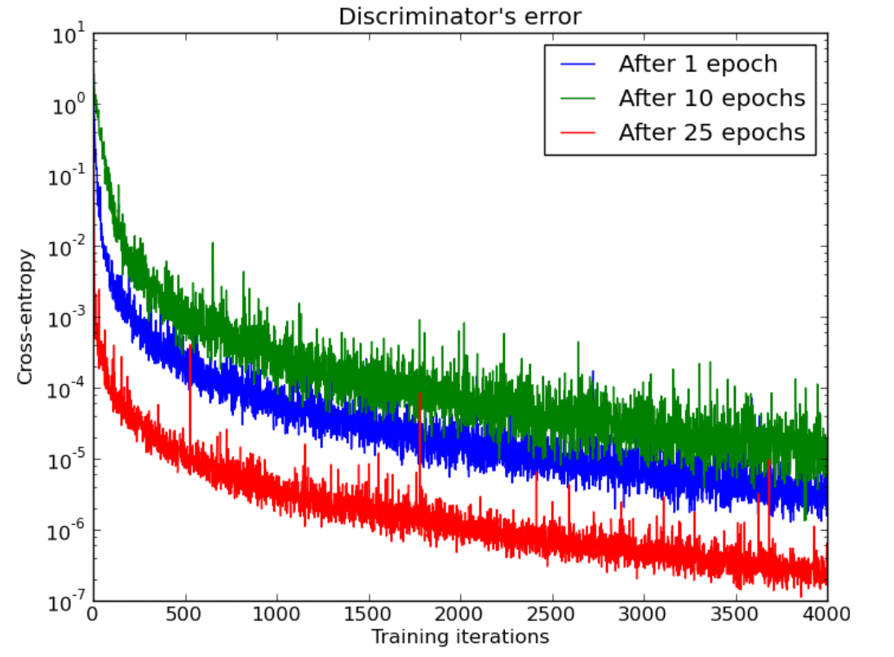
Why GAN Training is an Art?
Discriminator attains optimality much faster than the generator
Discriminator loss already 0 after a few iterations

Slide 4
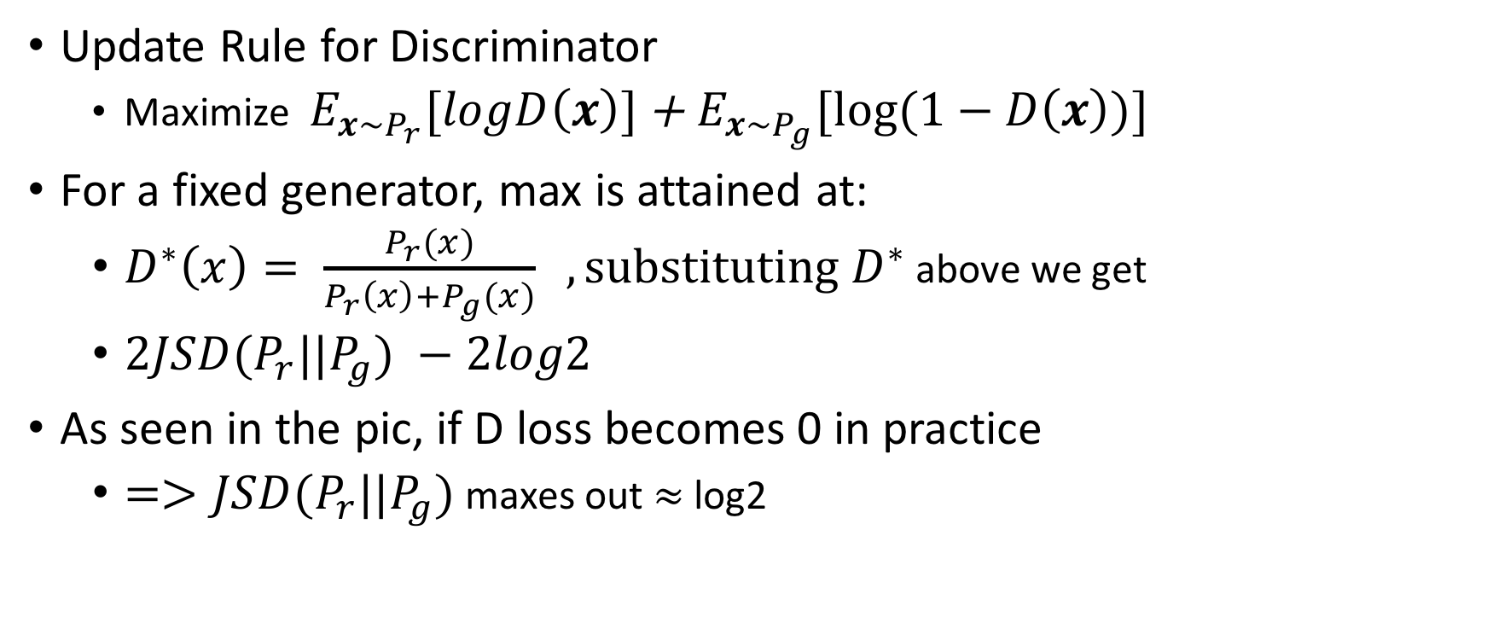
Some Notation first
Update Rule for Discriminator
Maximize $E_{x\sim P_{r}}[logD\left(x\right)]$ + $E_{x\sim P_{g}}[log⁡(1−D\left(x\right))]$
For a fixed generator, max is attained at:
$D^{∗}\left(x\right)= \frac{P_{r}(x)}{P_{r}\left(x\right)+P_{g}(x)} , substituting D^{∗}$ above we get
$2JSD(P_{r}||P_{g}) −2log2$
As seen in the pic, if D loss becomes 0 in practice
$=>JSD(P_{r}||P_{g})$ maxes out $≈$ log2

Slide 5
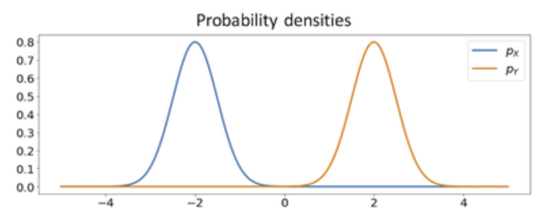

What causes JSD to max out?
Only possible if $P_{g}$ & $P_{r}$have disjoint supports

Slide 6


Or is it?
Low dimensional Manifolds in X
Support of $P_{g}$
High Dim Space
X
Support of $P_{r}$

Slide 7
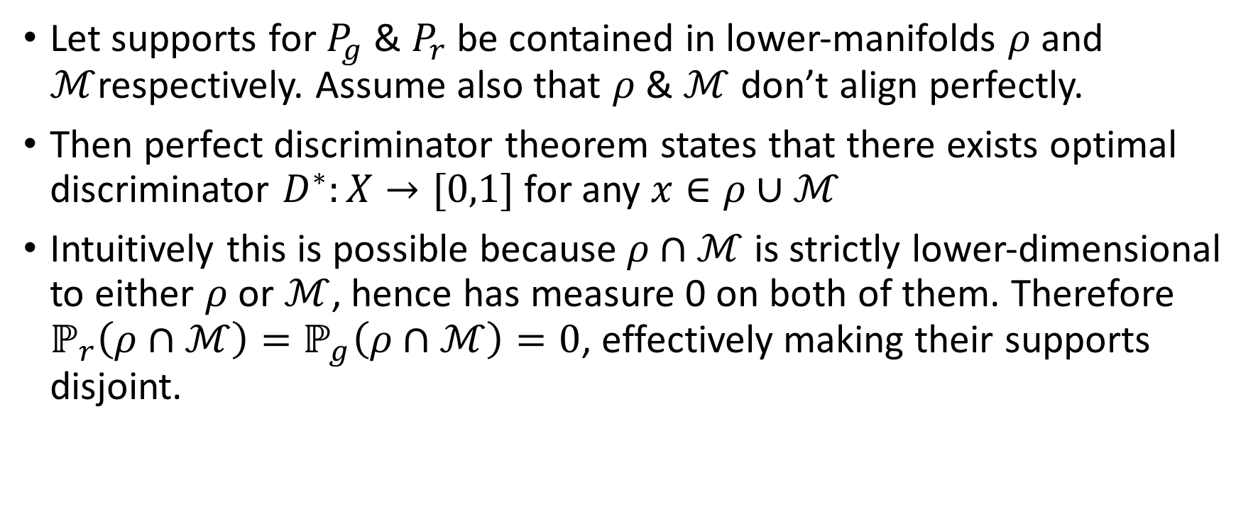
Perfect Discriminator Theorem
Let supports for $P_{g}$ & $P_{r}$ be contained in lower-manifolds $ρ$ and $ℳ$respectively. Assume also that $ρ$ & $ℳ$ don’t align perfectly.
Then perfect discriminator theorem states that there exists optimal discriminator $D^{∗}:X→[0,1]$ for any $x∈ρ∪ℳ$
Intuitively this is possible because $ρ∩ℳ$ is strictly lower-dimensional to either $ρ$ or $ℳ$, hence has measure 0 on both of them. Therefore $ℙ_{r}\left(ρ∩ℳ\right)=ℙ_{g}\left(ρ∩ℳ\right)=0$, effectively making their supports disjoint.

Slide 8
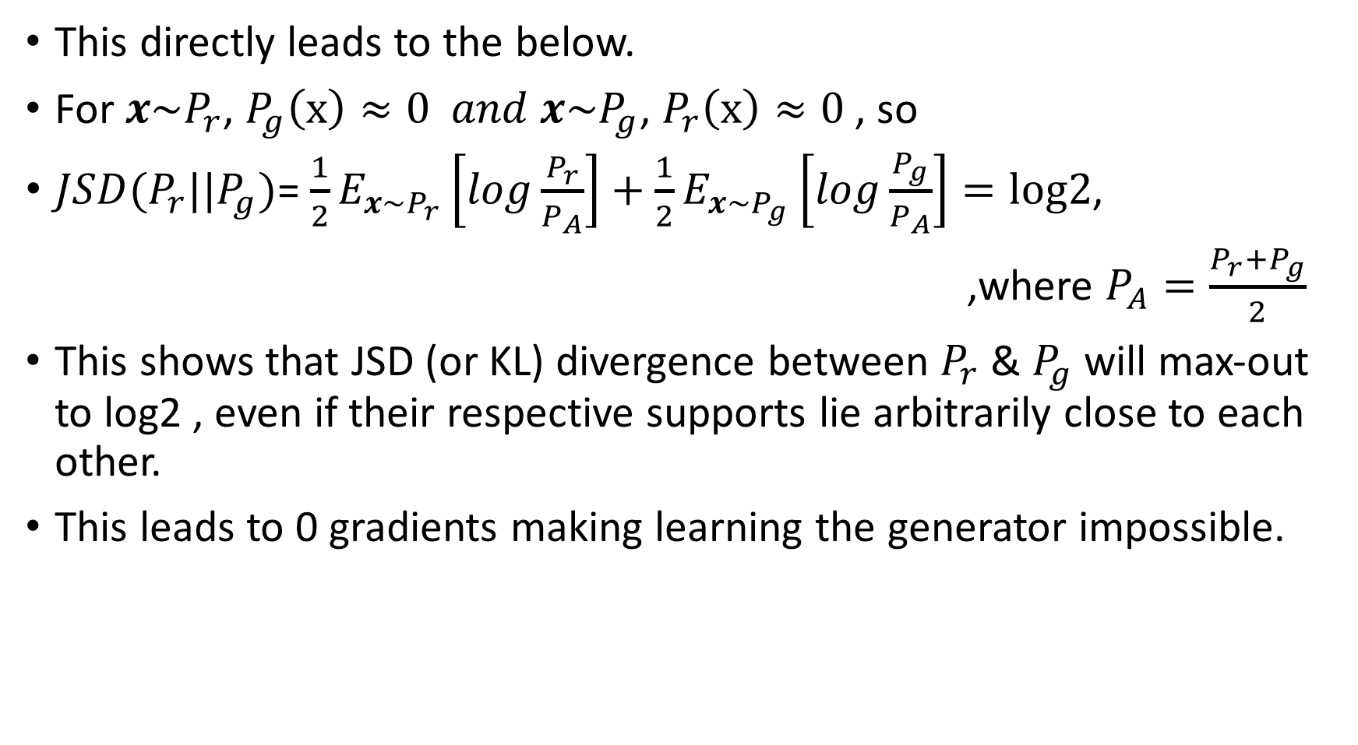
This directly leads to the below.
For $x\sim P_{r}$, $P_{g}\left(x\right)≈0 and x\sim P_{g}$, $P_{r}\left(x\right)≈0$, so
$JSD(P_{r}||P_{g})$=$\frac{1}{2}E_{x\sim P_{r}}\left[log\frac{P_{r}}{P_{A}}\right]+\frac{1}{2}E_{x\sim P_{g}}\left[log\frac{P_{g}}{P_{A}}\right]=log2$,
,where $P_{A}=\frac{P_{r}+P_{g}}{2}$
This shows that JSD (or KL) divergence between $P_{r}$ & $P_{g}$ will max-out to log2 , even if their respective supports lie arbitrarily close to each other.
This leads to 0 gradients making learning the generator impossible.

Slide 9
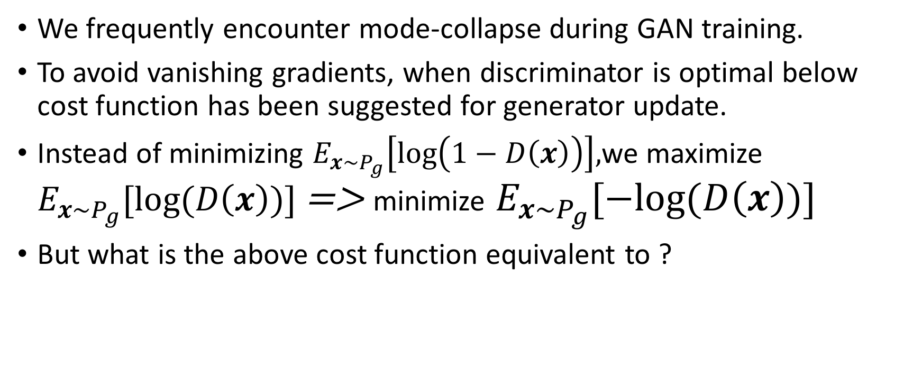
Is Mode-Collapse a feature of GANs?
We frequently encounter mode-collapse during GAN training.
To avoid vanishing gradients, when discriminator is optimal below cost function has been suggested for generator update.
Instead of minimizing $E_{x\sim P_{g}}\left[\log\left(1−D\left(x\right)\right)\right],$we maximize $E_{x\sim P_{g}}[log⁡(D\left(x\right))]$ => minimize $E_{x\sim P_{g}}[−log⁡(D\left(x\right))]$
But what is the above cost function equivalent to ?

Slide 10
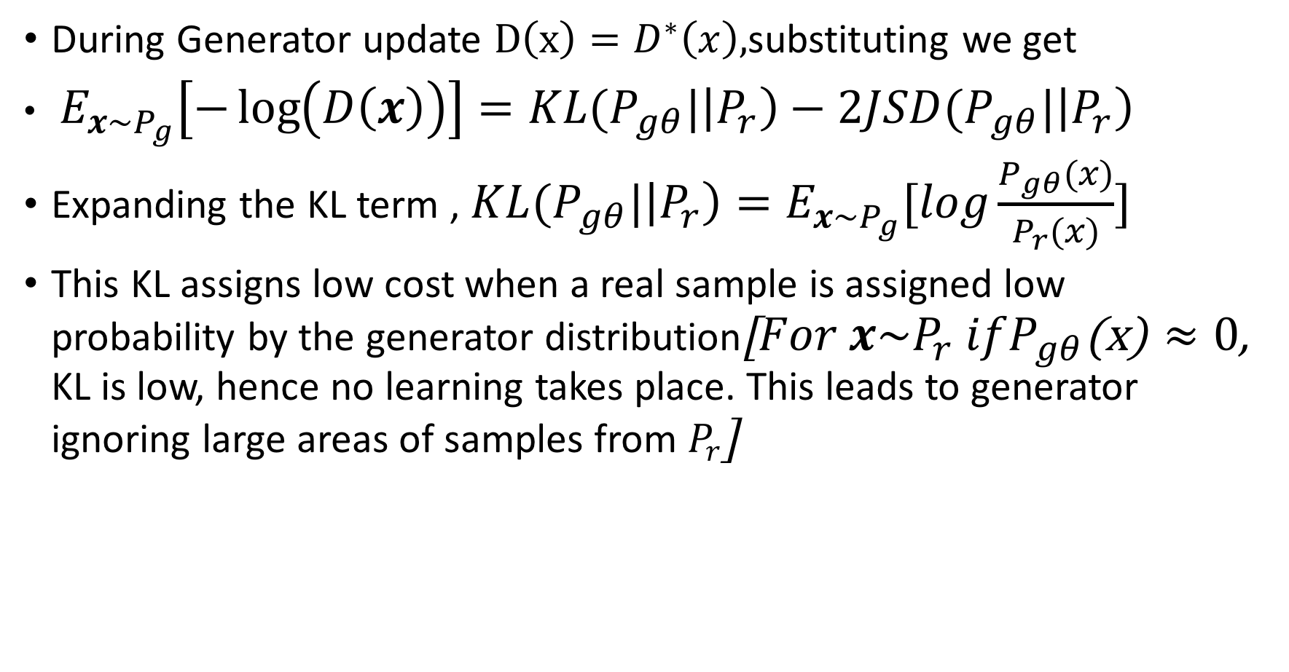
During Generator update $D\left(x\right)=D^{∗}\left(x\right),$substituting we get
$E_{x\sim P_{g}}\left[−\log\left(D\left(x\right)\right)\right]=KL(P_{gθ}|\left|P_{r}\right)−2JSD(P_{gθ}|\left|P_{r}\right)$
Expanding the KL term , $KL(P_{gθ}|\left|P_{r}\right)=E_{x\sim P_{g}}[log\frac{P_{gθ}(x)}{P_{r}(x)}]$
This KL assigns low cost when a real sample is assigned low probability by the generator distribution[$For x\sim P_{r} ifP_{gθ}$(x) $≈0$, KL is low, hence no learning takes place. This leads to generator ignoring large areas of samples from $P_{r}$]

Slide 11
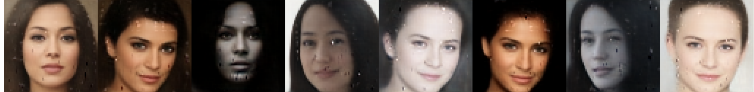
Mode Collapse Example

Slide 12
References
The theorem & equations referred here are presented in the paper ‘TOWARDS PRINCIPLED METHODS FOR TRAINING GENERATIVE ADVERSARIAL NETWORKS by Martin Arjovsky & Le ́on Bottou’(https://arxiv.org/abs/1701.04862)

