Slide 1

IILM UNIVERSITY, GREATER NOIDA
INTERNSHIP REPORT
HR Professional Practices
Garima Shukla
B.Tech CSE | Section 2CSE19 | Roll No. 25SCS1003003110
Batch 2026–27

Slide 2






OVERVIEW
What This Presentation Covers
Introduction
Organization Profile
Purpose and context of the internship
About Beep Learning
Problem Statement
Objectives & Scope
The gap this internship addresses
Goals and boundaries of the work
Tools, Methodology & Outcomes
Certification
How the training was delivered
Proof of successful completion
HR Professional Practices
2

Slide 3

4.1 INTRODUCTION
Building Practical HR Competence
Human Resource Management is a core functional area of any organisation — dealing with recruitment, training, development, and overall management of employees so that organisational goals can be achieved efficiently.
Core HR Functions Covered
This internship provided practical exposure to real-world HR practices followed by professionals in the industry, combining theoretical learning with hands-on assessments — culminating in a certified skill test.
Recruitment & Selection
Employee Onboarding
Performance Management
Compensation & Benefits
Statutory Compliance
HR Professional Practices
3

Slide 4




4.2 ORGANIZATION PROFILE
About Beep Learning
Beep Learning is an ed-tech and skill-development platform offering industry-oriented certification programmes across professional domains, including Human Resources — bridging the gap between academic knowledge and industry requirements through hands-on, competency-based training.
Google for Startups
Startup Leadership
Shark Tank India
Industry Recognised
Accelerator programme
Program participant
Featured startup
By 5000+ companies
HR Professional Practices
4

Slide 5
4.3 PROBLEM STATEMENT
Fresh graduates often possess strong theoretical knowledge but lack practical, hands-on exposure to real HR functions — recruitment workflows, employee engagement, documentation, and compliance.
This gap between academic learning and industry expectation makes it difficult for new entrants to adapt quickly to HR roles — the internship was undertaken to close this gap through structured, practice-oriented training.
HR Professional Practices
5

Slide 6
4.4 PROJECT OBJECTIVES
What the Internship Set Out to Achieve
1
Understand the fundamental functions and responsibilities of an HR professional.
2
Gain practical knowledge of recruitment and selection, from sourcing to onboarding.
3
Learn performance appraisal, employee engagement, and compensation management.
4
Understand statutory and legal compliance requirements relevant to HR.
5
Successfully complete the skill assessment and earn HR Professional certification.
HR Professional Practices
6

Slide 7

4.5 SCOPE OF THE PROJECT
Boundaries of the Internship
In Scope
Out of Scope
Core HR functional areas per curriculum
Recruitment & selection procedures
HR policies & employee lifecycle
Skills for an entry-level HR role
Advanced HR analytics software tools
International labour law
Specialised/advanced-level HR training
HR Professional Practices
7

Slide 8

4.6 TECHNOLOGIES & TOOLS USED
Supporting the Training Delivery
HRMS Concepts
MS Office Suite
Applicant tracking & HR management concepts from the curriculum
Word, Excel, and PowerPoint for documentation and presentations
Learning Management System
Communication Tools
Beep Learning's LMS for course delivery and the skill test
Coordination and discussion throughout the programme
HR Professional Practices
8

Slide 9
4.7 – 4.8 ARCHITECTURE & METHODOLOGY
A Structured, Sequential Learning Path
The training progressed sequentially from concept understanding to practical application, ending in a comprehensive skill test and certification.
1
2
3
4
5
HR Fundamentals
Recruitment & Selection
Performance & Rewards
Compliance
Skill Assessment
Roles & responsibilities
Sourcing, interviews, onboarding
Engagement, compensation & benefits
Statutory & documentation practices
Final test & certification
HR Professional Practices
9

Slide 10
4.9 EXPECTED OUTCOMES
What the Internship Delivered
Clear understanding of core HR functions and processes
Practical familiarity with recruitment & onboarding
Ability to apply HR concepts to real scenarios
HR Professional Certificate of Excellence, industry-recognised
HR Professional Practices
10

Slide 11
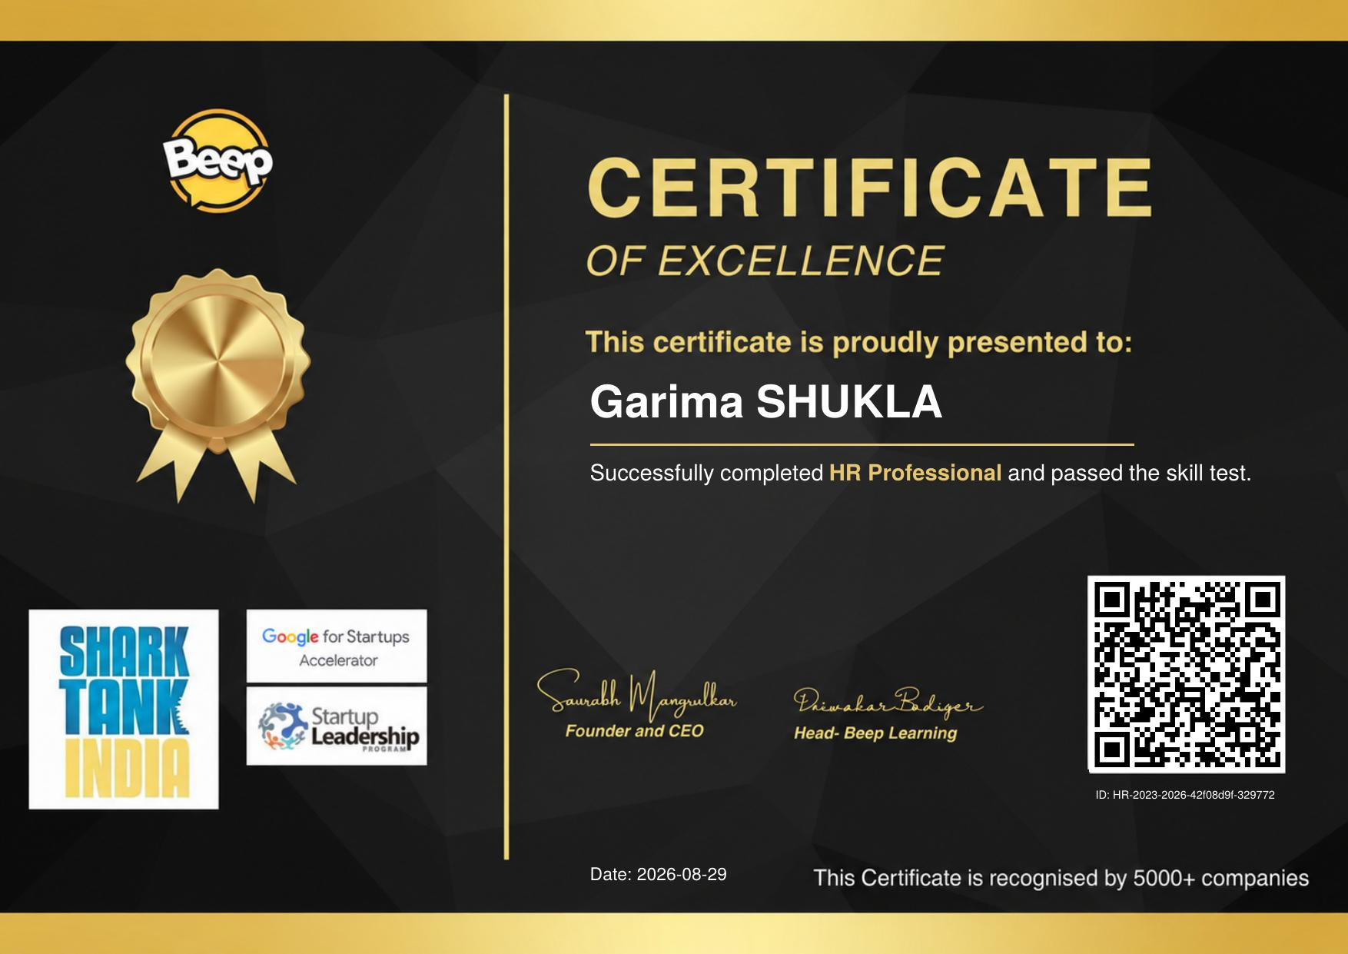
4.10 CERTIFICATION
Certificate of Excellence
Awarded to Garima Shukla for successfully completing HR Professional and passing the skill test — recognised by 5000+ companies.
HR Professional Practices
11

Slide 12
Thank You
Questions & Discussion
Garima Shukla | Section 2CSE19 | Roll No. 25SCS1003003110

