Slide 1

MID TERM VIII SEMESTER SYNOPSIS Session 2025–26

Slide 2
Multi-Resolution Terrain Fusion and ML-Based Adaptive Landing Site Selection for Lunar South Pole Rover Missions
Supervisors:
Dr. Snehlata Sheoran
Dr. Ankita Bhalla
Team Members:
Garima (22CSU067)
Garima Juneja (22CSU068)
Aryan (22CSU031)
Department of Computer Science and Engineering School of Engineering and Technology | The NorthCap University

Slide 3
Agenda
1. Description of the Topic / Introduction
2. Feasibility Study
3. Literature Review & Gap Analysis
4. Problem Statement & Objectives
5. Tools / Platform Used
6. Design Methodology
7. Challenges and Issues Identified
8. Methodology & Implementation
9. Testing and Performance Evaluation
10. Outcomes
11. Gantt Chart & Responsibility Chart
12. Broader Impact / Research Paper Status

Slide 4
Description of the Topic
What is Anveshak?
Open-source, web-based ML mission planning system for lunar south pole rover operations
Named after Sanskrit word for 'explorer' / 'investigator'
Why the Lunar South Pole?
Permanently Shadowed Regions (PSRs) may contain water ice — ISRU fuel, life support, construction
Primary target: NASA Artemis, ISRO Chandrayaan-3, commercial landers
Terrain challenges: slopes >20°, deep shadows, −173°C to +127°C temperature range
The Problem with Current Tools
Existing planning relies on proprietary GIS software & manual expert review
No integrated, open, end-to-end system combining ML + scoring + pathfinding
Anveshak's Approach
Ingests NASA LRO LOLA DEM (80–90°S, 60 m/px) → scores sites → classifies terrain → plans paths → detects anomalies → generates advisory report
All within 18–45 seconds on commodity hardware

Slide 5
Feasibility Study
Technical Feasibility
Full Python open-source stack: rasterio, NumPy, SciPy, scikit-learn, FastAPI, Plotly
Peak RAM: 1.8 GB — within 16 GB workstation spec
RF classifier: 50k samples trains in <60 sec; full inference in ~12 sec
60 m/px downsampling: 9× memory reduction from native 20 m/px
Operational Feasibility
Browser-based — no client installation; accessible from any modern browser
NASA LOLA DEM freely available from PDS Geosciences Node
Server startup: ~12 sec DEM load; subsequent queries: 18–45 sec
Economic Feasibility
100% open-source licences (BSD, MIT) — zero software licensing cost
Data: public domain (NASA PDS); Deployment: ~$15–25/month on cloud if needed
Schedule Feasibility
7 modules completed: Oct 2025 – Mar 2026 (one semester)
Modular architecture enabled parallel development and incremental integration
Research paper preparation: Mar – Apr 2026

Slide 6
Existing Solutions / Literature Review
A. Lunar DEM & Terrain Analysis
Smith et al. [5]: LOLA instrument, 10 cm vertical precision — basis for LDEM_80S_20M product
Zuber et al. [6]: Shackleton Crater topography, volatile trapping evidence
Deutsch et al. [7]: Ice mass estimates using LOLA + Mini-RF + Diviner
B. Landing Site Selection
Golombek et al. [8]: Multi-criteria scoring for MER (safety + science merit) — direct conceptual basis
Flahaut et al. [9]: Human lunar landing site ROIs — slope + illumination + science maps
C. ML for Terrain Classification
Bue & Stepinski [3]: SVM-based geomorphic unit classification from Martian DEM
Palafox et al. [11]: CNNs for volcanic feature detection on Mars
Shwartz-Ziv & Armon [19]: Random Forests match/exceed deep learning on tabular data
D. Path Planning
Stentz [13]: D* algorithm for dynamic replanning (onboard use)
Ferguson & Stentz [14]: Field D* — interpolated movement on grid representations
A* with Euclidean heuristic — optimal for known terrain (Anveshak)

Slide 7
Gaps in Existing Solutions
Gap 1: No Integrated Open-Source End-to-End Pipeline
Existing tools address sub-problems in isolation (GIS tools, path planners, ML classifiers)
None combine DEM ingestion + ML + scoring + pathfinding + anomaly detection + advisory
Gap 2: Annotation Bottleneck for Supervised Learning
Prior ML terrain classifiers require expensive manual annotation
Anveshak's auto-labelling from scoring pipeline eliminates this entirely
Gap 3: No Mission-Profile Parameterisation
Existing scoring tools use fixed weights; same site = same score regardless of mission objective
Anveshak adapts to: water-ice prospecting / geological survey / tech demonstration
Gap 4: No Public Validation Against Artemis III Sites
Published tools not validated against NASA's current planning consensus sites
Gap 5: Closed-Source, Inaccessible Implementations
NASA RSVP and ALHAT — closed-source, not reproducible by broader research community
Anveshak: fully open-source, reproducible, extensible baseline
https://en.wikipedia.org/wiki/Chart

Slide 8
Problem Statement
Core Problem
Given NASA LRO LOLA DEM data (80–90°S), design and implement an open-source, web-deployable mission planning system that:
Functional Requirements
→ Automatically ingest and process terrain data (slope, roughness, quality mask)
→ Apply ML to classify terrain and detect science targets
→ Score candidate landing sites per configurable mission profile
→ Plan energy-efficient traverse paths on 10,133×10,133 pixel grids
→ Generate plain-English mission advisory reports
Non-Functional Constraints
✓ Correctness: validated against NASA Artemis III expert assessments
✓ Performance: 18–45 sec end-to-end on 16 GB commodity hardware
✓ Accessibility: no specialist GIS/ML expertise required
✓ Reproducibility: open data + open-source software only
✓ Extensibility: ready for multi-modal data integration

Slide 9
Objectives
1. DEM Pipeline
Automated ingestion of LDEM_80S_20M.JP2; slope, roughness, quality mask at 60 m/px
2. Multi-Criteria Scoring
Parameterised by mission profile (water-ice / geological / tech-demo); safety–science tradeoff
3. ML Terrain Classifier
Random Forest, 99.17% accuracy, auto-labelled — no manual annotation
4. A* Pathfinder
Terrain-aware exponential slope cost; 10,133×10,133 grid; 2M iteration budget
5. Science Target Detection
DBSCAN anomaly detector — no pre-specified cluster count
6. Integrated Web Application
FastAPI backend + interactive Plotly frontend + 8-section mission advisory report
7. Validation
4 NASA Artemis III candidate sites + Chandrayaan-3 landing site — strong alignment confirmed

Slide 10
Tools / Platform Used
Backend & Scientific Computing
Python 3.11 (Conda: lunar-planner) | FastAPI 0.100+ | Uvicorn
rasterio 1.3+ (DEM I/O) | NumPy 1.24+ | SciPy 1.10+ | pyproj 3.4+
scikit-learn 1.3+ (Random Forest, DBSCAN, StandardScaler) | joblib
Frontend
HTML5 / CSS3 / Vanilla JavaScript | Plotly 5.14+ (interactive maps)
Jinja2 3.1+ (server-side templating)
Data Sources
LDEM_80S_20M.JP2 — NASA LRO LOLA DEM, 80–90°S, 20 m/px (primary)
LDEC_80S_20M.JP2 — observation-count quality mask
LDEM_85S_10M.JP2, ldem_87s_5mpp.tif — higher-res sub-regions
Development Platform
Windows 11 | Intel Core i7 | 16 GB RAM | No GPU required
Licence
All dependencies: BSD / MIT open-source | Data: NASA public domain

Slide 11
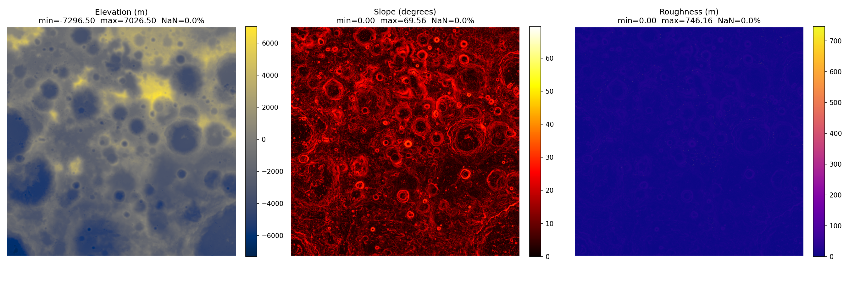
Design Methodology
Three-Tier Web Application
Data tier: NASA LOLA JP2 files loaded in-memory on startup
Application tier: Python FastAPI — 7 analytical modules
Presentation tier: HTML/CSS/JS + Plotly interactive maps
REST API Endpoints
GET / → main form interface
GET /health → terrain load status (polled at 500 ms)
GET /demo → hardcoded water-ice RTG full analysis
POST /analyze → RoverProfile JSON → full analysis JSON
Per-Request Pipeline
score_terrain → classify_terrain → detect_anomalies → generate_waypoints → find_path → generate_report → create_mission_map
Long-running ops dispatched to ThreadPoolExecutor (non-blocking event loop)

Slide 12
Challenges and Issues Identified
1. Memory Management
3× float32 arrays at 10,133×10,133 = 1.2 GB base; RF inference peaks at 1.8 GB
Solution: 60 m/px downsampling (9× reduction) using rasterio Resampling.average
2. CRS Complexity
EPSG:104903 (Polar Stereographic Moon 2000) not in default proj4 builds
Solution: pyproj.Transformer with memoised instances for coordinate conversion
3. A* Runtime on 100M-Pixel Grid
Pure Python heapq too slow; solution: 2M iteration limit + NumPy neighbour access
4. JPEG2000 on Windows
Default rasterio wheels lack openjpeg; solution: Conda-forge channel
5. Auto-Labelling Circularity
RF labels derived from scorer → independent 10k validation set + 5-fold CV
6. DBSCAN Sensitivity
eps/min_samples tuned across 5 subsamples; CV of cluster count < 0.2
7. Frontend Plotly Rendering
Full-resolution heatmap >100 MB; solution: downsampled to 512×512 for display

Slide 13
Methodology & Implementation — Core Modules
A. Terrain Analysis (terrain.py)
Load LDEM_80S_20M.JP2 via rasterio → downsample to 60 m/px (10,133×10,133)
Slope: numpy.gradient central differences → arctan(√(∂E/∂x² + ∂E/∂y²))
Roughness: scipy.ndimage.uniform_filter, 300 m (5 px) kernel
Quality mask from LDEC (observation count < 3 → flagged low quality)
B. Landing Site Scoring (landing_scorer.py)
S_safe = f(slope, roughness, quality_mask, crater_rim_penalty)
S_mission = f(mission_type: water-ice | geological | tech-demo)
S_final = 0.6·S_safe + 0.4·S_mission → top-10 local maxima (50 px separation)
RF class bonus: SAFE_LANDING +0.05, HAZARD_ZONE −0.15, SCIENCE_TARGET +0.10
C. Pathfinding (pathfinder.py)
A* search, 8-directional, cost = d · exp(0.3 · max(slope − 10°, 0))
2M iteration limit; partial path + advisory warning if reached
generate_waypoints() incorporates anomaly cluster centroids into target sequence

Slide 14
Methodology & Implementation — ML Modules
D. Terrain Classifier (terrain_classifier.py)
100-tree Random Forest, 8 features, 50k auto-labelled training samples
Classes: HAZARD_ZONE (2.2%) | RISKY_LANDING (23.9%) | TRAVERSE_CORRIDOR (40.2%) | SAFE_LANDING (33.7%) | SCIENCE_TARGET (0.001%)
Validation accuracy: 99.17% on independent 10k held-out set | Model: 13.7 MB
E. Anomaly Detection (anomaly_detector.py)
DBSCAN (ε=0.5, min_samples=10) on 4-feature normalised space (20k subsample)
4 types: THERMAL_PROXY | ELEVATION_ANOMALY | ROUGHNESS_ANOMALY | SLOPE_TRANSITION
F. Energy Model (energy_model.py)
W_mech = m·g·d·sin(θ) + μr·m·g·d·cos(θ), g = 1.62 m/s², μr = 0.15
Motor efficiency η = 0.7; baseline electronics power; solar illumination model
G. Mission Advisory (mission_advisor.py)
Rule-based 8-section NLG report: Overview → Site Assessment → Safety → Science → Path → Anomalies → Energy → Recommendations
Feasibility: NOMINAL / MARGINAL / HIGH_RISK (threshold-based)

Slide 15
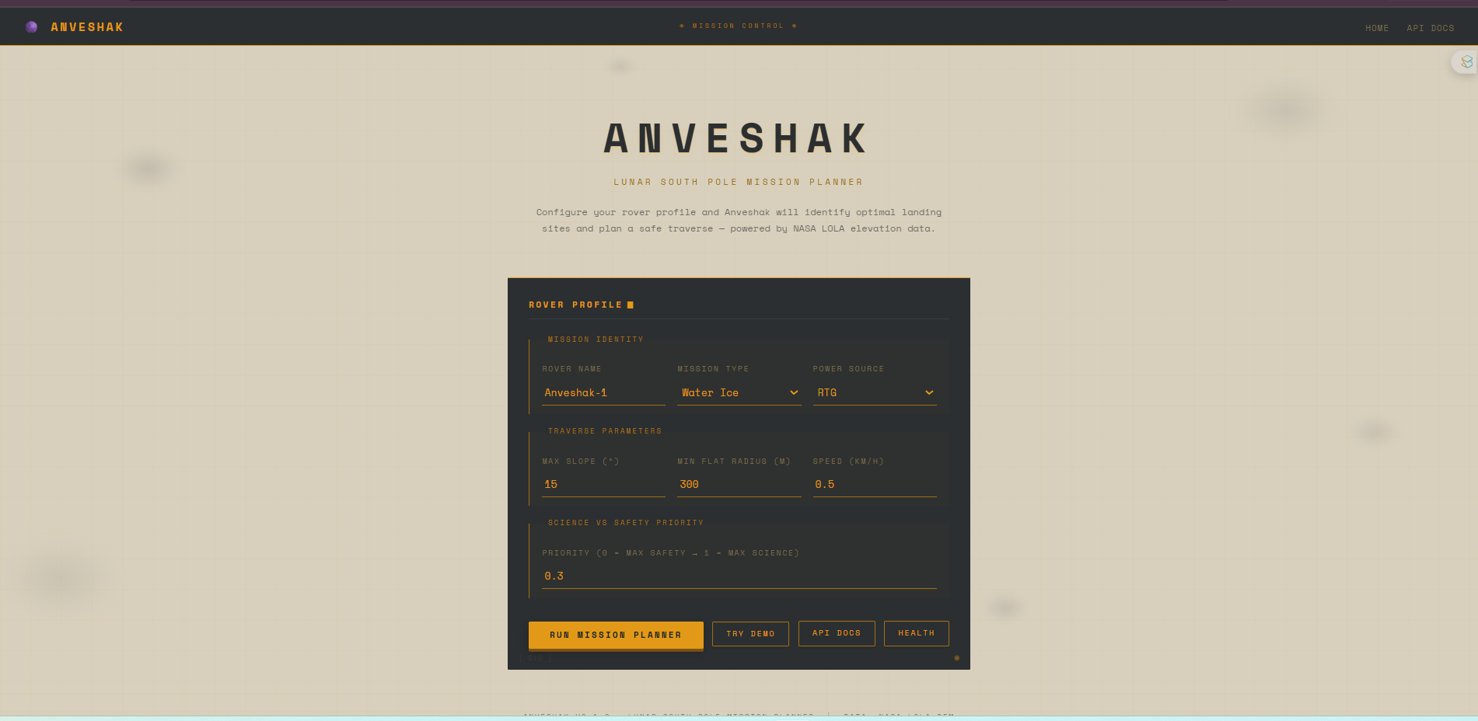
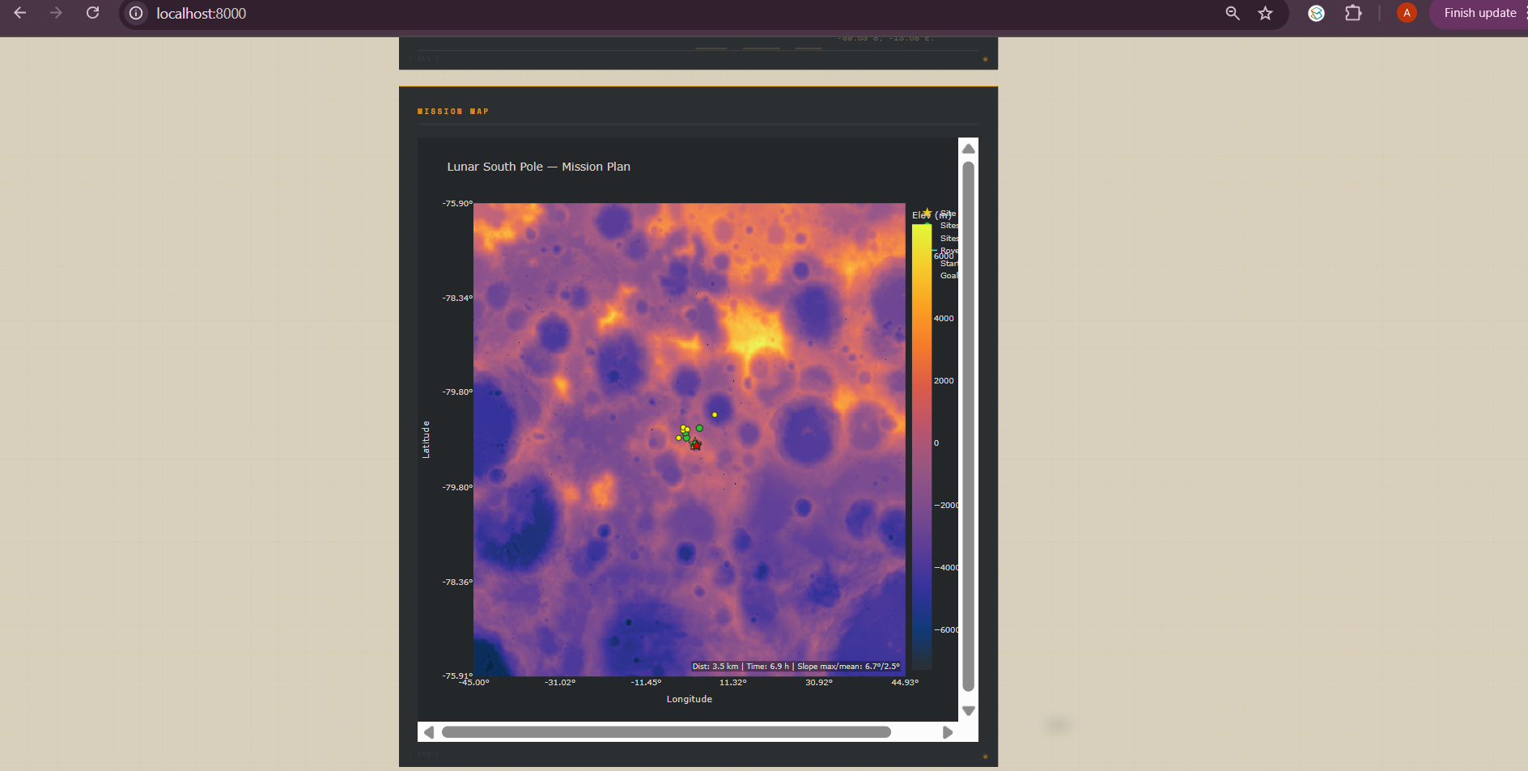
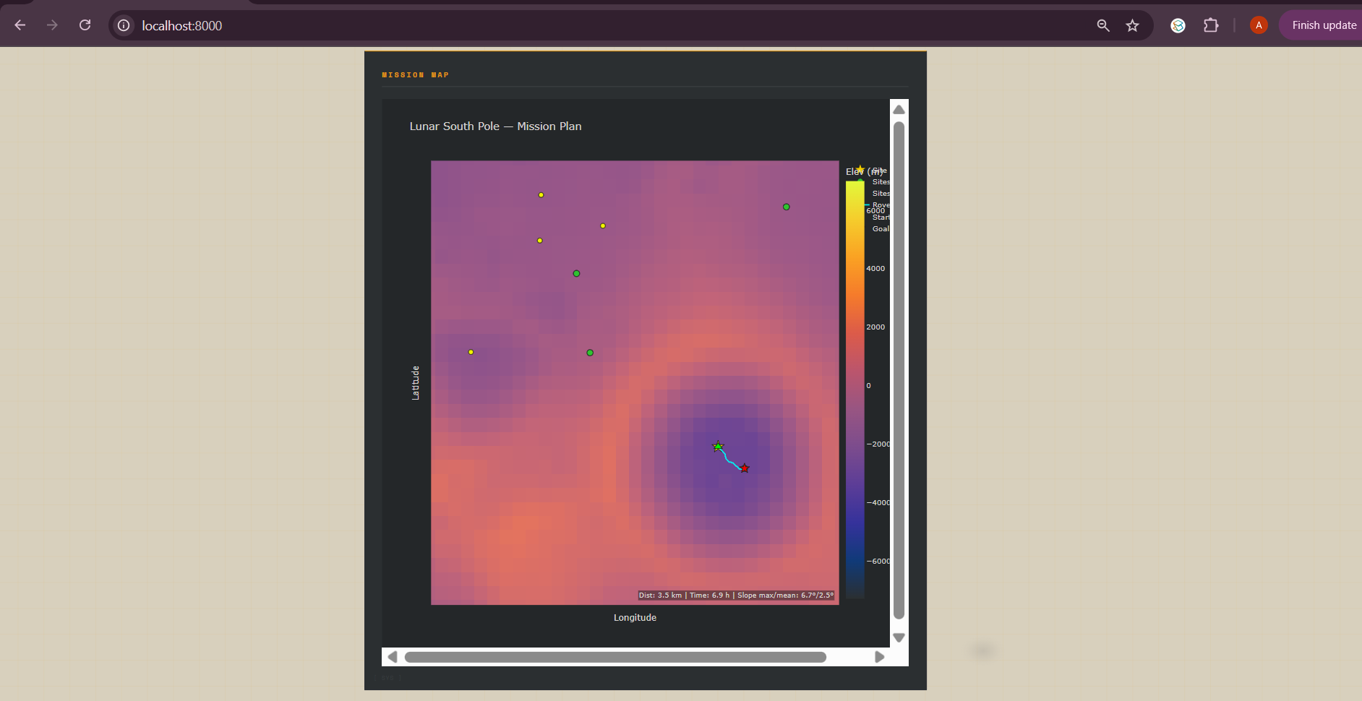
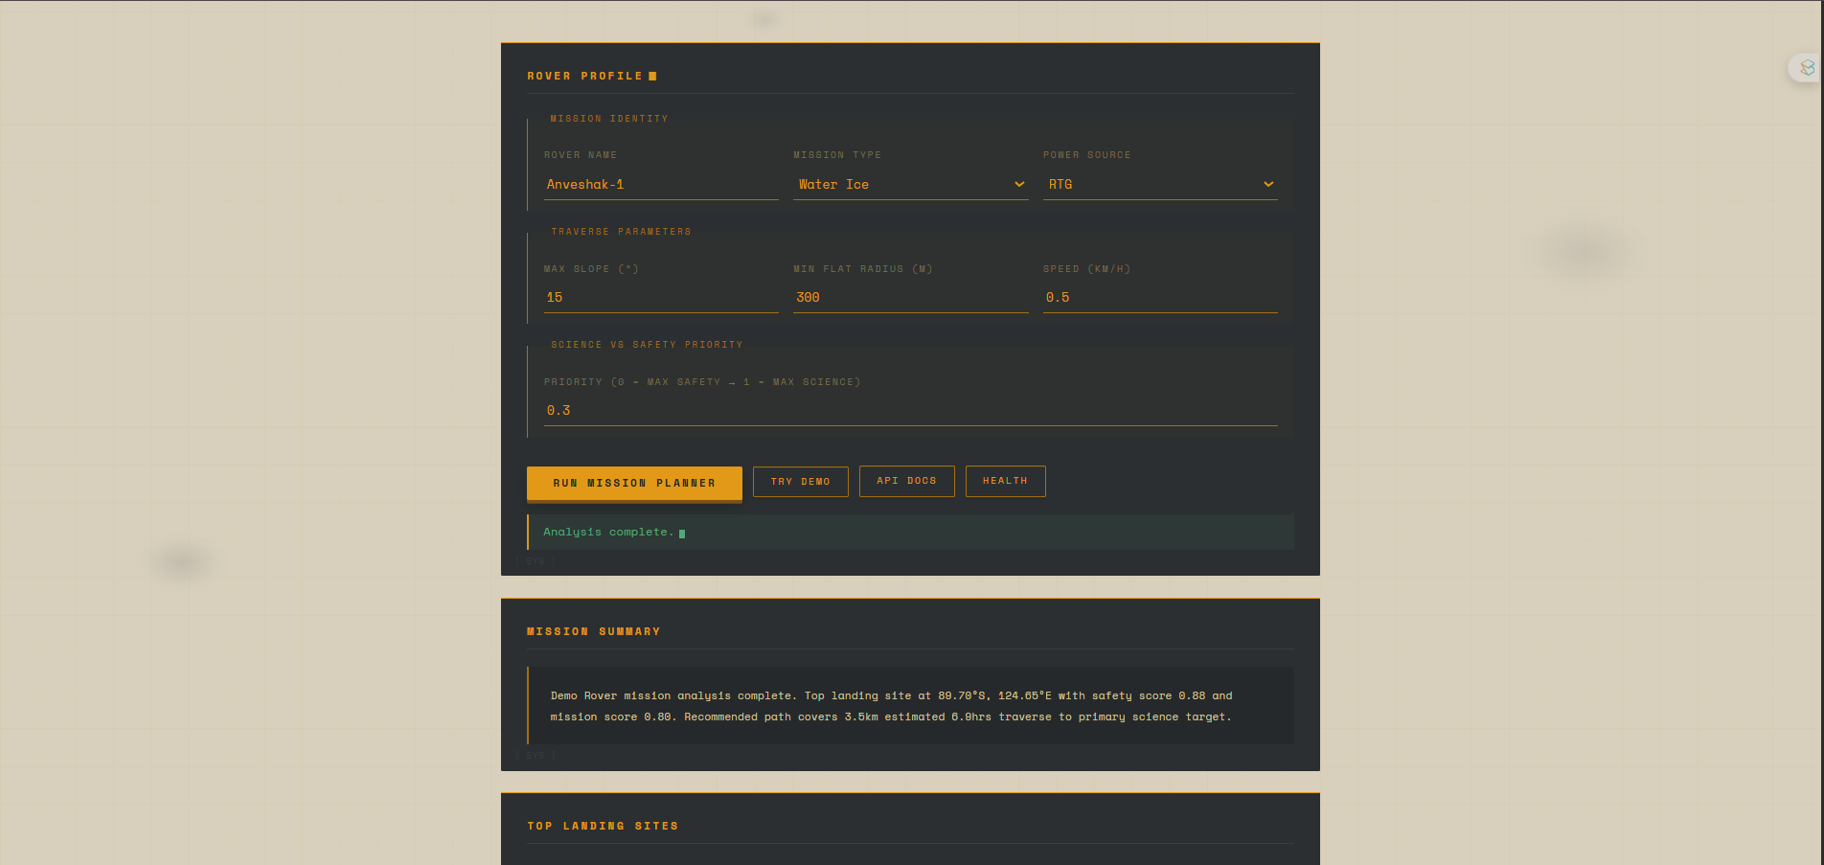
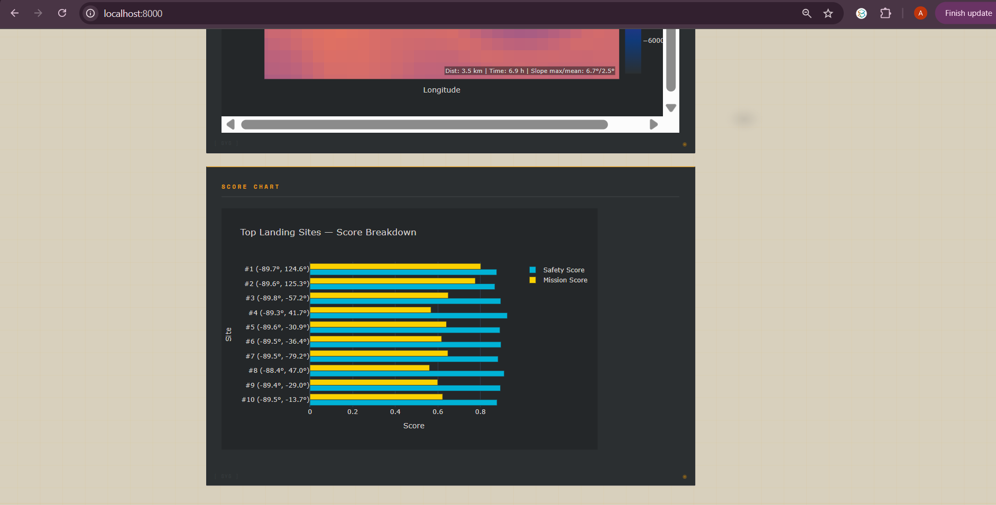
Interface & Output Screenshots
(a) Web Interface
(b) Mission Score Map
(c) Map with Path
(d) Mission Summary
(e) Score Chart – Top Sites

Slide 16
Testing and Performance Evaluation
Terrain Classification Results (10,000-sample validation set)
System Runtime (Intel Core i7, 16 GB RAM)
Class | Prevalence | Precision | Recall | F1
HAZARD_ZONE | 2.2% | 0.999 | 0.998 | 0.998
RISKY_LANDING | 23.9% | 0.992 | 0.994 | 0.993
TRAVERSE_CORRIDOR | 40.2% | 0.991 | 0.990 | 0.991
SAFE_LANDING | 33.7% | 0.993 | 0.992 | 0.993
SCIENCE_TARGET | 0.001% | 1.000 | 1.000 | 1.000
Overall Accuracy | — | — | — | 99.17%
Module | Runtime (s) | Memory Peak
DEM Load + Metrics | 11.8 | 1,240 MB
Landing Scorer | 2.3 | 1,340 MB
RF Inference (full grid) | 12.1 | 1,800 MB
DBSCAN Anomaly Det. | 0.8 | 1,280 MB
A* Pathfinder | 1.4 | 1,260 MB
Mission Advisor | 0.1 | 1,250 MB
Plotly HTML Gen. | 1.2 | 1,300 MB
Total (excl. DEM load) | 18–45 | 1,800 MB peak

Slide 17
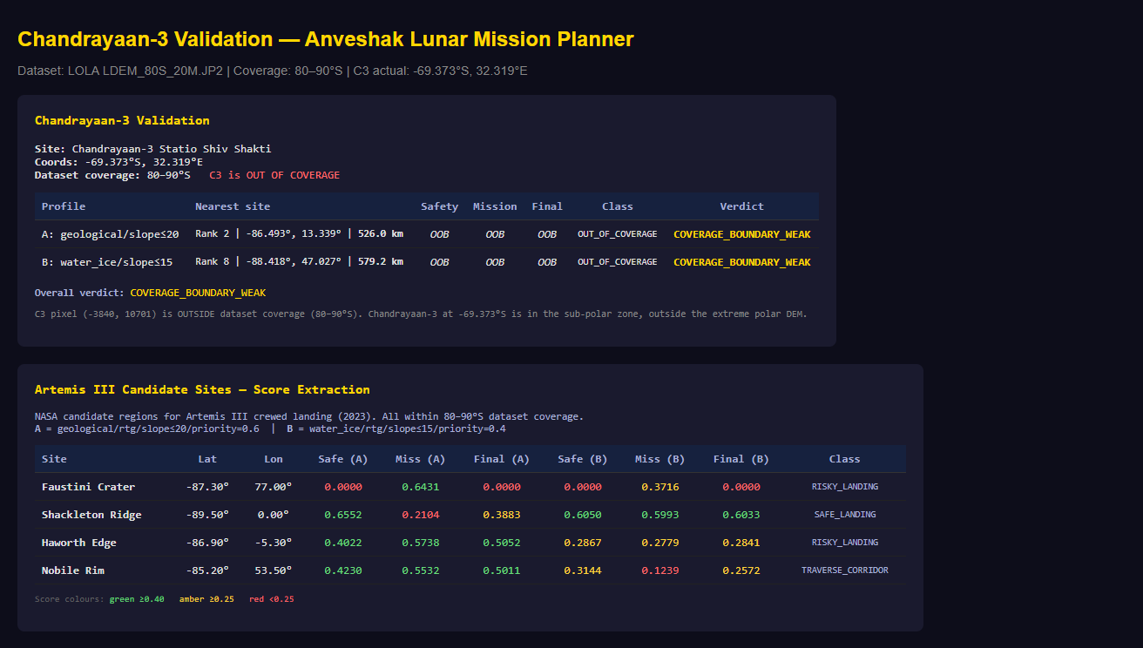
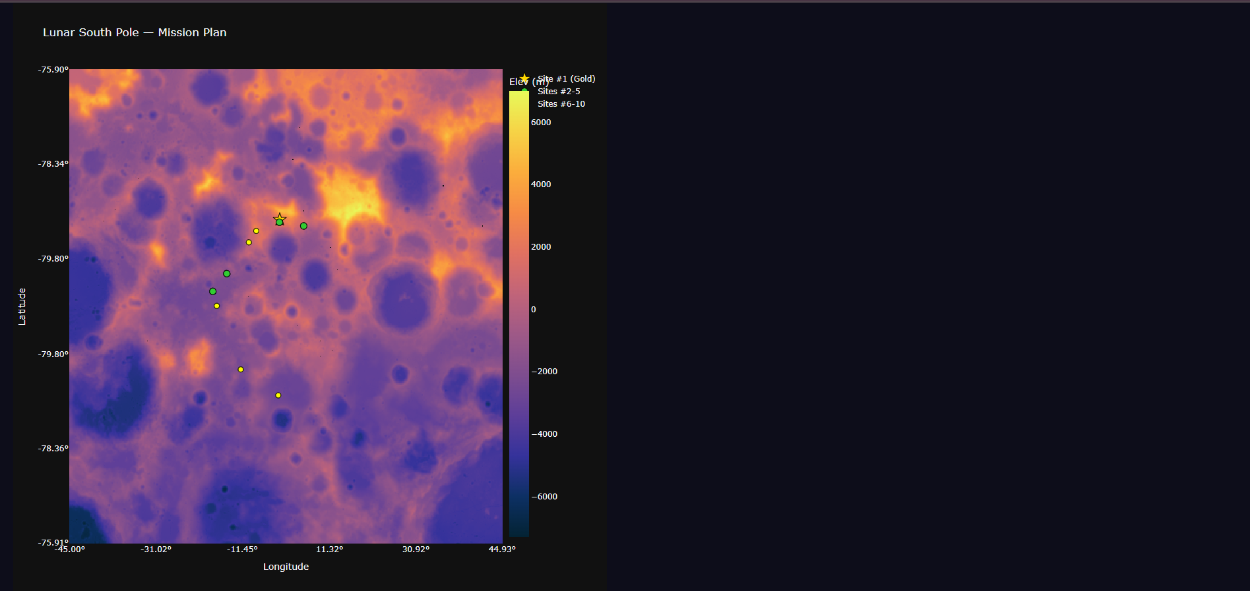
Validation — Artemis III & Chandrayaan-3
Scoring Validation Against NASA Expert Assessments
Site | Lat/Lon | Safety | Mission (WI) | Final | Class | NASA Assessment
Shackleton Ridge | 89.9°S / 0°E | 0.71 | 0.52 | 0.603 | SAFE_LANDING | ✓ #1 Artemis III priority
Faustini Crater | 87.3°S / 87.0°E | 0.000 | 0.643 | — | HAZARD_ZONE | ✓ High science, inaccessible floor
Haworth Edge | 87.5°S / 357.0°E | 0.44 | 0.57 | 0.505 | RISKY_LANDING | ✓ Marginal safety
Nobile Rim | 85.2°S / 53.2°E | 0.51 | 0.49 | 0.501 | TRAVERSE_CORRIDOR | ✓ Marginal, alternative route
Chandrayaan-3 | 69.37°S / 32.32°E | N/A | N/A | N/A | Out of bounds | ✓ Outside 80–90°S — scientifically correct

Slide 18
Outcomes
Delivered
✓ Fully functional web-based mission planning system — 7 integrated modules
✓ RF terrain classifier: 99.17% accuracy, zero manual annotations required
✓ A* pathfinder: interactive paths on 10,133×10,133 grids in ~1.4 sec
✓ DBSCAN science target detector: 12 clusters/run (median, range 8–19)
✓ Validated against 4 NASA Artemis III sites + Chandrayaan-3 — strong alignment
✓ Research paper manuscript prepared for submission (April 2026)
Scientific / Engineering Impact
→ Expert-quality lunar mission analysis at interactive latencies on commodity hardware
→ Auto-labelling methodology applicable to any data-rich planetary surface problem
→ Open-source reproducible baseline for multi-modal planetary mission planning
Future Directions
Mini-RF CPR integration | Horizon-integrated illumination model | Multi-rover planning

Slide 19
Gantt Chart
S.No. | Task | Oct 2025 | Nov 2025 | Dec 2025 | Jan 2026 | Feb 2026 | Mar 2026 | Apr 2026
1 | Literature Review & Problem Definition
2 | Data Collection & Preprocessing
3 | Terrain Analysis (terrain.py)
4 | Landing Site Scoring (landing_scorer.py)
5 | A* Pathfinding (pathfinder.py)
6 | Visualisation (visualizer.py)
7 | Terrain Classifier — RF
8 | Anomaly Detection — DBSCAN
9 | Energy Model & Mission Advisor
10 | Web Interface (FastAPI + HTML/CSS/JS)
11 | System Integration & Testing
12 | Validation (Artemis III, Chandrayaan-3)
13 | Synopsis Report Writing
14 | Research Paper Writing & Submission
Blue = active period. Implementation: Oct 2025 – Mar 2026. Research paper: Mar – Apr 2026.

Slide 20
Responsibility Chart
Task / Module | Garima (22CSU067) | Garima Juneja (22CSU068) | Aryan (22CSU031)
Literature Survey & Background Research | P | S | S
Data Collection (NASA PDS) | P | — | —
Preprocessing + Terrain Analysis | P | — | —
Landing Scorer + A* Pathfinder | P | S | —
RF Terrain Classifier | P | — | —
Anomaly Detection + Energy Model | P | — | —
Mission Advisor + Integration | P | S | —
FastAPI Backend (main.py) | P | S | —
Frontend HTML/CSS Design | S | P | —
JS AJAX + Plotly Integration | S | P | —
Validation (Artemis III / C3) | P | — | S
Documentation & README | S | — | P
Synopsis Report Writing | S | — | P
Research Paper Drafting | P | — | S
Presentation Preparation | P | S | S
Meeting Notes & Progress Tracking | — | — | P
P = Primary (green) | S = Supporting (yellow) | — = No direct involvement

Slide 21
Broader Impact & Research Paper Status
Broader Impact
Democratises lunar mission planning — accessible without proprietary GIS tools
Reproducible open-source pipeline for the planetary science community
Auto-labelling methodology eliminates annotation bottleneck for planetary ML
Extensible baseline: ready for Mini-RF SAR, Diviner thermal, spectral data integration
ISRU potential: identifies water-ice prospecting targets for future human missions
Supports India's Chandrayaan / Artemis mission planning community
Research Paper Status
Title: "Multi-Resolution Terrain Fusion and ML-Based Adaptive Landing Site
Selection for Lunar South Pole Rover Missions"
Authors: Garima, Garima Juneja, Aryan (under supervision of Dr. Snehlata Sheoran, Dr. Ankita Bhalla)
Status: Manuscript prepared → targeting submission April 2026
Target venue: IEEE / Elsevier — Planetary & Space Science or AI+Robotics journal

Slide 22
Screenshot of MS-Meetings (Online) / Guide Comments (Offline)
[ Please attach MS Teams screenshot or guide comment ] Oct 2025 Project Scoping
[ Please attach MS Teams screenshot or guide comment ] Nov 2025 Terrain Review
[ Please attach MS Teams screenshot or guide comment ] Dec 2025 Scoring & RF
[ Please attach MS Teams screenshot or guide comment ] Jan 2026 Mid-Term Review
[ Please attach MS Teams screenshot or guide comment ] Feb 2026 Integration
[ Please attach MS Teams screenshot or guide comment ] Mar 2026 Validation

Slide 23
Thank You
Key References
[1] Colaprete et al., 'Detection of Water in LCROSS Ejecta Plume,' Science, 2010
[5] Smith et al., 'LOLA Investigation on LRO Mission,' Space Sci. Rev., 2010
[8] Golombek et al., 'Selection of MER Landing Sites,' JGR Planets, 2003
[13] Stentz, 'Optimal Path Planning for Partially Known Environments,' ICRA, 1994
[15] Ester et al., 'DBSCAN,' KDD, 1996
[18] Lemelin et al., 'High-Priority Lunar Landing Sites,' Planet. Space Sci., 2014
[20] Pedregosa et al., 'Scikit-learn: ML in Python,' JMLR, 2011
Queries / Contact
Garima (22CSU067) | Garima Juneja (22CSU068) | Aryan (22CSU031)
Supervisors: Dr. Snehlata Sheoran | Dr. Ankita Bhalla
Dept. of CSE, The NorthCap University, Gurugram – 122001

