Slide 1
55 Superbowl Predictions
Garima Sharma

Slide 2
Data and Modeling Process
Data Collection
Data Manipulation
Data Modeling
Conclusion
Data sets were sourced from ESPN, Fortune, ProFootball, and other online sources.
The main data set consisted of the 2020 season NFL data including Team, Opponent, 15 variables of interest (score, rushing vs passing yards, turnovers, etc.).
Data was sanitized, manipulated, and reviewed for completeness in R. Data frames were created as needed throughout R program.
Data points were imputed from the primary data set, growing the number of variables from 15 to 24, including net metrics, home vs away metrics, etc.
Poisson Regression used to predict the scores and created a simulation function in R to predict the probabilities of those scores
The Tampa Bay Buccaneers are better scorers will score 29 points with 55% probability of winning
The Kansas City Chiefs will score 27 points with 38% probability of winning. The probability of tie is 5%

Slide 3
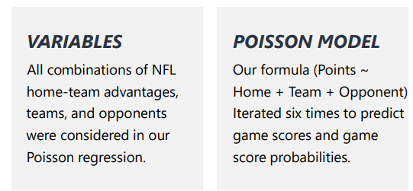
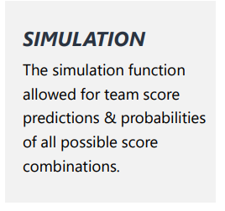
Model Selection
A Poisson regression is a form of generalized linear model used for analyzing multivariate problems, deriving data-driven insights, and building predictive models. Variable significance and model performance was stronger with Poisson vs Linear regression.
Model Coefficients Description
The Kansas City Chiefs have a Team estimate coefficient of -0.123204, while the Tampa Bay Buccaneers have a -0.066459. This indicates that both the teams are generally better scorers than the "average" NFL team but Tampa Bay Buccaneers are better. The Opponent values penalize and reward teams based on the quality of their opposition. This mimics the defensive strength of each team (Kansas City Chiefs 0.248341;Tampa Bay Buccaneers 0.233657). In this case, you are less likely to score against the Tampa Bay Buccaneers . The Tampa Bay Buccaneers are better scorers will score 29 points with 55% probability of winning. The Kansas City Chiefs will score 27 points with 38% probability of winning. The probability of tie is 5%
R code
Ref: https://dashee87.github.io/data%20science/football/r/predicting-football-results-with-statistical-modelling/

