Slide 1
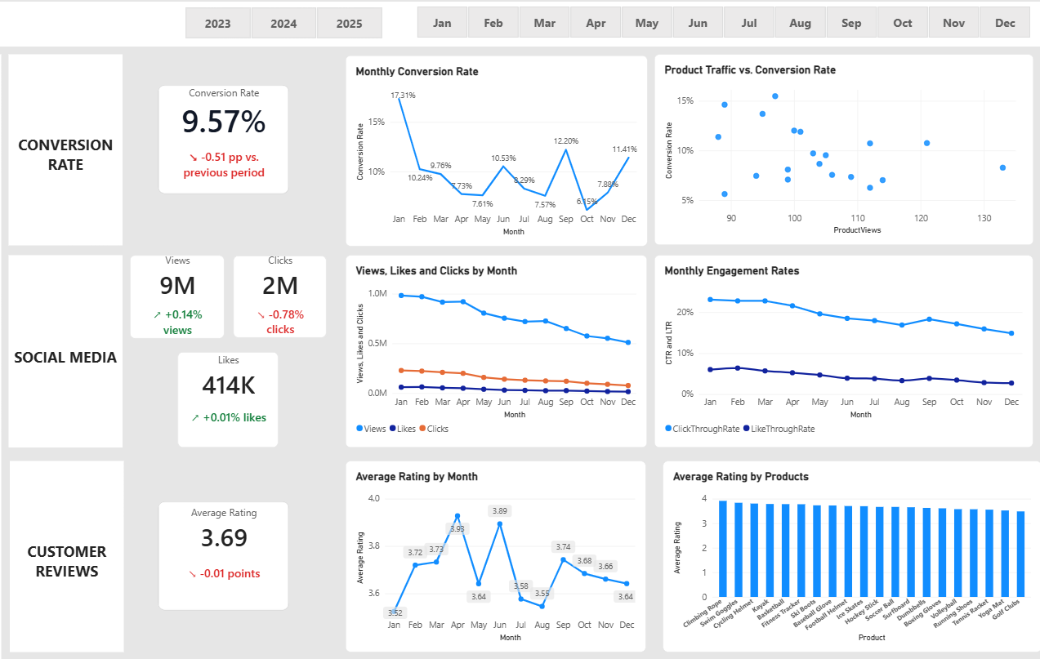
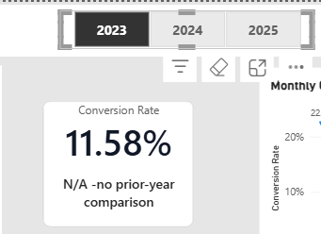
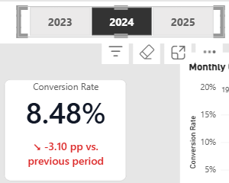
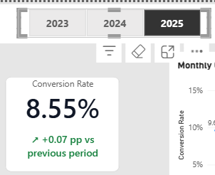
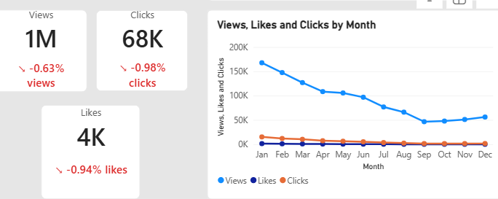
Overview
1. Decreased Conversion Rate: Conversion performance deteriorated significantly after 2023
Conversion fell from 11.58% in 2023 to 8.48% in 2024, a decline of 3.10 percentage points.
It recovered slightly to 8.55% in 2025, an improvement of just 0.07 percentage points.
The 2025 rate remains 3.03 percentage points below the 2023 rate.
Social media engagement metrics are slightly declining
Observation: ShopEasy recorded approximately 1M views, 68K clicks and 4K likes in 2025. The dashboard indicated year over year declines of 0.63%, 0.98%, and 0.94% respectively.
Business Implication: The declines suggest a slight weakening in reach and engagement, with clicks falling faster than views
Recommended Action: Analyze content-type performance and monthly engagement trends to identify which content drives meaningful interactions and website traffic. Reallocate marketing effort toward effective content and monitor engagement and click-through rate over time.
2025-

Slide 2
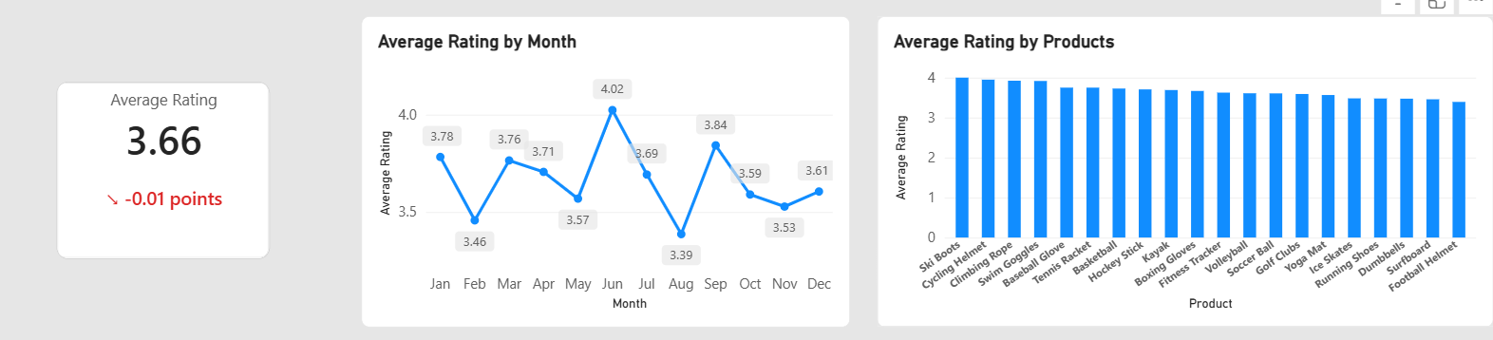
3. Customer reviews feedback
Observation: The average rating was 3.66/5 in 2025 and 3.69/5 across 2023-2025, a decrease of 0.01 points compared with 2024.
Business Implication:
1. Customer satisfaction was largely stable, and it remained consistent throughout the year,
2. Although stable, the average rating is below the target of 4.0, further analysis is required to determine which aspects of the customer experience needs improvement.
Recommended action:
Examine a negative reviews and sentiment patterns to identify the recurring issues. Prioritize improvements based on the frequency and impact of customer complaints, then track rating and negative sentiment over time.

Slide 3
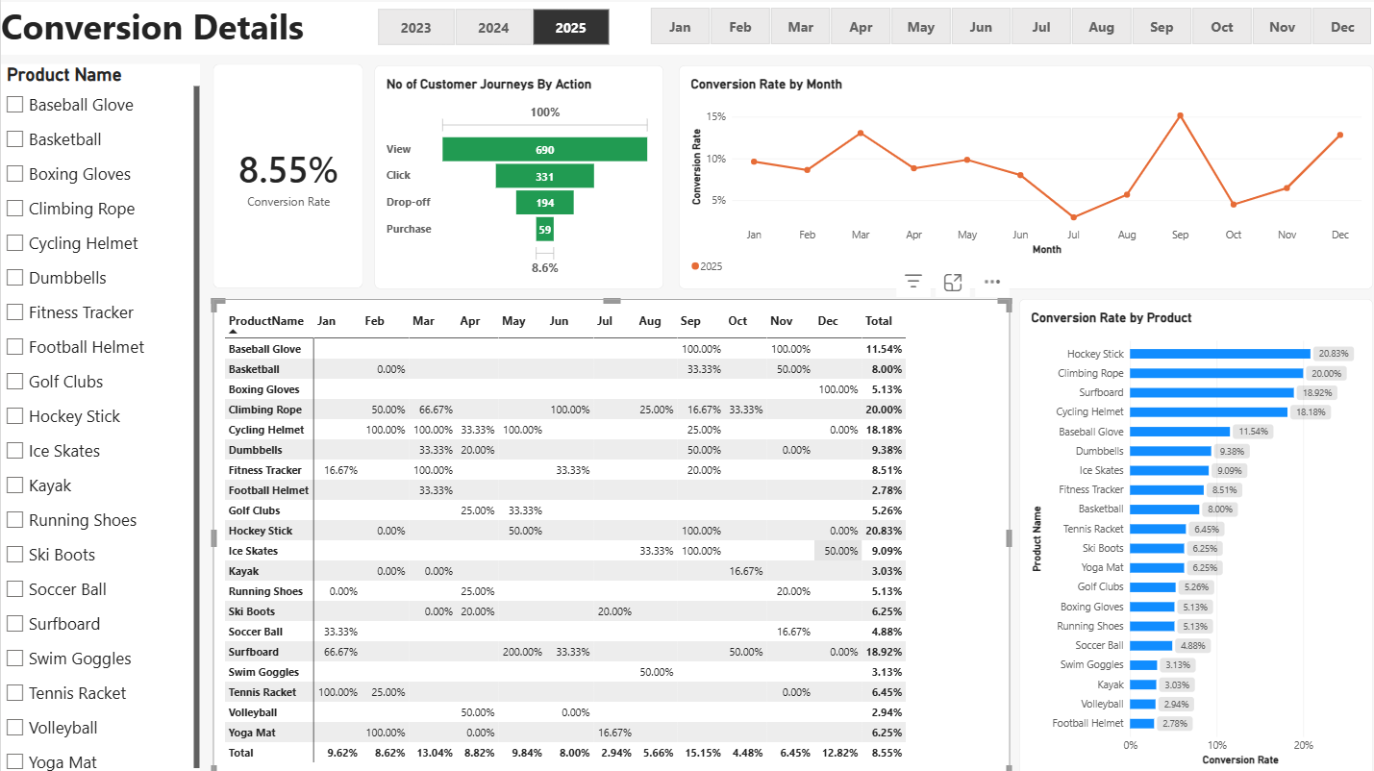
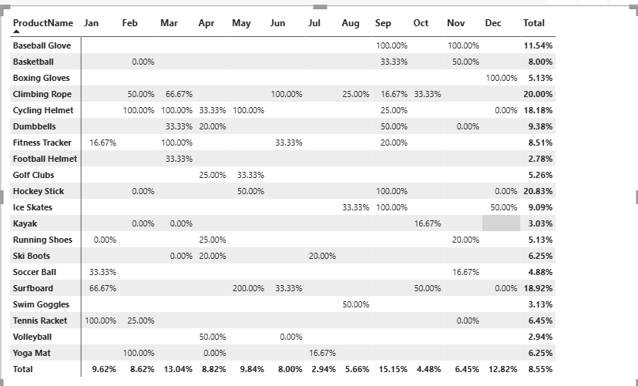
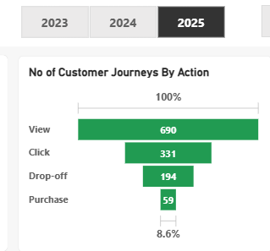
Conversion Details
1. Historical Conversion Trend:
Conversion declined from 2023 to 2025 and then a marginal recovery of 0.07 percentage points occurred in 2025.
But despite the recovery, conversion remains below the 2023 level
2. General Conversion Trend :
Throughout 2025, monthly conversion rates fluctuated considerably. September recorded the strongest performance at 15.15%, followed by March at 13.04% and December at 12.82%. This indicates variations in customer purchasing behavior and highlights opportunities to identify successful strategies from stronger-performing months.
3. Lowest Conversion Month:
July experienced the lowest overall conversion rate at 2.94%, indicating a significant drop in purchase conversion during this month. This presents an opportunity to investigate potential factors such as reduced campaign effectiveness, lower customer demand or friction in purchase journey.
4. Highest Conversion Month:
September recorded the highest conversion rate at 15.15%. The product-level analysis highlighted Baseball Glove, Hockey Stick, and Ice Skates, each achieving 100% conversion rate during September. This indicates strong product-level conversion efficiency and provides and opportunity to investigate the factors contributing to their performance.
5. Customer Journey Drop-off
In 2025, ShopEasy recorded 690 views, 331 clicks, 194 drop offs and 59 purchases. Although customers showed initial interest by clicking on products, only 59 purchases were completed.
There is considerably gap between customer engagement and completed purchases. This suggests potential friction during the purchasing journey, particularly after customers interact with products.
Possible factors:
Checkout abandonment.
Payment Failures
Unexpected delivery charges
Website or Server issues
Complicated checkout process

Slide 4
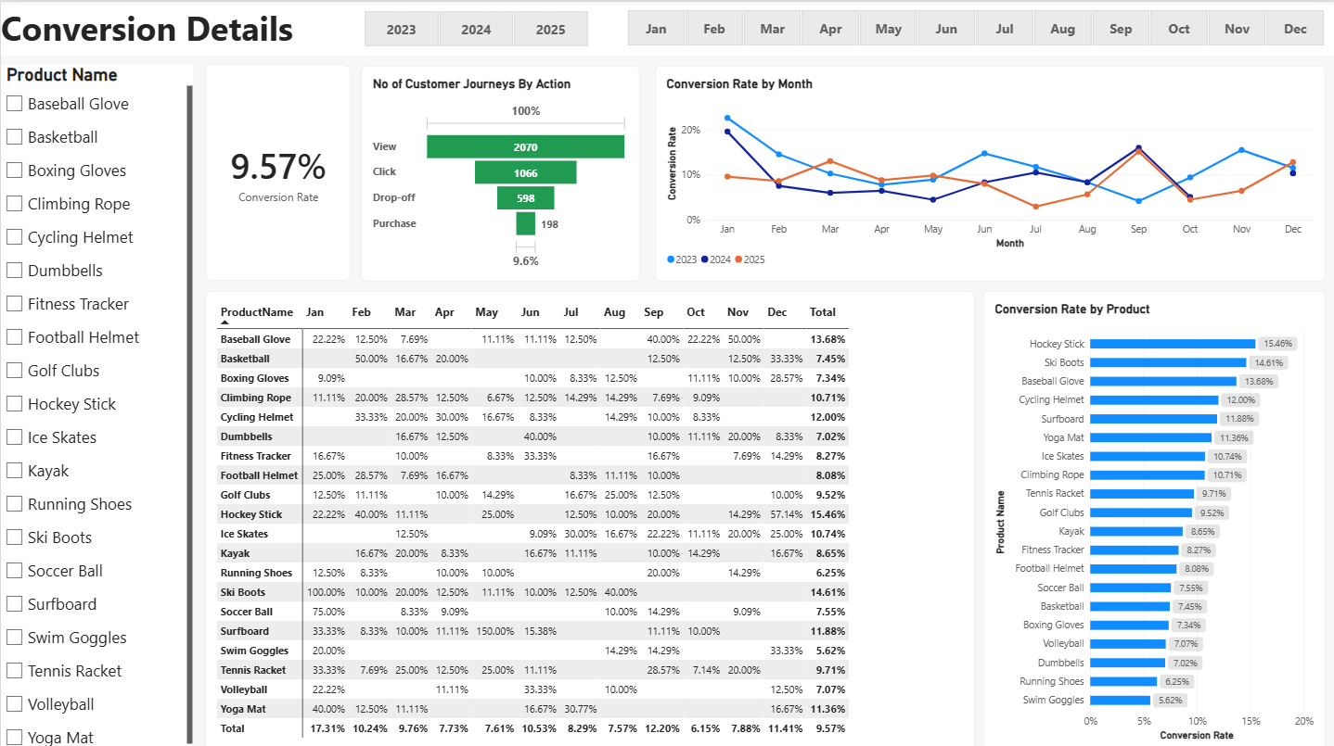
Key business recommendations:
For July: Investigate the reasons behind the conversion decline and consider targeted campaigns or promotions.
For September: Review campaign performance, product demand and pricing strategies to identigfy practices worth replicating.
For the three products: Check how many units of these products were actually sold to see whether their high conversion rates also resulted in more sales.
For Customer Drop-offs: ShopEasy should investigate the customer journey beyond the product-click stage by analysing checkout initiation, payment success and failure rates, and order completion.
Improving the checkout experience could help potentially lost purchases.

Slide 5
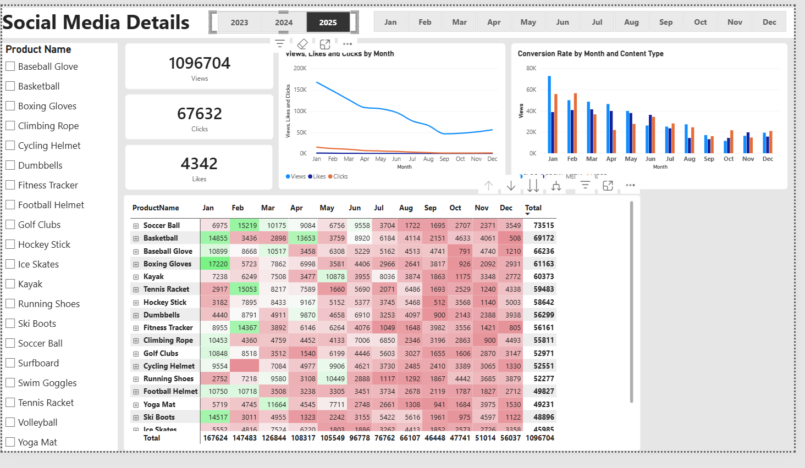
Engagement Rate
Declining Views: Views are highest in January(176K) and gradually declined, reaching their lowest level in September (46K). A slight recovery was observed from October t December, indicating reduced content visibility during most of the year.
Low Interaction Compared to Views:
Despite generating approximately 1.09 million views, the business received only 67.6K clicks and 4.3K likes, highlighting an opportunity to improve audience interaction through more engaging content and stronger calls to action.
Content Type Performance:
Blog content recorded the highest views in January, while video and Social Media content reached their peak views in February and March respectively. This indicates that different content types achieved their highest audience reach at different times of the year
Product Wise Content Performance -2025 :
i.) Top Performing Products: Soccer Ball (73.5K) views and Basketball(69.2K views) were the two highest-viewed products, indicating stronger audience interest in these products compared with the others.
ii.) Content Type Performance: For both soccer ball and basketball, blog content generated the highest total views compared with video and social media content. This suggests that blog content was an effective format for attracting audience attention for these products.
iii.) Monthly Content Performance: The month with the highest views varied by content type and product. For soccer ball , blog views peaked in March, video views peaked in February, and social media views peaked in April.
Product Views vs Product Performance – 2025
i. Difference between views and purchases: Soccer Ball (73.5K views) and BasketBall (69.2K views) were the two highest-viewed products. However, neither appeared among the top seven products in the purchase chart, suggesting a potential gap between product visibility and purchase activity.
ii. Products with Highest Purchases: Climbing Rope and Surfboard recorded the highest purchase counts, with 7 purchases each, followed by Cycling Helmet with 6 purchases.

Slide 6
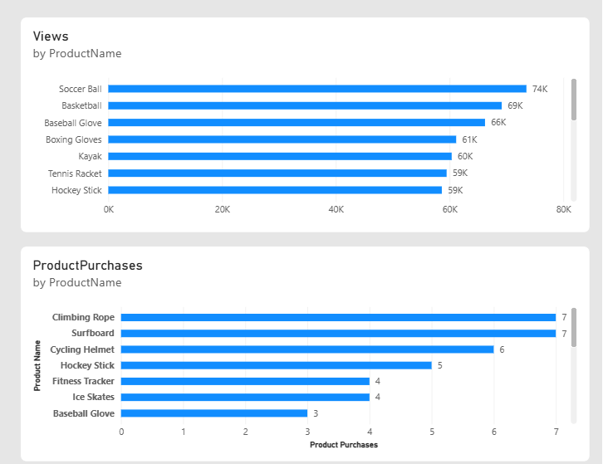
Business Key Recommendations:
Improve Content Visibility:
1. Investigate the reasons behind the decline in views from January to September by reviewing campaign performance, posting frequency and content reach.
2. Introduce fresh content strategies and targeted campaigns to improve visibility during months with lower views.
3. Analyze the slight recovery observed from October to December and identify successful strategies that can be repeated.
Increase Audience Interaction:
1. Create more engaging and relevant content to encourage viewers to interact with posts.
2. Include stronger calls to action (CTAs) such as encouraging users to visit product pages, explore offers or learn more about products.
3. Monitor clicks and likes regularly to evaluate whether the changes are improving audience interaction.
Optimize Content Type and Campaign Timing:
1. Analyze the topics and campaign strategies behind the peak performance of Blog in January, Video in February and Social Media in March.
2. Use these insights to plan content calenders and schedule campaigns around periods when particular content formats perform well.
3. Continue testing different content formats to identify opportunities to improve their performance throughout the year.
Strengthen Product-wise Content Strategies:
1. Prioritize content creation for popular products such as Soccer Ball and Basketball, which attracted the highest views.
2. Continue leveraging Blog content for these products, as it generated the highest views compared with Video and Social Media.
3. Experiment with different content formats for other products to identify which formats attract more audience attention.
Improve the Conversion of Product Interest into Purchase:
1. Investigate why highly viewed products such as Soccer Ball and BasketBall are not among the leading products by purchase volume.
2. Review product pricing, availability, product descriptions, customer feedback and the checkout experience to identify potential barriers to purchase.
3. Study the performance of Climbing Role and Surfboard, which recorded the highest purchase counts, and identify strategies that could be applied to other products.
4. Track product-level purchase rates alongside views to measure how effectively audience interest translates into purchases.

Slide 7
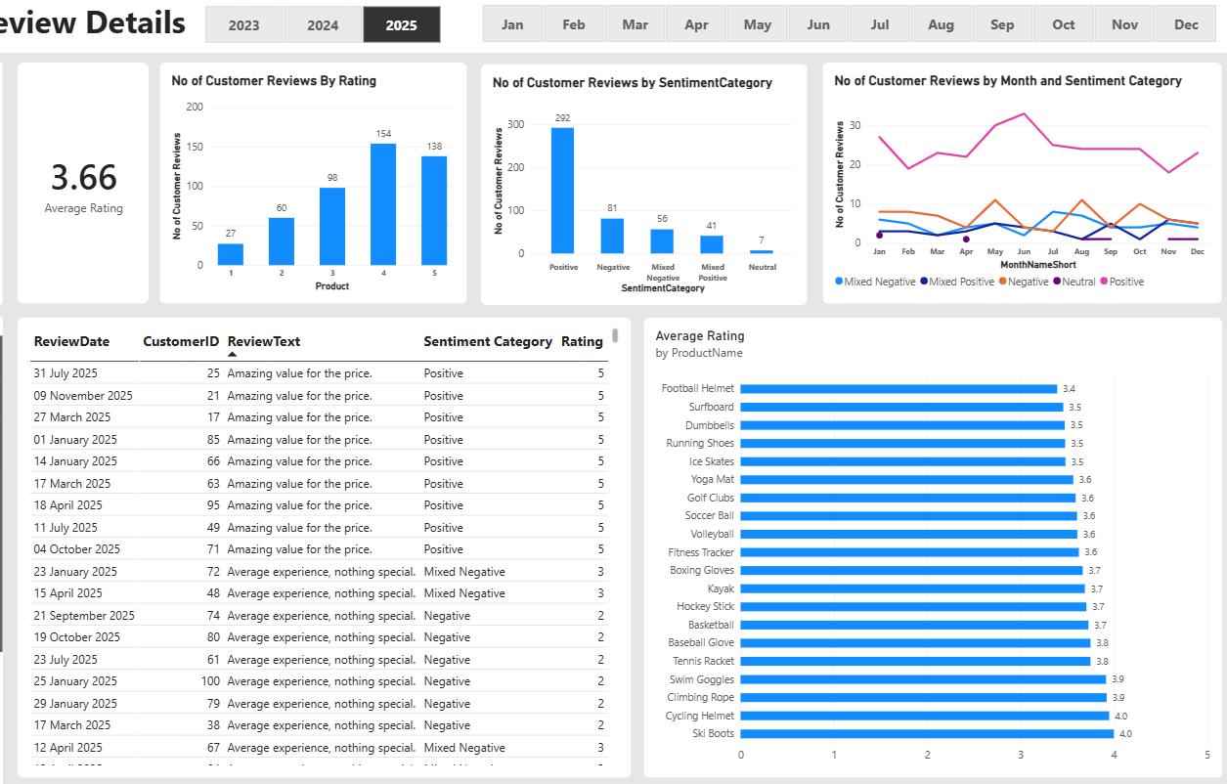
Customer Review Details 2025
Customer Rating Distribution:
The majority of customer reviews received higher ratings, with 154 reviews at 4 stars and 138 reviews at 5 stars, indicating generally positive customer experiences. However, 87 reviews received lower ratings (1–2 stars), highlighting opportunities to improve customer satisfaction.
Sentiment Analysis:
Positive sentiment dominated customer feedback, with 292 reviews, reflecting generally positive customer experiences. However, 81 negative and 56 mixed-negative reviews indicate areas where the business needs to investigate and improve the customer experience.
Opportunity to Improvement:
The presence of 41 mixed-positive and 56 mixed-negative reviews suggests opportunities to improve customer experiences. Analysing the specific concerns and positive aspects mentioned in these reviews could help the business address dissatisfaction and improve overall customer ratings.
Product –Wise Customer Satisfaction:
i.) Lowest-Rated Products: Football Helmet received the lowest average rating of 3.4 out of 5, followed by Surfboard, Dumbbells, Running Shoes and Ice Skates at approximately 3.5. This highlights potential areas where customer experience could be improved.
ii.) Highest-Rated Products: Ski Boots and Cycling Helmet received the highest average ratings of 4.0 out of 5, indicating relatively better customer satisfaction compared with other products.
iii.) Overall Product Satisfaction: Most products received average ratings between 3.5 and 3.8, suggesting that although customer feedback is generally positive, there is still room for improvement across several products.

Slide 8
Key Recommendations:
1. Customer Rating Distribution:
a. Address Low Ratings: Investigate the reasons behind 1-star and 2-star reviews to identify issues affecting customer satisfaction.
b. Maintain High Customer Satisfaction: Identify what customers appreciate about products receiving 4-star and 5-star ratings and maintain those product and service standards.
c. Improve Customer Experience: Prioritise improvements based on recurring issues identified in lower-rated reviews.
2. Sentiment Analysis:
a. Address Negative Feedback: Analyse negative and mixed-negative reviews to identify common customer complaints and take corrective action.
b. Strengthen Positive Experiences: Identify the factors contributing to positive reviews and continue delivering experiences that customers value.
c. Monitor Sentiment Trends: Regularly track positive, negative and mixed sentiment to evaluate whether customer satisfaction is improving.
3. Monthly Sentiment Trends:
a. Investigate Months with Higher Negative Feedback: Review customer comments from May, August and October to identify recurring concerns during these periods.
b. Identify Reasons for Positive Feedback: Analyse customer reviews from June, when positive sentiment peaked, to understand what contributed to better customer experiences.
c. Take Timely Corrective Actions: Monitor monthly sentiment trends and address emerging customer concerns before they become recurring issues.
4. Customer Feedback Analysis:
a. Identify Recurring Complaints: Group negative and mixed reviews into themes such as product quality, pricing, delivery and customer service.
b. Improve Products and Services: Share recurring customer concerns with the relevant teams and prioritise improvements based on their frequency and impact.
c. Use Customer Feedback for Improvement: Regularly review customer comments to understand changing expectations and identify opportunities to improve the overall experience.
5. Product-wise Customer Satisfaction
i.) Lowest-Rated Products:
a. Prioritise Football Helmet and other lower-rated products for further investigation.
b. Examine their negative and mixed reviews to identify specific product-related or service-related issues.
c.Work with the relevant teams to address the identified problems.
ii.) Highest-Rated Products:
a. Analyse positive feedback for Ski Boots and Cycling Helmet to understand which product features or customer experiences customers appreciate.
b. Apply successful practices, wherever relevant, to other products.
iii.) Overall Product Satisfaction:
a. Monitor average ratings across all products regularly.
b. Prioritise products with lower ratings for improvement.
c. Track rating changes over time to measure the impact of corrective actions.

Slide 9
Goals and Actions
Goals
Actions
Increase Conversion Rates:
Goal: Identify factors impacting the conversion rate and provide recommendations to improve it.
Insight: Highlight key stages where visitors drop off and suggest improvements to optimize the conversion funnel.
Enhance Customer Engagement:
Goal: Determine which types of content drive the highest engagement.
Insight: Analyze interaction levels with different types of marketing content to inform better content strategies.
Improve Customer Feedback Scores:
Goal: Understand common themes in customer reviews and provide actionable insights.
Insight: Identify recurring positive and negative feedback to guide product and service improvements.
Increased Conversion Rates:
Target High-Performing Products: Focus marketing efforts on products with strong conversion rates, such as Kayaks, Ski Boots and Baseball Gloves. Implement targeted promotions and personalised campaigns during peak-performing months to increase purchases. Also, consider actual purchase volumes and revenue when prioritising products to ensure marketing efforts generate meaningful sales.
Enhance Customer Engagement:
Revitalize Content Strategy: Experiment with engaging content formats such as interactive videos, product demonstrations and user-generated content to improve audience interaction. Strengthen calls to action (CTAs) across social media and blog content to encourage more clicks and product exploration. Focus additional efforts on historically lower-performing months to improve content visibility and engagement.
Improve Customer Feedback Scores:
Address Mixed and Negative Feedback: Establish a feedback process to regularly analyse mixed and negative reviews, identify recurring issues, and develop improvement plans. Follow up with dissatisfied customers to resolve their concerns and improve their experience. Monitor customer ratings over time, aiming to move the average rating closer to the 4.0 target.

