Slide 1

Project Name: Know Your Worth Team Name: Analytics Enthusiasts Topic: Data Scientists Income Statistics Presented By : Amna Hassan, Garima Chaudhary, Nameeta Tiwari, Nidhi Nigam, Sahil Wadhwa

Slide 2




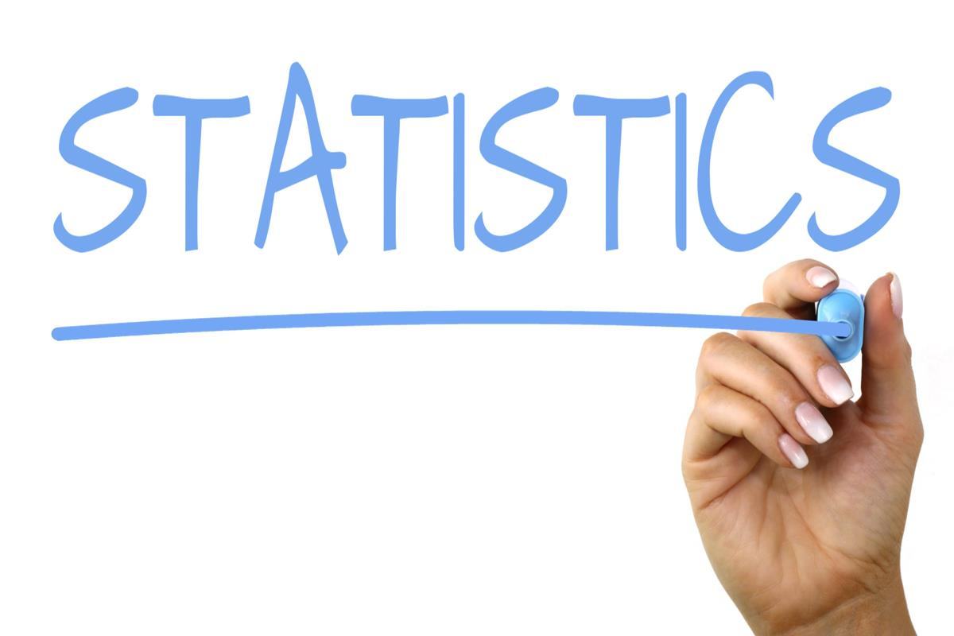

Tools Used:
Pandas
Matplotlib
Statistics
Python
NumPy

Slide 3

Why we choose this data?
Strategic Decision: Prioritizing salary data is strategic for data science students.
Relevance to Career:
Salary data guides career choices
Negotiation Skills:
Prepares students for future job negotiations.
Industry Insights:
Salary data provides industry insights.
Skill Development: Supports skill development.
Market Research:
Guides market research
Foundational Resource: Essential for aspiring data scientists.

Slide 4
Data Table: 11 Columns
Work_year
Experience Level
Employment Type
Job Title
Salary In USD
Salary Currency
Employee Residence
Remote Ratio
Company Location:
Company Size
Salary

Slide 5
Questions:
What is the salary distribution among different data science job titles?
How does company size influence data science salaries?
Does an employee's country of residence impact their salary?
What's the remote work ratio in data science job titles?
How does employment type affect salary?
Do companies in different locations pay significantly different salaries?

Slide 6
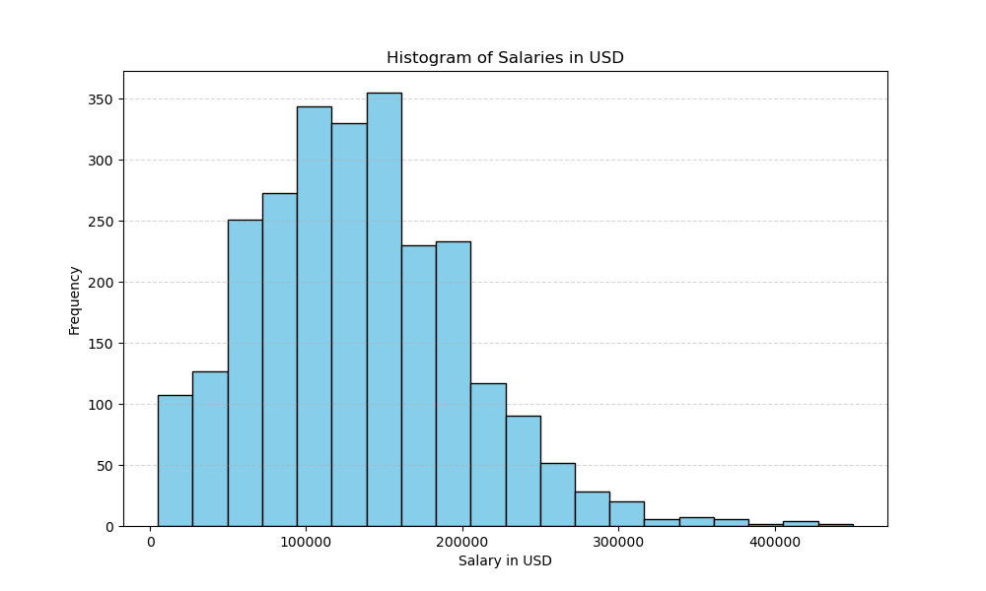
Salaries in USD
Total count = 2584.00
Mean = 133409.28
Std = 67136.84
Min Salary= 5132.00
25% = 84975.00
50% = 130000.00
75% = 175000.00
Max = 450000.00
Salaries vary greatly, with an average around $133,409.28, and a median at $130,000 but the range is broad, spanning from $5,132.00 to $450,000.00.

Slide 7
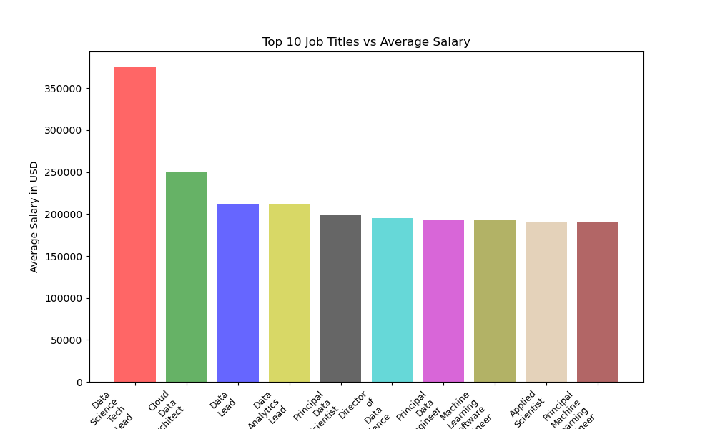
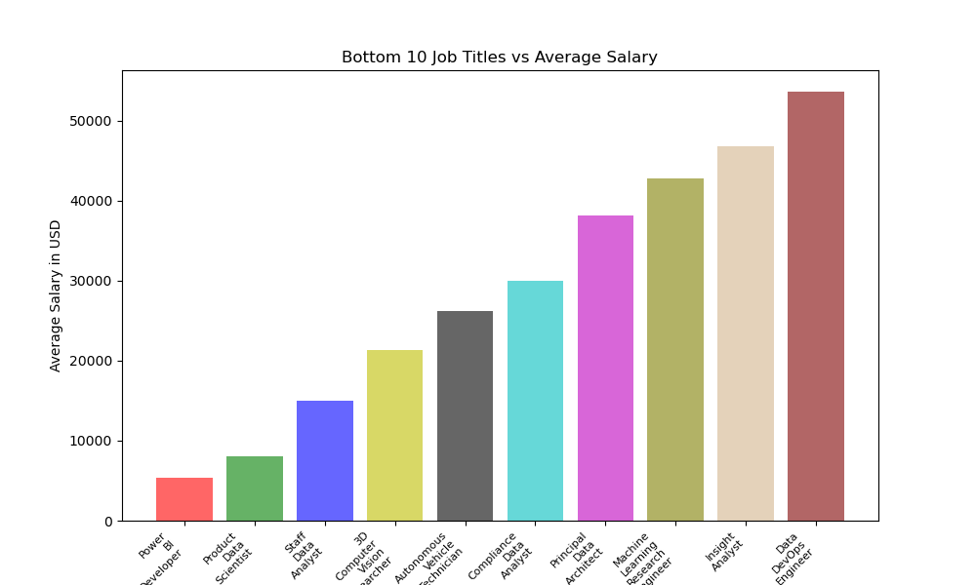
Job Titles Vs Salary Comparison
Bottom Ten Job Titles Vs Average Salary
Bottom Ten Job Titles Vs Average Salary
Top Ten Job Titles Vs Average Salary
Notes:
This analysis underscores substantial salary disparities between the top and bottom ten job titles. The highest salary in the top ten Job titles reaches $375,000, whereas the upper limit in the bottom ten job titles is $53,654.

Slide 8
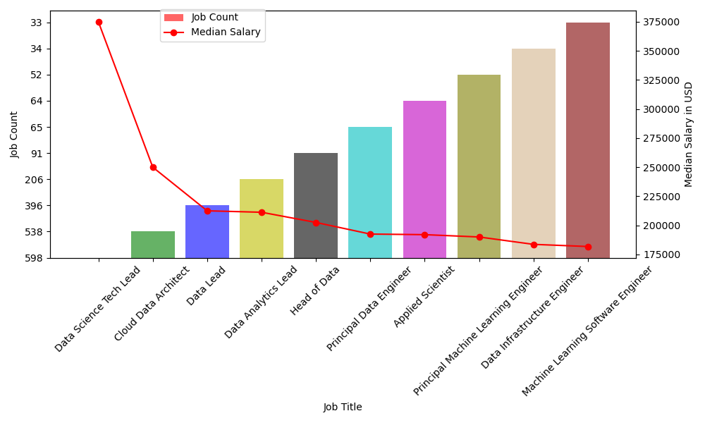
Job Title Vs Job Count Vs Median Salary

Slide 9
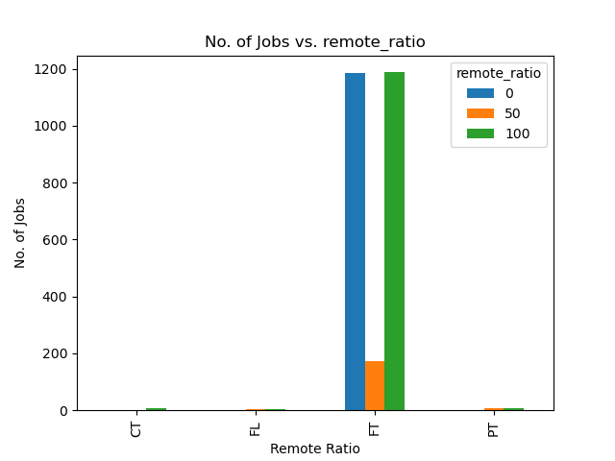
Remote Ratio Vs No. Of Jobs
Over 90% of the jobs are categorized as full-time (FT).
Out of the 2,547 full-time jobs:
47% are fully remote (100% remote).
47% are not remote at all (0% remote).
Only 6% are in a hybrid work mode.

Slide 10

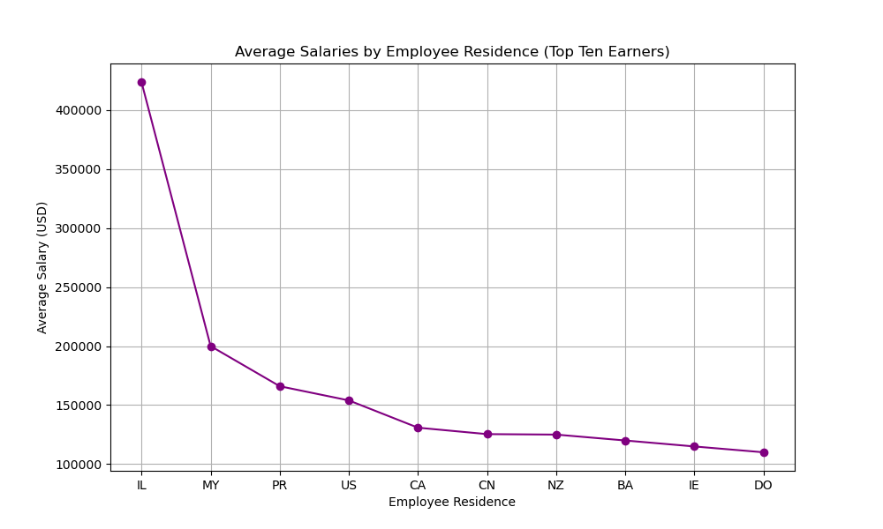
Average Salaries for Top Ten Employee Residences
Employees from Israel (IL) earn the highest average salaries. Followed by:
IL (Israel)
MY (Malaysia)
PR (Puerto Rico)
US (United States)
CA (Canada)

Slide 11
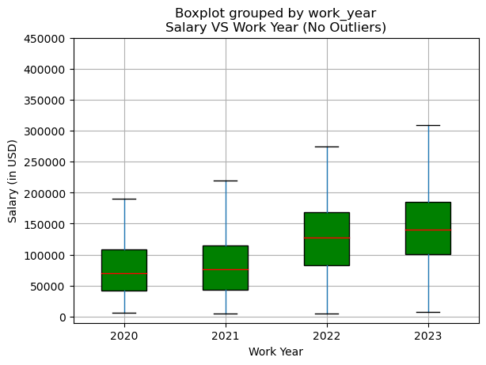
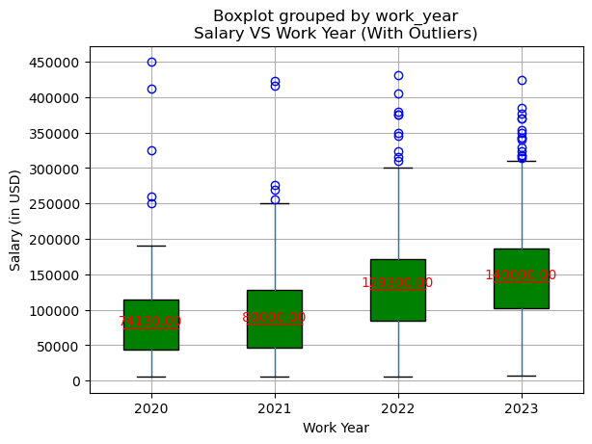
Average Salary Per Work Year
Boxplot with Outliers
Boxplot without Outliers
Outliers exist in the data. Median salaries remained stable in 2020 and 2021 but depicts substantial growth in 2022 and 2023.

Slide 12
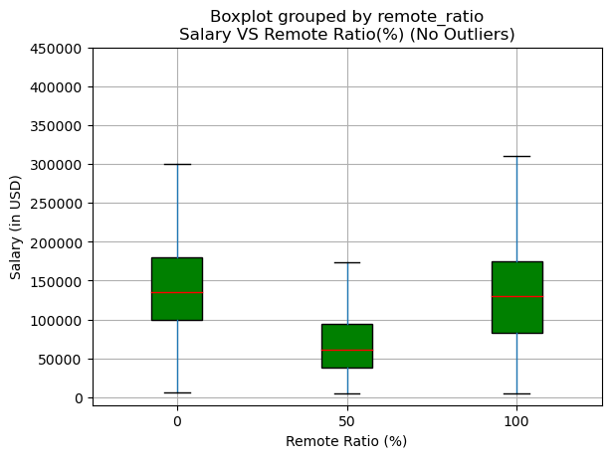
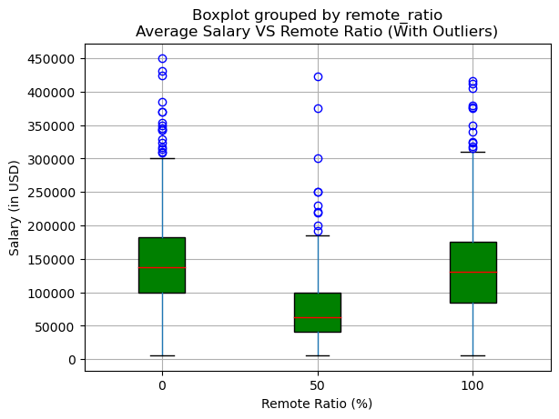
To what extent does the work model impact the average salaries of Data Science jobs?
Data contains outliers
After Outliers removal, median salaries drop.
Median salaries are lower for hybrid work compared to remote or on-site.

Slide 13
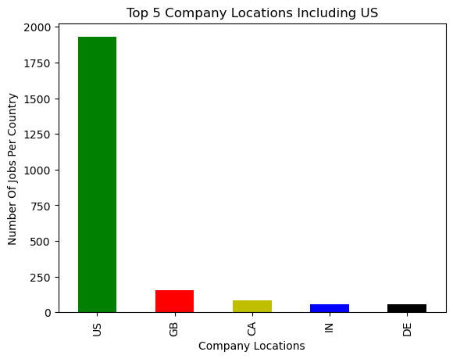
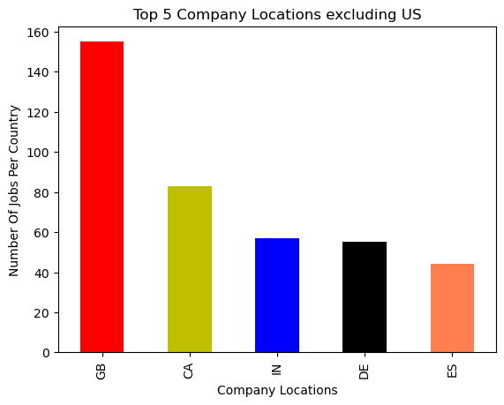
Which countries are the top five options after the US for a Data Science job hunt?
More than 94% of the job market are hosted in US.
Followed by : Great Brittan , Canada, India, Germany, Spain

Slide 14
Salaries in USD
Total count = 2584.00
Mean = 133409.28
Std = 67136.84
Min Salary= 5132.00
25% = 84975.00
50% = 130000.00
75% = 175000.00
Max = 450000.00
Salaries vary greatly, with an average around $133,409.28, and a median at $130,000 but the range is broad, spanning from $5,132.00 to $450,000.00.

Slide 15
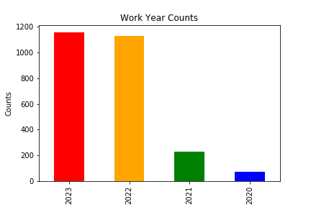
Work Year Percentage
2023 is the most common work year. Followed by:
2022.
2021
2020 is the work year with the fewest individuals.

Slide 16
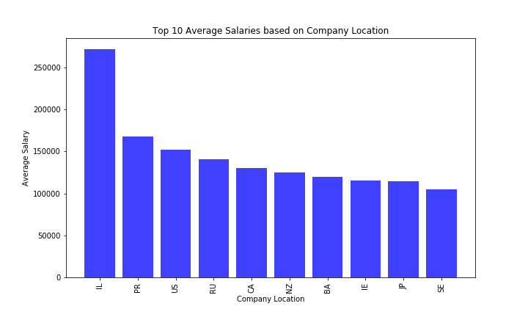
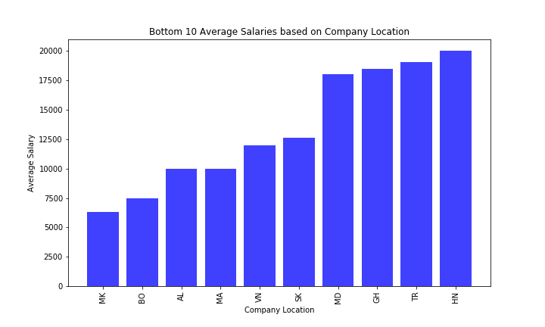
Company Location Vs Salary Comparison
Top Ten Company Locations Vs Average Salary
Bottom Ten Company Locations Vs Average Salary
Notes:
This analysis underscores substantial salary disparities between the top and bottom ten job titles. The highest salary in the top ten Job titles reaches $375,000, whereas the upper limit in the bottom ten job titles is $53,654.

Slide 17
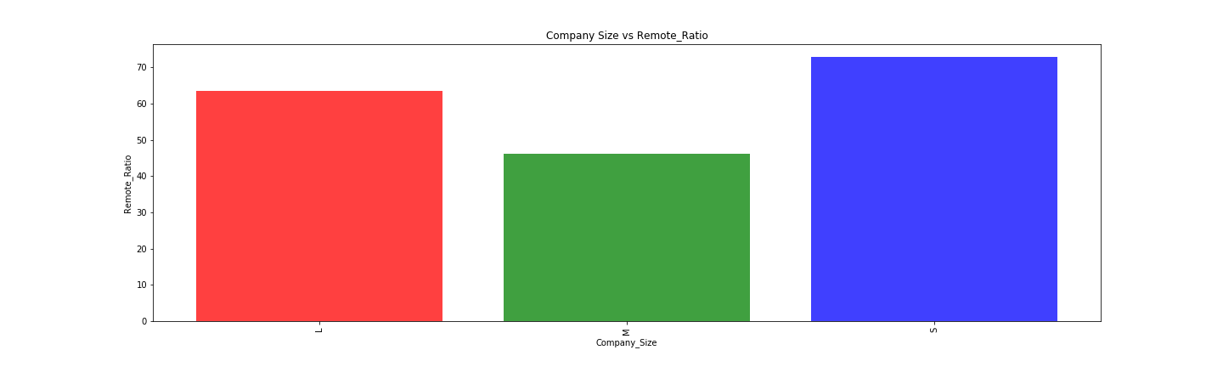
Company Size Vs Remote Ratio

Slide 18
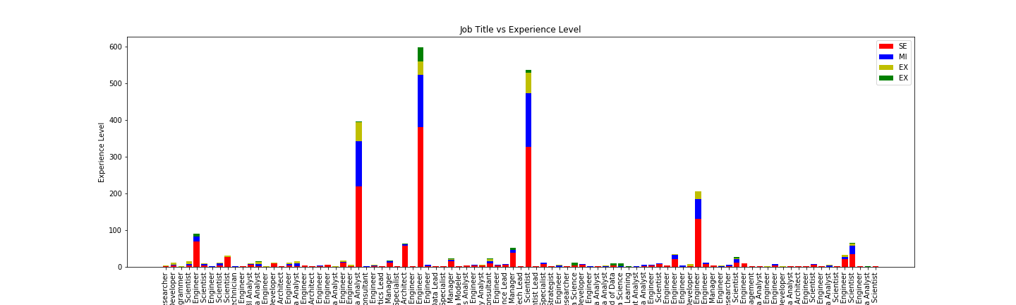
Job Title vs Experience Level

Slide 19
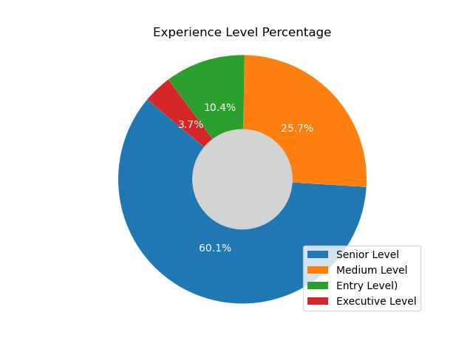
Experience Level Percentage
Senior Level" is the most prevalent experience level. Followed by:
Medium Level.
Entry Level
Executive Level has the fewest individuals.

Slide 20
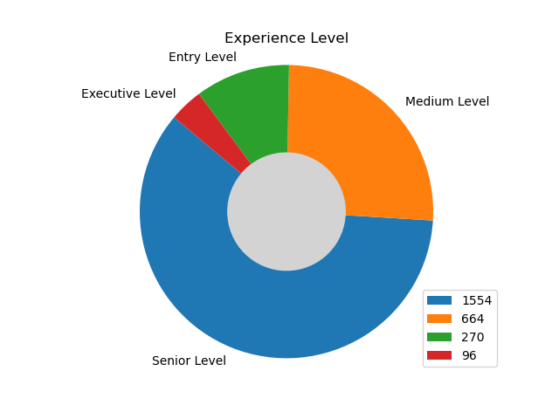
How does experience level affects job perspective

Slide 21
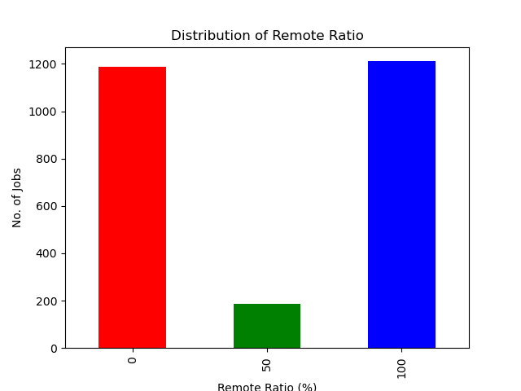
Distribution of # of Jobs by Remote work ratio
45.89% of employee population work on site( 0% remote ratio)
Almost equal proportion 46.86% employees work fully remotely (100% remote ratio)
Only a small fraction (7.23%) of employees work in a hybrid setup
Remote Ratio (%)

Slide 22
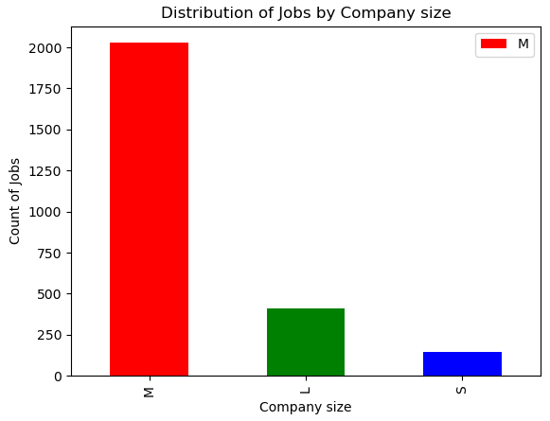
Distribution of # of Jobs by Company Size
M: Medium
L: Large
S: Small
Significant number (78.48%) of employees work for medium(M)-sized companies
15.82% employees work for large(L) size companies
5.68% employees work for small(S) size companies

Slide 23
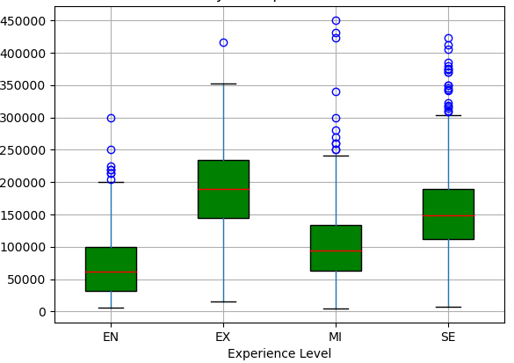
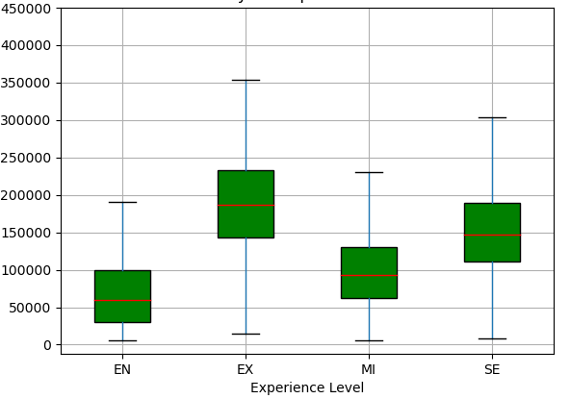
Salary in US Dollars for different experience levels
Boxplot with Outliers
Boxplot without Outliers
Salary (in USD)
Salary (in USD)
Executive-level (EX) experience has the highest median salary, followed by Entry-level(EN), Mid-level (MI), and Senior-level (SE)
Spread of salaries (as shown by the height of the boxes) also seems to increase with experience, indicating more variability in salaries for more experienced roles.

Slide 24
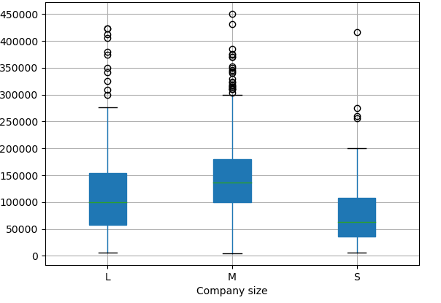
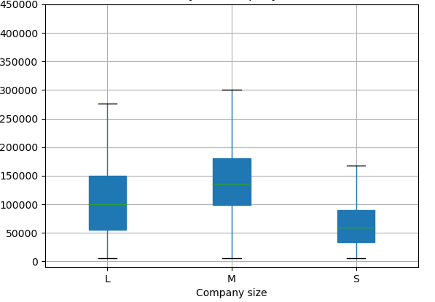
To what extent does the Company size impact the average salaries of Data Science jobs?
Boxplot with Outliers
Boxplot without Outliers
Salary (in USD)
Salary (in USD)
Medium(M) size company median salaries are highest followed by large(L) companies and then small(S) companies
The spread of salaries (as shown by the height of the boxes) is more for large size companies

Slide 25
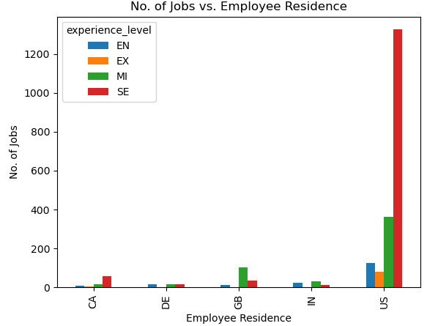
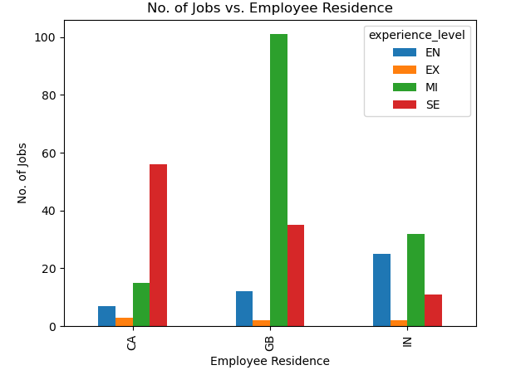
73.25% employees in data science jobs reside in US with various experience levels (Executive-level (EX), Entry-level(EN), Mid-level (MI), Senior-level (SE)
For the employees who reside in US, majority of them fall under the category of senior-level (SE) experience followed by middle-level (MI) experience
After US, the next top 3 employee residence countries (CA, GB, IN) contributes to 11.64% employment of the total jobs

Slide 26
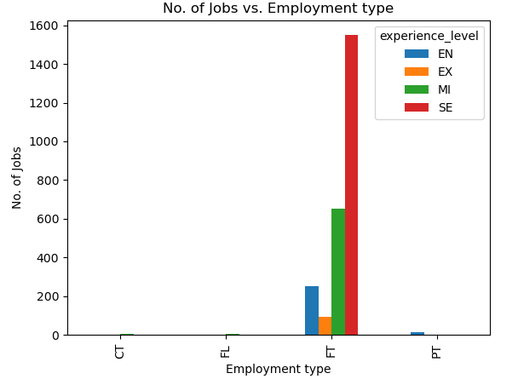
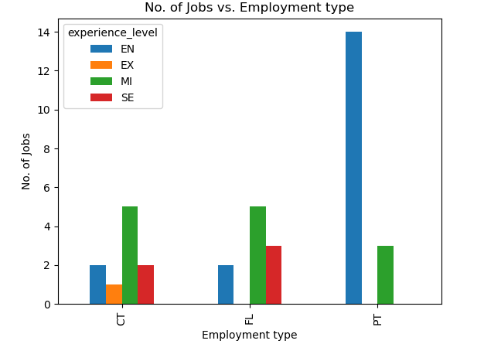
Distribution of different experience levels (Executive-level (EX), Entry-level(EN), Mid-level (MI), Senior-level (SE)) jobs among FT (Full Time) employees
Except FT(Full Time) employee category, only 1.43% number of jobs are in other employment type categories
Shows distribution for various experience levels in remaining employment type category

