Slide 1

Project Name: Know Your Worth
Team Name: Analytics Enthusiasts
Topic: Data Scientists Income Statistics Presented By : Amna Hassan, Garima Chaudhary, Nameeta Tiwari, Nidhi Nigam, Sahil Wadhwa

Slide 2

Why we choose this data?
Strategic Decision: Prioritizing salary data is strategic for data science students.
Relevance to Career:
Salary data guides career choices
Negotiation Skills:
Prepares students for future job negotiations.
Industry Insights:
Salary data provides industry insights.
Skill Development: Supports skill development.
Market Research:
Guides market research
Foundational Resource: Essential for aspiring data scientists.

Slide 3
Dataset Profiling
Work_year
Experience Level
Employment Type
Job Title
Salary In USD
Salary Currency
Employee Residence
Remote Ratio
Company Location:
Company Size
Salary

Slide 4
Questions:
What is the salary distribution among different data science job titles?
How does company size influence data science salaries?
Does an employee's country of residence impact their salary?
What's the remote work ratio in data science job titles?
How does employment type affect salary?
Do companies in different locations pay significantly different salaries?

Slide 5
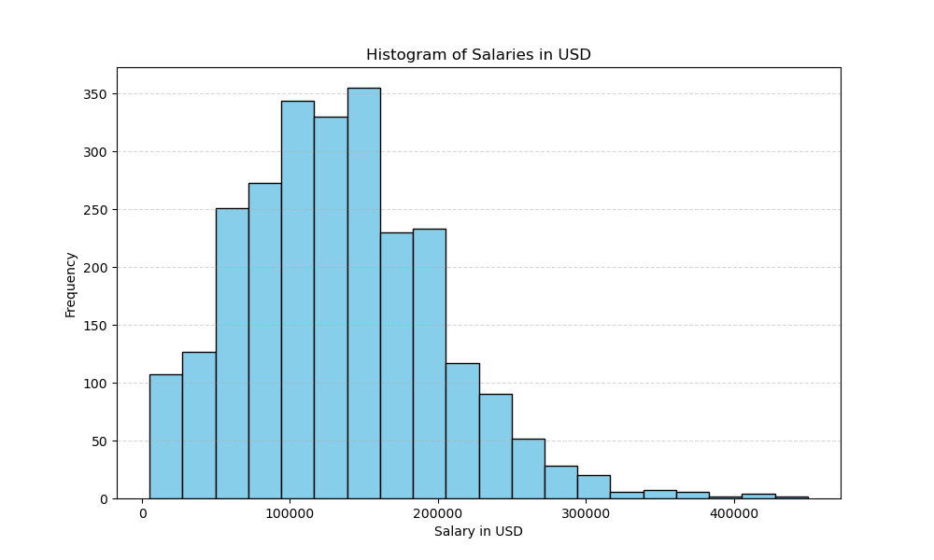
Salaries in USD
Total count = 2584.00
Mean = $133409.28
Std = 67136.84
Min Salary= $5132.00
25% = $84975.00
50% = 130000.00
75% = $175000.00
Max = $ 450000.00
Salaries vary greatly, with an average around $133,409.28, and a median at $130,000 but the range is broad, spanning from $5,132.00 to $450,000.00.

Slide 6
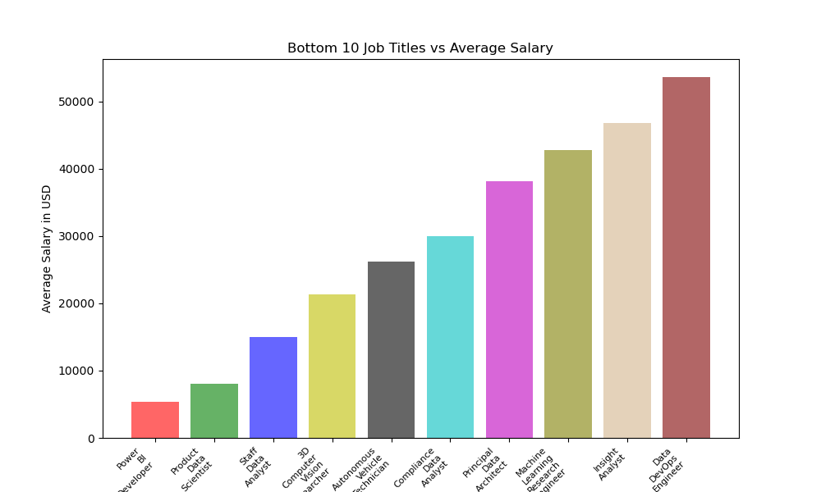
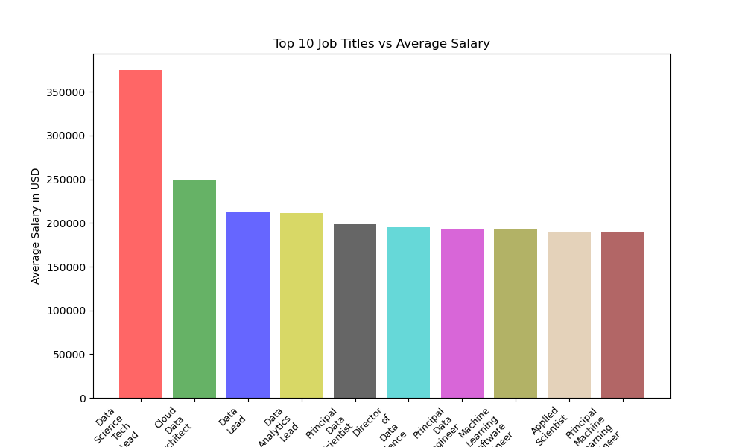
Job Titles Vs Salary Comparison
This analysis highlights significant salary differences between the top and bottom ten job titles
Top ten job titles max at $375,000, while bottom ten job titles peak at $53,654
Notes:
This analysis underscores substantial salary disparities between the top and bottom ten job titles. The highest salary in the top ten Job titles reaches $375,000, whereas the upper limit in the bottom ten job titles is $53,654.

Slide 7
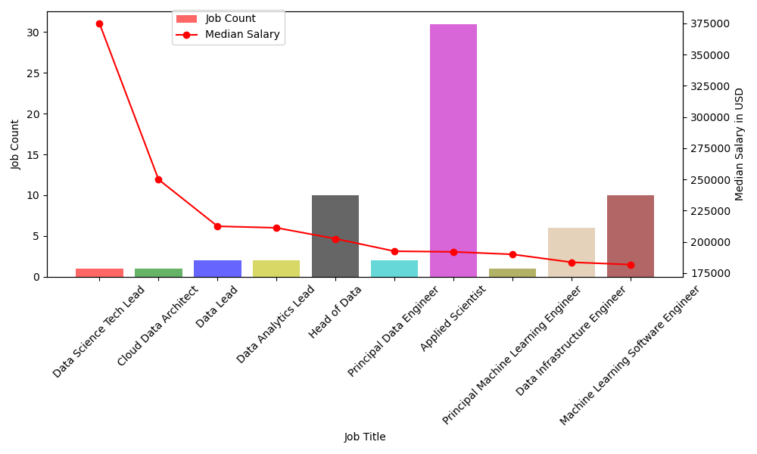
Job Title Vs Job Count Vs Median Salary
Interesting Findings:
Although Data Science Tech Lead" has the highest median salary
Whereas Applied Scientist" offers more job opportunities despite a lower median salary

Slide 8
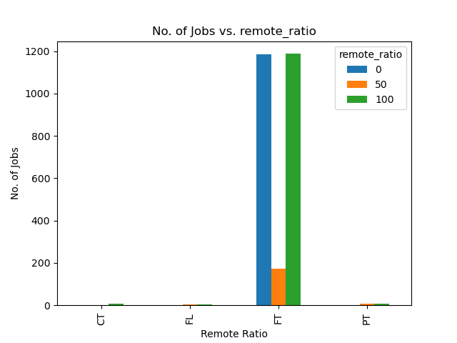
Remote Ratio Vs No. Of Jobs
Over 90% of the jobs are categorized as full-time (FT).
Out of the 2,547 full-time jobs:
47% are fully remote (100% remote).
47% are not remote at all (0% remote).
Only 6% are in a hybrid work mode.

Slide 9
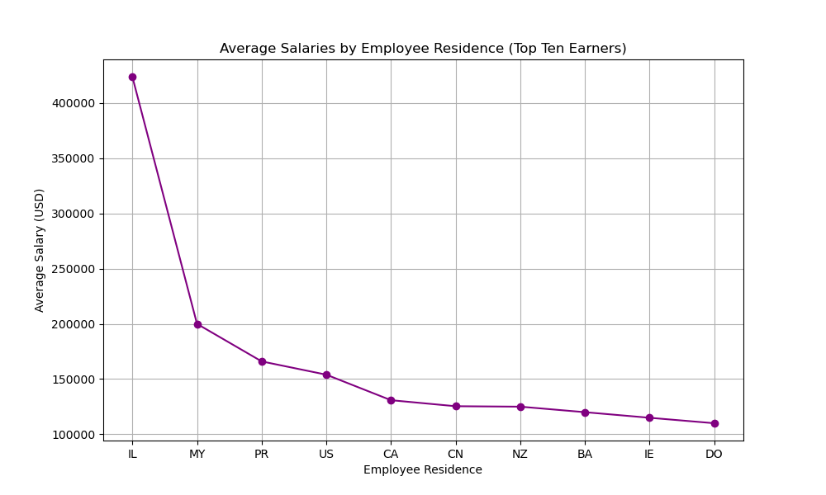

Average Salaries for Top Ten Employee Residences
Employees from Israel (IL) earn the highest average salaries. Followed by:
IL (Israel)
MY (Malaysia)
PR (Puerto Rico)
US (United States)
CA (Canada)

Slide 10
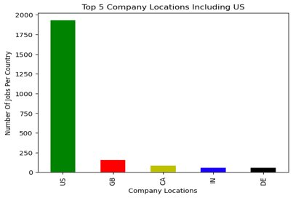
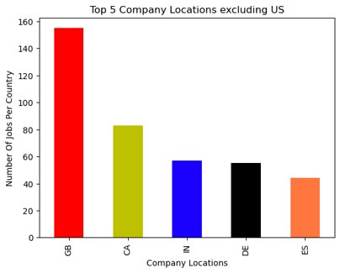
Top 5 countries for Data Science Jobs
More than 98% of the Data Science Jobs are offered by companies located in US
The next five choices would be Great Britain, Canada, India, Germany and Spain

Slide 11
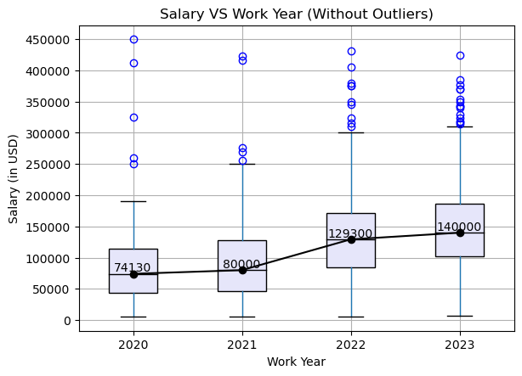
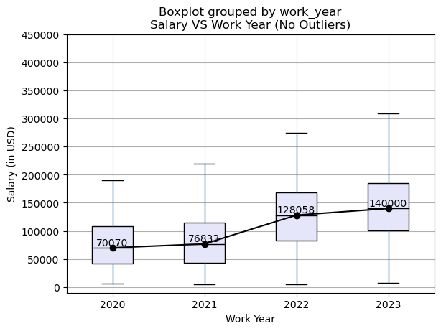
Median Salary Changes Over The Years
Boxplot with Outliers
Boxplot without Outliers
Median salaries remained stable in 2020 and 2021 but depicts substantial growth in 2022 and 2023 despite many outliers being present in the Data Set.

Slide 12
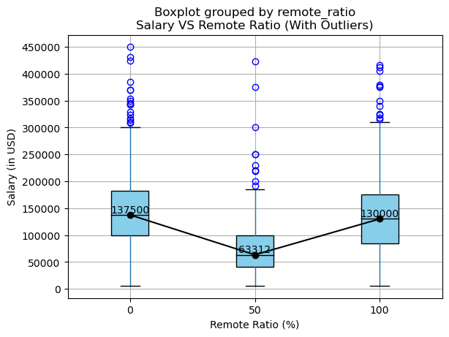
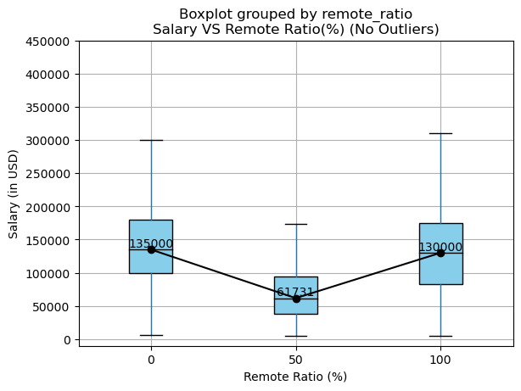
Impact Of Work Model Type On Median Salary Values
Boxplot with Outliers
Boxplot without Outliers
Data contains outliers
After Outliers removal, median salaries drop in on site and hybrid work model.
Still Median salaries are much lower for hybrid work model compared to remote or on-site.

Slide 13
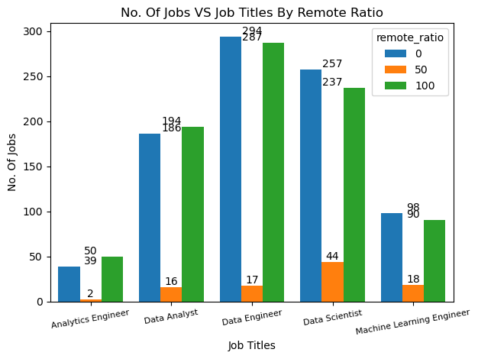
How does remote ratio affect the number of jobs for a particular job title?
Analysis :-
Overall for all job titles most jobs were either fully remote or on-site work model.
Hybrid models were not preferable by the stakeholders.

Slide 14
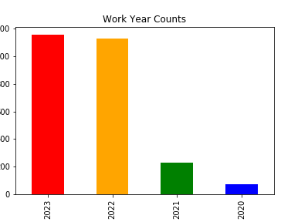
Work Year Percentage
2023 is the most common work year. Followed by:
2022
2021
2020 is the work year with the fewest individuals.

Slide 15
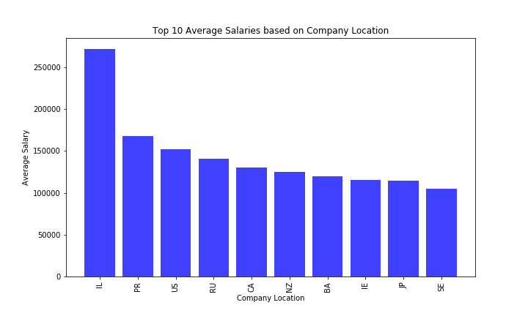
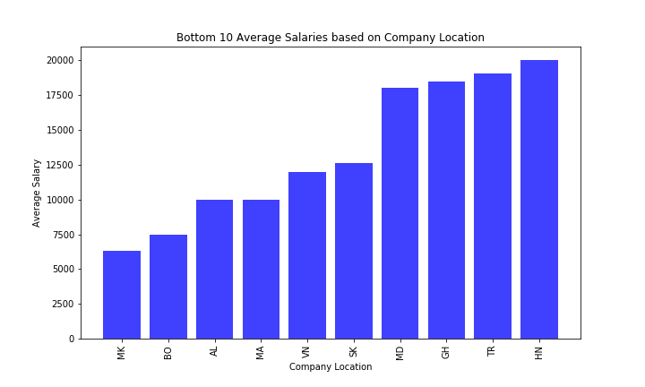
Which of the company locations have the top and bottom ten average salaries?"
Top Ten Company Locations Vs Average Salary
Bottom Ten Company Locations Vs Average Salary
The top 3 average salaries belong to company locations in IL, PR and US
The bottom 3 average salaries belong to company locations in MK, BO and AL
Large Salary Variation
Notes:
This analysis underscores substantial salary disparities between the top and bottom ten job titles. The highest salary in the top ten Job titles reaches $375,000, whereas the upper limit in the bottom ten job titles is $53,654.

Slide 16
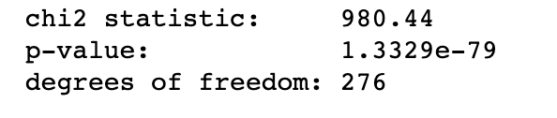
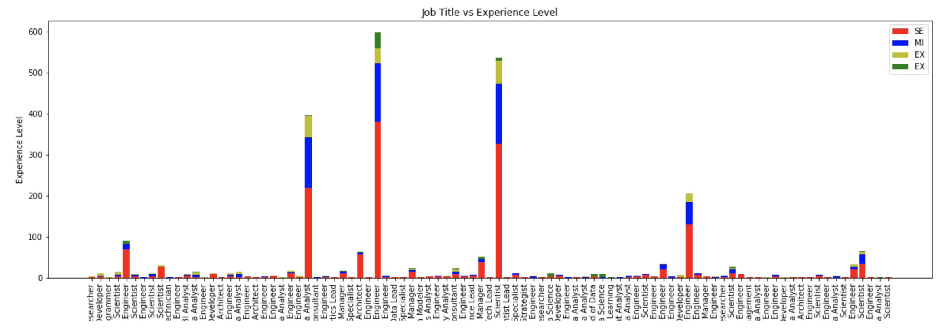
Job Title vs Experience Level
Null Hypothesis: The two variables, job title and experience level are dependent on each other
Because our chi-square of independence test has a p-value less than 0.05, we reject our null hypothesis which means that job title and experience level are independent of each other
Alternate Hypothesis: The two variables, job title and experience level are independent of each other

Slide 17
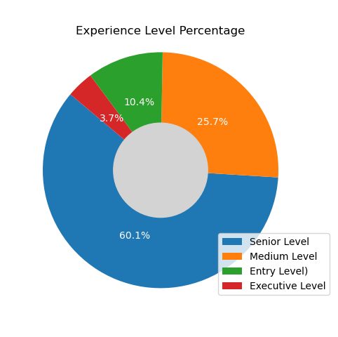
Distribution of jobs among different experience level employees
Senior Level experience holds over 60% of job.
Medium Level experience 25.7%
Entry Level experience 10.4%
Executive Level experience 3.7%

Slide 18
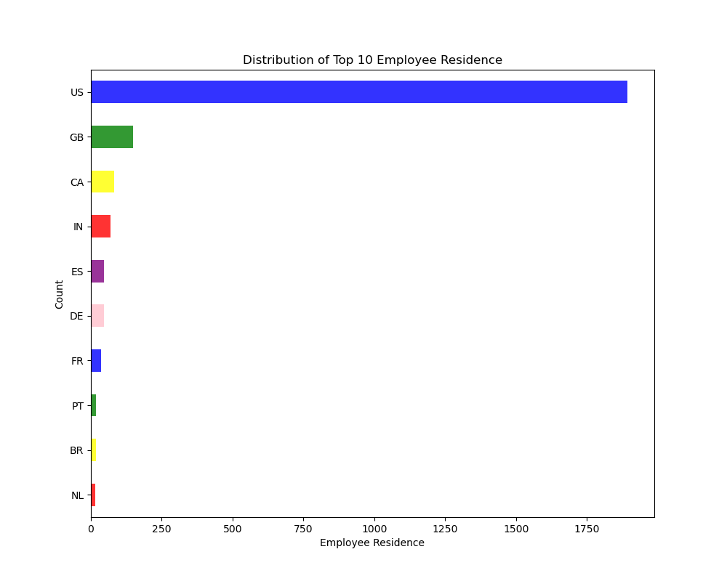
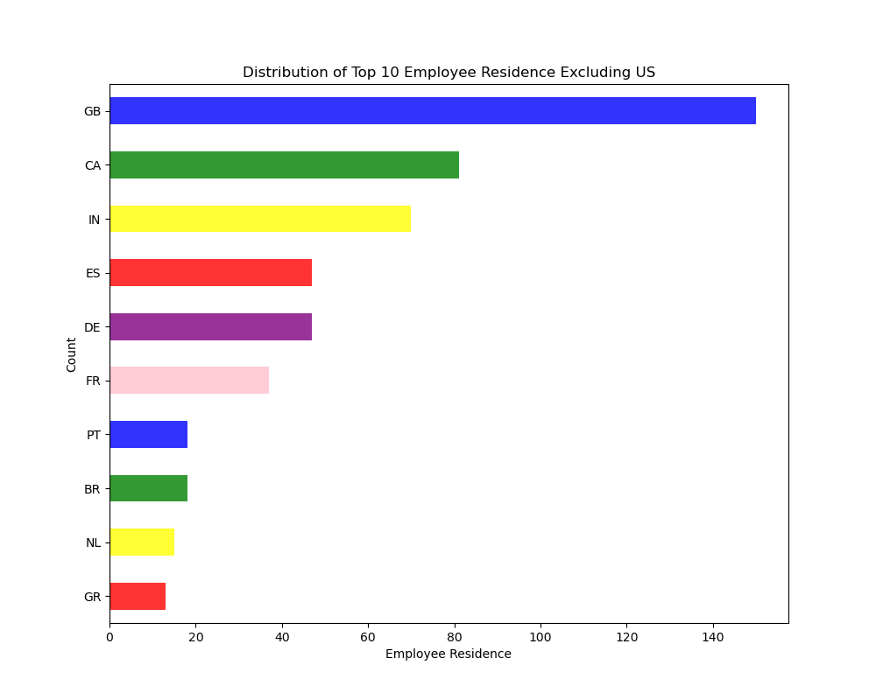
Which country residents are employed most in data science jobs?
After US , top three positions are taken by United Kingdom(GB), Canada(CA), India(IN), followed by Spain(ES), Germany(DE) , France(FR)
About 73 % of data science jobs employ US resident.

Slide 19
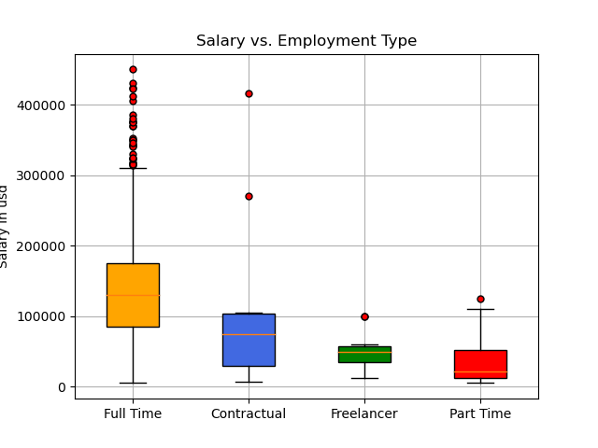
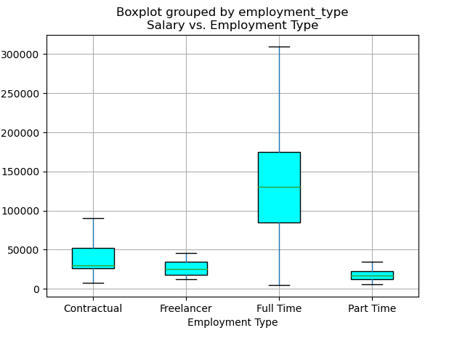
Does Salary varies for different types of employment?
Full Time employees have highest median salary, followed by Contractual , Part Time and Freelancer
Removing outliers, increased spread for Full TimeEmployees and decreased the spread for Contractual , Freelancer and Part Time Employees

Slide 20
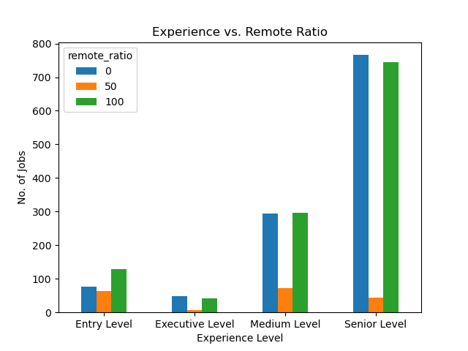
Experience vs Remote Ratio
Across all categories of experience the majority of employees preferred to work either 100% remote or 100% On-Site.
Least preferred Hybrid work environment.

Slide 21
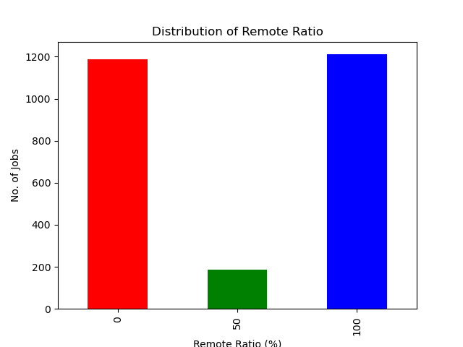
Distribution of no. of Jobs by Remote work ratio
45.89% of employee population work on site( 0% remote ratio)
Almost equal proportion 46.86% employees work fully remotely (100% remote ratio)
Only a small fraction (7.23%) of employees work in a hybrid setup
Remote Ratio (%)

Slide 22
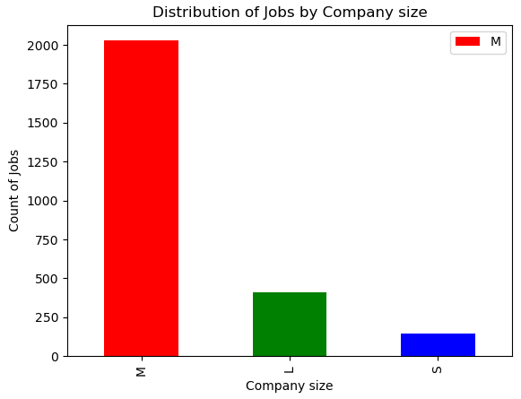
Distribution of no. of Jobs by Company Size
M: Medium
L: Large
S: Small
Significant number (78.48%) of employees work for medium(M)-sized companies
15.82% employees work for large(L) size companies
5.68% employees work for small(S) size companies

Slide 23
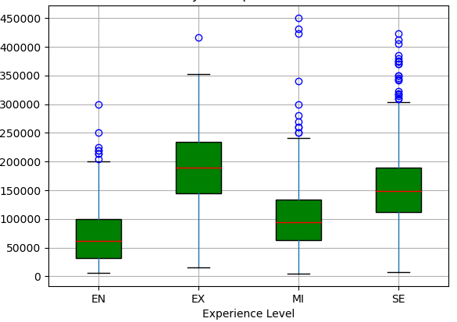
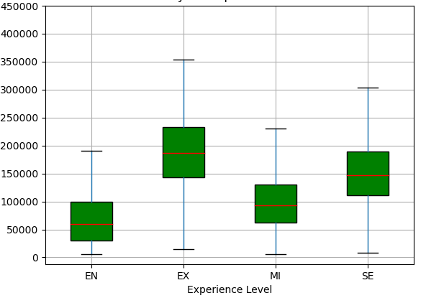
Salary in US Dollars for different experience levels
Boxplot with Outliers
Boxplot without Outliers
Salary (in USD)
Salary (in USD)
Executive-level (EX) experience has the highest median salary, followed by Entry-level(EN), Mid-level (MI), and Senior-level (SE)
Spread of salaries increases with experience level, indicating more variability in salaries for more experienced roles

Slide 24
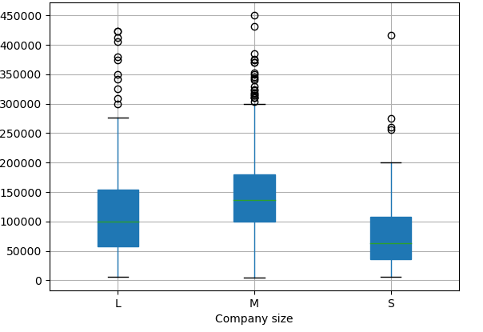
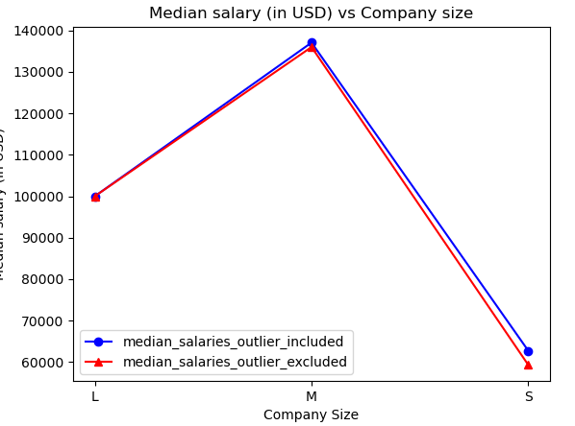
To what extent does the Company size impact the average salaries of Data Science jobs?
Boxplot with Outliers
Salary (in USD)
Median salary (in USD)
Medium(M) size company median salaries are highest followed by large(L) companies and then small(S) companies
The spread of salaries is more for large size companies
The median salary variation with company size doesn’t change much with and without outliers

Slide 25
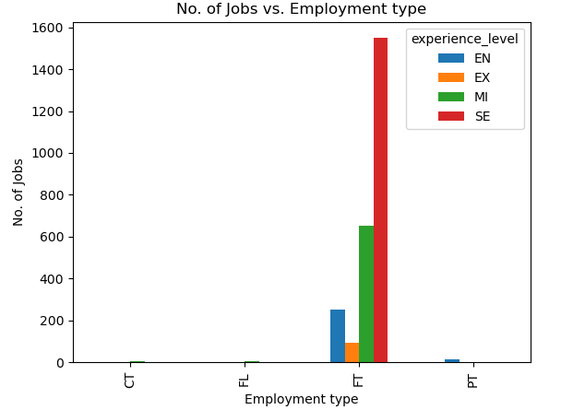
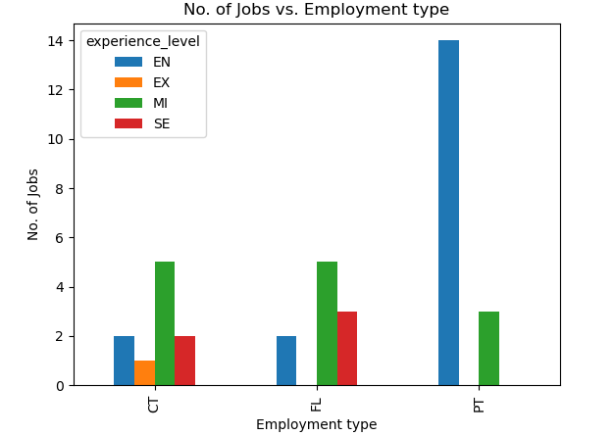
Distribution of different experience levels (Executive-level (EX), Entry-level(EN), Mid-level (MI), Senior-level (SE)) jobs among FT (Full Time) employees
No of Jobs distribution with employment type and experience level
Except FT(Full Time) employee category, only 1.43% number of jobs are in other employment type categories
Shows distribution for various experience levels in remaining employment type category

Slide 26




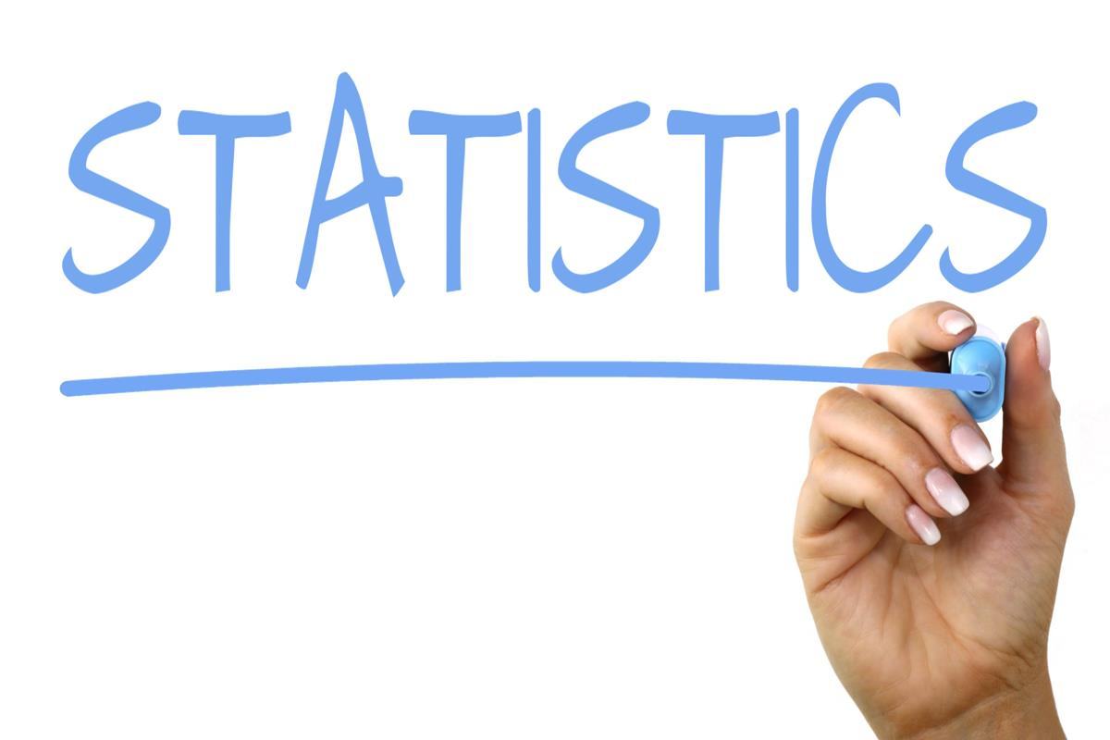

Tools Used:
Pandas
Matplotlib
Statistics
Python
NumPy

Slide 27

Conclusion
This detailed analysis on data science salaries provides a good overview on salaries distribution across various variables
Key highlights:
US contributes to the major portion of the data science jobs
Data science jobs have doubled since year 2020 to now
Companies located in Israel (IL) are paying highest salaries followed by companies located in Puerto Rico(PR) and then United States(US)
Most employees working in data science jobs are working as full time employees and at the senior level experience
Medium size companies provide most jobs and highest median salaries
Median salaries increases with higher experience levels and a wider distribution
Data Science Tech Lead" has the highest median salary whereas Applied Scientist" offers more job opportunities despite a lower median salary

