Slide 1

Project Name: Know Your Worth Team Name: Analytics Enthusiasts Topic: Data Scientists Income Statistics Presented By : Amna Hassan, Garima Chaudhary, Nameeta Tiwari, Nidhi Nigam, Sahil Wadhwa

Slide 2




Tools Used:
Pandas
Matplotlib
Statistics
Python

Slide 3

Why we choose this data?
Strategic Decision: Prioritizing salary data is strategic for data science students.
Relevance to Career:
Salary data guides career choices, education decisions, and financial planning.
Negotiation Skills:
Prepares students for future job negotiations.
Industry Insights:
Salary data provides industry insights.
Career
Planning:
It guides long-term career planning and sets milestones.
Skill Development: Understanding salary trends supports skill development.
Market Research:
Guides market research and business choices.
Foundational Resource: Essential for aspiring data scientists.

Slide 4

Data Table: 11 Columns
Work_year
Experience Level
Employment Type
Job Title
Salary In USD
Salary Currency
Employee Residence
Remote Ratio
Company Location:
Company Size
Salary

Slide 5
Analyzing:
Job Titles vs. Income Correlation
Company Size Impact on Salaries
Residence and Salary Relationship
Geographical Location and Salaries
Data Science Remote Work Ratio
Employment Type vs. Salary Impact

Slide 6
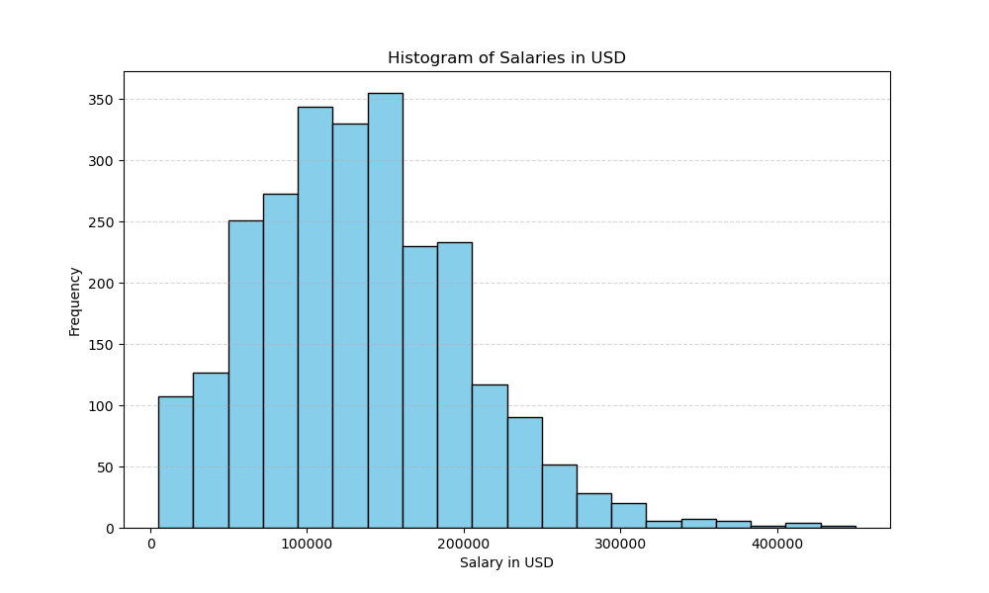
Salaries in USD
Total count = 2584.00
Mean = 133409.28
Std = 67136.84
Min Salary= 5132.00
25% = 84975.00
50% = 130000.00
75% = 175000.00
Max = 450000.00
Salaries vary greatly, with an average around $133,409.28, and a median at $130,000 but the range is broad, spanning from $5,132.00 to $450,000.00.

Slide 7
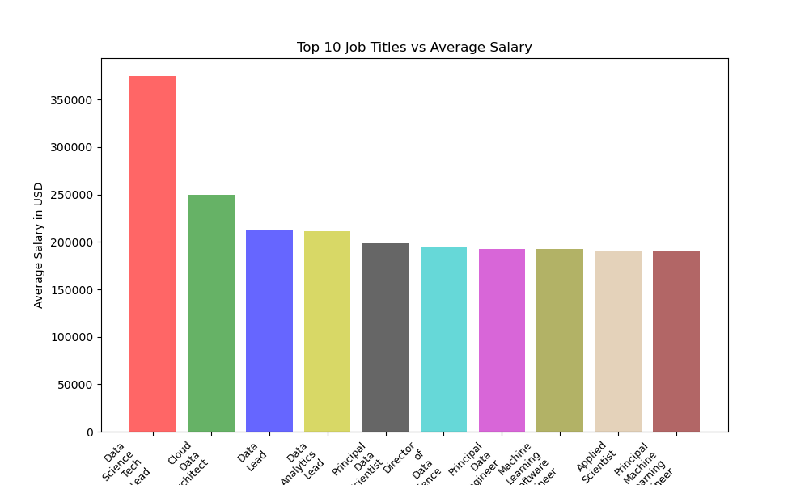
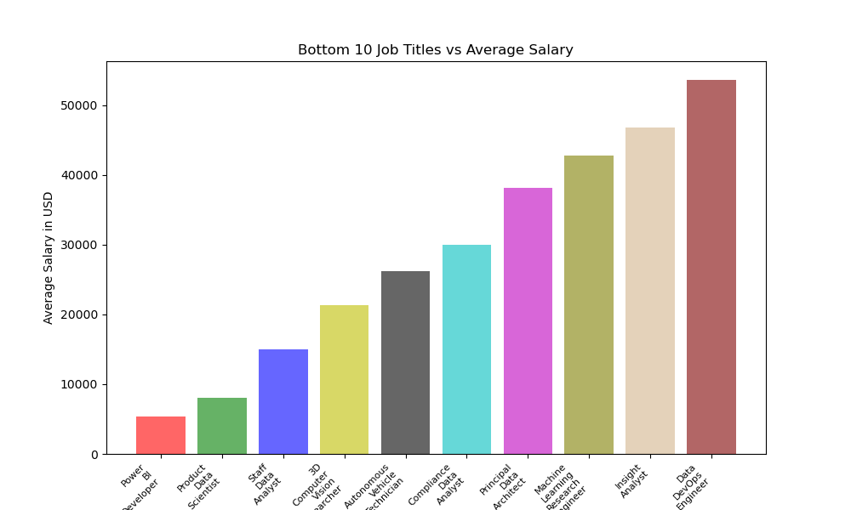
Job Titles Vs Salary Comparison
Bottom Ten Job Titles Vs Average Salary
Bottom Ten Job Titles Vs Average Salary
Top Ten Job Titles Vs Average Salary
Notes:
This analysis underscores substantial salary disparities between the top and bottom ten job titles. The highest salary in the top ten Job titles reaches $375,000, whereas the upper limit in the bottom ten job titles is $53,654.

Slide 9
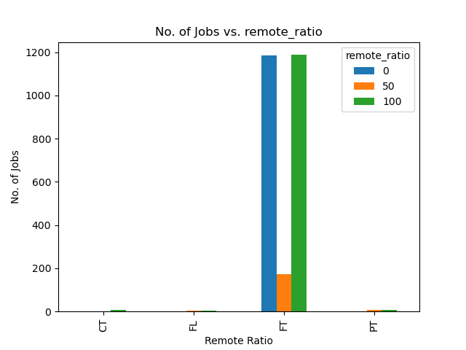
Remote Ratio Vs No Of Jobs
Over 90% of the jobs are categorized as full-time (FT).
Out of the 2,547 full-time jobs:
47% are fully remote (100% remote).
47% are not remote at all (0% remote).
Only 6% are in a hybrid work mode.

Slide 10

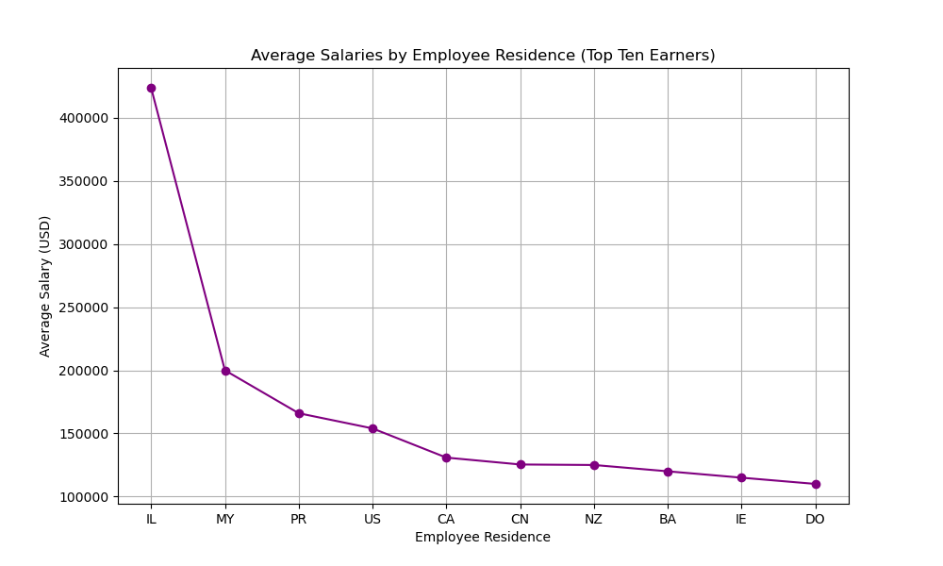
Average Salaries for Top Ten Employee Residences
Employees from Israel (IL) earn the highest average salaries. Followed by:
IL (Israel)
MY (Malaysia)
PR (Puerto Rico)
US (United States)
CA (Canada)

Slide 11
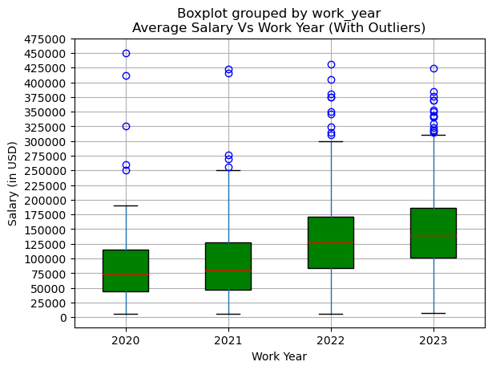
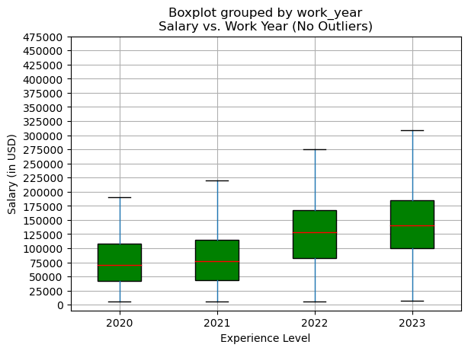
Average Salary Per Work Year
Boxplot With Outliers
Boxplot Without Outliers
Analysis Nidhi?

Slide 12
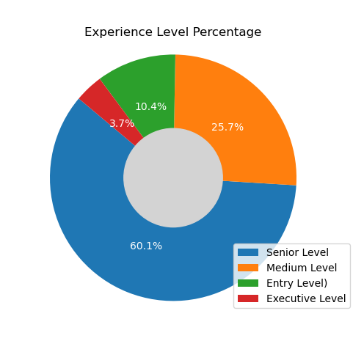
Experience Level Percentage
"Senior Level" experience has the highest number of individuals.
Next is "Medium Level" experience.
Then comes "Entry Level" experience.
"Executive Level" experience has the fewest individuals in the dataset.

