Slide 1

Project Name: Know_Your_Worth Team Name: Analytics Enthusiasts Topic: Data Scientists Income Statistics Presented By : Amna Hassan, Garima Chaudhary, Nameeta Tiwari, Nidhi Nigam, Sahil Wadhwa

Slide 2

Why we choose this data?
Strategic Decision: Prioritizing salary data is strategic for data science students.
Relevance to Career:
Salary data guides career choices, education decisions, and financial planning.
Negotiation Skills:
Prepares students for future job negotiations.
Industry Insights:
Salary data provides industry insights.
Career
Planning:
It guides long-term career planning and sets milestones.
Skill Development: Understanding salary trends supports skill development.
Market Research:
Guides market research and business choices.
Foundational Resource: Essential for aspiring data scientists.

Slide 3

Data Table: Columns
This Dataset contains 11 columns:
Work_year
Experience Level
Employment Type
Job Title
Salary In USD
Salary Currency
Employee Residence
Remote Ratio
Company Location:
Company Size
Salary

Slide 4
Questions:
What is the correlation between different data science job titles and income levels?
How does the size of a company , impact the salaries of its employees?
What is the relationship between an employee's primary country of residence and their salary?
How does the geographical location of a company's headquarters or primary office impact the salaries of its employees?
What is the ratio of remote work arrangements among various job titles within the field of data science?
How does the type of employment for a role, such as part-time (PT), contract (CT), or full-time (FT), influence the corresponding salary ?

Slide 5




Tools Used:
Pandas
Matplotlib
Statistics
Python

Slide 6

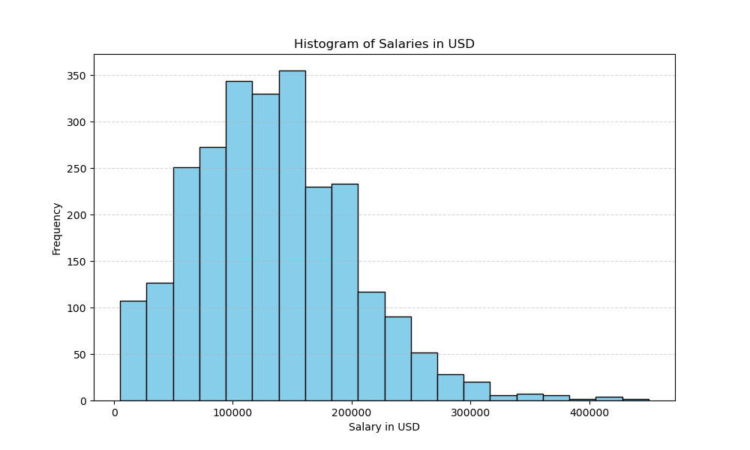
Salaries in USD
The histogram appears to have a peak in the lower salary range, suggesting that a significant number of job positions have salaries on the lower end of the scale. This peak indicates that a portion of the data corresponds to lower-paying roles.

Slide 7
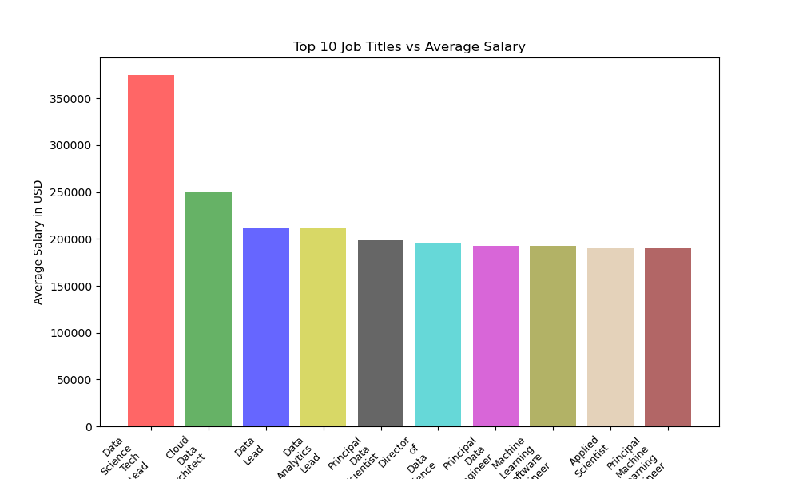
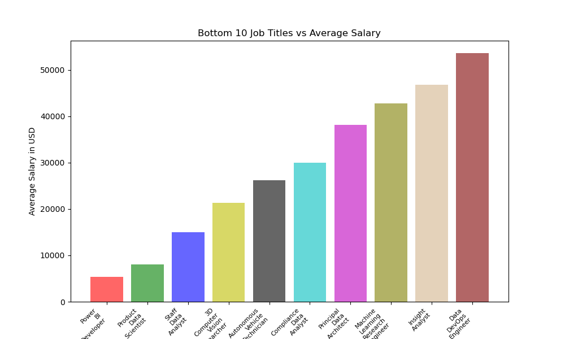
Job Titles Vs Salary Comparison
Bottom Ten Titles Vs Average Salary
Bottom Ten Job Titles Vs Average Salary
Top Ten Job Titles Vs Average Salary
Notes:
This analysis underscores substantial salary disparities between the top and bottom ten job titles. The highest salary in the top ten Job titles reaches $375,000, whereas the upper limit in the bottom ten job titles is $53,654.

Slide 8

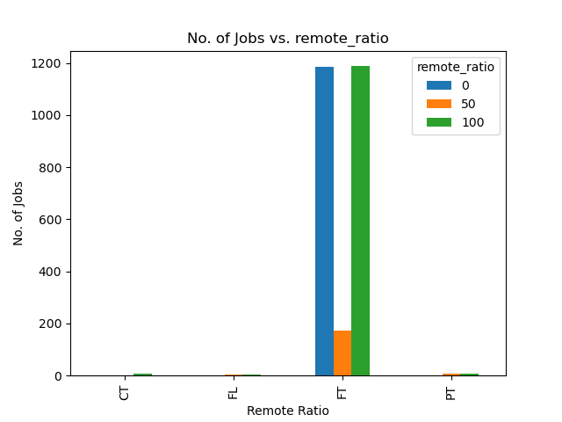
Remote Ratio Vs No Of Jobs
The graph clearly demonstrates most job postings favor either "100% Remote" or "100% Full Time" work arrangements, with fewer opportunities for "Hybrid" work models.

Slide 9

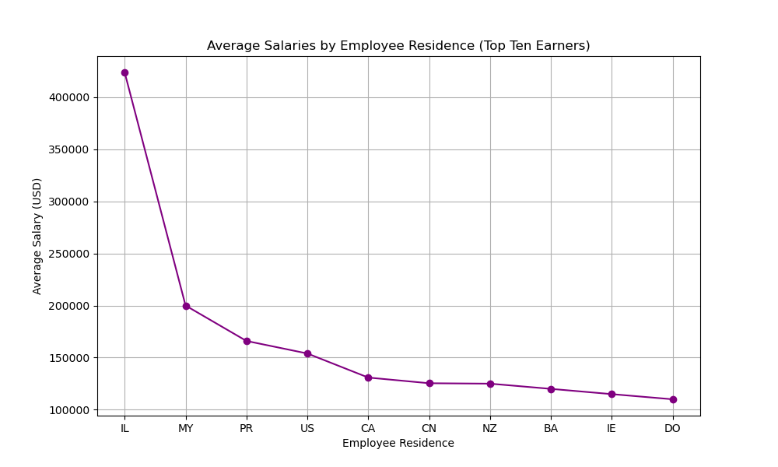
Comparison of Average Salaries and Top Ten Earning Employ Residence

Slide 10

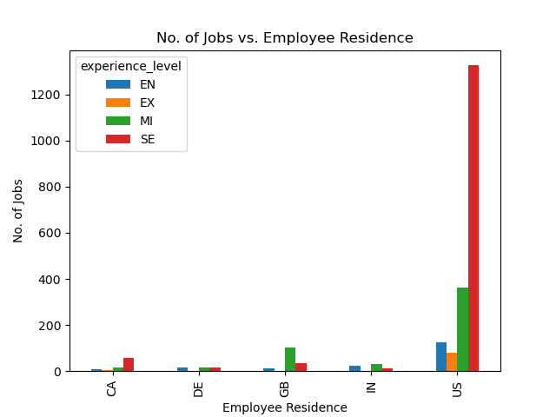
Comparison of No Of Jobs In Different Employment types.
Garima's Analysis ?

