Slide 1
Capstone Presentation
Analysis of Customer Churn
Presented By-
Garima Gangwar

Slide 2
Business Problem Understanding
An E Commerce company going through a challenging phase of retaining customers keeping in mind the current market situation and high market competition and to stand by this the company wants to develop a model through which they can customer churn and provide segmented offers to the potential churners. In this company, we observed that one account have multiple customers which indicates that losing one account may lead to losing multiple customers.
Therefore, We as a data analyst are consulting the firm for developing a model which could provide better churn prediction so that they can make necessary changes in their business model and customize marketing and advertising campaign to retain the customers and add new customers.

Slide 3
Key Information About Data
Dataset contains 11260 rows and 19 columns.
Variables are of integer, string and float data types and few are also categorical in nature.
Data does not show any duplication.
Variables have presence of null values in data.
Numerical variables are not normally distributed and are skewed in nature.
10 attributes required clean-up.
Special characters such as #,&,+,$,@ present.
Target variable (Churn) shows that data is imbalance in nature.

Slide 4
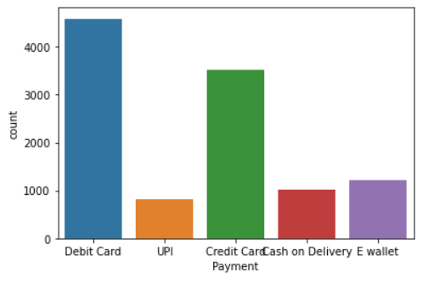
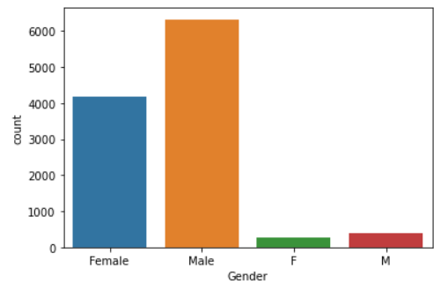
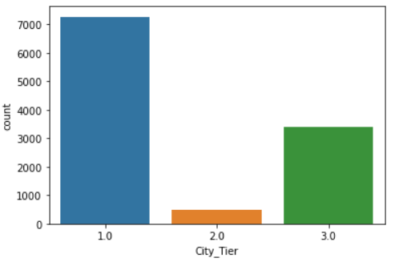
EDA (Univariate Analysis)
Majority customers belongs to Tier-1 City.
Majority customers prefers debit and credit Card as their mode of payment.
Count of male customers are Higher.

Slide 5
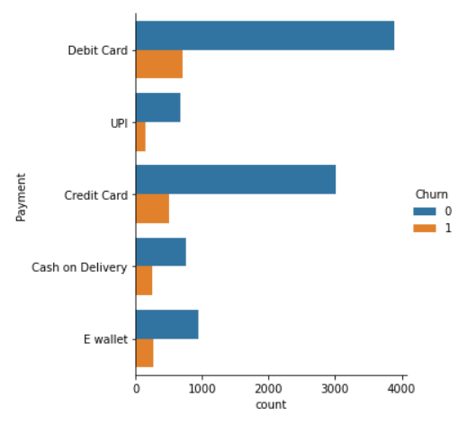
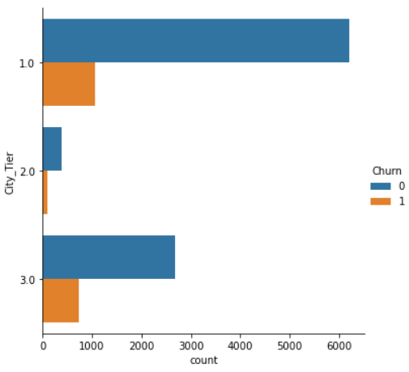
EDA (Bi-variate Analysis)
Customer from Tier-1 and Tier-3 shows high trend to churn.
Payment preference with debit and credit card showing high number of churn.

Slide 6
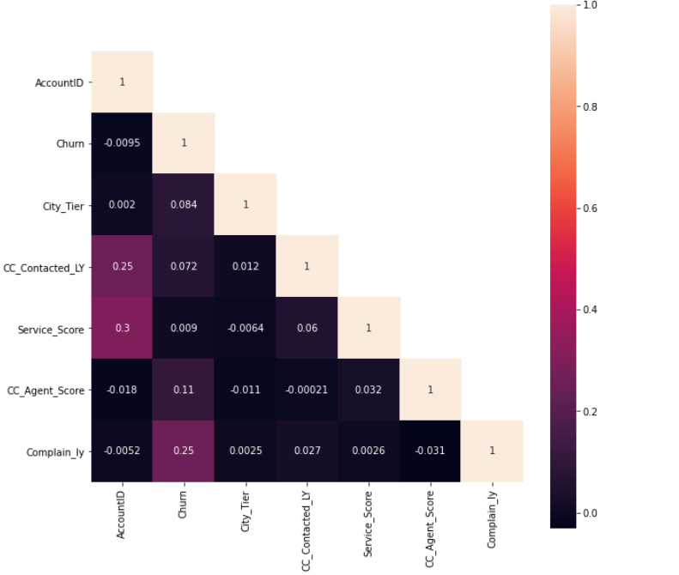
EDA (Multivariate Analysis)
City tier shows negative correlation with churn
CC_contacted_last shows high correlation with target variable
Service score shows moderate correlation with target variable

Slide 7
Modelling Approach Used & Why-
Steps performed before Model Building: -
Treating null values
Outlier treatment
Treating Anomaly
Scaling data
Replacing Object type categorical variable with integer types
Modelling Approach:-
Checking behaviour of customers against the pattern and alert about potential churners for the business.
Get information about the customer’s pain points and choosing effective retention actions.
Building classification model regarding shared behavioural pattern of customers who already abandon purchasing.
Building classification model to categorize customers in different class/category (churner/non-churner).
To do the same we have below mentioned machine learning models:-
Logistic Regression
Linear Discriminant Analysis (LDA)
KNN
Naïve Bayes
Bagging (Random Forest)
Ada- Boosting
Gradient Boosting
Support Vector Machine (SVM)
The above mentioned models can be hyper tuned to attain better accuracy.

Slide 8
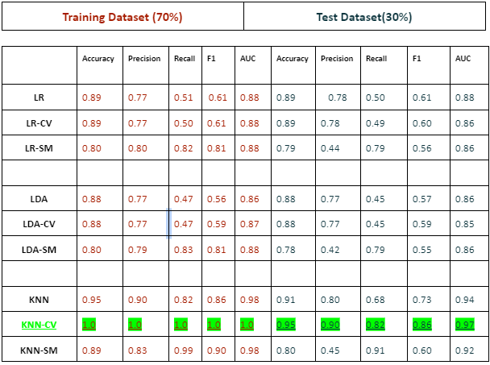
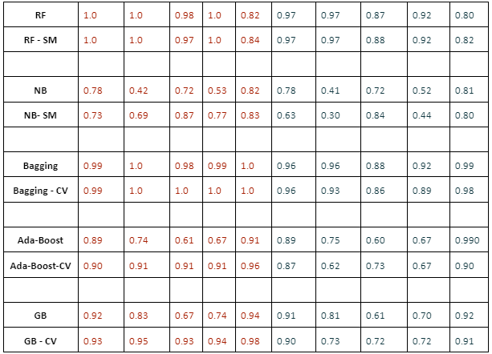
Comparison of Model Performance

Slide 9
Best Model: KNN is the best model! Why?
Why KNN-CV?
Good fit - Comparable train and test performance.
Precision,Recall, f1-score and Accuracy - Precision, Recall, f1-score, Accuracy and AUC are highest.
The model looked like it overfit on train dataset, a further 5-fold and 10-fold cross-validation was done on complete dataset in which the F1-score on all folds was either comparable or greater than test data f1-score.
Interpretable - KNN Feature Importance provided by SKlearn.

Slide 10
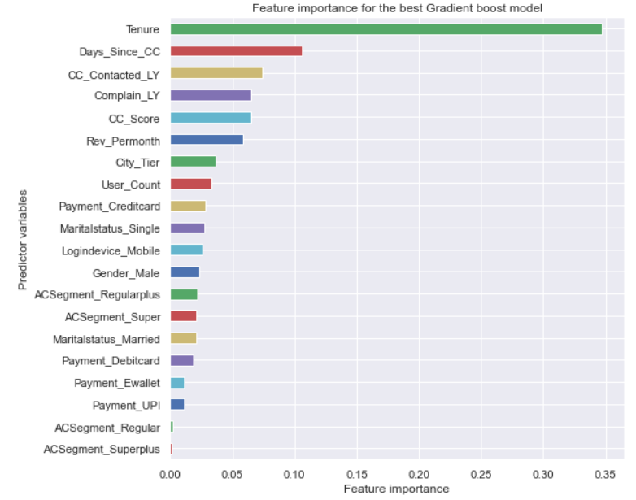
Top Predictors for the best model
Tenure has the highest influence on the model. Contributes 35% of all attributes feature importance.
The next 4 features together contributes to 31% of importance.
Days since customer care contacted - 11%.
Number of times customer care was contacted last year - 7%.
Weather a complaint was made last year or not - 7%.
Customer care agent score - 6%.
Revenue per month attribute contributes to 6% of all feature importance. The churn in high revenue customers is more than in low revenue customers.
City tier and other features all have individual contributions of less than 5% each.

Slide 11
Key Business insights & Recommendations
Insights from Analysis-
Business have visibility in tier-1 city.
Mostly customer rated “3” for the services provided by the business.
Transaction of UPI and e-wallet is very low.
Insights from Model Building-
From the above tabular representation of all the scores for training and testing dataset across various model we can conclude that the KNN model with default values of hyper-parameters is best optimized for the given dataset.
Model with bagging and boosting is also well optimized but difference in accuracy for training and testing dataset is little on the higher side as compared to KNN.
Other model’s namely Naïve Bayes, LDA and SVM worked well on training dataset but the accuracy came down when performed over testing dataset. Which indicates overfitting of data in that model.
Recommendations-
Conducting satisfaction survey to understand change in customers behavior.
Business need to make sure that all complaints and queries raised are resolve on time.
Business can promote using their own e-wallet as payment option by giving certain discount over the bill.
Business needs to increase in visibility in Tier-2 city for better customer acquisition.
Business can promote payment via standing instruction in bank account or UPI which can be hassle free and safe for customers.

Slide 12
Thank You

