Slide 1
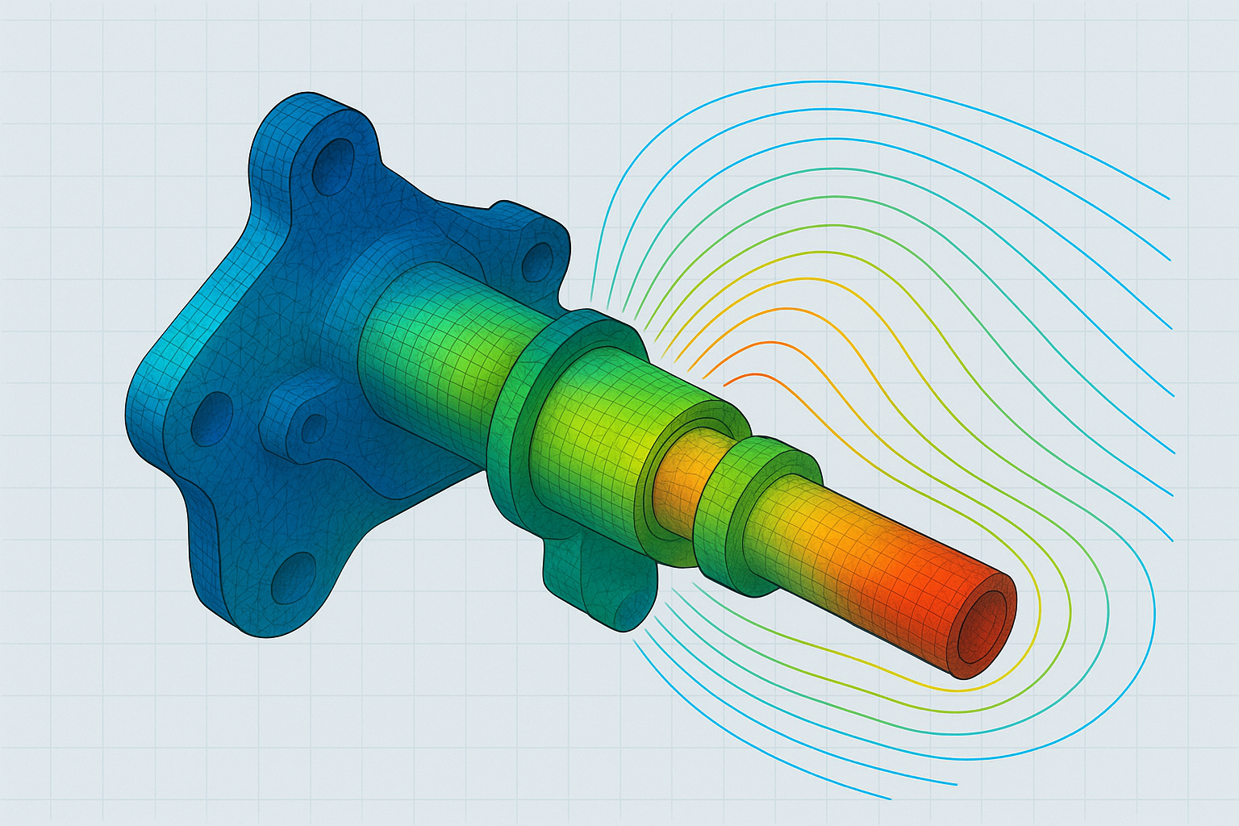


Slide 2
CAD file
CAE result summary
Interface AI with simulation software
CAE simulation requirements
Setup parameters – mesh, contacts
Boundary Conditions
Material Assignment
Solver type and settings
Axial AI

