Slide 1
Event Boundaries &
Recognition Memory
How event segmentation shapes encoding and discrimination in the Mnemonic Similarity Task
Both (n = 51)
Item Only (n = 56)
Task Only (n = 53)
BRSM 2026 · Replication & Extension of Morse et al. (2023) · N = 160

Slide 2
Background
What is Event Segmentation?
What is the MST?
We don't experience life as one long stream — our brains slice it into discrete chunks called events.
When context changes (new scene, new goal), the hippocampus detects an event boundary and updates its internal model of what's happening.
This updating takes cognitive effort — and that effort can affect how well nearby items are remembered.
The Mnemonic Similarity Task (MST) tests two distinct aspects of memory:
REC — Basic Recognition
Can you tell if you've seen this object before?
REC = P("old" | Target) − P("old" | Foil)
LDI — Mnemonic Discrimination
Can you tell a similar lure from the original?
LDI = P("similar" | Lure) − P("similar" | Foil)
Morse et al. (2023) showed boundary effects are directional:
Pre-boundary items → better discrimination
Post-boundary items → worse recognition
Lure bins 1–5: Bin 1 = nearly identical to original (hardest)
Bin 5 = clearly different (easiest to discriminate)
Zacks et al. (2007) · Morse et al. (2023) · Stark et al. (2013, 2019)

Slide 3
Study Design
Both (n = 51)
Item Only (n = 56)
Task Only (n = 53)
Items shift between objects & scenes
every block, AND the encoding question
changes each block.
Items alternate between objects &
scenes each block, but the encoding
question stays the same throughout.
Items stay as scenes throughout,
but the encoding question changes
each block.
Boundary type:
Boundary type:
Boundary type:
Perceptual + Task boundary
Perceptual boundary only
Task boundary only
Encoding:
40 events × 7 items each = 280 images · 3 sec per image · Encoding question: "Does it fit in a shoebox?"
Test phase:
60 targets (20 Pre / 20 Mid / 20 Post) + 60 lures (20 Pre / 20 Mid / 20 Post) + 30 foils → respond: Old / Similar / New
Event positions within each 7-item block:
POST:
item 1 — just after boundary
MID:
items 2–6 — middle of event
PRE:
item 7 — just before boundary

Slide 4
Research Questions
Q1
Do event boundaries enhance or impair recognition memory?
Q2
Do boundaries make it harder to tell similar objects apart?
They impair it — slightly. Post-boundary items were recognised less well (REC = 0.597) than items from the middle or end of an event (~0.63).
Not clearly in this study. Discrimination (LDI) was nearly identical across positions. Design differences from Morse et al. (2023) likely explain the null result.
Q3
Does crossing a boundary take extra cognitive effort at encoding?
Q4
Does lure similarity determine how hard discrimination is?
Yes. Participants were ~0.15s slower to respond to post-boundary items — but only when the boundary involved a task-shift. A perceptual shift alone was not enough.
Yes, robustly. LDI rose steadily from Bin 1 (lure nearly identical, LDI ≈ 0.20) to Bin 5 (lure clearly different, LDI ≈ 0.40) across all conditions and positions.
Q5
Does the type of boundary (perceptual vs. task) matter?
Yes. Task-shifts drove the RT cost at boundaries. Item-Only (perceptual shift only) showed flat RT and no REC decline — suggesting the task component is the critical ingredient.

Slide 5
What We Predicted
H1
Event boundaries slow down encoding
H2
Boundaries impair basic recognition memory
Post-boundary items should take longer to respond to — the brain must update its event model at each transition.
Post-boundary items may be recognised less well — cognitive resources spent on updating the event model leave less capacity for encoding item identity.
Prediction: Post RT > Pre = Mid
Prediction: Post REC < Pre / Mid
H3
Boundaries impair mnemonic discrimination
H4
More similar lures are harder to discriminate
Post-boundary lures should be harder to reject — fine-grained pattern separation requires attentional resources that are diverted at boundaries.
LDI should increase from Bin 1 (lure nearly identical to target) to Bin 5 (lure clearly different). This validates the graded difficulty structure of the MST.
Prediction: Post LDI < Pre / Mid
Prediction: LDI: Bin 1 < Bin 2 < … < Bin 5
Statistical tests: Repeated-measures ANOVA on encoding RT, REC, and LDI · Post-hoc pairwise t-tests with Holm–Bonferroni correction

Slide 6
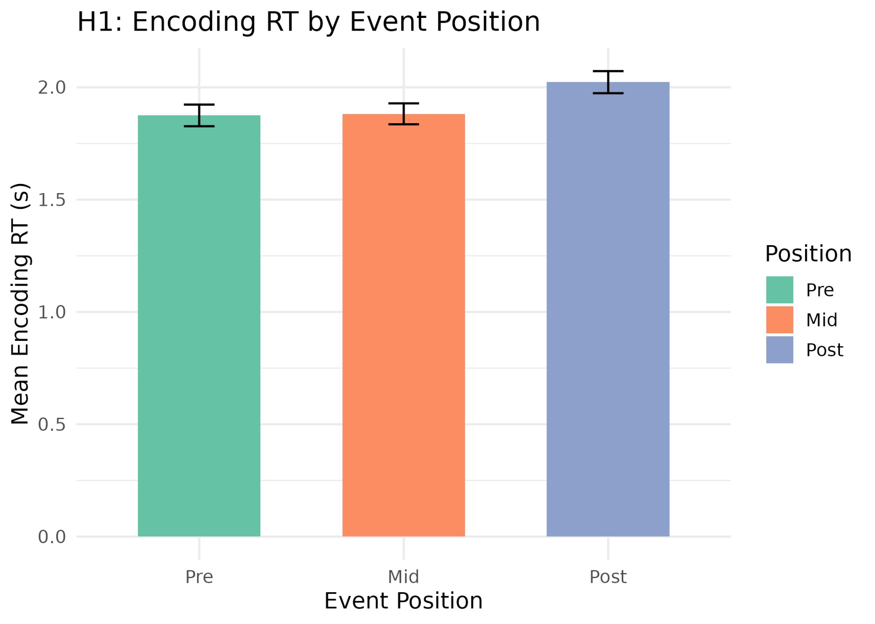
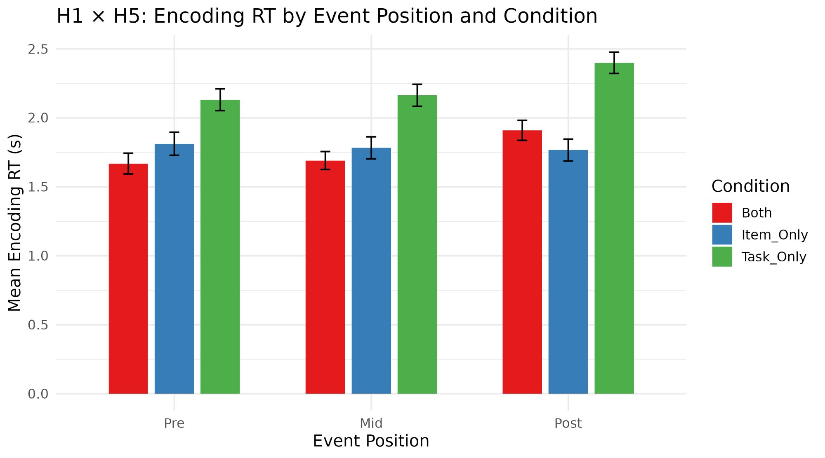
H1 — Do event boundaries slow down responses during encoding?
Fig 1. Mean encoding RT by event position (all participants)
Fig 2. Encoding RT broken down by condition
✓ H1 SUPPORTED
H5 INSIGHT
Post-boundary items were responded to ~0.15s slower than Pre and Mid items (2.03s vs ~1.87s).
The RT slowing only appeared in Both and Task-Only — not in Item-Only.
This tells us the task-shift component of the boundary drives the RT cost.

Slide 7
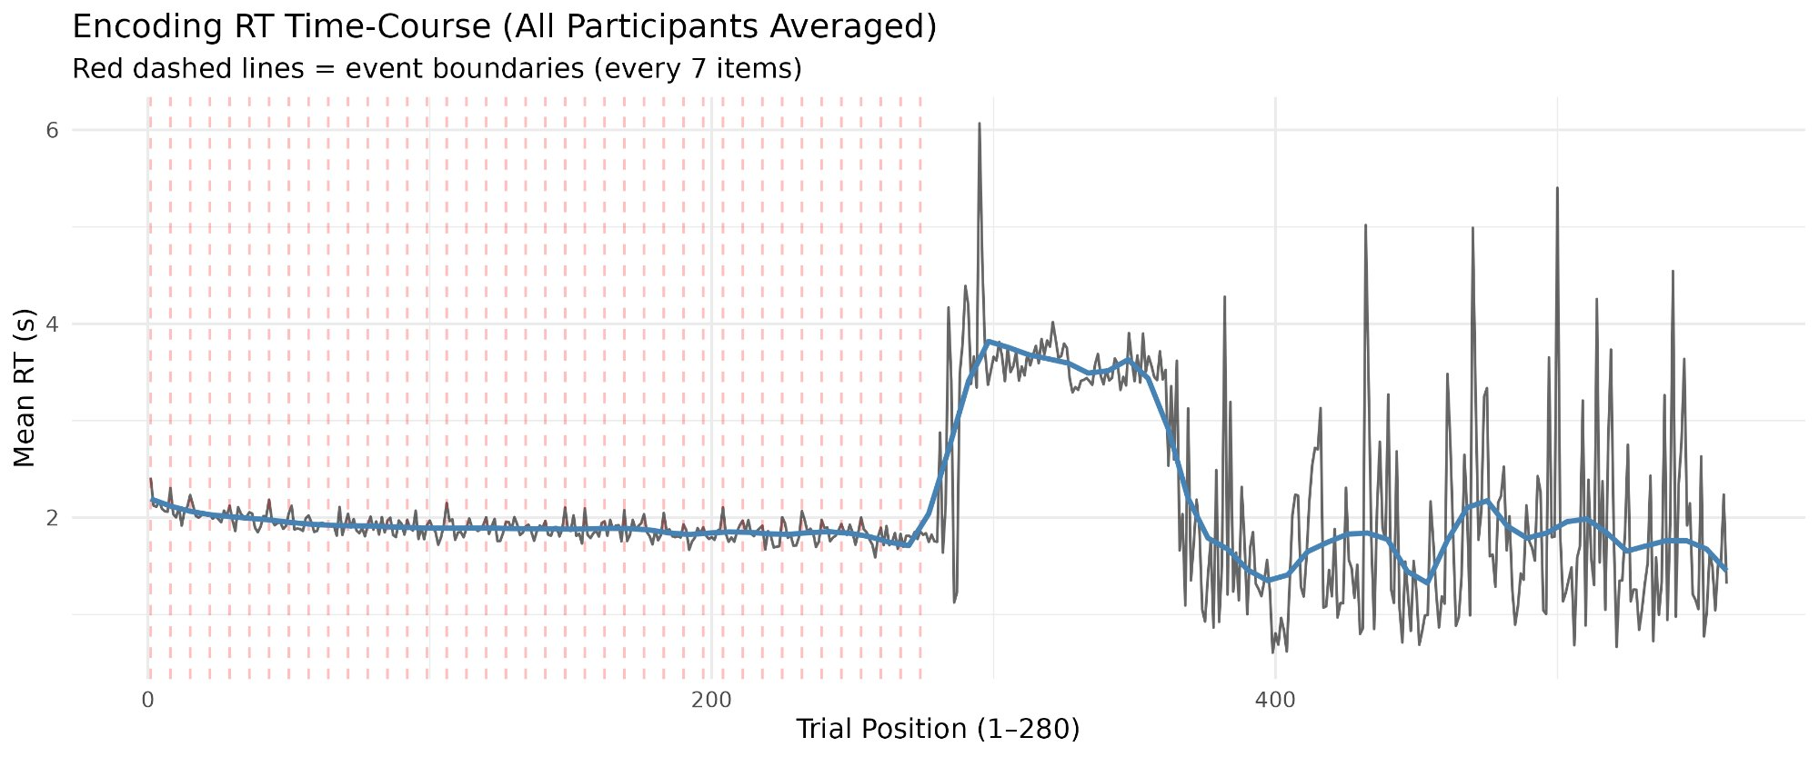
H1 — Seeing the boundary effect across the whole experiment
Fig 13. Trial-by-trial encoding RT (averaged across all participants). Red dashed lines = event boundaries (every 7 trials). Blue curve = LOESS smoothed trend.
What to notice: The sharp rise after trial ~280 marks the condition transition (task-shift participants enter a new block type). In the first half, each event boundary triggers a small RT spike — the rhythmic pattern predicted by Event Segmentation Theory.

Slide 8
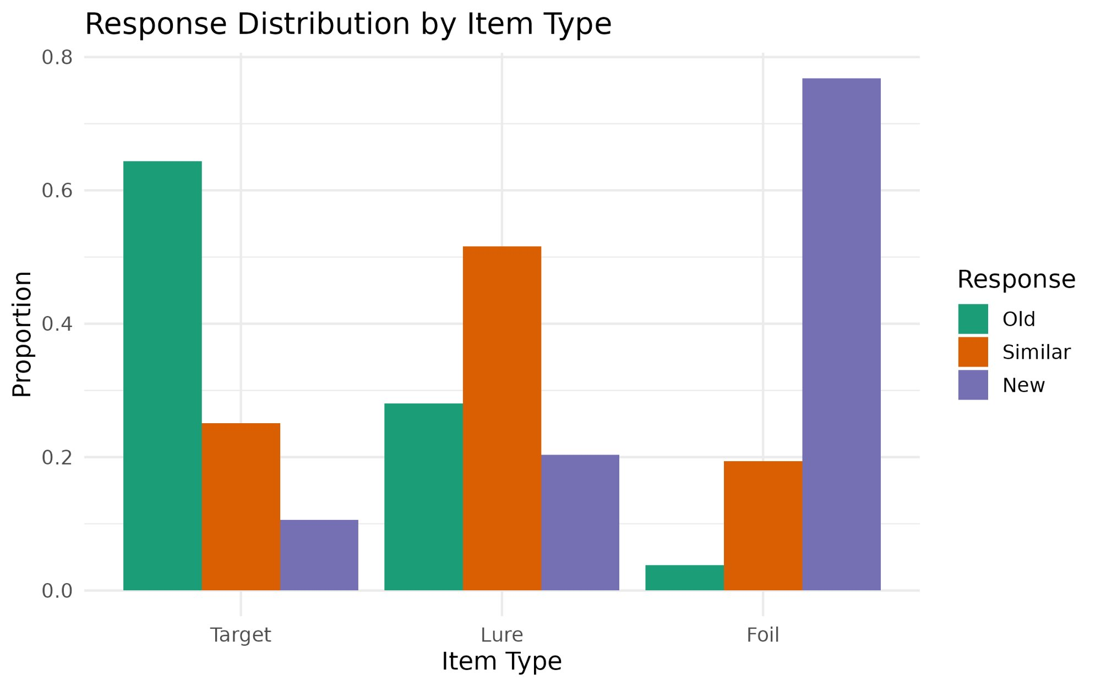
Manipulation Check — Did the task work?
Targets → mostly 'Old'
65% of the time participants correctly said 'Old' to items they had actually seen. The MST is working.
Foils → mostly 'New'
76% correct rejection of completely new items. Participants were not just guessing.
Lures → mostly 'Similar'
52% 'Similar' — participants recognised that lures resembled, but were not identical to, studied items. This is the key MST signal.
Fig 3. Response proportions (Old / Similar / New) for each item type.
✓ Task functioning as designed — proceed to hypothesis testing.

Slide 9
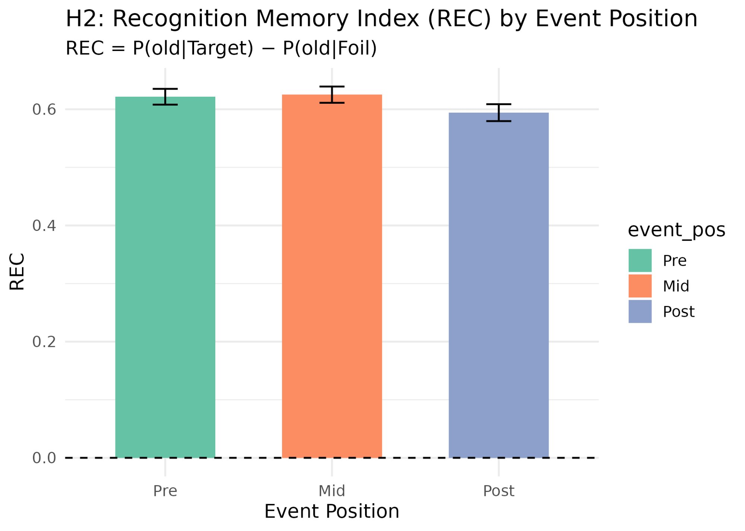
H2 — Do boundaries affect how well items are recognised?
How to read this
REC > 0 means participants correctly recognised targets above chance.
A lower REC bar = poorer memory for items at that position.
The dashed line at 0 = chance performance.
~ H2 PARTIALLY SUPPORTED
Post-boundary items showed lower REC (0.597) compared to Pre (0.628) and Mid (0.636).
The difference is directionally consistent with Morse et al. (2023) — but modest in size.
Items right after an event boundary are slightly harder to recognise.
Fig 4. Recognition Memory Index (REC) by event position. REC = P(old|Target) − P(old|Foil).

Slide 10
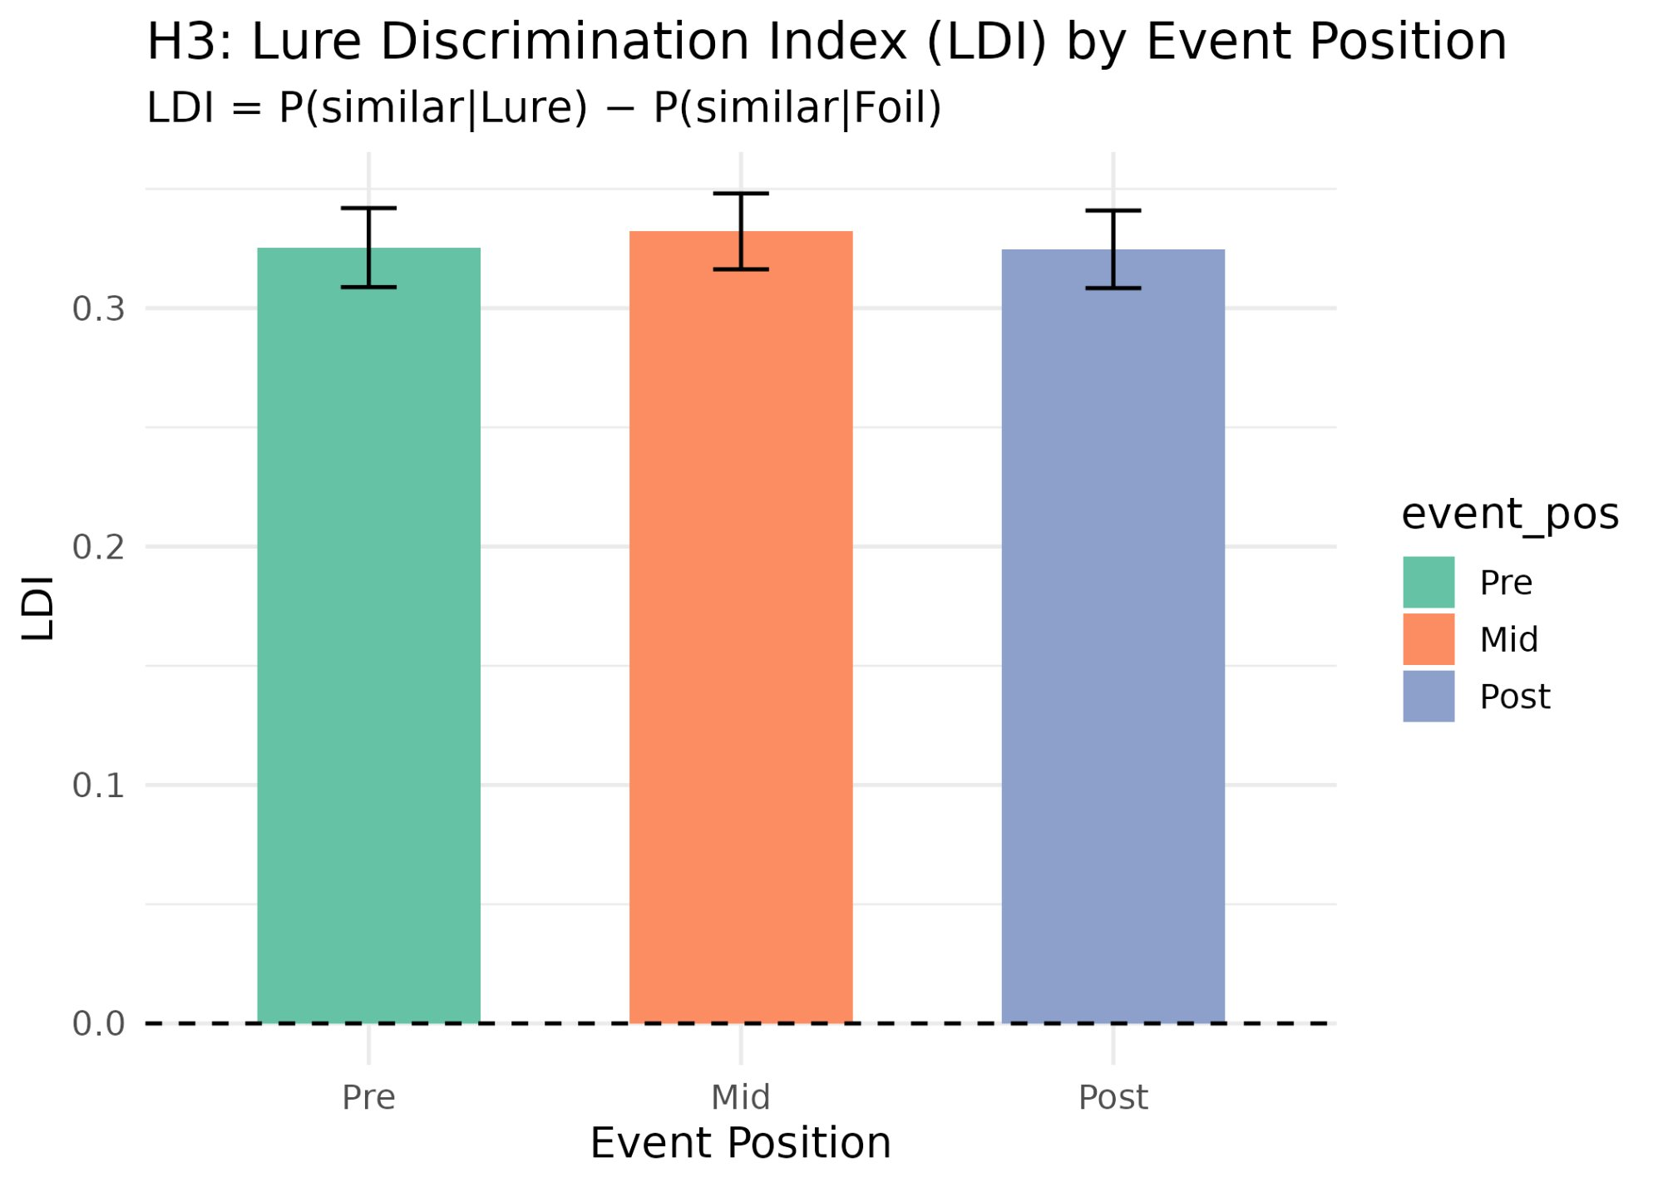
H3 — Do boundaries affect the ability to discriminate similar items?
How to read this
LDI > 0 means participants correctly flagged lures as 'Similar' above chance.
A lower LDI bar = worse discrimination between the original item and a similar copy.
This reflects hippocampal pattern separation.
✗ H3 NOT SUPPORTED
LDI was nearly identical across Pre (0.333), Mid (0.337), and Post (0.331).
There was no meaningful difference — boundaries did not impair or enhance discrimination ability.
Possible reasons: our 3-response design and 7-item blocks differ from the original study.
Fig 6. Lure Discrimination Index (LDI) by event position. LDI = P(similar|Lure) − P(similar|Foil).

Slide 11
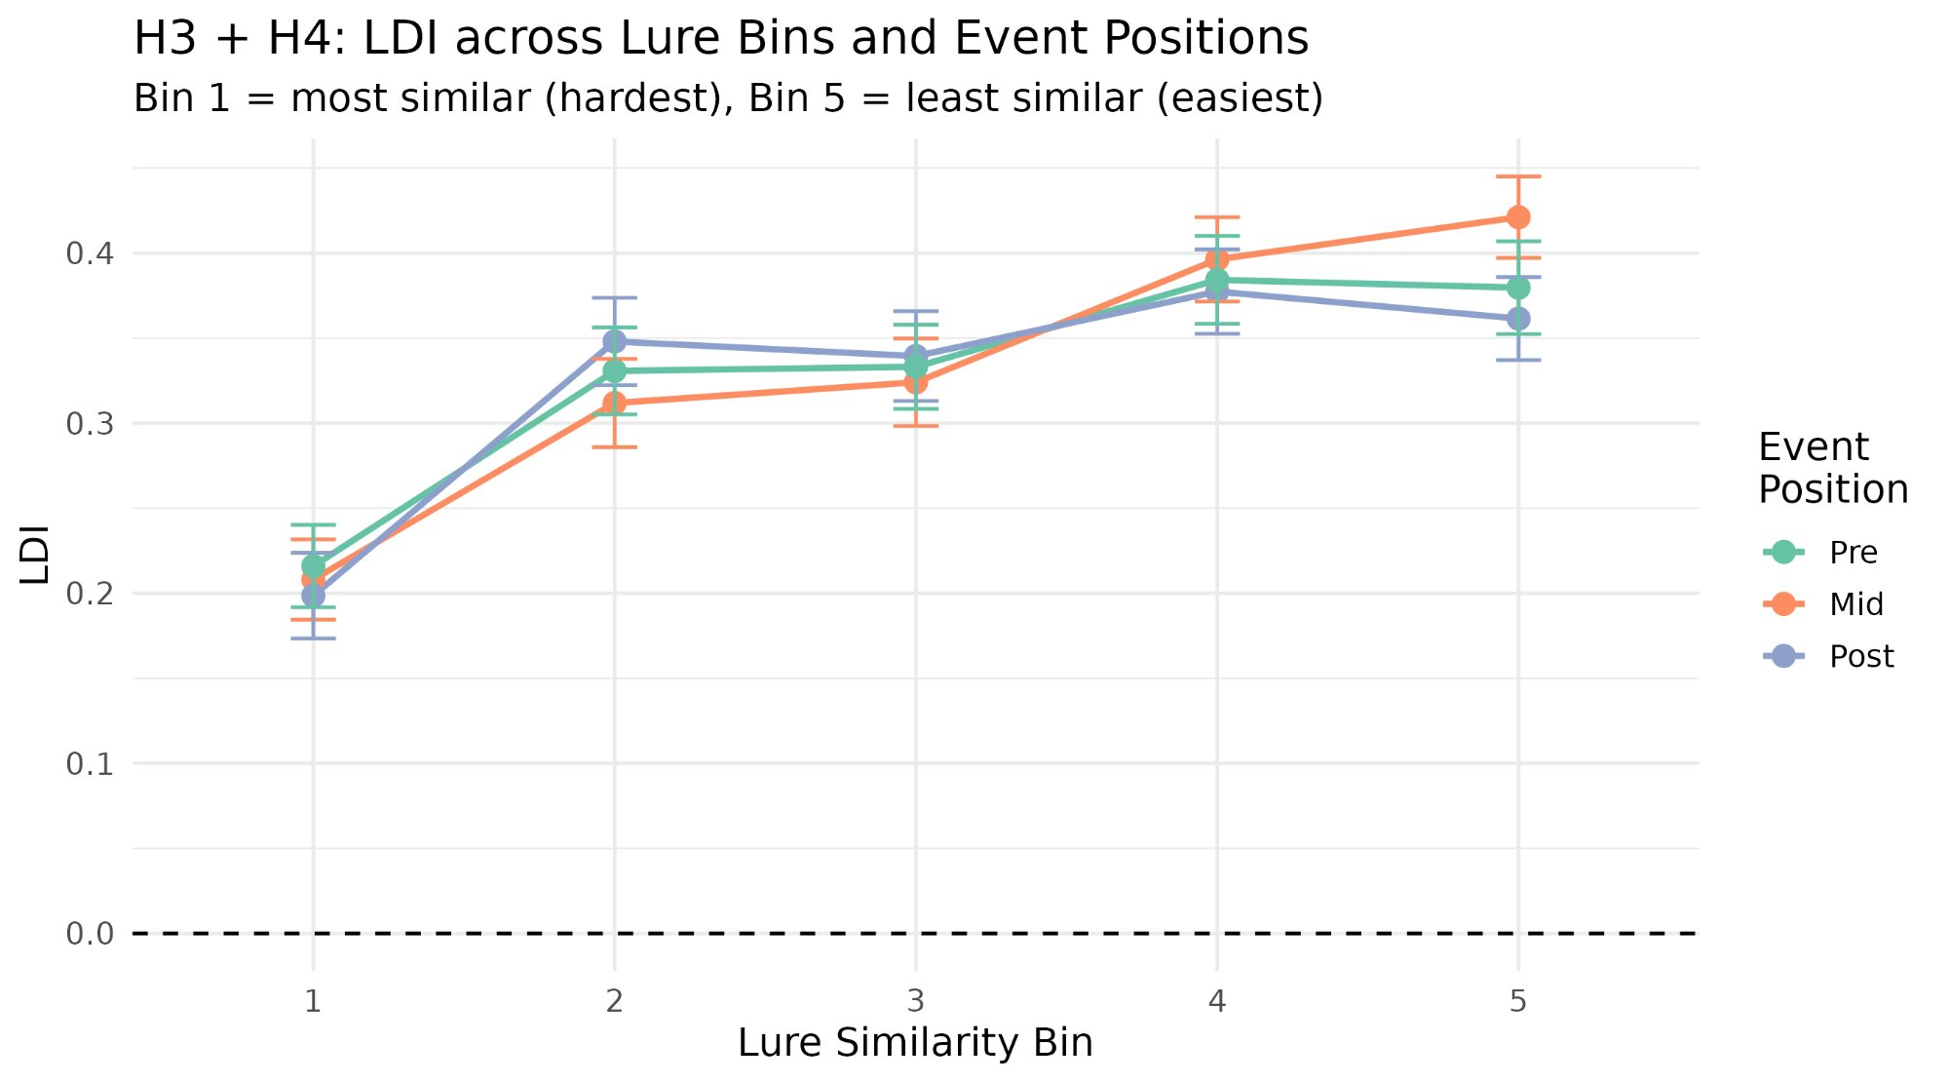
H4 — Are more similar lures harder to discriminate?
Bin 1 — Most Similar
LDI ≈ 0.20 at Bin 1. The lure looks nearly identical to the target, so the hippocampus must work hard to separate the two memory traces.
Bin 5 — Least Similar
LDI ≈ 0.40 at Bin 5. When the lure is clearly different, discrimination is easier — the gradient holds across all event positions.
✓ H4 Confirmed
LDI increases consistently from Bin 1 to Bin 5 at every position. The graded difficulty structure of the MST is validated.
Fig 8. LDI across lure similarity bins 1–5, by event position. Bin 1 = most similar (hardest). Bin 5 = least similar (easiest).

Slide 12
Conclusions
H1
Supported
H2
Partial
Event boundaries do slow processing
Boundaries modestly impair recognition
Post-boundary encoding RT was reliably slower — but only when the boundary included a task-shift (Both & Task-Only). Item-Only showed no effect, revealing the task component is key.
Post-boundary items had slightly lower REC (0.597 vs ~0.63). The pattern directionally replicates Morse et al. (2023) but is subtle, suggesting a real but small encoding cost.
H3
Not Supported
H4
Confirmed
No boundary effect on discrimination
Similarity gradient is robust
LDI was flat across all three positions. Design differences — 3-response test, 7-item blocks, shoebox question — may explain the failure to replicate Morse et al.'s LDI finding.
LDI increased monotonically Bin 1 → 5 in every condition and position. The graded structure of the MST is functioning as expected — harder lures are harder to discriminate.
Morse et al. (2023) · Zacks et al. (2007) · Stark et al. (2013, 2019) · Kirwan & Stark (2007)

Slide 13
Limitations & Future Directions
01
Replicate with a 2-response test
02
Test at finer lure-bin granularity
Our Old / Similar / New test differs from Morse et al.'s Old / New design. Switching to 2-response may restore the LDI boundary effect by removing the 'Similar' option that participants relied on heavily.
H4 was confirmed but H3 was not. It's possible a boundary effect exists at Bin 1 only (hardest lures). An item-level analysis may reveal a position × bin interaction that aggregated data masks.
03
Increase block length to 10 items
04
Neural correlates with fMRI / EEG
Morse et al. used 10-item events; we used 7. With 7 items, 'Mid' collapses positions 2–6 — a coarser measure. Longer blocks give more statistical power to detect within-event gradients.
Link encoding-phase RT spikes to hippocampal boundary responses. Are post-boundary RT costs correlated with boundary-triggered memory updating in CA1 or the entorhinal cortex?
Thank you · BRSM 2026

Slide 14
References
Baldassano, C., et al. (2017). Discovering event structure in continuous narrative perception and memory. Neuron, 95(3), 709–721.
Ben-Yakov, A., & Dudai, Y. (2011). Constructing realistic engrams: Poststimulus activity predicts subsequent episodic memory. J. Neuroscience, 31(24), 9032–9042.
Ben-Yakov, A., & Henson, R. N. (2018). The hippocampal film editor: Sensitivity and specificity to event boundaries in continuous experience. J. Neuroscience, 38(47), 10057–10068.
Kirwan, C. B., & Stark, C. E. L. (2007). Overcoming interference: fMRI investigation of pattern separation in the medial temporal lobe. Learning & Memory, 14(9), 625–633.
Morse, S. J., Karagoz, A. B., & Reagh, Z. M. (2023). Event boundaries directionally influence item-level recognition memory. [Preprint]
Radvansky, G. A., & Zacks, J. M. (2014). Event Cognition. Oxford University Press.
Stark, S. M., et al. (2013). A task to assess behavioral pattern separation (BPS) in humans: Data from healthy aging and mild cognitive impairment. Neuropsychologia, 51(12), 2442–2449.
Stark, S. M., Kirwan, C. B., & Stark, C. E. L. (2019). Mnemonic similarity task: A tool for assessing hippocampal integrity. Trends in Cognitive Sciences, 23(11), 938–951.
Yassa, M. A., & Stark, C. E. L. (2011). Pattern separation in the hippocampus. Trends in Neurosciences, 34(10), 515–525.
Zacks, J. M., et al. (2007). Event perception: A mind-brain perspective. Psychological Bulletin, 133(2), 273–293.
Stimuli: Stark Lab MST Image Sets · starklab.bio.uci.edu

