Slide 1
Superstore Sales Dashboard - Task 3
Garima Negi | Data Analyst Internship @ Elevate Labs
Tool Used: Power BI
Date: August 2025

Slide 2
Project Objective & Dataset
- Analyze Superstore sales dataset to extract business insights
- Create an interactive dashboard using Power BI
- Visualize key performance indicators for stakeholders
- Dataset Source: Kaggle (Superstore Sales Excel dataset)

Slide 3
Key KPIs Tracked
- Total Sales
- Total Profit
- Order Count
- Profit Margin %
- Sales vs Last Year
- Sales by Region, Segment, Category and State

Slide 4
Dashboard Overview
→ Visuals: KPIs, Line Chart, Bar Chart, Donut Chart, Map
→ Slicers: Region, Segment, Category, Order Date
→ Fully interactive and dynamic layout

Slide 5
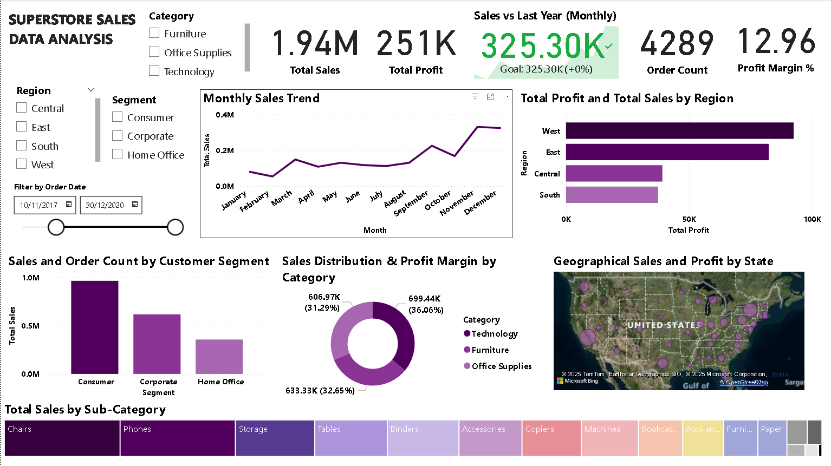

Slide 6
Key Business Insights
📌 Technology category had the highest sales (₹699K)
📌 West region was most profitable (~₹100K profit)
📌 Consumer segment generated the most orders
📌 Sales peaked in Q4 (Oct–Dec) across multiple years
📌 Office Supplies had moderate sales but lower profit margin

Slide 7
Tools Used & Learning
Tools Used:
- Power BI
- DAX (Data Analysis Expressions)
- Excel (for cleaning)
Learnings:
- Creating DAX measures for KPIs
- Designing interactive dashboards
- Interpreting real business data for decision-making

