Slide 1

Deep learning-based ovarian cancer subtypes identification using multi-omics data
Published: 24 August 2020
Authors:
Long-Yi Guo
Ai-Hua Wu,
Yong-xia Wang,
Li-ping Zhang,
Hua Chai &
Xue-Fang Liang
Second School of Clinical Medicine, Guangzhou University of Chinese Medicine, Guangzhou, 510020, China
Center for Reproductive Medicine, Guangdong Hospital of Traditional Chinese Medicine, Guangzhou, 510120, China
PMID: 32863885
PMCID: PMC7447574
DOI: 10.1186/s13040-020-00222-x
Team Details:
Garima Singh (1806143)
Mrinal (1806149)
Notes:
1 slide: Details of selected paper (title of the paper, authors and their university/institute affiliation, the year of publication, and the journal/conference details) and the team details (Name and Roll No of team members)

Slide 2
DATA SET DESCRIPTION- FEATURES,
CLASSES, PRE-PROCESSING:
We used the multi-omics ovarian data for our training and testing purpose. Here, multi-omics dataset refers to the dataset containing multiple omes which in our cases are genomes.
The data type of our dataset is real. The given data basically contains the mutation in genes of the patients suffering from ovarian cancer over a period of time.
SOURCE : The Cancer Genome Atlas(TCGA) shared the data of patients suffering from various types of cancers. The data is available on their website https://portal.gdc.cancer.gov. The data has been shared from Surgical Oncology Research Lab of Boston and UCLA School of Medicine. The data is generated from the RNA-seq and mRNA information of the patients.
Notes:
Data-set description used: source, #features, types of features (real, integral, etc), #classes, and the names of the classes. Pre-processing (if any).

Slide 3
SAMPLE ROW AND EXPLANATION
TCGA.2W.A8YY.01 TCGA.4J.AA1J.01
-0.369700774 -0.711083223
-0.376244799 -0.747875378
TCGA(The Cancer Genome Atlas) dataset contains the reports of various cancer patients including their imaging, cancer type and gene mutation and then the dataset is prepared on all the factors.
We have considered the data of two patients suffering from cancer whose data was prepared based on three types of omics data which includes mRNA, miRNA and CNV. These data are further studied to classify various types of cancers and also for the treatment purpose of the patient.
Notes:
A sample row from the dataset. In case, you did not use the dataset given in the paper, mention the alternate dataset used by you, and what are the differences in the datasets.

Slide 4
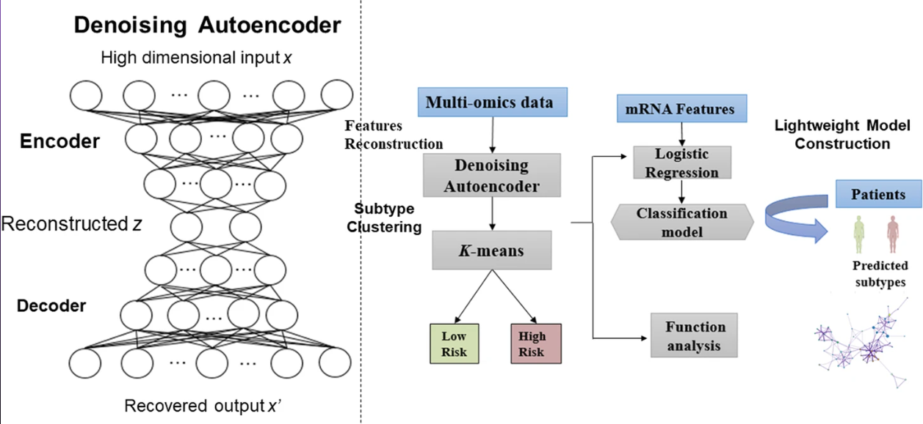
MODEL PROPOSED IN PAPER
The model proposed in the paper is logistic regression classification model with mRNA data. The cluster subtype used to build the model is k-means.
Notes:
The model proposed in the paper

Slide 5
MODEL PROPOSED BY US AND KEY DIFFERENCES IN BOTH MODELS
The model used by us is logistic regression classification model which uses K-means clustering techniques. We have chosen to align with the paper specifications and techniques as closely as possible but changed certain values to improve accuracy score.
The paper used DAE-k means clustering method which we have already seen. We used k-means which has lower silhouette score compared to the one used in paper. The optimal number of clusters are again determined using silhouette score. In the model, we tested the k from [2, 8] and we finally used k=2 as it had the highest silhouette score.
After obtaining the labels clustered by k-means, we built a light-weighted mRNA model for reducing the number of genes needed to identify cancer subtypes by using logistic regression algorithm.
Notes:
The model proposed in the paper and the model implemented by you. What are the differences (if any)?
One Epoch is when an ENTIRE dataset is passed forward and backward through the neural network only ONCE.
Since one epoch is too big to feed to the computer at once we divide it in several smaller batches.

Slide 6
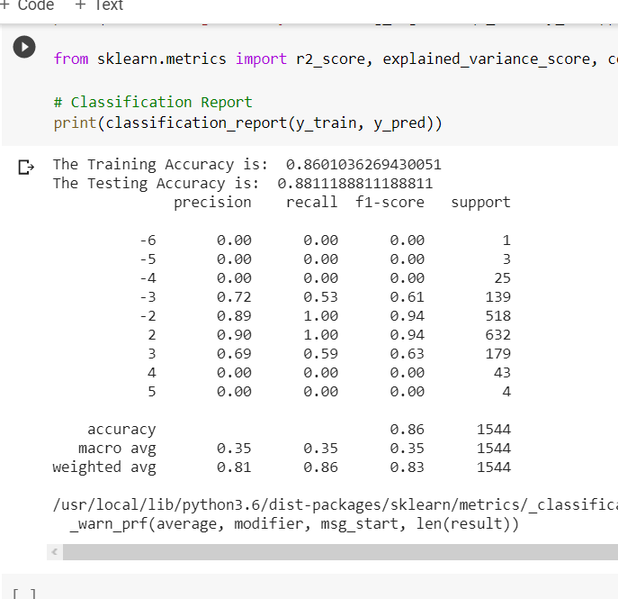
RESULTS OBTAINED
We had our dataset of patients, which we split for training and testing of our model. We randomly split our dataset and applied our Logistic Regression model on our training and testing dataset.
Further, we calculated the feature importance of various columns to select the best suited one which in turn would improvise our model.
Finally, we calculated training and testing accuracy of our model.
Notes:
results obtained.

Slide 7
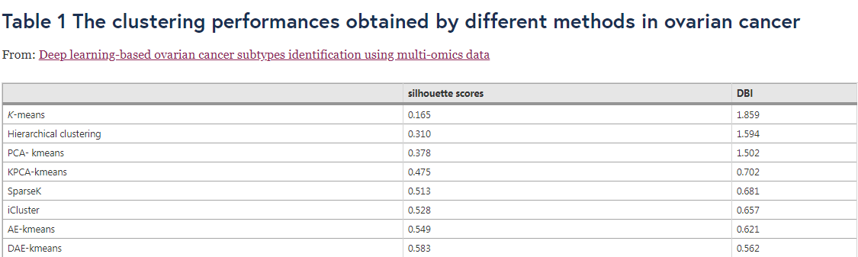
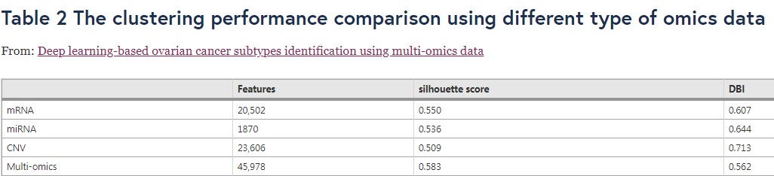
DIFFERENCES IN ACCURACY VALUES
Why we used DAE-Kmeans and multi-omics data?
Notes:
The silhouette score is used to measure the cluster performance and the log rank p-value to measure the differences of the different subtypes of cancers. The higher silhouette score means the method achieved better performance for clustering, and the lower log-rank p-value means the greater differences in cancer subtypes.
We used the silhouette scores and Davies Bouldin scores (DBI) to evaluate the clustering performances of the methods. It is obviously that without any dimensionality reduction method, K-means achieved lowest silhouette score and highest DBI among these methods. And the methods based on traditional dimensionality reduction methods (PCA, KPCA) performed only better than k-means and hierarchical clustering, but worse than SparseK, iCluster and two deep learning-based methods. The results in Table 1 prove the power of deep learning, and DAE-kmeans perform best than any other methods indicated the superiority of our method.
In Table 2 we give the clustering performance comparison using different type of omics data. The results indicated that when using single type of omics data, the mRNA performed best with the silhouette score 0.550, and the CNV achieved worst performance with silhouette score value of 0.509. The miRNA performed better than CNV but worse than mRNA. It is obviously that clustering using multi-omics in our deep learning framework achieved 6% higher silhouette score and 7.41% lower DBI, compared with which obtained by using mRNA data.
DAE-K means is better custering method because its silhouetter score is hogh

Slide 8
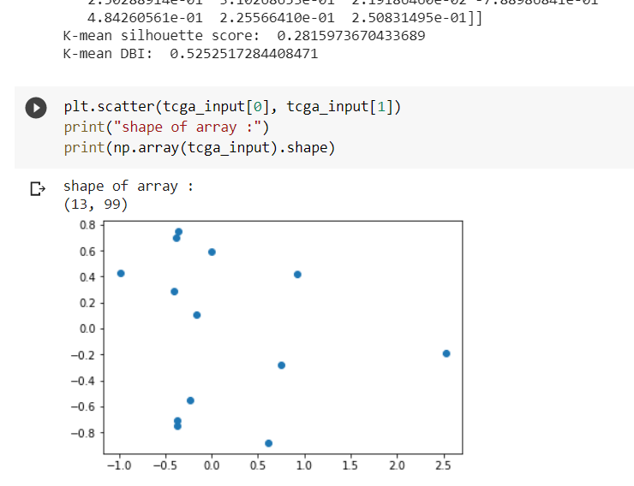
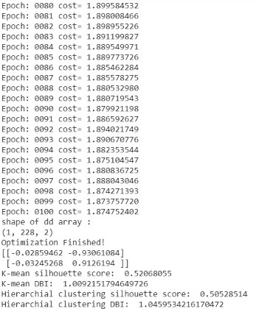
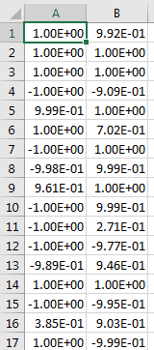
SAMPLE RESULT AND EXPLANATION
Different cost values for different epochs helped us to run our model making various assumptions and then select the assumption corresponding to best cost value among the given epochs.
We also calculated silhouette values for some clustering methods. DAE-K means has the highest values. So, we used DAE-K means clustering in our model.
Notes:
PUT sample row screenshot of obtained result and brief explanation

Slide 9
CONCLUSION AND REFERENCES
We designed a novel deep learning-based framework for ovarian cancer subtype identification, and a logistic regression method was used to build the light-weighted classification model.
Compared to identify subtypes using single omics data, the multi-omics data analysis can utilize more information. Hence, we proposed a model which in turn would help to robustly identify ovarian cancer subtypes.
Ovarian cancer ranks 5th in cancer death among women. It has high mortality rate. Also risk of getting ovarian cancer is quite high. So, identifying molecular subtypes of ovarian cancer is important.
References:
https://biodatamining.biomedcentral.com/articles/10.1186/s13040-020-00222-x
https://linkinghub.elsevier.com/retrieve/pii/S0090825810002623
https://clincancerres.aacrjournals.org/content/14/16/5198
Notes:
Take from paper theory

Slide 10
THANK YOU
Team Details:
Garima Singh (1806143)
Mrinal (1806149)

