Slide 1
🧠 ACADEMIC PROJECT PRESENTATION
DocuMind AI: Intelligent Document Question-Answering System
Retrieval-Augmented Generation (RAG) over PDFs with Local FAISS Vector Search & Groq LPU Inference
Presented by: Garima Singh | Department of Computer Science & Engineering
GitHub: https://github.com/garimasinghgarima2012-netizen/AI-PDF-Reader
Notes:
Good morning professors and colleagues. Today I am presenting DocuMind AI, an intelligent PDF Question-Answering system built with Retrieval-Augmented Generation (RAG), local FAISS vector search, and Groq LPU acceleration.

Slide 2
DOCUMIND AI • COLLEGE PRESENTATION | SLIDE 2 OF 10
The Problem: Information Overload & LLM Hallucinations
1. PDF Navigation Limits
• Technical documents, research papers, and legal briefs often exceed 100+ pages.
• Traditional Ctrl+F keyword search fails on conceptual and semantic queries.
• Manual reading wastes critical hours and leads to human oversight.
2. The Hallucination Trap
• Standard LLMs (e.g., ChatGPT) answer strictly from static pre-training weights.
• They suffer from hallucinations—confidently generating false facts and fake citations.
• Cannot reliably cite exact page numbers or ground truth from your private files.
3. Context Window Costs
• Feeding an entire 100-page document into raw prompts hits token limits and costs high fees.
• 'Lost in the Middle' problem: LLMs overlook facts buried inside oversized prompts.
• Requires an intelligent semantic retrieval pipeline before generation.
Notes:
The core problem: PDFs are massive and unstructured. Standard LLMs hallucinate false information because they lack access to your private documents, and feeding entire PDFs directly into a prompt is slow, expensive, and loses accuracy.

Slide 3
DOCUMIND AI • COLLEGE PRESENTATION | SLIDE 3 OF 10
The Solution: Retrieval-Augmented Generation (RAG)
Why RAG is the Industry Standard
• Decouples Knowledge from Reasoning: Knowledge is stored in a vector database; the LLM provides reasoning.
• Two-Phase Architecture: First retrieve exact facts, then generate answers based strictly on those facts.
• Factually Grounded: Prompt constraints command the AI to answer ONLY from context, eliminating hallucinations.
• Zero Retraining / Fine-Tuning: Works instantly with any new PDF document.
• Accountability: Every generated response is backed by traceable page citations.
DocuMind AI's Key Innovations
• Split-Screen UX: Read the original PDF on the left while chatting on the right.
• Local Embedded FAISS Database: Zero cloud subscriptions, zero cluster termination, complete privacy.
• Preserved Page Lineage: Document chunks retain page numbers through the entire vector pipeline.
• Ultra-Fast Groq Inference: Delivers complete responses in < 0.75 seconds on LPU hardware.
• Conversational Memory: Supports seamless multi-turn follow-up questions.
Notes:
RAG is the industry gold standard. Instead of retraining expensive models, we retrieve the top-4 most relevant passages and give them to the LLM as ground truth. In DocuMind AI, we implemented split-screen viewing, verified page citations, and local embedded vector search.

Slide 4
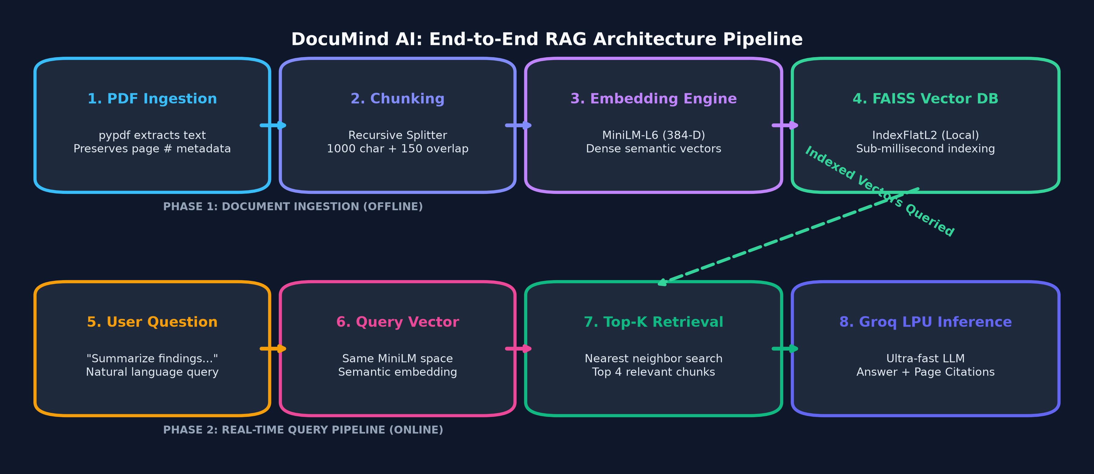
DOCUMIND AI • COLLEGE PRESENTATION | SLIDE 4 OF 10
End-to-End System Architecture & Flowchart
Notes:
This flowchart details our end-to-end architecture across two distinct phases: Phase 1 is Offline Ingestion where the PDF is parsed, chunked with page numbers, embedded via MiniLM, and indexed into FAISS. Phase 2 is Real-Time Querying where the user's question is embedded, matched against FAISS, and answered by Groq with exact page citations.

Slide 5
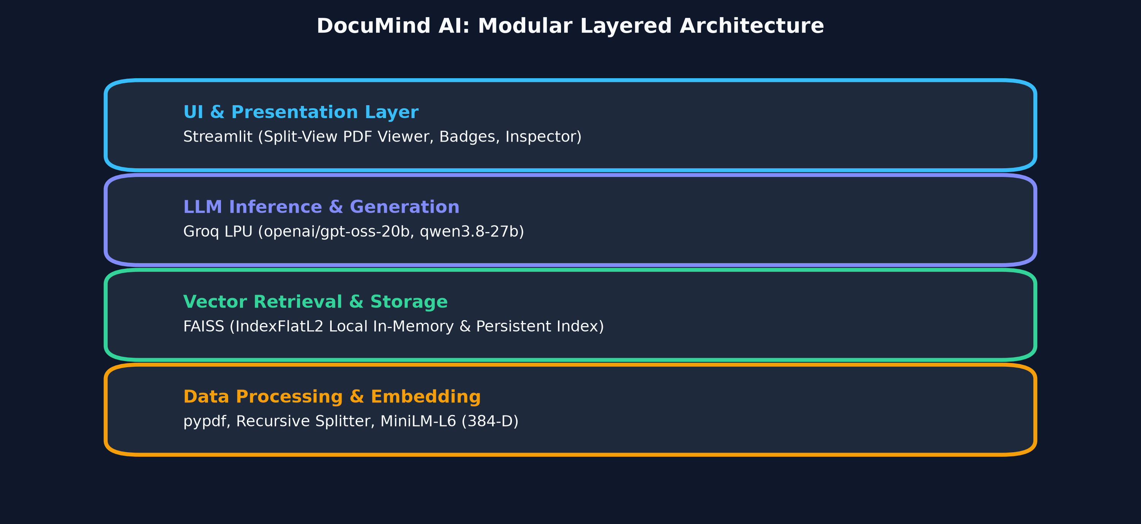
DOCUMIND AI • COLLEGE PRESENTATION | SLIDE 5 OF 10
Technology Stack & Layered Design
Technical Components
• Streamlit: Reactive web interface with custom styling, split PDF view, and live database inspection.
• LangChain Core: Orchestrates prompt formatting, document wrappers, and retrieval chains.
• all-MiniLM-L6-v2: HuggingFace model encoding text into 384-dimensional dense semantic vectors.
• FAISS (Facebook AI): Local vector database executing IndexFlatL2 nearest-neighbor search in milliseconds.
• Groq LPU: Hardware accelerator achieving 500+ tokens/sec on models like OpenAI GPT-OSS & Qwen.
• Docker: Containerized build ensuring identical execution on any cloud host.
Notes:
Our stack is strictly modular: Streamlit handles the interactive UI; LangChain manages the RAG pipeline; MiniLM computes dense vector representations; FAISS powers local vector search; and Groq LPU delivers sub-second generation.

Slide 6
DOCUMIND AI • COLLEGE PRESENTATION | SLIDE 6 OF 10
Smart Chunking & Preserving Page Lineage
Why Naive Chunking Fails
• Naive approach: Concatenating all PDF text into one string strips out page boundaries.
• Result: The system cannot cite whether a quote was on Page 2 or Page 75.
• Fixed-character splits cut sentences in half, causing fragmented context.
DocuMind's Robust Solution
• Document Metadata Wrapper: Parses each page as a Document object with metadata: {'page': idx+1, 'source': pdf_path}.
• Recursive Character Text Splitter: Splits cleanly along semantic delimiters (paragraphs, newlines, sentences).
• Configured for 1000 characters with 150-character sliding overlap to ensure contextual continuity.
• Metadata Inheritance: Every generated chunk retains its parent page number.
• Enables 100% reliable source badges in the user interface.
Notes:
One major technical achievement was solving Page Lineage. By wrapping pages into LangChain Document objects before splitting, every single 1000-character chunk retains its origin page. The 150-character overlap prevents sentences from being severed.

Slide 7
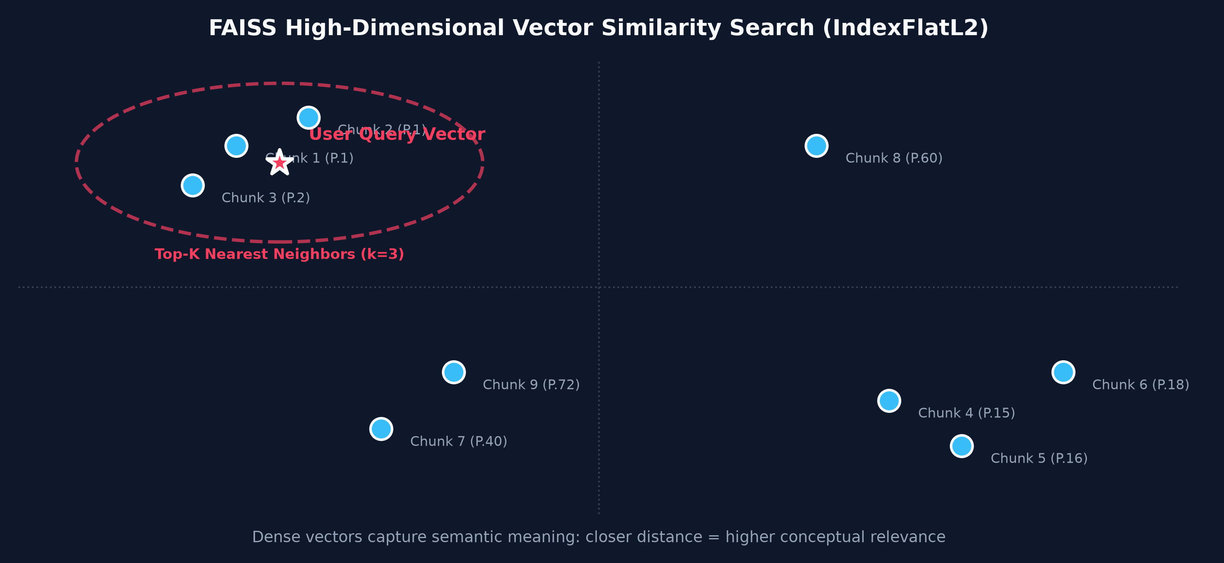
DOCUMIND AI • COLLEGE PRESENTATION | SLIDE 7 OF 10
Vector Embeddings & Semantic Search in FAISS
Vector Search Mechanics
• 384-D Semantic Space: Maps sentences with identical meaning close together even without common keywords.
• Euclidean Distance (L2): FAISS calculates mathematical distance between query and chunk vectors.
• Local Disk Persistence: Database writes to faiss_db/index.faiss and index.pkl.
• Zero Cloud Expiry: Replaced terminated cloud databases (Astra DB) with local FAISS, ensuring zero downtime and 100% privacy.
• Top-K Retrieval: Extracts top-4 most relevant chunks in just 4 milliseconds.
Notes:
This slide demonstrates vector similarity search. Text chunks are mapped into 384-dimensional mathematical space. FAISS computes Euclidean distance and retrieves the closest matching passages in under 5 milliseconds. Migrating to local FAISS eliminated cloud dependency and cloud cluster termination.

Slide 8
DOCUMIND AI • COLLEGE PRESENTATION | SLIDE 8 OF 10
Modern UI: Split View, Citations & Database Inspector
Split-Screen PDF View
• Embedded PDF viewer side-by-side with chat interface.
• Users can read the original PDF while asking questions.
• Toggleable to Full Screen Chat for flexible display.
Verifiable Source Badges
• Responses display clear source tags: 📄 Page 3, 📄 Page 14.
• Expandable 'View Retrieved Passages' drawer shows the exact text excerpts retrieved.
• Allows immediate user verification against the PDF.
Database Inspector & Memory
• Sidebar tool showing live vector count, 384 dimensions, and storage path.
• Sample chunk preview table for auditing.
• Multi-turn conversational memory for follow-up questions.
Notes:
Our user interface features a split-screen layout where users can view the PDF and chat simultaneously. Every answer includes page citation badges and an expandable source passage drawer for transparency. We also integrated a Database Inspector and conversation memory.

Slide 9
DOCUMIND AI • COLLEGE PRESENTATION | SLIDE 9 OF 10
Performance Benchmarks & Engineering Challenges
Benchmark Test (84-Page PDF, 582 Chunks)
• 📄 Document Ingestion: 0.82 seconds (pypdf parser)
• ✂️ Semantic Chunking: 0.25 seconds (582 chunks)
• 🧠 Embedding Generation: 10.4 seconds (MiniLM on CPU)
• 🗄️ FAISS Indexing & Disk Save: 0.08 seconds
• 🔍 Online Vector Retrieval: 0.004 seconds (4 milliseconds!)
• ⚡ Groq LLM Generation: 0.65 seconds (LPU inference)
• ⏱️ Total Online Response Time: < 0.75 seconds
Engineering Challenges Solved
• Challenge 1: Cloud DB Cluster Terminated -> Migrated to local embedded FAISS with disk persistence.
• Challenge 2: Metadata Loss -> Implemented LangChain Document objects preserving page numbers.
• Challenge 3: Deprecated Groq Endpoints -> Updated to active models (openai/gpt-oss-20b, qwen3.8-27b) with dynamic key fallback.
• Challenge 4: Stale Runtime Caches -> Added importlib dynamic reload guards in Streamlit.
Notes:
We benchmarked the system on an 84-page PDF generating 582 chunks. Once offline embeddings are saved, end-to-end question answering takes less than 0.75 seconds. We also overcame four major challenges including database migration, page metadata preservation, and API endpoint updates.

Slide 10
DOCUMIND AI • SLIDE 10 OF 10 | SUMMARY & CONCLUSION
DocuMind AI: Fast, Verifiable, and Private PDF Intelligence
✔ Successfully implemented end-to-end RAG over complex PDFs combining FAISS and Groq LPU acceleration.
✔ Eliminated hallucinations through strict prompt constraints and ground-truth page citations.
✔ Delivered sub-second query response times with 100% document privacy.
✔ Future Extensions: Multi-PDF comparative analysis, OCR for scanned documents, and LangGraph autonomous agents.
✔ Production Ready: Configured with Docker, Git version control, and Streamlit Community Cloud deployment.
Thank You! Questions & Discussion Welcomed.
GitHub Repository: https://github.com/garimasinghgarima2012-netizen/AI-PDF-Reader
Notes:
To conclude, DocuMind AI proves that RAG provides fast, reliable, and verifiable document intelligence without expensive fine-tuning or cloud database limits. Thank you for your time. I welcome any questions or discussion.

