Slide 1
Precision medicine for cancer treatment capstone Project
Aakansh Tiwari | Garima Sood | Samia Feroze

Slide 2
Agenda background Data Variable selection modelling validation interpretation of results

Slide 3
Client introduction
BACKGROUND | DATA | VARIABLE SELECTION | MODELLING | VALIDATION | INTERPRETATION OF RESULTS
The Center for Translational Data Science is a research center pioneering translational data science to advance biology, medicine, and environmental research.
GDC a tool started by CDIS became a core component of the National Cancer Moonshot headed by Joe Biden.
GDC went live in 2016. with approximately 4.1 petabytes of data from National Cancer Institute-supported research programs, including some of the largest and most comprehensive cancer genomics datasets in the world -- such as TCGA and TARGET -- and more than 14,000 anonymized patient cases.
Research Areas:
Data Commons and Cloud
Complex Systems
High performance analysis
Bio-informatics
Pipelines for large scale data analysis
Open source data management

Slide 4



PROBLEM STATEMENT
BACKGROUND | DATA | VARIABLE SELECTION | MODELLING | VALIDATION | INTERPRETATION OF RESULTS
Why?
What?
How?
Why are we doing this?
What is the solution?
How are we solving it?
Patients diagnosed with cancer receive the same treatment based on type. Yet, response to the same treatment varies across patients, delaying patient recovery
This is solvable by the concept of precision medicine, an approach to patient care that allows doctors to select treatments that are most likely to help patients based on a genetic understanding of their disease
Using Breast cancer data, we will prove that “Different responses of patients to a particular treatment is driven by the difference in the levels of their gene expressions”

Slide 5
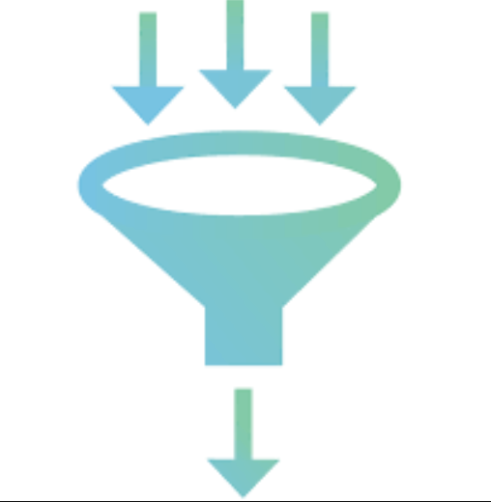


RESEARCH PURPOSE
BACKGROUND | DATA | VARIABLE SELECTION | MODELLING | VALIDATION | INTERPRETATION OF RESULTS
To derive an algorithm that can predict the best treatment for a breast cancer patient based on our dataset
The model will use progression free interval as a treatment outcome measure and evaluate treatments accordingly
Our three main research objectives:
3|
1|
Identify molecular and clinical features of high importance in predicting the progression free survival of a breast cancer patient
2|
Identify the interactions between genes and drugs affecting the progression free survival (treatment outcome) of the patients
Build a treatment outcome prediction model using the selected molecular features, clinical features, and treatment history

Slide 6
Data

Slide 7
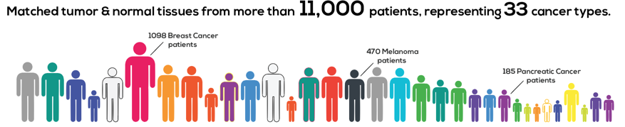
DATA
BACKGROUND | DATA | VARIABLE SELECTION | MODELLING | VALIDATION | INTERPRETATION OF RESULTS
Publicly available TCGA (The Cancer Genome Atlas) genomic and clinical data comprising:
mRNA (messenger RNA) sequence data
miRNA (micro RNA) sequence data
DNA methylation data
Clinical data

Slide 8


WHAT IS THE methylation, mrna & mirna data about?
RNAs copying gene information to create proteins
miRNAs silencing additional genes as per requirement for protein to be made
Genes present in all cells of the body
BREAST CELL
NUCLEUS
Protein synthesis
RIBOSOMES
X
Methylation:
Genes silenced within nucleus (not available for copying by RNA)
RNAs taking relevant genetic information outside nucleus
X
TRANSCRIPTION
TRANSLATION

Slide 9
Clinical DATA
BACKGROUND | DATA | VARIABLE SELECTION | MODELLING | VALIDATION | INTERPRETATION OF RESULTS
Consists of demographic, diagnostic, treatment and survival indicators
Demographic and Diagnostic features
Tumor stage
Menopause status
Treatment features
Radiation therapy flag
Lymph node count
Drug counts
Race
Survival indicators
Progression Free Interval: Period since treatment began during which the disease hasn’t worsened
Overall Survival time: Period from the date of diagnosis until the date of death/date of last follow up (depending on vital status)

Slide 10
Variable selection

Slide 11
Selecting features relevant to Breast cancer
BACKGROUND | DATA | VARIABLE SELECTION | MODELLING | VALIDATION | INTERPRETATION OF RESULTS
Summarizing the genomic features is paramount given their high dimensionality
~ 100,000 genomic features
Differential Expression Analysis
Recursive Feature Elimination
10 genomic features

Slide 12
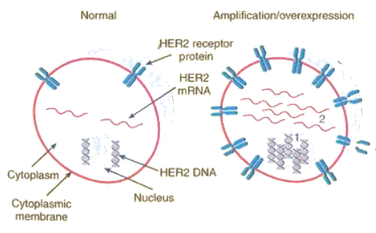
1. Differential expression analysis
BACKGROUND | DATA | VARIABLE SELECTION | MODELLING | VALIDATION | INTERPRETATION OF RESULTS
Every cell nucleus contains the complete genome, however only a small percentage of the genome is expressed in each cell
DEA is carried out on normalized counts to identify genes that are differentially expressed in breast cancer samples against normal samples using the DESeq2 library in R
Large set of genes deemed differentially expressed, warranting further reduction
Normal breast cell vs cancerous breast cell

Slide 13
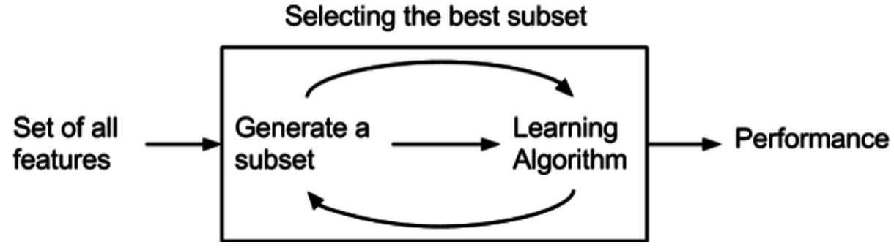
2. Recursive feature elimination
BACKGROUND | DATA | VARIABLE SELECTION | MODELLING | VALIDATION | INTERPRETATION OF RESULTS
RFE employed to eliminate redundancies and avoid overfitting
Random Forest model fit to variables selected in previous step
Determine which feature is the least important in making predictions on the testing dataset and drop this feature
Select feature set that yields highest classification accuracy

Slide 14



Final feature set
BACKGROUND | DATA | VARIABLE SELECTION | MODELLING | VALIDATION | INTERPRETATION OF RESULTS
1
mRNA genes: ENSG00000102796, ENSG00000198832, ENSG00000100906, ENSG00000134917, ENSG00000103269
miRNA gene: hsa.mir.146a
Dependent variable:
PFI time*
~
1
Methylation CpG sites: cg05337753, cg02282892
1
Clinical: tumor_stage_1, tumor_stage_3
Treatment: Doxorubicin, Paclitaxel, Trastuzumab, Epirubicin, Tamoxifen, Docetaxel, Letrozole, Carboplatin, Cyclophosphamide, Anastrozole, Fluorouracil, Exemestane, Methotrexate
*PFI time preferred over Overall Survival time as some deaths in data might occur due to non-cancer causes

Slide 15
Modeling

Slide 16

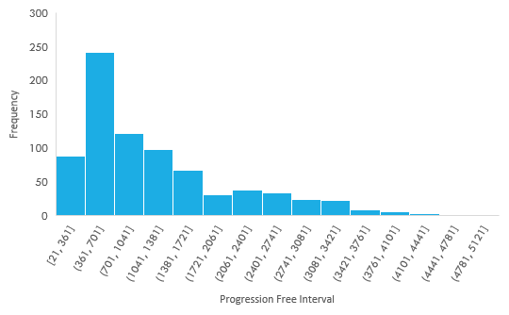

Pfi time binned into classes and modeled as dependent variable
BACKGROUND | DATA | VARIABLE SELECTION | MODELLING | VALIDATION | INTERPRETATION OF RESULTS
Considering the small sample size, equal frequency binning done for PFI to keep the analysis powerful by focusing on the causes of larger variation in the PFI time as compared to smaller changes (days of few weeks)
Considering two options:
Two bin classification (n=180 each) Three bin classification (n=120 each)
A
B
1
2
1
2
3
2.1 yrs.
1.5 yrs.
4 yrs.

Slide 17
prediction of two pfi time buckets
BACKGROUND | DATA | VARIABLE SELECTION | MODELLING | VALIDATION | INTERPRETATION OF RESULTS
Dependent variable classes:
PFI < 2.1 years (0)
PFI > 2.1 years (1)
Model evaluation:
Model | Cross-validated Accuracy (Sensitivity) | False Positive Rate
Logistic regression (Lasso) | 71% | 14%
Random Forest | 70% | 15%
SVM (Polynomial) | 72% | 11%
SVM (Radial) | 73% | 14%
Metrics for model evaluation:
Cross-Validated Accuracy (Sensitivity): High variation in sensitivity of the small test sample with varying test-train splits, and hence not trustworthy
False positive rate: We want to control the prediction of a higher PFI for a patient compared to the actual PFI
Results from four different binary classification models
Polynomial SVM is the best model for predicting PFI time with two buckets, considering its performance on both the Accuracy and False Positive Rate metrics
Improvement: We can explore the prediction of a more granular bucketing to increase the amount of variation being predicted, while keeping the model performance under consideration

Slide 18
Pfi time binned into classes and modeled as dependent variable
BACKGROUND | DATA | VARIABLE SELECTION | MODELLING | VALIDATION | INTERPRETATION OF RESULTS
Considering the small sample size, equal frequency binning done for PFI to keep the analysis powerful by focusing on the causes of larger variation in the PFI time as compared to smaller changes (days of few weeks)
Considering two options:
Two bin classification (n=180 each) Three bin classification (n=120 each)
A
B
1
2
1
2
3
2.1 yrs.
1.5 yrs.
4 yrs.

Slide 19
prediction of THREE pfi time buckets
BACKGROUND | DATA | VARIABLE SELECTION | MODELLING | VALIDATION | INTERPRETATION OF RESULTS
Dependent variable classes:
PFI < 1.5 years (1)
PFI <= 4 years (2)
PFI > 4 years (3)
Model evaluation:
Model | Cross-validated Accuracy (Sensitivity) | False Positive Rate
Random Forest | 57% | 21%
SVM (Polynomial) | 54% | 22%
SVM (Radial) | 56% | 23%
Metrics for model evaluation:
Cross-Validated Accuracy (Sensitivity): High variation in sensitivity of the small test sample with varying test-train splits, and hence not trustworthy
False positive rate: We want to control the prediction of a higher PFI for a patient compared to the actual PFI
Results from three different multi-classification models
Random Forest is the best model for predicting PFI time with three buckets, considering its performance on both the Accuracy and False Positive Rate metrics

Slide 20
Model selection
BACKGROUND | DATA | VARIABLE SELECTION | MODELLING | VALIDATION | INTERPRETATION OF RESULTS
We selected the three class PFI prediction model because it provides the ability to differentiate the survival classes better than the binary classification
Random Forest is better suited for multi-class classification and is not contingent on centering and scaling of the test data for accurate predictions. Hence, we have selected the Random Forest model with genes selected from survival analysis and recursive feature elimination, as our final model
With an accuracy of 57%, our model is 24 percentage points more accurate compared to the 33% random chance of prediction of one of the three classes
Since a tree based model gave us the best performance, our data has multiple inherent interactions within its structure which we will explore in the further slides

Slide 21
Comparison of features – genes vs. drugs
BACKGROUND | DATA | VARIABLE SELECTION | MODELLING | VALIDATION | INTERPRETATION OF RESULTS
Why compare the two?
Drug data will have some genetic information encoded because of prescription decision based on clinical attributes of the patient. Clinical attributes are in turn driven by genetic modifications
Other comparison:
Performance of genes selected after feature selection (DEA, survival model, and RFE) vs. the top 10 Principal Components from genetic data
Accuracy of models:
Model | Cross-validated Accuracy (Sensitivity)
Drugs only | 48%
Genes + Clinical | 49%
Gene PCA + Clinical + Drugs | 52%
Genes + Clinical + Drugs | 57%
Using only genes + clinical vs. only the drug data gave similar accuracies (~48%), which is lower than both the variables modeled together (57%)
Modeling the genes selected using DEA, survival models, and RFE, gave better accuracy as compared to the top 10 PCs from genetic data

Slide 22
Model validation

Slide 23
BACKGROUND | DATA | VARIABLE SELECTION | MODELLING | VALIDATION | INTERPRETATION OF RESULTS
MODEL validation – Why do we need it?
Situation – Sample & Bias
Model based on 360 samples (only)
Drugs are not prescribed randomly but based on certain features of the patients
Sampling is retrospective and not completely random. May lead to biased and confounded results
Solution – Permutation Testing
Permute the outcome variable (PFI) to create multiple datasets with random assignment of PFI buckets to the feature sets
Fit the finalized model to these datasets and record the cross-validation accuracies
Plot a histogram of all the accuracies obtained above and measure the p-value of the accuracy of our original model

Slide 24
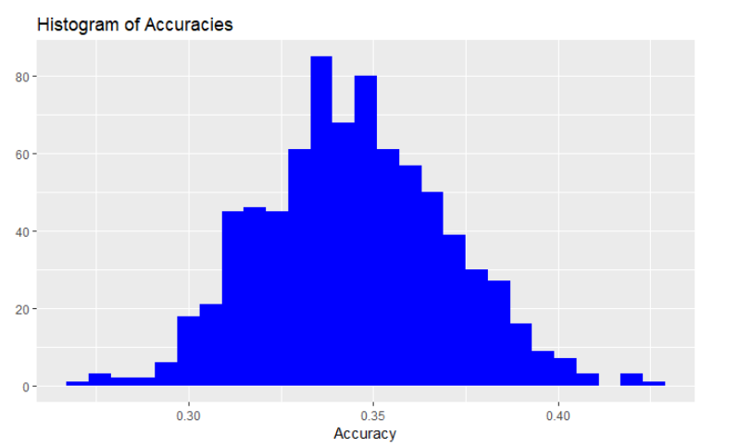
MODEL validation – Results
BACKGROUND | DATA | VARIABLE SELECTION | MODELLING | VALIDATION | INTERPRETATION OF RESULTS
Histogram of the cross-validated accuracies of models trained with 800 permuted samples
The highly significant p-value of our model’s accuracy shows that the model result and hence the dependence of patient PFI on the selected features is not by random chance
No. of models →
56.8%
Accuracy of our model
<2.2e-16
p-value of this accuracy in the distribution
0.30---- ------------------0.35-------------- --------0.40------------ ----------0.45---------------- ------0.50----------------------0.55 0.568
Accuracy →

Slide 25
Qualitative findings Interaction AMONG drugs and genes

Slide 26


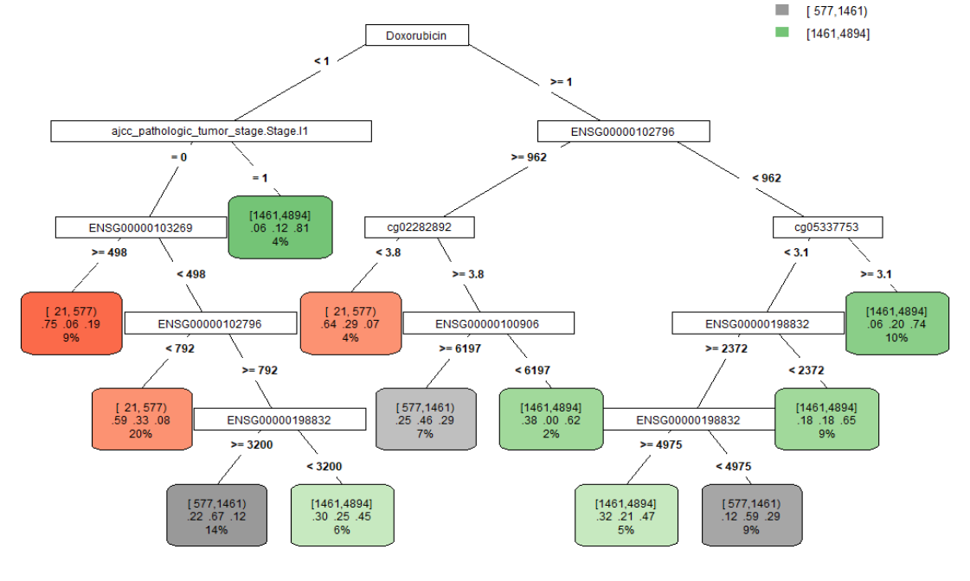

Identifying interactions and quantifying their effects on pfi TIME
BACKGROUND | DATA | VARIABLE SELECTION | MODELLING | VALIDATION | INTERPRETATION OF RESULTS
Identify by fitting a simple classification tree model
Quantify through the significance and coefficients of the interaction terms in an ordered logistic regression model
<1.5 yrs
1.5 – 4 yrs
>4 yrs
Interaction | Coeff.
Doxorubicin : tumor_Stage.I1 | 23.39
Doxorubicin : tumor_Stage.I1 : RHBDL1 | -10.57
Doxorubicin : tumor_Stage.I1 : DHRS12 | 20.53
tumor_Stage.I1: RHBDL1 | -9.95
Doxorubicin : DHRS12 | -0.51
Doxorubicin : DHRS12 : cg05337753 | -0.36
DHRS12 : cg05337753 | -0.30
tumor_Stage.I1

Slide 27

Visualizing effect of interacting features on probability of the 3 PFI buckets
Illustration
Tumor Stage > 1
Tumor Stage = 1
1
< 1.5 years
2
1.5 – 4 years
Gene 2 (High)
> 4 years
3
Lighter the area within the box, higher the probability of a better Progression Free Interval
3
2
Gene 2 (Low)
1
Gene 1 Expression →
Gene 1 Expression →

Slide 28
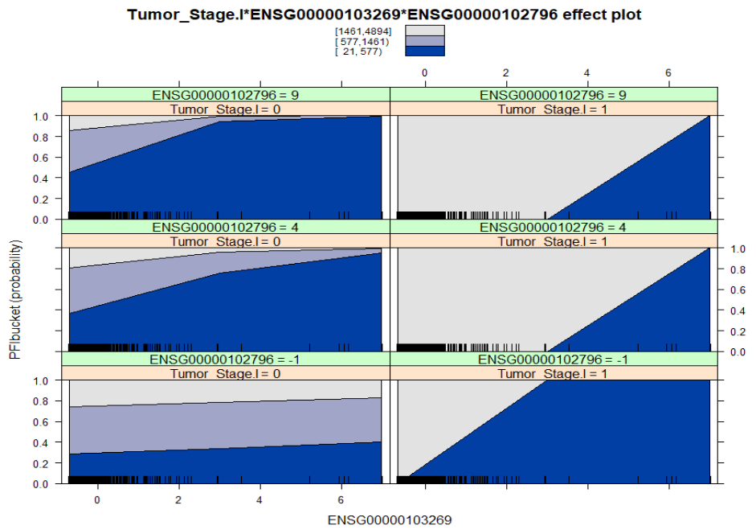
effect of the Tumor Stage*RHBDL1*DHRS12 interactions on PFI TIME
BACKGROUND | DATA | VARIABLE SELECTION | MODELLING | VALIDATION | INTERPRETATION OF RESULTS
Stacked charts of probability of patients belonging to each of the survival buckets given the combination of:
Tumor Stage 1 flag (left >1, right =1)
RHBDL1 expression (increasing left to right)
DHRS12 expression (increasing bottom to top)
Insights:
Tumor Stage 1 patients have a better PFI compared to patients at higher stages
Increasing expression of RHBDL1 gene implies reduced PFI time (tumor_Stage.I1: RHBDL1 coef. = -9.95)
Increasing expression of DHRS12 gene implies increased PFI time for Tumor Stage 1 patients (tumor_Stage.I1: DHRS12 coef. = 17.88)
Tumor Stage > 1
Tumor Stage = 1
DHRS12 = High
DHRS12 = Med
DHRS12 expression levels →
DHRS12 = Low
RHBDL1 expression levels →
RHBDL1 expression levels →

Slide 29
effect of the Tumor Stage*RHBDL1*DHRS12 interactions on PFI TIME
BACKGROUND | DATA | VARIABLE SELECTION | MODELLING | VALIDATION | INTERPRETATION OF RESULTS
Stacked charts of probability of patients belonging to each of the survival buckets given the combination of:
Tumor Stage 1 flag (left >1, right =1)
RHBDL1 expression (increasing left to right)
DHRS12 expression (increasing bottom to top)
Insights:
Tumor Stage 1 patients have a better PFI compared to patients at higher stages
Increasing expression of RHBDL1 gene implies reduced PFI time (tumor_Stage.I1: RHBDL1 coef. = -9.95)
Increasing expression of DHRS12 gene implies increased PFI time for Tumor Stage 1 patients (tumor_Stage.I1: DHRS12 coef. = 17.88)
Tumor Stage > 1
Tumor Stage = 1
DHRS12 = High
DHRS12 = Med
DHRS12 expression levels →
DHRS12 = Low
RHBDL1 expression levels →
RHBDL1 expression levels →

Slide 30
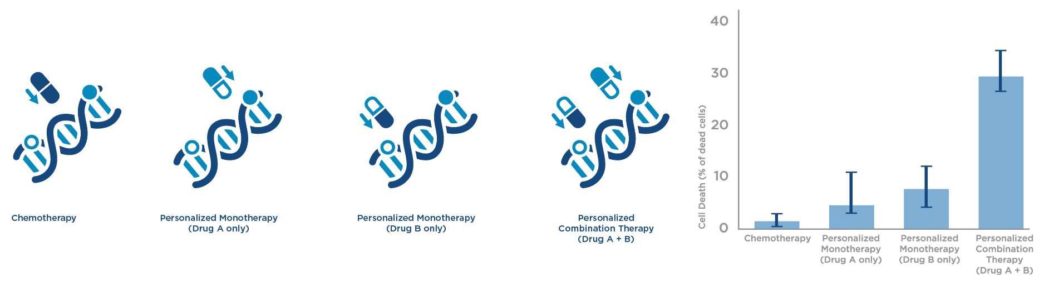
Studying effectiveness of drugs on tumors due to different gene expression variations
BACKGROUND | DATA | VARIABLE SELECTION | MODELLING | VALIDATION | INTERPRETATION OF RESULTS
We compared the effectiveness of Trastuzumab and Doxorubicin in terms of PFI on patients with different genetic variations, based on the observation that they are
the most effective, and
prescribed to a good proportion of patients in our sample
Illustration: Using gene-drug interaction for prescribing treatment
Survival time

Slide 31
Prep to understand next three slides
Illustration
Doxorubicin (Low)
Doxorubicin (High)
Trastuzumab
Both
Lighter the area within the box, higher the probability of a better Progression Free Interval
Trastuzumab (High)
Neither
Doxorubicin
Trastuzumab (Low)
Increasing expression levels →
Increasing expression levels →

Slide 32
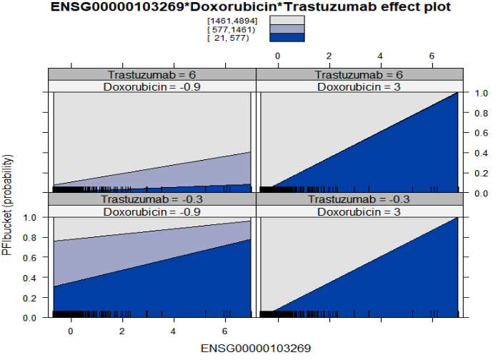
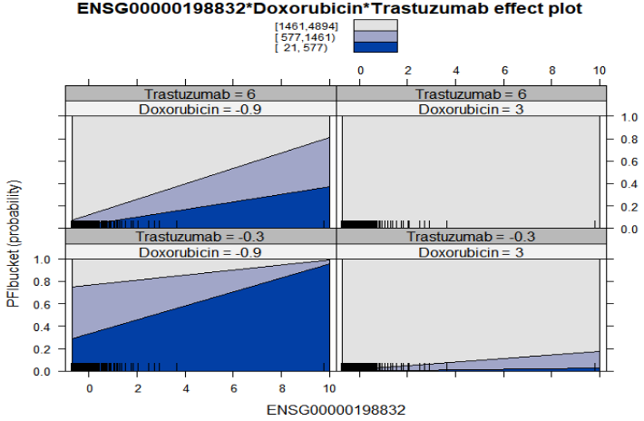
effect of gene-drug interactions on PFI TIME
BACKGROUND | DATA | VARIABLE SELECTION | MODELLING | VALIDATION | INTERPRETATION OF RESULTS
Trastuzumab is more effective in improving PFI of patients with high RHBDL1 expression
vs.
Doxorubicin works better for high SELENOM expression
Doxorubicin (Low)
Doxorubicin (High)
Doxorubicin (Low)
Doxorubicin (High)
Trastuzumab (High)
Trastuzumab (High)
Trastuzumab (Low)
Trastuzumab (Low)
RHBDL1 expression levels →
RHBDL1 expression levels →
SELENOM expression levels →
SELENOM expression levels →

Slide 33
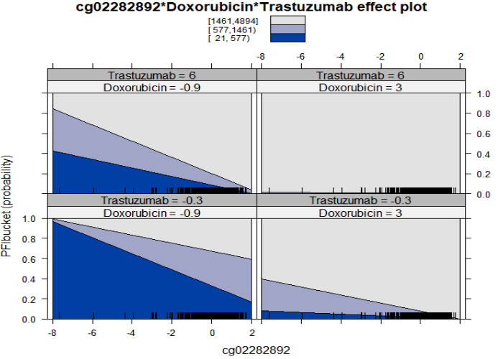
effect of gene-drug interactions on PFI TIME
BACKGROUND | DATA | VARIABLE SELECTION | MODELLING | VALIDATION | INTERPRETATION OF RESULTS
Lower methylation levels of cg02282892 also indicate lower PFI and Doxorubicin works better on such patients as compared to Trastuzumab
Doxorubicin (Low)
Doxorubicin (High)
Trastuzumab (High)
Trastuzumab (Low)

Slide 34
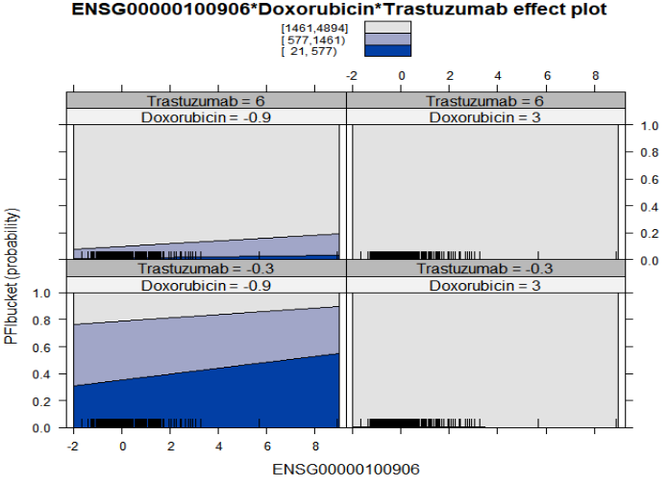
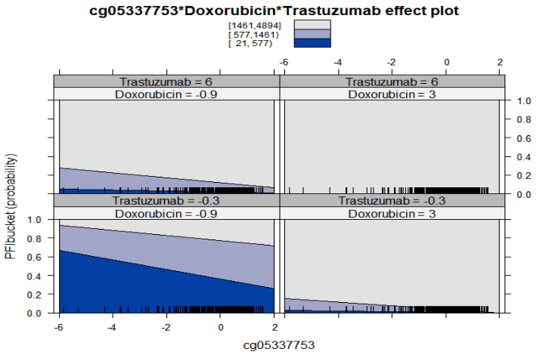
effect of gene-drug interactions on PFI TIME
BACKGROUND | DATA | VARIABLE SELECTION | MODELLING | VALIDATION | INTERPRETATION OF RESULTS
Both the drugs show similar efficacy for NFKBIA and methylation cg05337753 variations
Doxorubicin (Low)
Doxorubicin (High)
Doxorubicin (Low)
Doxorubicin (High)
Trastuzumab (High)
Trastuzumab (High)
Trastuzumab (Low)
Trastuzumab (Low)
NFKBIA expression levels →
cg05337753 expression levels →

Slide 35

Example of Application area for this research
Genomic information has already helped to shape the development and use of some of the newest cancer treatments
For example,
Trastuzumab works only for women whose tumors have a particular genetic profile called HER-2 positive (subtype)
the Drug imatinib was designed to inhibit an altered enzyme produced by a fused version of two genes found in chronic myelogenous leukemia
Source: https://cancergenome.nih.gov/cancergenomics/impact

Slide 36
LIMITATIONS of the study
LIMITATIONS & FUTURE STEPS
Sample & Dimensionality
Small sample size and aggressive feature selection
Limited to US geography
Drug data
Dosage information not available
Order of use of therapies not taken into account
Modeling
Data not sufficient for test-train validation
Drugs modeled individually but some were prescribed in combination
Only chemotherapies considered as they were the most commonly prescribed
Drug assignment bias still exists even after permutation testing. The right way here would be to design a clinical trail with randomized drug assignment but that is difficult to accomplish

Slide 37
Future steps
LIMITATIONS & FUTURE STEPS
Gather data from multiple data sources to try and increase the sample size
Modeling
Interpretations & model evaluation
Work in tandem with cancer genetics experts to validate the outputs of gene selection algorithms, modeling of drug combinations, and interpreting interactions results
Perform modeling for other cancer types and with other molecular datasets (protein, mutation) to validate the same hypothesis
Data
Understand the level of genetic information already accounted for by clinical variables to avoid confounding effects of certain genes

Slide 38
QUESTIONS

Slide 39
APPENDIX

Slide 40
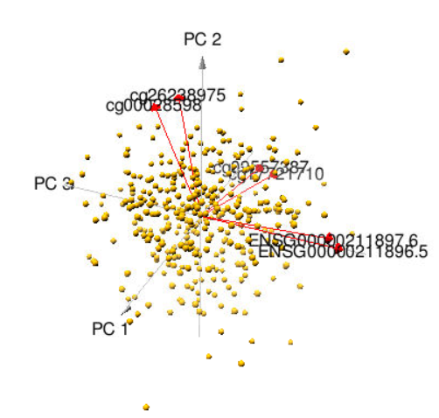
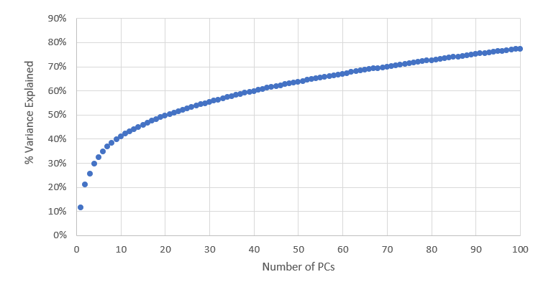
Principal Component analysis
Top 10 components explained 40% of the overall variance
Low interpretability
Variance Explained with the number of principal components
Principal Components 1, 2 and 3 of the entire omics data with important variable loadings

Slide 41
PREDICTION OF SQ.ROOT(PFI TIME)
Given the small sample size of the final dataset (360), we used cross-validated train metrics to measure the model performance. We were getting a high variance in the test performance results with different test-train split seeds due to the small sample size of test data.
Results:
Models | Cross- validated R square
Linear Regression | 28.4%
RF Regression | 33.4%
SV Regression | 27.2%
Conclusion : To test the capability of the combination of drugs history data and genetic/ clinical features in predicting the PFI time better, we divided the PFI time into three buckets.

Slide 42
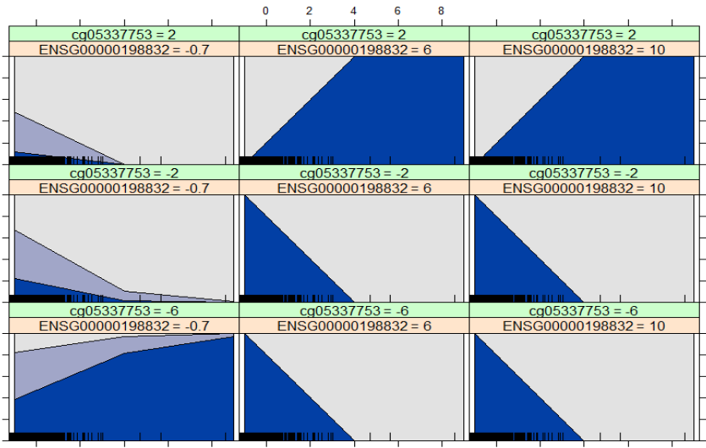
effect of gene interactions on survival
BACKGROUND | DATA | VARIABLE SELECTION | MODELLING | VALIDATION | INTERPRETATION OF RESULTS
Stacked charts of probability of patients belonging to each of the survival buckets given the combination of:
cg05337753 methylation (increasing bottom to top)
DHRS12 expression (increasing within the box, left to right)
SELENOM expression (increasing left to right)
Insight:
cg05337753 and SELENOM interact in such a way that the PFI time reduces at very low and very high expression values (explained by the negative coefficient for interaction)
At higher cg05337753 methylation, increase in SELENOM expression reduces PFI time.
cg--753 * DHRS12 * Cg---892
SELENOM (Low)
SELENOM (Med)
SELENOM (High)
cg--753 (High)
cg--753 (Med)
SELENOM expression levels →
cg--753 (Low)
DHRS12 expression levels →

Slide 43
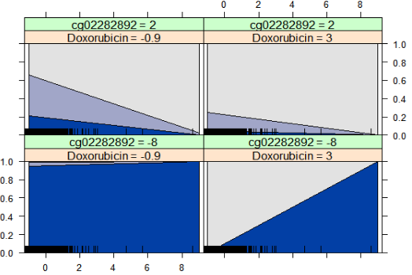
effect of gene-GENE interactions on PFI TIME
BACKGROUND | DATA | VARIABLE SELECTION | MODELLING | VALIDATION | INTERPRETATION OF RESULTS
Stacked charts of probability of patients belonging to each of the survival buckets given the combination of:
Doxorubicin (increasing left to right)
DHRS12 expression (increasing within the box, left to right)
cg02282892 methylation (increasing bottom to top)
Insights:
Higher the methylation, better the survival
PFS time reduces with increasing expression levels of DHRS12 gene at lower levels of cg02282892 methylation (explained by the negative coefficient for interaction)
This effect of DHRS12 gene on PFS time weakens at higher cg02282892 methylation
Doxoribicin * DHRS12 * Cg---892
2
Doxorubicin (Low)
Doxorubicin (High)
High Cg---892
Cg---892 expression levels →
Low Cg---892
DHRS12 expression levels →

Slide 44
effect of gene-GENE interactions on PFI TIME
BACKGROUND | DATA | VARIABLE SELECTION | MODELLING | VALIDATION | INTERPRETATION OF RESULTS
Stacked charts of probability of patients belonging to each of the survival buckets given the combination of:
Doxorubicin (increasing left to right)
DHRS12 expression (increasing within the box, left to right)
cg02282892 methylation (increasing bottom to top)
Insights:
Higher the methylation, better the survival
PFS time reduces with increasing expression levels of DHRS12 gene at lower levels of cg02282892 methylation (explained by the negative coefficient for interaction)
This effect of DHRS12 gene on PFS time weakens at higher cg02282892 methylation
Doxoribicin * DHRS12 * Cg---892
2
Doxorubicin (Low)
Doxorubicin (High)
High Cg---892
Cg---892 expression levels →
Low Cg---892
DHRS12 expression levels →

