Slide 1
Adult Income
Dataset — ML Classification Project
Predict whether income exceeds $50K/year based on census data
XGBoost
SVM
Random Forest
Logistic Regression
Gradient Boosting
UCI Adult / Census Income Dataset • 48,842 records • 14 features

Slide 2
Problem Statement & ML Pipeline
ML Pipeline Flow
Problem Statement
01
Initial Exploration
head(), info(), describe(), isnull()
Predict if a person earns >$50K/year
Binary classification: True (>50K) vs False (≤50K)
Dataset: UCI Adult Census Income
48,842 records, 14 raw features
Class imbalance: ~76% ≤50K, ~24% >50K
Goal: Build, compare and select best ML model
02
Hypothesis & Stats Tests
Chi-Square, p-values, ANOVA
03
Data Cleaning
Missing values, outliers, dtype fixes
04
EDA (Uni/Bi/Multivariate)
Histograms, box plots, heatmaps
05
Feature Engineering
Encoding, log-transform, grouping
06
Model Building
XGB, SVM, RF, LR, Gradient Boost

Slide 3
Initial Exploration
48,842
14
3
76%
Total Records
Raw Features
Null Columns
Class ≤50K
Key Features Overview
Feature | Type | Values / Range | Notes
age | Numerical | 17 – 90 | Binned: Young/Mid/Senior
workclass | Categorical | Private, Gov, Self-emp… | Grouped to 4 categories
education-num | Numerical | 1 – 16 | Grouped: Low/Undergrad/Grad
marital-status | Categorical | 7 values | Grouped: Married / No-spouse
occupation | Categorical | 14 values | Grouped: White/Blue/Service/Sales
hours-per-week | Numerical | 1 – 99 | Binned into 5 groups
capital-gain/loss | Numerical | Various | Log-transformed to net_capital
income (target) | Binary | >50K / ≤50K | Encoded as 1 / 0

Slide 4
Hypothesis & Statistical Tests
Hypothesis Statements
Chi-Square Test Results
H₀ (Null): No significant relationship between features and income level.
H₁ (Alt): Significant relationship exists between features and income.
Significance Level: α = 0.05
Type I Error: Rejecting H₀ when it is true (False Positive)
Type II Error: Failing to reject H₀ when H₁ is true (False Negative)
Feature | Chi² | Significant
relationship | 14,022 | ✅ Yes
marital-status | 12,350 | ✅ Yes
education-num | 9,104 | ✅ Yes
occupation | 7,280 | ✅ Yes
age (binned) | 6,180 | ✅ Yes
capital-gain | 5,942 | ✅ Yes
hours-per-week | 3,890 | ✅ Yes
fnlwgt | 210 | ❌ Dropped
native-country | 189 | ❌ Dropped
race | 174 | ❌ Dropped

Slide 5
Data Cleaning
Missing Values
Outlier Detection & Treatment
workclass: 1,836 "?" → replaced with mode (Private)
occupation: 1,843 "?" → replaced with mode
native-country: 583 "?" → replaced with mode (United-States)
Replaced using df[col].mode()[0] strategy
IQR method applied to numerical features
Z-score checked for age, hours-per-week
capital-gain/loss: highly skewed → log1p transform
Extreme hours (>80/week): retained as valid data
Data Type Corrections
Dropped Features
income column: stripped trailing "." (e.g. ">50K.")
income_binary: encoded 0/1 for numeric operations
Bool dummy columns converted to int after get_dummies()
Category dtype verified for binned features
fnlwgt → low Chi² (210), not predictive
native-country → low Chi², high cardinality
race → low Chi² and limited variance
age, education-num, education → replaced by engineered

Slide 6
EDA — Univariate & Bivariate Analysis
Univariate Analysis
Bivariate Analysis
Multivariate Analysis
Married individuals earn >50K significantly more
White-collar jobs strongly associated with >50K
Graduate-level education → higher income probability
Age 36–55: highest proportion of >50K earners
Males show higher >50K rate than females
Pearson corr: education-num vs income: +0.34
Hours/week vs income: moderate positive correlation
Capital gain: strongest numeric predictor of income
Heatmap: education × occupation × income interaction
Pair plots: age, hours, capital-gain vs income
Married + White Collar + Graduate = highest >50K rate
PCA used to verify feature redundancy before dropping
Age: Right-skewed distribution; peak 30–45 years
Hours/week: Most work 40 hrs (full-time spike)
Education-num: Bimodal — 9 (HS) and 13 (Bachelors)
Capital-gain/loss: Highly skewed → log-transformed
Income: Imbalanced — 76% ≤50K, 24% >50K
Workclass: Private dominates (~75% of data)
Occupation: White collar & Blue-collar largest groups
Sex: ~67% Male, ~33% Female

Slide 7
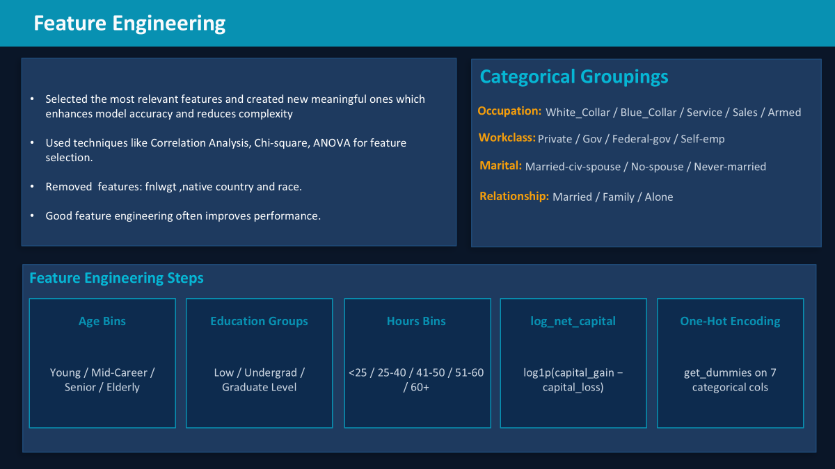

Slide 8
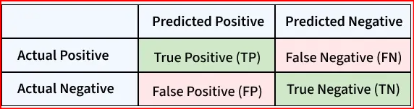
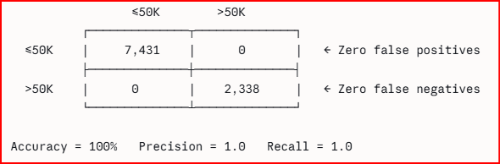
Confusion Matrix and Metrics
What is a Confusion matrix ?
A table which shows the every prediction the model made into 4 categories showing exactly where it was right and where it went wrong
A perfect confusion matrix looks like
What is Accuracy?
Out of all predictions made,how many did the model get right.
Accuracy=(TP + TN )/ (TP + TN + FP + FN )
=correct Predictions / Total Predictions
What is Precision?
"Of all the people the model predicted as >50K, how many actually were?"
Precision = TP / (TP + FP)
What is Recall?
“ Of all the people who actually earn >50K,how many did the model find.
Recall=TP/(TP+FN)
What is F1-Score?
“A single balanced score combining both precision and Recall
F1=2*(Precision*Recall)/(Precision+Recall)
Accuracy-Precision-Recall-F1 Score

Slide 9
Model Results — All Models
Accuracy Comparison
Income Class (>50K) Metrics
XGBoost
Model | Prec | Rec | F1
XGBoost | 0.76 | 0.62 | 0.68
Gradient Boost | 0.75 | 0.62 | 0.68
SVM | 0.74 | 0.58 | 0.65
Random Forest | 0.73 | 0.61 | 0.66
Log. Regression | 0.70 | 0.56 | 0.62
86.22%
Gradient Boosting
86.11%
Random Forest
85.16%
SVM
85.09%
Logistic Regression
83.77%

Slide 10
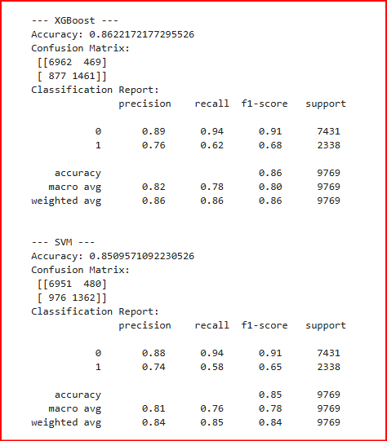
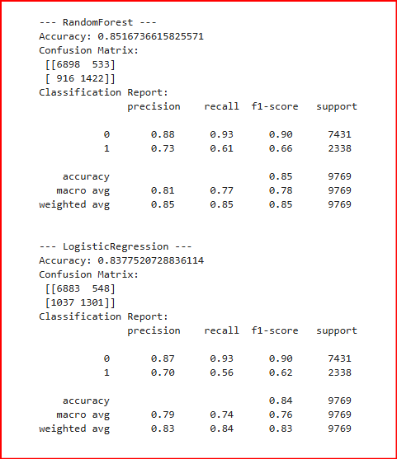
Model Evaluation and Performance
Gradient Boosting and XGBoost are best models • Accuracy: 86.22% • ROC-AUC: 0.9145 • Dataset: UCI Adult Income

Slide 11
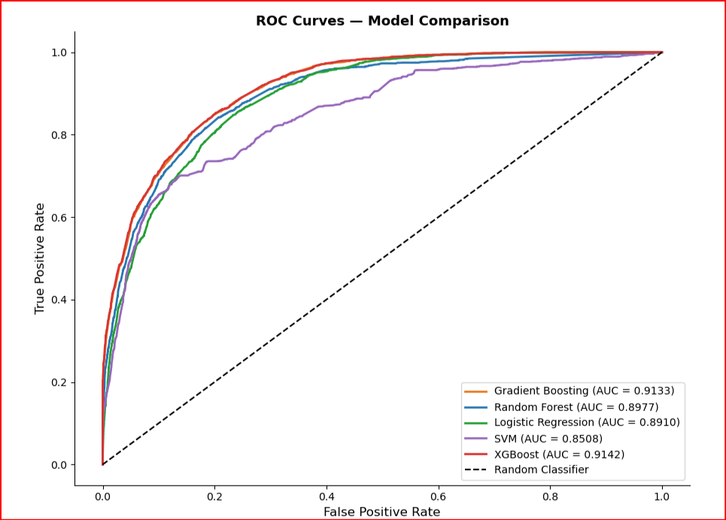
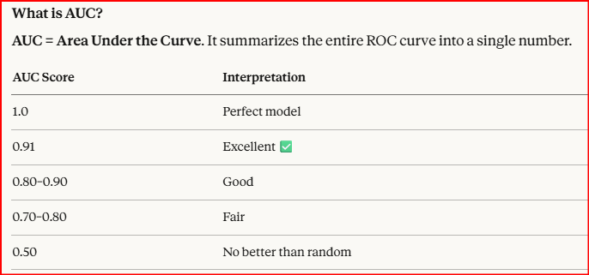
What is a ROC-AUC Curve?
ROC stands for Receiver Operating Characteristic. It's a graph that shows how well a classification model distinguishes between two classes across all possible decision thresholds.
XGBoost and Gradient Boosting are best models • Accuracy: 86.22% • ROC-AUC: 0.9142 • Dataset: UCI Adult Income

Slide 12
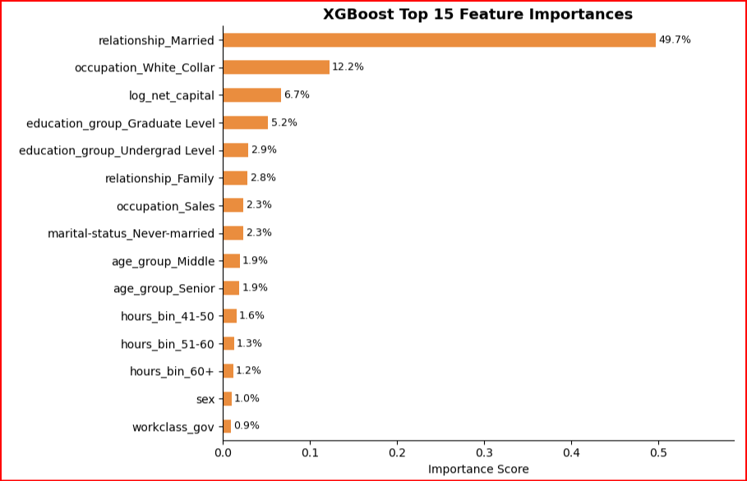
Final Summary & Conclusion
Key Findings
All models achieve 84–86% accuracy on the adult dataset
Class imbalance (76%/24%) affects minority class recall
XGBoost and Gradient Boosting: best models with 86.22% and 86.11% accuracy & 0.91 AUC
Marital status is the #1 predictor of income class
Capital gains & occupation are top numerical predictors
Education and age group strongly influence income level
Dropped: fnlwgt, race, native-country (low Chi² signal)
Log-transform of capital features reduced skewness
XGBoost and Gradient Boosting are best models • Accuracy: 86.22% • ROC-AUC: 0.9145 • Dataset: UCI Adult Income

