Slide 1
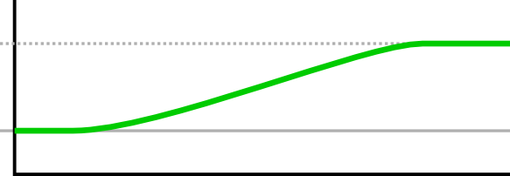
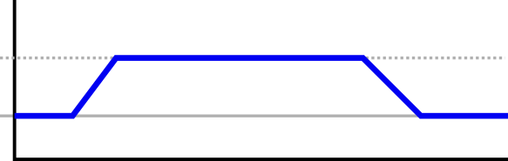
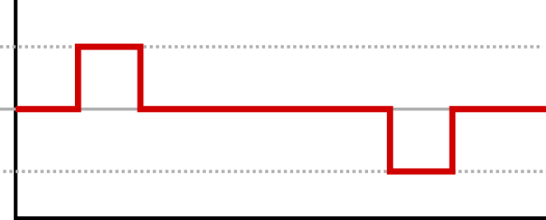
s₂
Position(m)
s₁
Time (s)
v
Velocity (m·s⁻¹)
0
Time (s)
a
0
Acceleration(m·s⁻²)
-a
Time (s)

Slide 2
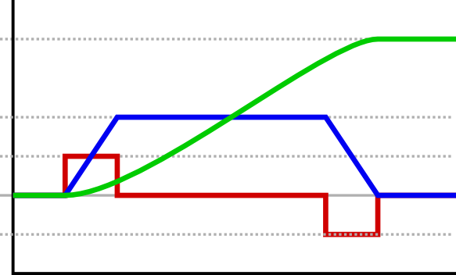
s
v
a
0
-a
Time (s)
Position(m)
Velocity (m·s⁻¹)
Acceleration(m·s⁻²)

Slide 3
Velocity PID
K_{p}
v_{set}
Limiter
K_{i}
Limiter
i_{set}
K_{d}
v_{actual}

Slide 4
Velocity PID
Limiter
K_{p}
K_{d}
K_{i}
Limiter
i_{set}

Slide 5
Controller
Position PID
v_{input}
v_{set}
v_{actual}
Velocity PID
i_{input}
i_{set}
i_{actual}
Current PID
SVPWM
Motor

Slide 6
v_{input}
i_{input}
v_{set}
i_{set}
Controller
Position PID
Velocity PID
Current PID
SVPWM
v_{actual}
i_{actual}
Motor

Slide 8
Manipulator
Actuators
Rigid body
Sensors
Controllers
Motors
Links
Gripper

Slide 9
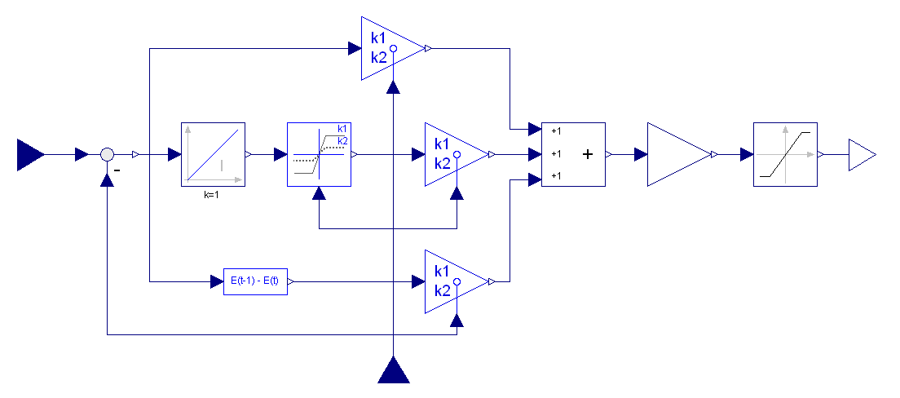
K_{p}
v_{set}
K_{i}
_{N}
K_{d}
v_{actual}

Slide 10
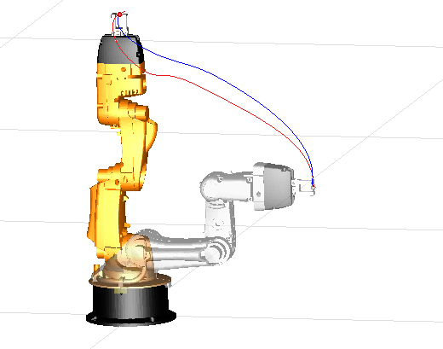
Model
Actual

