Slide 1


The 27th IEEE International Symposium on High-Performance Computer Architecture
Layerweaver: Maximizing Resource Utilization of Neural Processing Units via Layer-Wise Scheduling
Young H. Oh† , Seonghak Kim*, Yunho Jin*, Sam Son*, Jonghyun Bae* Jongsung Lee*, Yeonhong Park*, Dong Uk Kim*, Tae Jun Ham*, Jae W. Lee*
*Seoul National University
†Sungkyunkwan University

Slide 2
Neural Processing Units for Clouds
Hardware resources in Neural Processing Units (NPUs)
Computing units (TOP/s), On-chip buffers (MB), Off-chip memory bandwidth (GB/s)
Compute-to-Memory Bandwidth Ratio varies widely among NPUs
According to target applications (Training or Inference), service scenarios, area budget, etc.

Slide 3
Characteristics of DNN Models
Arithmetic Intensity (Ops/Byte):
How many compute operations are performed per byte loaded from off-chip DRAM
The metric is determined by:
Type of Layer: Convolution >> Depth-wise Convolution > Matrix Multiply > Embedding Lookup
Batch Size: Large batch > Small batch
High Reuse, Relatively
Many Operations with Data
Off-chip DRAM
Off-chip DRAM
Low Batch Matrix Multiplication,
Embedding Lookup, etc.
High Batch Convolution, Depth-wise Convolution, etc.
Off-chip DRAM
Off-chip DRAM
Off-chip DRAM
Off-chip DRAM
Off-chip DRAM
PE
Array
PE
Array
PE
Array
Off-chip DRAM
PE
Array
PE
Array
PE
Array
PE
Array
PE
Array
PE
Array
PE
Array
PE
Array
PE
Array
Shared Buffer
PE
Array
Shared Buffer
PE
Array
PE
Array
PE
Array
PE
Array
PE
Array
Low Reuse, Relatively
Frequent New Data Fetch
Infrequent data fetch
Low Arithmetic Intensity
High Arithmetic Intensity

Slide 4
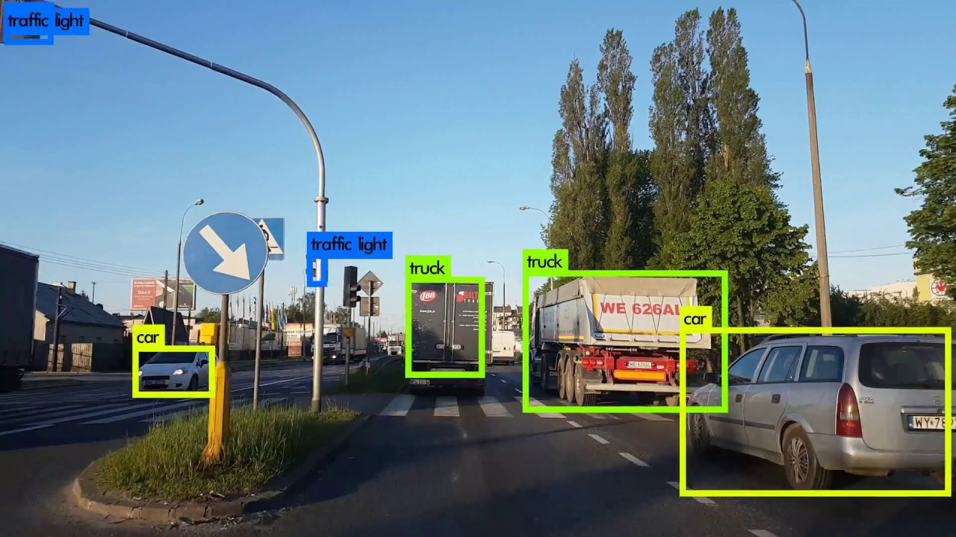
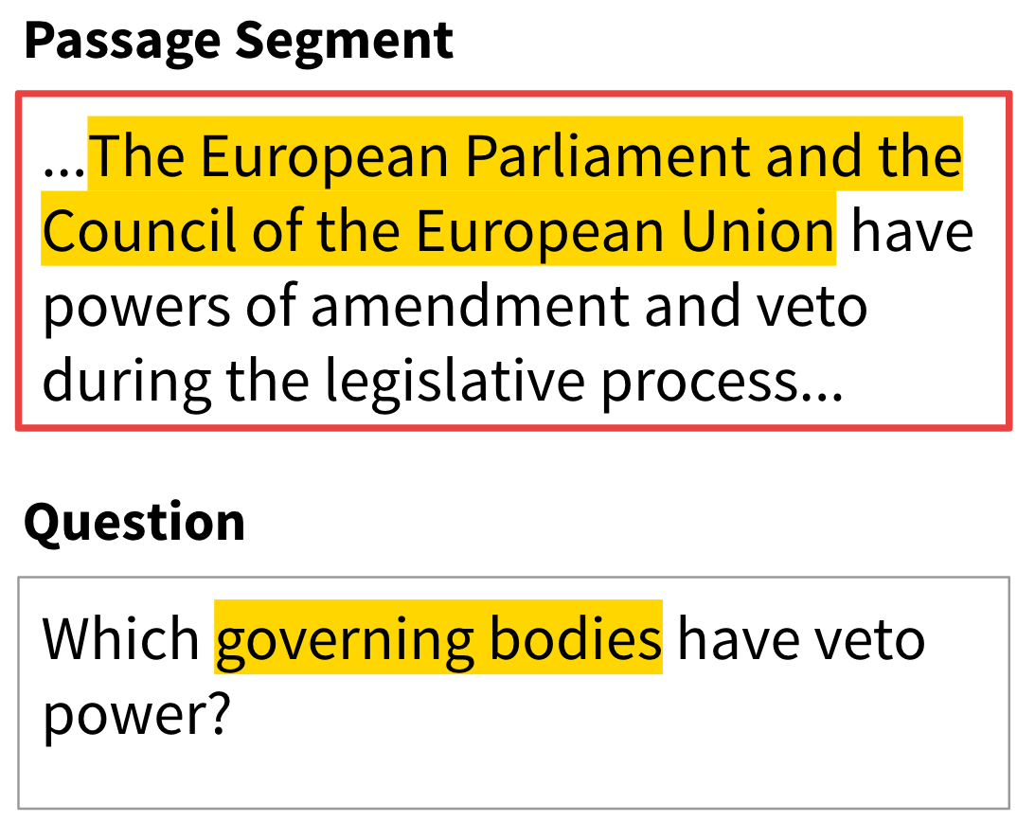
NPU Resource Underutilization Problem
NPU Capabilities
DNN Model Characteristics
Compute to Memory
Bandwidth Ratio
≈
Arithmetic
Intensity
Should be balanced for high resource utilization
PE
PE
PE
Throughput (TOP/s)
Compute-bound (e.g. CNNs)
High Arithmetic Intensity
We need to close this gap between compute-to-memory bandwidth ratio (NPU) and arithmetic intensity (DNN model) to achieve high utilization.
PE
PE
PE
Global Shared Buffer
PE
PE
PE
Off-chip DRAM
Memory Bandwidth (GB/s)
Memory-bound (e.g. NLP)
Low Arithmetic Intensity

Slide 5
NPU Resource Underutilization Problem
No one-size-fits-all NPUs for various DNN models and batch sizes
Compute-centric accelerators are well-suited for Vision Tasks
Memory-centric accelerators prefers NLP & Recommendation Tasks
Significant mismatch between Arithmetic Intensity and Compute-to-Memory BW ratio
Longer memory access time
Memory Util.
…
Comp-centric
Goya
Compute Util.
NNP-I
Cambricon
Eyeriss
Longer compute time
Mem-centric
TPUv3
Memory Util.
…
TPUv3
Compute Util.
Arithmetic Intensity > Comp. to MemBW Ratio
Time
Arithmetic Intensity < Comp. to MemBW Ratio
* Each acronym corresponds to BERT-base (BB), BERT-large (BL), NCF recommendation (NCF), XLNet (XL), InceptionV3 (IC), MobileNetV2 (MN), ResNet50 (RN), ResNeXt50 (RX)

Slide 6
NPU Resource Underutilization Problem
This mismatch leads to Resource Underutilization
Conventional way: Double-Buffering / Decoupled Access-and-Execution (Prefetching)
Mem-intensive Model
DRAM Channel Idle Time
Double-buffering or Prefetching
Memory Util.
Compute Util.
Compute Idle Time
Comp-intensive Model
Imbalance between NPU and DNN models
Mem-intensive Model
Comp-intensive Model
Time

Slide 7
NPU Resource Underutilization Problem
This mismatch leads to Resource Underutilization
Conventional way: Double-Buffering / Decoupled Access-and-Execution (Prefetching)
Problem: Sub-optimal scheduling as interleaving over the model boundary is not allowed
Our Proposal: Layer-wise interleaving for balanced resource utilization
Challenge: Finding a proper prefetch timing is non-trivial due to limited on-chip buffers
DRAM Channel Idle Time
Double-buffering or Prefetching
Memory Util.
Compute Util.
Compute Idle Time
Layer-wise
Interleaving
Memory Util.
Large benefits w/ time-multiplexing
Compute Util.
Mem-intensive Model
Comp-intensive Model
Time

Slide 8
Layerweaver: Maximizing NPU Resource Utilization
Layerweaver efficiently interweaves layer-wise execution of multiple DNNs to maximize resource utilization and throughput of NPU by utilizing a lightweight scheduler
Proposes a lightweight scheduling algorithm that efficiently interleaves multiple DNNs
Carefully considers on-chip memory size, output forwarding, and starvation
Does not require special hardware support to be readily applicable to existing NPUs
Achieves high throughput and nearly-full resource utilization on 16 pairs of DNN models, various inference scenarios, and NPUs

Slide 9
Presentation Outline
Resource Underutilization Problem of DNN Accelerators
Layerweaver: Maximizing Temporal Resource Utilization
Building Efficient DNN Serving System w/ Layerweaver
Overview of Greedy Scheduler w/ Service Requests
Calculation of Compute and Memory Idle Time
Layer Selection Process
Evaluation
Conclusions

Slide 10

Overview of Layerweaver Serving System
Other Workers
Host Processor
NPU
Commands
Greedy
Scheduler
PCIe
NPU Core
Feedback
Finish any?
Comp-intensive
C2
M2
C1
M1
Global Buf.
Load
Balancer
Interweaved
Inst. Streams
(Appended)
Off-chip DRAM
Mem-intensive
Request Q
Request Streams
Assuming a frontend load balancer that distributes a mix of both memory- and compute-intensive requests at pre-determined rates to worker nodes
Host processor triggers the greedy, layer-wise scheduler when a schedulable batch is formed
Greedy Scheduler accepts requests and adds them to the (scheduling) candidate group
Then the scheduler selects the next layer to schedule from this candidate group leading to the least idle time in compute/memory resources

Slide 11
Light-weight Scheduling Algorithm of Layerweaver
Observation: To minimize idle time, keep a proper decoupling distance
Def. Decoupling distance: Time difference btw. the last fetch completion (T_{m}) and computation finish (T_{c})
Too long decoupling distance: Potential Memory Idle Time
Too short decoupling distance: Potential Compute Idle Time
Long decoupling
distance
Short decoupling
distance
On-chip memory is full,
Memory Idle Time
Input data not yet prepared,
Compute Idle Time
Memory
C1
C2
Memory
C1
C2
…
Compute
C1
C2
Compute
C1
C2
T_{m}
T_{c}
Time
T_{m}
T_{c}
Time
* Dependence graph of input & output activation is omitted

Slide 12
Light-weight Scheduling Algorithm of Layerweaver
Calculating Compute Idle Time
When too short decoupling distance exists, there could be Compute Idle Time
Before starting computation of B1, the input data of B1 should be prepared
Mem. Time
Mem. Time
Memory
A1
A2
Memory
A1
B1
Compute
A1
A2
Compute
A1
B1
Decoupling distance
Decoupling distance
Compute Idle Time = 0
Compute Idle Time = Mem. Time – Decoupling distance

Slide 13
Light-weight Scheduling Algorithm of Layerweaver
Calculating Memory Idle Time
When too large decoupling distance exists, there could be Memory Idle Time
Free on-chip buffer size for now = 600 KB
= 600 KB / 100 GB/s (Mem. BW) = 6 us
Time to fetch 600 KB (6us)
Memory
A1
A2
Compute
A1
Decoupling distance
Memory Idle Time = 0

Slide 14
Light-weight Scheduling Algorithm of Layerweaver
Calculating Memory Idle Time
When too large decoupling distance exists, there could be Memory Idle Time
Free on-chip buffer size for now = 600 KB
= 600 KB / 100 GB/s (Mem. BW) = 6 us
Memory Idle Time = Decoupling distance – 6 us
Buffer size limit is met
Time to fetch 600 KB (6us)
Memory
A1
B1
B1
Compute
A1

Slide 15
Light-weight Scheduling Algorithm of Layerweaver
Calculating Memory Idle Time (Cont’d)
Some models have Inherent Memory Idle Time, which cannot be removed by scheduling
To prevent additional memory idle time, keep minimum decoupling distance
Inherent Memory Idle Time
(Scheduling cannot remove this)
Increased Memory Idle Time caused by
B3 and its increased decoupling distance
Memory
A1
A1
…
…
Compute
A1
B3
A1
Very large decoupling distance
The same amount available for prefetch
Time for “total” on-chip buffer size
available for prefetch

Slide 16
Light-weight Scheduling Algorithm of Layerweaver
Layer Selection
Detailed formal descriptions about every idle time case are available in our paper
After exactly calculates the idle time of “each layers in progress” from K candidate requests ~ O(k)
Select the layer that incurs minimum memory and compute idle time, and repeat for N layers ~ O(kN)
Host Processor
Greedy Scheduler
Request Q
Model | Progress
C0 | -
Idle Time
20
5
0
Comp-intensive
C2
C1
M1
Mem-intensive
M1 | -
C2 | -
Layer 1
To NPU
Candidate Group
Selected layer after scheduling

Slide 17
Presentation Outline
Resource Underutilization Problem of DNN Accelerators
Layerweaver: Maximizing Temporal Resource Utilization
Building Efficient DNN Serving System w/ Layerweaver
Overview of Greedy Scheduler w/ Service Requests
Calculation of Compute and Memory Idle Time
Layer Selection Process
Evaluation
Conclusions

Slide 18
Evaluation Methodology & Inference Scenario
Evaluation Scenario: Single- / Multi-batch Streams (Extended Single-stream in MLPerf [1])
Accelerators: Memory-centric (Google TPUv3 style) & Compute-centric (Intel NNP-I style) NPUs
Baseline Strategy: Memory-only / Compute-only / Fair / AI-MT [2]
Metrics: Normalized System Throughput (STP), Time Utilization (%)
N
…
Batch size
t₀₀
t₀₁
t₀₂
t₀₃
M
t_{i j} = Processing time for jth query of request i streams
…
t₁₀
t₁₁
t₁₂
Input Timeline for Multi-Batch Streams (# of Streams = 2)
[1] Reddi et al., ”MLPerf Inference Benchmark”, ISCA ’20
[2] Baek et al., “A Multi-Neural Network Acceleration Architecture”, ISCA ’20

Slide 19
Performance Evaluation (System Throughput)
Scenario: Single-Batch Streams (# of Streams = 2) on TPUv3-style NPU
Layerweaver: 60.1% throughput increase over the baseline (Fair)
Against AI-MT: Layerweaver shows 21.6% higher geomean STP than AI-MT
AI-MT: State-of-the-art time-multiplexed DNN multi-tasking technique
Layerweaver estimates the resource idle time more precisely than AI-MT based on a simple heuristic
For various Multi-Batch Streams configurations, Layerweaver outperforms all the other schemes
Smaller benefits w/
biased config.
Batch Size
Batch Size
Memory-centric NPU
Compute-centric NPU
Single-Batch Streams (# of Streams = 2)
Multi-Batch Streams (# of Streams = 2, Geomean)

Slide 20
Overall NPU Resource Utilization
Evaluation Scenario: Single-Batch Streams (# of Streams = 2) w/ TPUv3-style NPU
Layerweaver almost fully (Geomean 99.7% / 91.3% for Compute / Memory) utilizes active cycles
ResNeXt causes Inherent Memory Idle Time and about 29-31% drop in memory active cycles (Red box)
As we discussed this drop is not attributed to scheduling decisions
Memory- or Compute-only suffers severely from either compute or memory bandwidth underutilization
AI-MT shows sub-optimal results due to imprecise estimation of resource idle time
Compute (PE) Active Cycles
Memory (DRAM) Active Cycles

Slide 21
Scheduling Overhead
Layerweaver scheduler has O(kN) complexity
k: # of candidate models, N: total # of layers to schedule
Carefully modeled scheduling overhead on a host processor
Intel i7-7700K CPU @ 4.20GHz
Greedy Scheduler Throughput is 15 layers / us
Compared to the single batch-1 layer latency which ranges from 4.7us to 221us
The scheduling overhead is negligible
Also, scheduling happens off-critical path most of the time using host CPU
Thus, Layerweaver can flexibly support dynamically-changing request patterns at runtime

Slide 22
Layerweaver: Maximizing NPU Resource Utilization
Layerweaver efficiently interweaves layer-wise execution of multiple DNNs to maximize resource utilization and throughput of NPU by utilizing a lightweight scheduler
Proposes a lightweight scheduling algorithm that efficiently interleaves multiple DNNs
Carefully considers on-chip memory size, output forwarding, and starvation
Does not require special hardware support to be readily applicable to existing NPUs
Achieves high throughput and nearly-full resource utilization on 16 pairs of DNN models, various inference scenarios, and NPUs

Slide 23
The 27th IEEE International Symposium on High-Performance Computer Architecture
Layerweaver: Maximizing Resource Utilization of Neural Processing Units via Layer-Wise Scheduling
Young H. Oh† , Seonghak Kim*, Yunho Jin*, Sam Son*, Jonghyun Bae* Jongsung Lee*, Yeonhong Park*, Dong Uk Kim*, Tae Jun Ham*, Jae W. Lee*
*Seoul National University
†Sungkyunkwan University
Author Contact Info: younghwan@skku.edu

