Slide 1
Short-Circuit Dispatch Accelerating Virtual Machine Interpreters on Embedded Processors
Channoh Kim†
Sungmin Kim†
Hyeon Gyu Cho
Dooyoung Kim
Jaehyeok Kim
Young H. Oh
Hakbeom Jang
Jae W. Lee
Sungkyunkwan University, Korea
†Equal contributions
June 20th 2016
ISCA-43, Seoul, Korea
Notes:
Hello, everyone.⬇ Welcome to my talk. I am Channoh Kim from Sungkyunkwan University.
Today, // I will talk about my work // titled Short-Circuit D⬆ispatch // for Accelerating virtual machine interpreters // on embedded processors.
This work is done with my colleagues // at Sungkyunkwan university.
<0:30>

Slide 2




Motivation (1): Today’s Scripting Languages
Already widely used in various application domains
JavaScript, Lua, Python, R, Ruby, PHP, etc.
Enabling many complex, production-grade applications
[+] High productivity
High level of abstraction, flexible type systems, automatic memory management, etc.
[-] Low efficiency
Dynamic type checking, interpretation/JIT overhead, garbage collection, etc.
Notes:
Today // scripting **languages** are // widely used // in various application domains.
The scripting languages // provide productivity benefits //
with high level of abstraction // and powerful built-in functions.
However, // the scripting languages are // still // much slower // than native programming languages like C
because of dynamic type checking, // interpreter and JIT overhead, // and garbage collection, // etc.
<1:07>

Slide 3
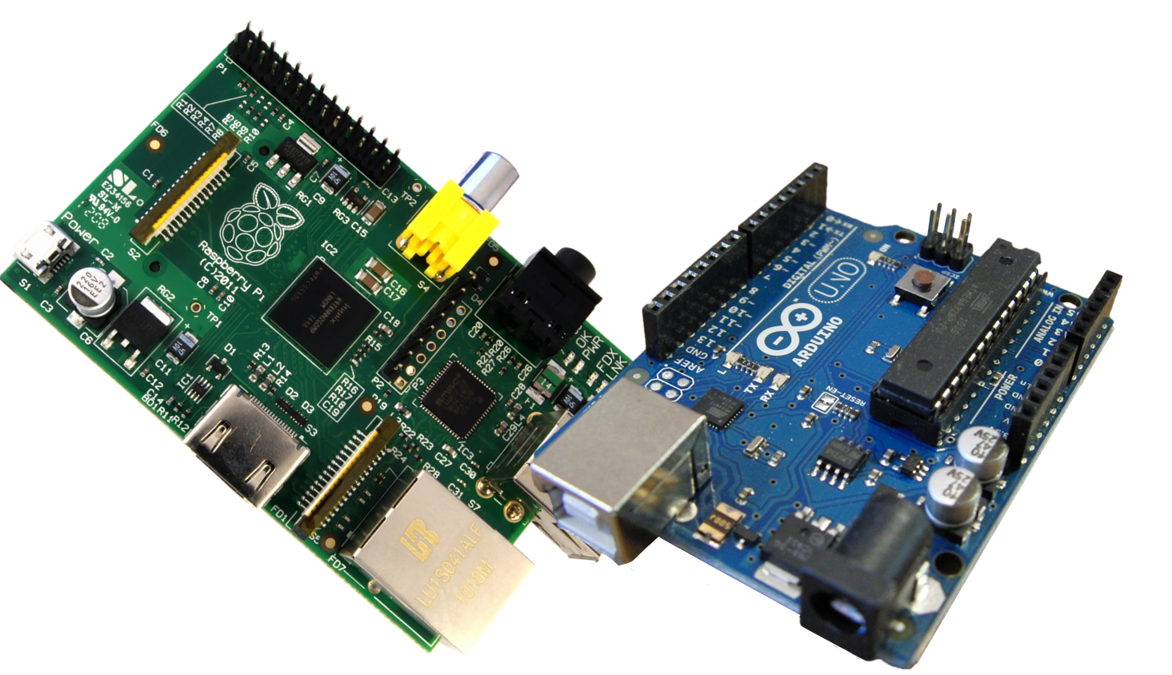
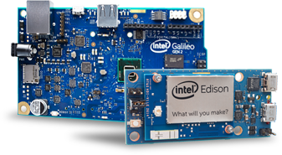
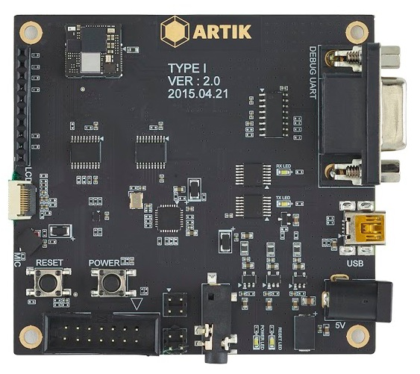
Motivation (2): Emerging Single-Board Computers
Emerging single-board computers for so-called DIY electronics
Arduino, Raspberry Pi, Intel Edison/Galileo, Samsung ARTIK, etc.
Platforms for emerging IoT applications
[+] Low cost, low power, small form factor
[-] Severe resource constraints
Single-core, in-order pipeline running at low frequency
Limited memory/storage space and power budget
Arduino and Raspberry pi
Intel Galileo and Edison
Samsung ARTIK
Notes:
On the hardware front,
single-board computers have // recently // emerged to // enable various IoT // applications,
such as // Arduino, Raspberry Pi, etc.
These platforms have // very low cost, // low power, // and small form factor, // which is good.
However, // they have severe // resource constraints, // typically featuring //
single-core // in-order pipeline // running at tens to hundreds of Mhz // with
limited memory // and storage space // and power budget.
<1:53>

Slide 4
Motivation (3): Scripting Languages + Single-Board Computers
Productivity benefits for IoT programming
Ease of programming and testing
Natural support for event-driven programming model
Seamless client-server integration (e.g., using HTML5/JavaScript)
But, too slow on IoT platforms
JIT compilation: not viable due to severe resource constraints
VM interpreter: wastes CPU cycles for
Recurring cost of bytecode dispatch
Dynamic type checks
Boxing/unboxing objects
Garbage collection
Focus of this work
Notes:
How about // using those high-productivity languages // for IoT programming?
Well, // there are several benefits of doing this, // such as
Ease of programming and testing
Natural support for // event-driven programming model
Seamless client // server integration⬇
Unfortunately, // still // it’s too slow.
JIT compilation may not **be** viable // due to severe resource constraints.
In contrast, // VM interpreters have // smaller resource footprints, // but // waste CPU cycles for
- Bytecode dispatch
Dynamic type checks
Boxing/unboxing objects
and garbage collection⬇
<click> In this work, // we focus on the first one, // which is the recurring cost of // bytecode dispatch.

Slide 5
Motivation (4): Sources of Inefficiency in Bytecode Dispatch Loop
Bytecode dispatch in VM interpreters
Uses significant # of dynamic instructions
Examples on x86-64*: Python (16-25%), JavaScript (27%), CLI (33%)
Two main sources of inefficiency
Hard-to-predict indirect jump
Redundant computation
Bytecode decoding
Bound check
Target address calculation
for (;;) {
Bytecode bc = *(VM.pc++);
int opcode = bc & mask;
// interpreter-specific
// bookkeeping code (omitted)
switch (opcode) {
case: LOAD
do_load(RA(bc),RB(bc));
break;
case: ADD
...
default:
error();
}
}
* [CGO’15] Rohou et al., Branch Prediction and the Performance of Interpreters: Don’t Trust Folklore.
Notes:
Then // why the bytecode dispatch loop is so slow?
This C code shows // a canonical bytecode dispatch loop.
It fetches a bytecode,
extracts an opcode from it,
and jumps to the correct target // for the bytecode
This dispatch code, // shown in gray, //
uses a significant number of dynamic instructions.
According to a recent study, // it takes about 10 to 30 percent // of total instruction counts.
So here. We identify // two main sources of inefficiency:
First, hard-to-predict indirect jumps
Second, redundant computation // for // decode, // bound check, // and target address calculation

Slide 6
Our Proposal: Short-Circuit Dispatch (SCD)
SCD: Architectural support for fast bytecode dispatch in VM* interpreters
Key idea: Using part of BTB space as efficient, SW-managed bytecode jump table
Upon bytecode fetch, BTB is looked up using the bytecode (instead of PC) as key
If hits: short-circuited to the correct bytecode handler If not: falls back to the original slow path
Key results
Eliminates most of branch mispredictions and redundant computation
Incurs minimal hardware cost (0.7%)
* Meant for high-level language VMs (as in “JVM”), but not for system virtualization (as in “VMware”)
Notes:
To eliminate this two sources of // inefficiency, we propose // Short-Circuit D⬆ispatch,
which is // a low-cost // architectural support // for fast bytecode dispatch // in VM interpreters.
The key idea is // to use part of BTB space // as efficient, SW-managed // bytecode jump table.
So, // once a bytecode is fetched, // BTB is looked up using the bytecode // instead of PC as key
If it hits!!, // it’s short-circuited // to the correct bytecode handler.
If not!!, // it falls // back to the original slow path.
By using SCD
We were able to effectively // eliminate // the two sources of inefficiency // in dispatch loop
with minimal hardware cost
<4:30>
<5:20>

Slide 7
Outline
Motivation and key idea
Short-Circuit Dispatch (SCD)
SCD Design
ISA extension
Example walk-through
Design issues
Evaluation
Summary
Notes:
Let’s move on // the details of // our proposed architecture
4:30

Slide 8
SCD Design (1): Canonical Dispatch Loop
for (;;) {
Bytecode bc = *(VM.pc++);
int opcode = bc & mask;
switch (opcode) {
case: LOAD
do_load(RA(bc),RB(bc));
break;
case: ADD
...
default:
error();
}
}
Fetch a bytecode
Decode
Bound-check
redundant
computation
Jump address calculation
Jump
Execute the bytecode
Notes:
This slides shows a canonical dispatch loop in VM interpreters.
At every iteration, //
<click> the interpreter fetches a new bytecode,
<click> extract an opcode from it,
<click> and calculates // the target address for the bytecode, // and jump to the address.
<click> Finally, it executes the bytecode and <click> repeats this forever.
Although simple, this code represents // a very common pattern // in VM interpreters.
<click> The dispatcher code has // some redundant computations, // which are shown in gray.

Slide 9
SCD Design (2): Overview
Extend BTB to support two entry types
Bytecode jump table entries (JTEs)
Conventional BTB entries
SCD-augmented dispatch loop
Fetch bytecode and extract opcode
Look up BTB using the opcode
if hits: go to <fastpath>
else: go to <slowpath>
Fetch a bytecode
Fetch &
extract opcode
Look up BTB
<slowpath> no
Hit?
Decode
yes <fastpath>
Bound-check
Jump address calculation
Jump
Jump and update
Execute the bytecode
Notes:
To accelerate bytecode dispatch, // we first extend BTB // to hold bytecode jump table entries, or JTEs,
as well as the conventional BTB entries.
<click>
And then the dispatch loop is modified as follows.
It first fetches a bytecode and extracts its opcode.
<click> and looks up the BTB // to retrieve the corresponding JTE // using the opcode as key.
<click> If it hits, // it directly jumps // to the target address // for the bytecode.
<click> If not, it goes to the slow path, which executes the original codes // for jump address calculation.

Slide 10
SCD Design (3): Overview
Five instructions
<inst>.op (.op suffix): extracts an opcode from the value of <inst>
bop (branch-on-opcode): looks up BTB using the opcode for fast dispatch
jru (jump-register-with-jte-update): jumps and updates BTB with a new JTE
jte_flush and set_mask: bookkeeping instructions (please refer to the paper)
Three registers
Rop (Opcode register): holds an opcode to dispatch
Rmask (Mask register): holds a 32-bit mask to extract an opcode
Rbop-pc (BOP-PC register): holds the PC value of bop instruction
Notes:
To realize this, // we add five new instructions // and three special registers.
We first add // a dot-op suffix // to extract an opcode // from the value of the instruction
and bop instruction // to look up BTB // using the opcode for fast dispatch.
Third, jru instruction,
which jumps // and inserts // a new jump table entry // into the BTB.
Finally, // there are two other instructions // for bookkeeping // which I’m not doing to cover in this presentation // due to limited time.
Please // refer to the paper // for details.
Also we add three special registers.
First, opcode register, which holds // an opcode to dispatch.
( to be used for BTB lookup.)
Second, mask register. It holds // a 32-bit mask // to extract the opcode from a bytecode.
Third, BOP-PC register. It holds // the PC value of the bop instruction.
Now, // I will move on to the details of // these instructions.

Slide 11
ISA Extension (1): <inst>.op
<inst>.op suffix
Update Rop with the value of <inst>
Rop ← <inst> & Rmask
Fetch & extract opcode
Look up BTB
Fetch:
...
lw s11 ← 0(a5)
<slowpath> no
Hit?
Decode
yes <fastpath>
lw.op s11 ← 0(a5)
value of <inst>
Bound-check
0x3f
Rmask
Jump address calculation
Jump and update
s11
Rop
e.g., ADD r0 r0 r1
Opcode(ADD)
Execute the bytecode
Notes:
First, // dot-op suffix .
This suffix // can be applied to // any instruction,
and extracts an opcode // from the value of the instruction.
<click> Let’s say // there is a load instruction // that fetches a bytecode.
<click> We can apply // a dot-op suffix // to this instruction, like this.
<click>
Then // the opcode is // automatically extracted // from the value of the load // by applying a mask, //
and stored // into the opcode register.
<click>
For example, // the load instruction // fetches a bytecode, // say “add r0 r0 r1”,
SCD extracts // the opcode of bytecode ADD // using the mask register
and stores it // to the opcode register.

Slide 12
ISA Extension (2): bop
bop (branch-on-opcode)
Look up BTB using the opcode as key
If hits, PC ← BTB[Rop]
else, PC ← PC + 4
Fetch & extract opcode
Look up BTB
<slowpath> no
Hit?
Decode
yes <fastpath>
B T B
Bound-check
bop?
Target address
BTB entry
BTB entry
BTB entry
BTB entry
J
0
0
0
0
Jump address calculation
PC
key
1 0
Jump and update
Rop
Target (ADD)
1
Opcode(ADD)
Execute the bytecode
J: JTE bit
Notes:
Second, // bop instruction // looks up BTB // using the opcode as key.
If it hits, // the dispatch loop // directly jumps to the target address // retrieved from the BTB.
Otherwise, // it just moves // to the next instruction.
<click> For example, // let’s say // bop instruction is just fetched.
Then // it looks up the BTB // using the opcode stored in Rop register, // which is ADD in this example.
Since // there is a JTE // holding the target address of ADD, // SCD immediately jumps to the target address.
<click>
To distinguish JTEs from conventional BTB entries, // we add a new flag, // called JTE bit.

Slide 13
ISA Extension (3): jru
jru (jump-register-with-jte-update)
Jump-register & insert a new JTE into BTB
PC ← Rsrc, BTB[Rop] ← Rsrc
Fetch & extract opcode
Look up BTB
Jump:
jr a5
<slowpath> no
jru a5
Hit?
※ a5 == Target (ADD)
Decode
yes <fastpath>
B T B
Bound-check
bop?
Target address
BTB entry
BTB entry
BTB entry
BTB entry
J
0
0
0
0
Jump address calculation
PC
key
1 0
Jump and update
Rop
Target (ADD)
1
Opcode(ADD)
Execute the bytecode
J: JTE bit
Notes:
**If** there is no corresponding JTE, // it goes through the slow path.
The slow path // executes // the original dispatch code.
<click> The only modification is // that we replace the indirect jump instruction // <click> with jru instruction.
This instruction jumps to the target address,
<click> *and* inserts a new JTE into the BTB, // with the target address of // bytecode ADD.

Slide 14
Example Walk-through
Script
Bytecodes
B T B
a = 1
LOAD r0 #1
miss
J | Target address
0 | BTB entry
0 | BTB entry
0 | BTB entry
0 | BTB entry
b = 2
LOAD r1 #2
hit
a = a + b
ADD r0 r0 r1
miss
1
Target (LOAD)
1
Target (LOAD)
1
1
1
Target (LOAD)
Target (LOAD)
Target (LOAD)
c = 3
LOAD r2 #3
hit
1
1
1
Target (ADD)
Target (ADD)
Target (ADD)
a = a + c
ADD r0 r0 r2
hit
J: JTE bit
SCD eliminates two source of inefficiency in dispatch loop
Branch mispredictions
Redundant computation (if it hits in the BTB)
Notes:
This slide illustrates // how SCD works // with a simple example.
We have a simple script <click>, the compiled bytecodes <click>, and a BTB with no JTEs.
<click> The first bytecode is LOAD, for which there is no JTE.
So, it takes the slow path, and BTB is updated with the target address // of bytecode LOAD.
<click> The second bytecode is also LOAD, and now it hits in the BTB.
Thus, SCD immediately jumps to the target address // for LOAD
<click> The third bytecode is a new bytecode ADD,
Again // it goes to the slow path, // and the BTB is updated with a new JTE.
<click> The fourth and <click> fifth bytecode is LOAD and ADD.
In both cases, // the interpreter takes the fast path.
<click> Thus, SCD effectively eliminates // both branch mispredictions and redundant computation,
which are // the two main source of inefficiency // in dispatch loop,

Slide 15
Topics Not Covered in this Presentation
Please refer to the paper for the following information:
Details of pipeline design
Conflict reduction between BTB entries and JTEs
OS context switching
Multiple jump tables
Evaluation against the state-of-the-art software/hardware techniques
Evaluation on higher-performance core (Cortex-A8 class)
Detailed power and area analysis using synthesizable RTL
etc.
Notes:
Because of limited time, // this presentation does not cover all components of // our design and evaluation.
This slide enumerates // some of those topics,
and please // refer to the paper // if you are interested.

Slide 16
Outline
Motivation and key idea
Short-Circuit Dispatch
Evaluation
Methodology
Performance Results on Simulator
Performance Results on FPGA
Area and Power Consumption
Summary
Notes:
We now move on to evaluation. (12:00)

Slide 17
Evaluation Methodology (1): Two Evaluation Platforms
 | Gem5 Simulator | FPGA
ISA | 64-bit Alpha | 64-bit RISC-V v2
Pipeline | Single-Issue In-Order, 1GHz Fetch1/Fetch2/Decode/Execute (4 stages) | Single-Issue In-Order, 50MHz Fetch/Decode/Execute/Mem/WB (5 stages)
Branch Predictor | Tournament predictor 512-entry (global); 128-entry (local) 256-entry, 2-way BTB with RR replacement policy 8-entry return address stack 3-cycle branch penalty | 32B predictor (128-entry gshare) 62-entry, fully-associative BTB with LRU replacement policy 2-entry return address stack 2-cycle branch miss penalty
Caches | 16KB, 2-way, 2-cycle L1 I-cache 32KB, 4-way, 2-cycle L1 D-cache 10-entry I-TLB, 10-entry D-TLB 64B block size with LRU | 16KB, 4-way, 1-cycle L1 I-cache 16KB, 4-way, 1-cycle L1 D-cache 8-entry I-TLB, 8-entry D-TLB 64B block size with LRU
Notes:
We use both // gem5 simulator and FPGA // to evaluate SCD.
For gem5 simulator // we take architectural parameters // from ARM Cortex-A5.
For FPGA emulation // we use the default parameters // for RISC-V Rocket Core.
We summarize the parameters in the table.

Slide 18
Evaluation Methodology (2): Workloads
Lua-5.3.0
47 bytecodes
35 native instructions for dispatch
No JIT supported, GC turned off
SpiderMonkey-17.0 (JavaScript)
229 bytecodes
29 native instructions for dispatch
Both GC and JIT turned off
Benchmarks
11 scripts for each from Computer Language Benchmarks Game*
* http://benchmarksgame.alioth.debian.org
Notes:
For workloads, // we use two production-grade interpreters, Lua and SpiderMonkey.
Lua has 47 distinct bytecodes. The dispatch code consists of 35 native instructions.
We also use SpiderMonkey for JavaScript, which has 229 bytecodes.
The dispatch code consists of 29 native instructions.
We turned off garbage collection for both cases.
Unfortunately, we were not be able to build SpiderMonkey // for RISC-V // due to missing C++ libraries,
and only use Lua // for FPGA emulation.
We take 11 scripts for each interpreters from Computer Language Benchmarks Game.

Slide 19
Overall Speedups on Simulator
19.9%
14.1%
Geomean speedups
Lua: 19.9% (Max: 38.4% for mandelbrot)
JavaScript: 14.1% (Max: 37.2% for fannkuch-redux)
Notes:
We first show // the overall speedups over // the out-of-the-box baseline // on gem5 simulator.
<click> For Lua, // SCD achieves // geomean speedup of about twenty percent (19.9%)
with maximum speedup of thirty eight percent (38.4%) for mandelbrot.
<click> For SpiderMonkey, SCD achieves // geomean speedup of fourteen percent (14.1%)
with maximum speedup of thirty seven percent (37.2%) for fannkuch-redux.

Slide 20
Branch MPKI on Simulator
Branch misprediction rate (MPKI)
Reduction in branch misprediction rate (in MPKI)
Lua: 15.0 → 4.4
JavaScript: 18.9 → 13.6
Notes:
The two main sources of // performance improvements are //
the reduction in // branch mispredictions // and redundant computation.
<click> This slide shows //reduction in branch misprediction rate.
As you see in this graph,
there is a // significant // reduction in misprediction rate //
in MPKI: from fifteen point o to // four point four for Lua
and from eighteen point nine to thirteen point six for JavaScript.
This reduction // results // from a lower misprediction rate // for the indirect jump // in the dispatch loop.

Slide 21
Instruction Counts on Simulator
Normalized instruction counts
Reduction in dynamic instruction count
Lua: 10.2% (Max: 15.4% for random)
JavaScript: 9.6% (Max: 15.9% for fannkuch-redux)
Notes:
The second source of inefficiency // is redundant computation to // calculate jump target address.
As shown in this graph, // SCD significantly reduces // dynamic instruction count //
by ten point two percent (10.2%) for Lua // and nine point six percent (9.6%) for JavaScript on average.

Slide 22
Overall Speedups on FPGA
12.0%
Geomean speedup
Lua: 12.0% (Max: 22.7% for mandelbrot)
Notes:
Evaluation on FPGA // also shows // significant speedups // for Lua.
<click> SCD achieves // geomean speedup of twelve percent (12.0%)
with a maximum speedup of twenty two point seven percent (22.7%) for Mandelbrot.

Slide 23
Area and Energy Consumption
0
0
BTB
Others
Minimal area/power costs (at 40nm technology node)
Area overhead: 0.72% (0.59% by BTB)
Power overhead: 1.09% (0.90% by BTB) → EDP improvement: 24.2%
Notes:
Finally, // we estimate // area and power overhead // by synthesizing our RTL code //
using Synopsys Design Compiler
The total area and power consumption // are increased by zero point seven two percent (0.72%)
and about one percent (~1%), respectively, // most of which are // coming from // the BTB module.
This leads // to a twenty four point two percent (24.2%) // EDP improvement // for Lua.

Slide 24
Summary
Two main sources of inefficiency in bytecode dispatch loop
Hard-to-predict indirect jump
Redundant computation for decode, bound check, and target address calculation
Short-Circuit Dispatch (SCD) effectively eliminates both
Low-cost architectural support for fast bytecode dispatch
Using part of BTB as efficient, software-managed bytecode jump table
SCD accelerates production-grade VM interpreters
Geomean (Maximum) speedups: 19.9% (38.4%) for Lua, 14.1% (37.2%) for JavaScript
24.2% EDP improvement with only 0.72% area overhead at 40nm technology node
Notes:
In summary, there are two main sources of inefficiency in the bytecode dispatch loop.
hard-to-predict indirect jump and redundant computation
To eliminate // this two sources of inefficiency,
we propose // Short-Circuit Dispatch
which is // a low-cost // architectural support // for fast bytecode dispatch
The key idea is // to use part of BTB space // as efficient, // SW-managed bytecode jump table.
By using SCD
We were able to // effectively // eliminate // the two sources of inefficiency // in dispatch loop
with minimal hardware cost
This concludes my talk and thank you for your attention.

