Slide 1


A Portable, Automatic Data Quantizer for
Deep Neural Networks
Young H. Oh†§ Quan Quan*§ Daeyeon Kim* Seonghak Kim* Jun Heo*
Sungjun Jung* Jaeyoung Jang† Jae W. Lee*
*Seoul National University
†Sungkyunkwan University
§ Equal contributions
November 1st, 2018
PACT 2018, Limassol, Cyprus

Slide 2
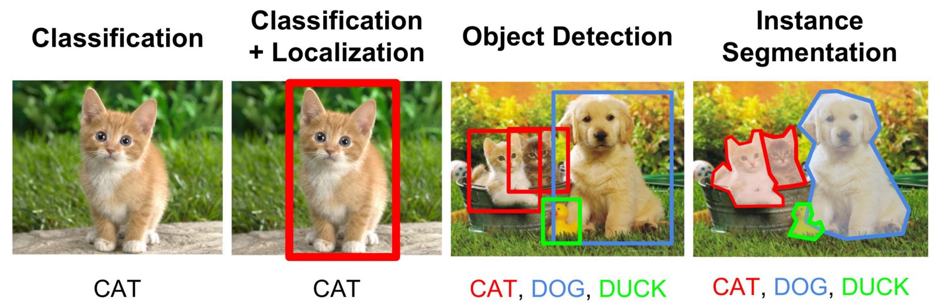
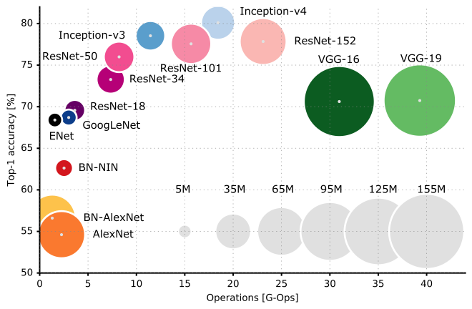
Today’s Complex Deep Neural Networks (DNNs)
Complex problems require wider and deeper DNNs
  Spatially scaling networks for higher-resolution images
  Additional layers to achieve higher accuracy
Computation and memory requirements increase accordingly
  Example: ResNet-152 requires 22.6 GOPS/image
  Parameter size increases as well (up to hundreds of MBs)
More general problem, and complex model
Image source: CS231n - Object detection. http://cs231n.Stanford.edu/slides/2016/winter1516_lecture8.pdf

Slide 3
Quantization for DNNs (1)
Motivational example: Redundancy in CNN weight parameters
  8 or fewer bits suffice for achieving full top-1 accuracy for popular CNNs
  Most of weight parameters are distributed over a short dynamic range
Quantization reduces both memory usage and computation strength.
Number of weights
LeNet
Cuda-convnet
AlexNet
VGG16
Bit width vs. Top-1 accuracy
Distribution of weight parameters

Slide 4
Quantization for DNNs (2)
Challenge: How to find compact number representations for a given DNN while satisfying user constraints (e.g., Top-1 accuracy)?
  Various number types (e.g., FLOAT, FIXED, EXP) and bit widths are used.
  Each quantized layer has different impact on overall accuracy.
  Quantization strategy varies across different underlying hardware
Number Type | Bit Width | DNN / Platform
floating-point (FLOAT) | 32 | FLOAT(32): Baseline for all DNNs
 | 16 | Half-float on Nvidia Pascal GPU
 | 9 | MS-fp9 on BrainWave
fixed-point (FIXED) | 16 | FIXED(16) on embedded FPGA
 | 10 | FIXED(10) for Maxout training
 | 8 | FIXED(8) on Google TPUv1
Exponent (EXP) | 4 | EXP(4) for log2-quantization
Binary | 1 | Binary neural networks

Slide 5
Quantization for DNNs (3)
Limitations of existing quantizers #1: Small coverage of search space
  Example: Search space of ResNet-50
    A: # of feasible (type, bit width) pairs = 42
    B: # of distinct residual blocks (layers) = 17
    C: Two dimensions of weights and activations = 2
    ⇒ Total size of search space = A^{B*C} = 42³⁴ ≈ 1.55*10⁵⁵
  Thus, existing quantizers often sacrifice coverage to reduce search cost.
    Ristretto^{[1]}: FIXED(2^{n}) types only, single global type for all activations
    TensorFlow tf.quantize^{[2]}: FIXED(8) for both weights and activations
    Stripes^{[3]}: Activations only, FIXED(16) for weights
    ⇒ Negative impact on the quality of quantization!
[1] Gysel et al., “Ristretto: A Framework for Empirical Study of Resource-Efficient Inference in Convolutional Neural Networks”, IEEE NNLS ’18.
[2] https://www.tensorflow.org/api_docs/python/tf/quantize
[3] Judd et al., “Stripes: Bit-serial deep neural network computing”, MICRO ’16.

Slide 6





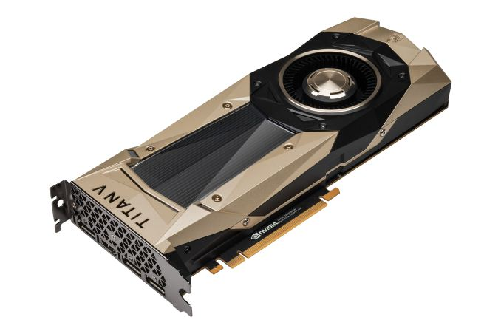
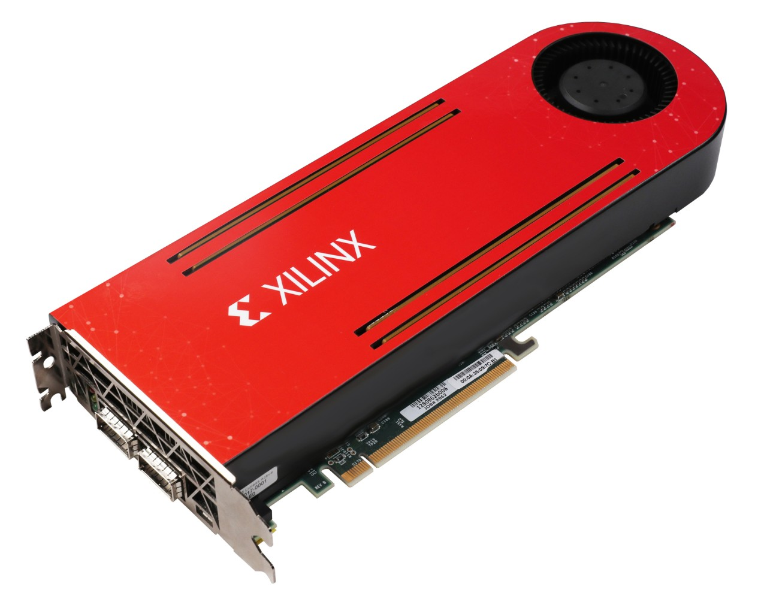
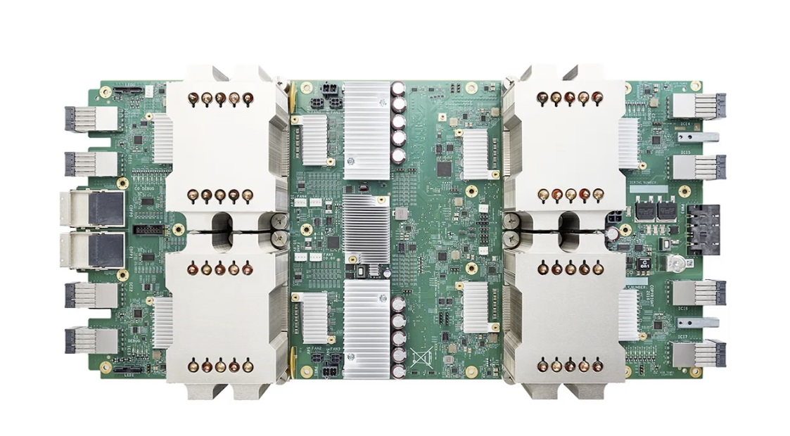



Quantization for DNNs (4)
Limitations of existing quantizers #2: Lack of portability
  Ad-hoc solution tightly coupled to a specific framework and/or hardware device
  Hard to extend to other frameworks/hardware
  Examples: Ristretto (Caffe on GPU), tf.quantize (TensorFlow), TensorRT (Nvidia GPU), Stripes (Stripes architecture)
Frameworks
We need a portable quantization framework!
Quantizer
Stripes quantizer
Ristretto
???
tf.quantize
Hardware
Custom precision
8/16b INT & FLOAT
Arbitrary precision
8b INT
Stripes [MICRO ’16]
ASIC
Volta GPU
FPGA
TPU

Slide 7
Our Proposal: libnumber
libnumber: A portable, automatic data quantizer for DNNs
  High coverage: Popular types with variable bit widths, layer-wise quantization for both weights and activations
  Fast: Efficient two-pass search algorithm
  Portable: Packaged as C++ library with Number abstract data type (ADT)
Key results: Using 11 DNNs (9 CNNs + 2 MLPs)
  Geomean 8.28x reduction in total storage requirements over FLOAT(32)
    38.1% less space than Ristretto, 69.6% less than Stripes
  Geomean speedups of 3.79x (4.19x) for bit-parallel (bit-serial) hardware
  Demonstrated portability using three DNN frameworks
    Caffe, DarkNet, TensorFlow (and counting…)

Slide 8
Outline
Introduction
libnumber
  Overview
  Number Abstracted Data Type
  Auto-tuner
Evaluation
  Methodology
  Results
Summary

Slide 9
Overview of libnumber (1)
DNN
developer
Objective func.
Error margin
Inputs to libnumber
  Pre-trained model (e.g., ResNet-50)
  Error margin (e.g., up to 1% accuracy loss)
  Objective function (e.g., minimizing total # of bits)
  Supported (type, bit width) pairs (e.g., FLOAT(16, 32), FIXED(2-32), EXP(2-9))
Output from libnumber
  Compact number representation (type, bit width, exponent bias) for each tuned layer
libnumber
Output configuration
Pre-trained
model
Layer | Type | BW | Bias
Conv1.wgt | FIXED | 5 | -1
Conv1.act | FIXED | 6 | -3
Platform
expert
Supported
(Type, bit width)
pairs
Provided by
DNN developer
by platform expert

Slide 10
Overview of libnumber (2)
Using libnumber takes two-step process
  Step #1: Apply Number ADT to target layers (e.g., CONV, FC layers)
    Number ADT encapsulates internal representation of weights and activations of the layer
  Step #2: Invoke the auto-tuner with network and platform descriptor files
    Automatically searching for compact data representation for each target layer
Will explain these two components in greater detail
Number
configuration file
(config.txt)
Number ADT-applied
DNN framework
DNN
developer
Network
descriptor
Number ADT
update()
test()
accuracy
Auto-tuner
Platform
expert
Platform
descriptor
Optimal
configuration
Model optimizer

Slide 11
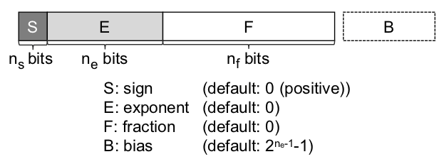
Component #1: Number ADT (1)
All popular number formats for DNNs can be generalized into an IEEE-754 based canonical number format
  Represented by a 4-tuple of <n_{s} , n_{e} , n_{f} , B>
  Number ADT is a generic number type parameterized by the 4-tuple.
    Can represent any number in the canonical form
Quantization formulated as auto-tuning problem
  How to find an optimal 4-tuple for each target layer, while satisfying user-specified constraints (e.g., target Top-1 accuracy)?

Slide 12
Component #1: Number ADT (2)
Example: Applying Number ADT to fully-connected layer
  Simply replace FLOAT(32) arrays to quantize with Number arrays in C++
  Each array has distinct object name to be quantized independently (omitted)
  Auto-tuner finds a 4-tuple <n_{s}, n_{e}, n_{f}, B> for each Number array
float input [in_c][h][w];
float filter[out_c][in_c][h][w];
float output[out_c];
// Computation of fully connected layer
for (int i=0; i<out_c; ++i) {
for (int j=0; j<in_c; ++j) {
for (int k=0; k<h; ++k) {
for (int l=0; l<w; ++l) {
output[i] += filter[i][j][k][l]*
input[j][k][l];
}}}}
...parse configuration files...
Number input [in_c][h][w];
Number filter[out_c][in_c][h][w];
float output[out_c];
// Computation of fully connected layer
for (int i=0; i<out_c; ++i) {
for (int j=0; j<in_c; ++j) {
for (int k=0; k<h; ++k) {
for (int l=0; l<w; ++l) {
output[i] += (filter[i][j][k][l]*
input[j][k][l]).asFloat();
}}}}
...initialization process...

Slide 13
Component #2: Auto-tuner (1)
Python-based interface to configure the auto-tuner
  Platform descriptor
    Key-value pair of device name and a list of supported number formats
  Network descriptor
    DNN-specific parameters such as target layer’s name, sub-layers, etc.
    Error margin to constrain accuracy loss due to quantization
    Objective function to set the optimization goal (e.g., minimize total bit count)
// Parameters for FPGA
supported_formats = {
‘FPGA’:{
‘FLOAT’: [16, 32],
‘FIXED’: range(2, 33),
‘EXP’ : range(2, 10)
}
}
// Parameters for LeNet
layer_name = [‘c1’, ‘c2’]
layer_size = [500, 25000]
err_margin = 0.07
cmd = “./build/caffe <option>”
f_obj = <objective function>
Platform descriptor file
Network descriptor file

Slide 14
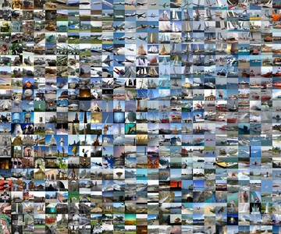
Component #2: Auto-tuner (2)
Features of the tuning algorithm
  Two-pass algorithm to reduce the latency of single iteration
  Exponent bias as first-class tuning target
  Supporting group representation with object name (for inception, residual modules)
Large # of test dataset
Randomly sampled
small test dataset
Full test dataset
Initialize
Coarse-grained
search
Fine-tuning
Accuracy
recovery
Fine-tuning
Final
configs
Pass 1
Fast search with small dataset
Pass 2
Fine-tuning with full dataset

Slide 15
Component #2: Auto-tuner (3)
Example: Tuning LeNet* - Pass 1 with “small” dataset
  Phase 1, 2: Tuning with small “randomly sampled” MNIST dataset
  Accuracy constraint (Error margin): 0.9728 (1% loss)
- Iteration 0: initial configuration
Initialization
Phase 1:
Coarse-grained search
(Small dataset)
 | Conv1 | Conv2 | Accuracy | f_obj
Weight | Float 32 | Float 32 | 0.983 | 113
Activation | Float 32 | Float 32
Coarse-grained search
Platform constraints
Go to next
tuning phase
// Platform descriptor
supported_formats = {
‘FPGA’:{
‘FLOAT’: [16, 32],
‘FIXED’: range(2, 33),
‘EXP’ : range(2, 10)
}
}
// Network descriptor
layer_name = [‘c1’, ‘c2’]
layer_size = [500, 25000]
err_margin = 0.01
cmd = “./caffe <option>”
f_obj = total_storage_cap
* Y. LeCun “LeNet-5, convolutional neural networks”.

Slide 16
Component #2: Auto-tuner (4)
Example: Tuning LeNet - Pass 1 with “small” dataset
  Phase 1, 2: Tuning with small “randomly sampled” MNIST dataset
  Accuracy constraint (Error margin): 0.9728 (1% loss)
Iteration 1: Global binary search
- Iteration 0: initial configuration
Initialization
Phase 1:
Coarse-grained search
(Small dataset)
 | Conv1 | Conv2 | Accuracy | f_obj
Weight | Float 32 | Float 32 | 0.983 | 113
Activation | Float 32 | Float 32
Coarse-grained search
Float 16
Float 16
0.983
56
Float 16
Float 16
Go to next
tuning phase
Iteration 2: Minimize bit width, change type
 | Conv1 | Conv2 | Accuracy | f_obj
Weight | Fixed 8 | Fixed 8 | 0.984 | 28
Activation | Fixed 8 | Fixed 8

Slide 17
Component #2: Auto-tuner (5)
Example: Tuning LeNet - Pass 1 with “small” dataset
  Phase 1, 2: Tuning with small “randomly sampled” MNIST dataset
  Accuracy constraint (Error margin): 0.9728 (1% loss)
Iteration 7: Phase 1 finished (Select the best)
Initialization
Phase 1:
Coarse-grained search
(Small dataset)
 | Conv1 | Conv2 | Accuracy | f_obj
Weight | Fixed 3 | Fixed 3 | 0.977 | 10
Activation | Fixed 3 | Fixed 3
Coarse-grained search
Tune
bias
Tune
bit width
Iteration 8: Tuning bias layer-by-layer
Phase 2:
Fine-tuning bias,
bit width and type
(Small dataset)
 | Conv1 | Conv2 | Accuracy | f_obj
Weight | Fixed 3 | Fixed 3 | 0.976 | 10
Activation | Fixed 3 | Fixed 3
Tune
number type
0.976
10
Go to next tuning phase
Bias tuning → No changes in f_obj.
But, changes in accuracy

Slide 18
Component #2: Auto-tuner (6)
Example: Tuning LeNet - Pass 1 with “small” dataset
  Phase 1, 2: Tuning with small “randomly sampled” MNIST dataset
  Accuracy constraint (Error margin): 0.9728 (1% loss)
Iteration 19: Bias tuning finished (Best)
Initialization
Phase 1:
Coarse-grained search
(Small dataset)
 | Conv1 | Conv2 | Accuracy | f_obj
Weight | Fixed 3 | Fixed 3 | 0.98 | 10
Activation | Fixed 3 | Fixed 3
Coarse-grained search
Tune
bias
Tune
bit width
Better accuracy !
Iteration 20: Tuning bit width layer-by-layer
Phase 2:
Fine-tuning bias,
bit width and type
(Small dataset)
 | Conv1 | Conv2 | Accuracy | f_obj
Weight | Fixed 3 | Fixed 3
Activation | Fixed 3 | Fixed 3
Fixed 2
Fixed 2
Tune
number type
Fixed 2
0.98
8
0.976
0.975
7
9
Fixed 2
Go to next tuning phase
7
Best f_obj is selected !
Conv2 – Weight –
Conv1 – Weight –
9
Conv1, Conv2 – Activation –
8
Configuration Set

Slide 19
Component #2: Auto-tuner (7)
Example: Tuning LeNet - Pass 2 with “full” dataset
  Phase 3, 4: Now “fully covers” MNIST dataset
  Accuracy constraint (Error margin): 0.9743 (1% loss)
Initialization
Globally increase bit width of all layers
until met accuracy constraints
Phase 3:
Accuracy recovery
(Full dataset)
Recover accuracy (if necessary)
Tune
bias
Tune
bit
width
Repeat the same loop in Phase 2,
but with full dataset
Phase 4:
Fine-tuning bias,
bit width and type
(Full dataset)
Tune
number type
Final config.

Slide 20
Outline
Motivation and design goals
libnumber
  Overview
  Number Abstracted Data Type
  Auto-tuner
Evaluation
  Methodology
  Results
Summary

Slide 21
Methodology (1)
11 Benchmarks: 9 CNNs + 2 MLPs
  Caffe: ResNet-50, Network-in-Network, GoogleNet, VGG-16, Cuda-convnet, LeNet, MLP-C, MLP-M
  DarkNet: DarkNet-reference, Tiny-YOLO (Object detection)
libnumber compared to two existing quantizers
  Ristretto: FIXED(2^{n}) types only, single global type for all activations^{[1]}
  Stripes: Activations only, FIXED(16) for weights^{[2]}
[1] Gysel et al., “Ristretto: A Framework for Empirical Study of Resource-Efficient Inference in Convolutional Neural Networks”, IEEE NNLS ‘18.
[2] Judd et al., “Stripes: Bit-serial deep neural network computing”, MICRO ‘16.

Slide 22
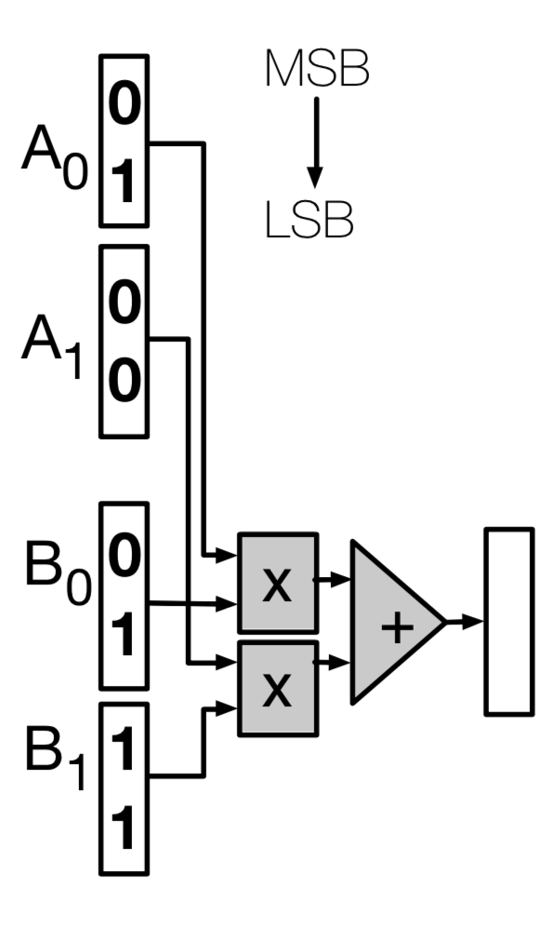
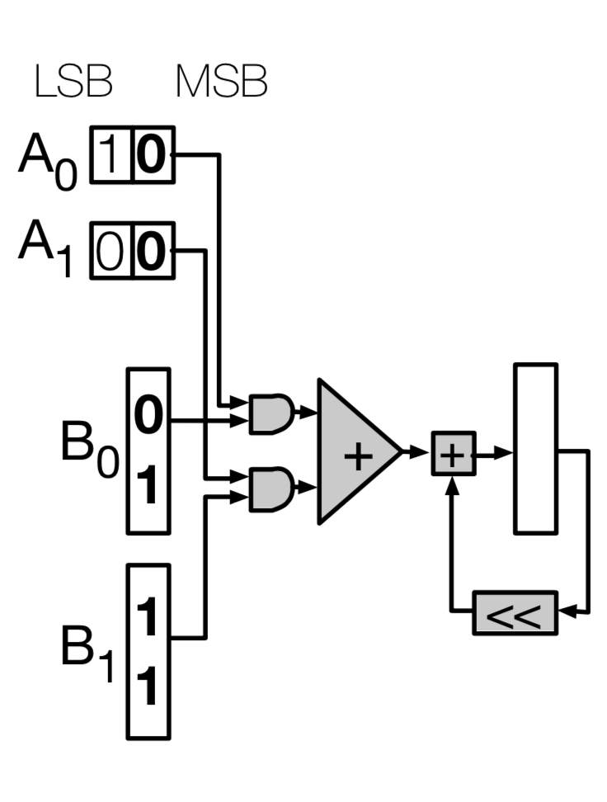
Methodology (2)
Speedups evaluated on two different architectures
  Architecture #1: bit-parallel accelerator based on Zhang et al.^{[1]}
    High-Level Synthesis (HLS) for FPGA
    Quantized data is packed into 32-bit words for performance
    Supports FLOAT(32), FIXED(2-16) and EXP(2-9)
  Architecture #2: bit-serial accelerator based on Stripes ^{[2]}
    Simple theoretical model from Stripes
    Performance is directly scalable to bit widths of activations
    Uses FIXED-only (FIXED(16) for weights, FIXED(2-16) for activations)
[1] Zhang et al., “Optimizing FPGA-based Accelerator Design for Deep Convolutional Neural Networks”, FPGA ‘15.
[2] Judd et al., “Stripes: Bit-serial deep neural network computing”, MICRO ‘16.

Slide 23
Results (1): Model Compression Ratio
Model parameter size
  Normalized to FLOAT(32) baseline with 7% and 1% tolerance of accuracy loss
    Lower is better.
  Geomean reduction of 8.91x in parameter size over FLOAT(32) for maximum 7% accuracy loss
    Geomean 8.28x reduction in total storage requirements over FLOAT(32)
    38.1% less space than Ristretto, 69.6% less than Stripes

Slide 24
Results (2): Speedups on Bit-Parallel Accelerator
Speedups
  Normalized to the FPGA baseline with FLOAT(32) for all layers^{[1]}
  Geomean 3.79x speedups for 11 benchmarks
  93% and 18% higher speedups over Stripes and Ristretto
[1] Zhang et al., “Optimizing FPGA-based Accelerator Design for Deep Convolutional Neural Networks”, FPGA ‘15.

Slide 25
Results (3): Speedups on Bit-Serial Accelerator
Speedups
  Normalized to DaDianNao^{[1]} using FIXED(16) for all layers
  Number configurations for Stripes taken from the original paper^{[2]}
  Geomean 4.19x speedups for 6 benchmarks
  A reduction in bit width leads to performance boost more directly than FPGA
[1] Chen et al., “DaDianNao: A Machine-Learning Supercomputer”, MICRO ’14.
[2] Judd et al., “Stripes: Bit-serial deep neural network computing”, MICRO '16.

Slide 26
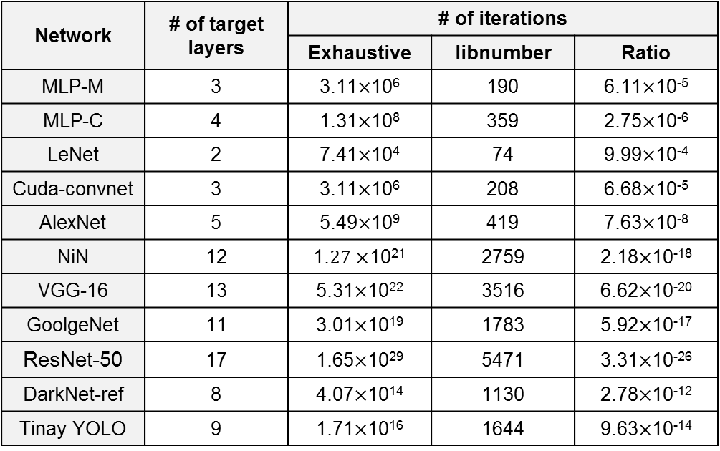
Results (4): Search Cost
Search time = (# of iterations) * (latency of single iteration)
  # of iterations of libnumber: Ranging from 74 to 5471
  Latency of single iteration: Geomean 2.52x reduction by taking two-pass search
  Actual search time ranges from minutes to tens of hours (Nvidia GTX 1080 Ti)
Network | # of target layers | # of iterations
 |  | Exhaustive | libnumber | Ratio
MLP-M | 3 | 3.11$×$10⁶ | 190 | 6.11$×$10⁻⁵
MLP-C | 4 | 1.31$×$10⁸ | 359 | 2.75$×$10⁻⁶
LeNet | 2 | 7.41$×$10⁴ | 74 | 9.99$×$10⁻⁴
Cuda-convnet | 3 | 3.11$×$10⁶ | 208 | 6.68$×$10⁻⁵
AlexNet | 5 | 5.49$×$10⁹ | 419 | 7.63$×$10⁻⁸
NiN | 12 | 1.$27×$10²¹ | 2759 | 2.18$×$10⁻¹⁸
VGG-16 | 13 | 5.31$×$10²² | 3516 | 6.62$×$10⁻²⁰
GoolgeNet | 11 | 3.01$×$10¹⁹ | 1783 | 5.92$×$10⁻¹⁷
ResNet-50 | 17 | 1.65$×$10²⁹ | 5471 | 3.31$×$10⁻²⁶
DarkNet-ref | 8 | 4.07$×$10¹⁴ | 1130 | 2.78$×$10⁻¹²
Tinay YOLO | 9 | 1.71$×$10¹⁶ | 1644 | 9.63$×$10⁻¹⁴

Slide 27
Conclusion
libnumber: A portable, automatic data quantizer for DNNs
  High coverage: Popular types with variable bit widths, layer-wise quantization for both weights and activations
  Fast: Efficient two-pass search algorithm
  Portable: Packaged as C++ library with Number abstract data type (ADT)
libnumber effectively separates the concerns of developing a DNN model from low-level optimization like quantization.

