Slide 1
Student Concentration Tracker
A Prototype Software Project
Presented by: MAHFUZ IBRAHIM
Course: Software engineering
Date:

Slide 2
Problem Statement
• Students often lose concentration in class.
• Teachers struggle to measure and track participation.
• Leads to poor engagement and reduced learning outcomes.

Slide 3
Objectives
1. Record daily student participation.
2. Evaluate engagement levels.
3. Rate students (Engaged, Moderate, Needs Attention).
4. Provide recommendations for improvement.
5. Visualize concentration trends.

Slide 4
Proposed Solution
A simple software where:
- Teacher inputs student name and participation mark (0–10).
- System calculates averages and engagement ratings.
- Provides class-level reports and recommendations.
- Displays charts of concentration trends.

Slide 5
Features (MVP)
• Add student participation records
• View reports with ratings
• Calculate class averages
• Show engagement trend charts
Optional (Future): Leaderboard, PDF Export, Login system

Slide 6
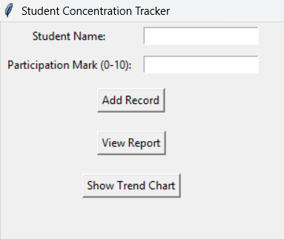
Prototype / Mockup
User Interface of the software prototype:

Slide 7
How It Works
1. Teacher enters student name + participation mark.
2. Data stored in database.
3. System calculates averages.
4. Generates student report & class recommendations.
5. Displays trend chart.

Slide 8
Demo Example
Example Data:
- Aisha: 9 = Highly Engaged 🎯
- Musa: 6 = Moderate 🙂
- Joy: 4 = Needs Attention ⚠️
Class Average: 6.3
Recommendation: Add interactive activities to boost focus.

Slide 9
Future Enhancements
• Add leaderboard for most engaged students.
• Export reports to PDF.
• Add teacher login system.
• Mobile and web app versions.

Slide 10
Conclusion
• Student Concentration Tracker helps teachers monitor engagement.
• Provides ratings, recommendations, and visual trends.
• Prototype demonstrates potential for full classroom management system.
• Supports improved teaching and learning outcomes.

Slide 11
THANK YOU

