Slide 1

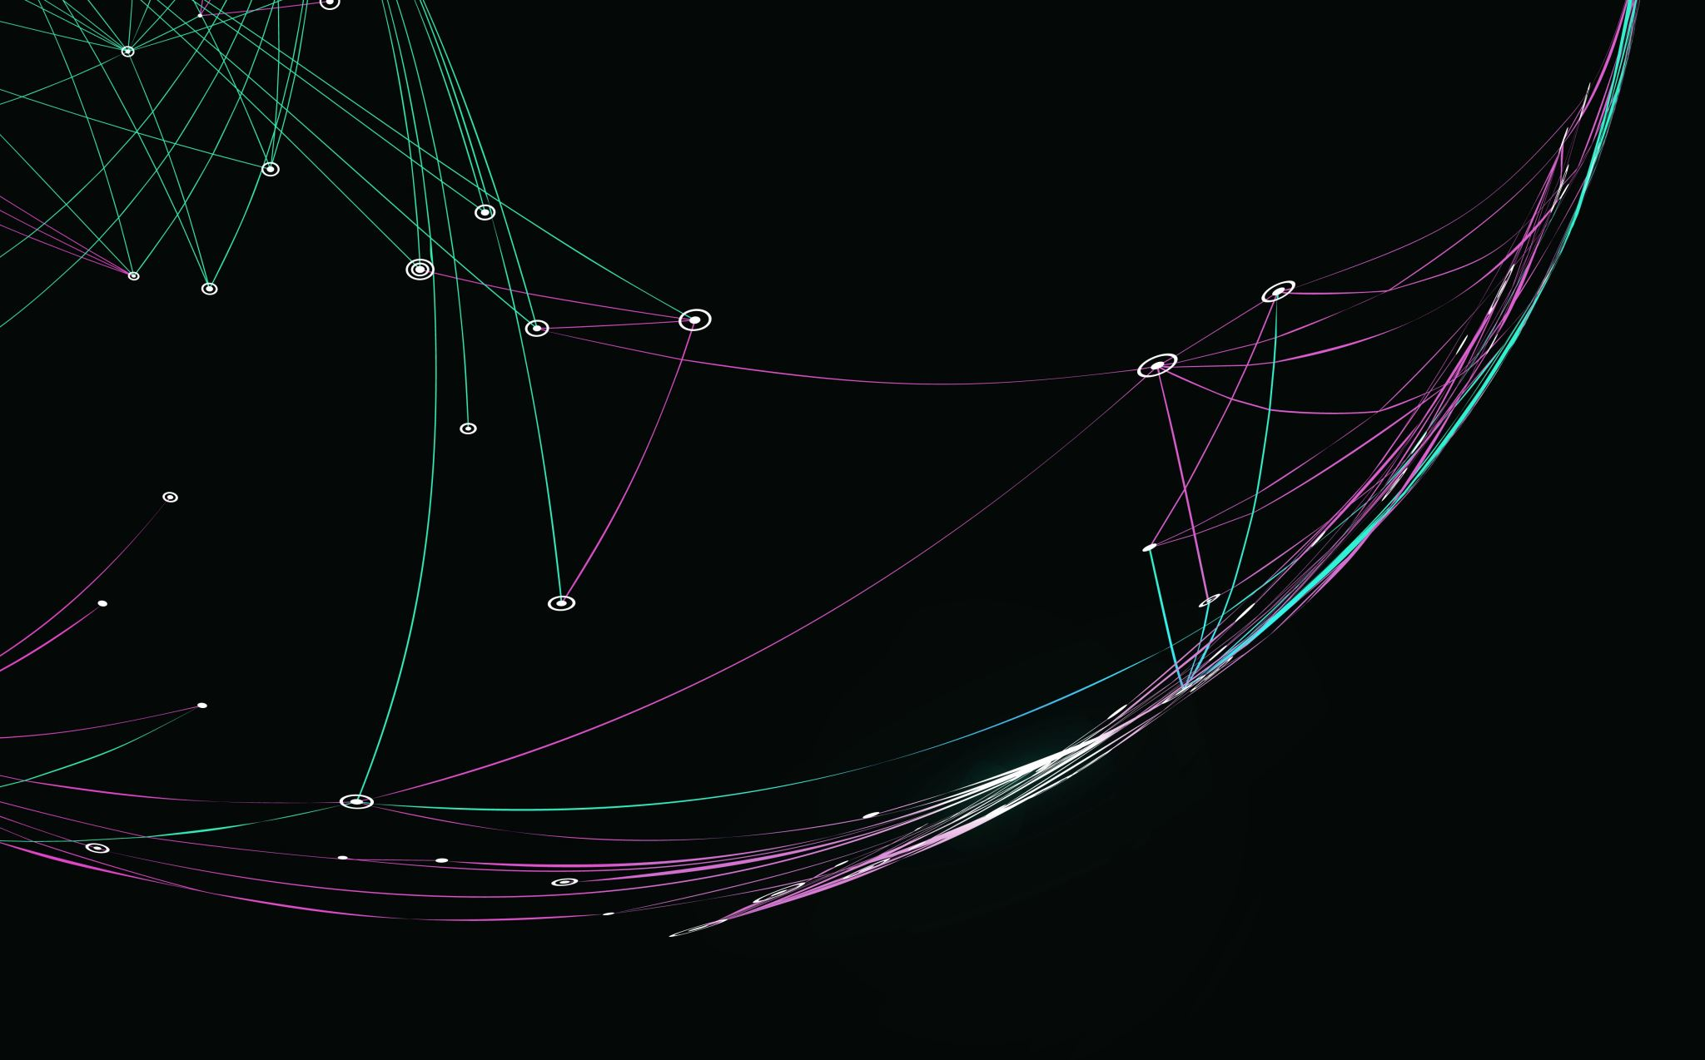
Paraphrase Detection System
Team Members:
Sreeja Garlapati
Bharath Kondreddy
Mahesh Gundagoni

Slide 2
Introduction
Understanding Paraphrase Detection: Exploring how NLP identifies varying expressions of the same idea in different sentence constructions.
Significance in Language Processing: Highlighting the role of paraphrase detection in improving the accuracy and reliability of NLP systems.
Deep Learning Approaches: Discussing the application of neural network models like BERT and LSTM in recognizing paraphrased text.
Challenges and Solutions: Addressing common obstacles in paraphrase detection, such as linguistic nuances and contextual variations, and proposing potential solutions.
Real-world Applications: Illustrating the use of paraphrase detection in fields like education (detecting plagiarism), customer service (understanding varied customer queries), and content management (identifying duplicate content).

Slide 3
Statement of Project Objectives
Develop a Robust Model: Create an intelligent system that can accurately identify whether two given sentences are paraphrases of each other.
Enhance NLP Applications: Improve natural language processing applications by enhancing the understanding of sentence similarity. This will benefit tasks like information retrieval, question answering, and text summarization.
Contribute to Research: Contribute to the field of NLP by exploring novel approaches, evaluating existing methods, and addressing the challenges of paraphrase detection.
User Experience Improvement: Provide a reliable system that enhances user experience when dealing with text data. Users will benefit from better search results, more accurate chatbots, and improved content recommendation systems.

Slide 4
Statement of Value
Enhanced Content Understanding: A successful paraphrase detection system improves content understanding by identifying equivalent expressions. Users benefit from more accurate search results, chatbots, and recommendation systems.
Efficient Information Retrieval: Paraphrase detection enhances information retrieval. Users can find relevant documents even when the wording varies, leading to more efficient searches.
Educational Resource: Your project serves as an educational resource for researchers, teachers, and students. It contributes to the NLP community by sharing insights, methodologies, and lessons learned.
Practical Applications: Beyond academia, paraphrase detection has practical applications in plagiarism detection, content summarization, and automated essay grading.
Advancing NLP Research: By addressing the challenges of paraphrase detection, you contribute to the advancement of natural language processing research. Your work may inspire novel approaches and foster collaboration.

Slide 5
Review of the state of the Art and Relevant Works:
Neural Methods Dominating:
Recent advances favor neural methods for paraphrase generation.
Neural architectures provide contextualized representations and generate fluent, diverse, and human-like paraphrases.
Typology of Paraphrases:
Propose a refined typology of paraphrases to better represent different types.
Investigate how this typology is reflected in popular datasets and its impact on detection capabilities

Slide 6
Approach
Siamese Networks:
Implement Siamese neural networks to learn sentence embeddings. These networks compare two input sentences and produce a similarity score.
Train the network using positive (paraphrase) and negative (non-paraphrase) sentence pairs.
Use contrastive loss or triplet loss to optimize the embeddings.
Pre-trained Language Models (e.g., BERT):
Fine-tune pre-trained language models (such as BERT, RoBERTa, or DistilBERT) on paraphrase detection tasks.
Leverage contextualized word representations to capture sentence semantics.
Add a classification layer for binary paraphrase/non-paraphrase prediction.
LSTM-based Models:
Design Long Short-Term Memory (LSTM) networks to encode sentence sequences.
Combine the LSTM outputs to create sentence embeddings.
Train the model using labeled paraphrase pairs.

Slide 7
Deliverables
Upon the completion of our project, we will deliver the following components, each integral to the project’s success and in alignment with our stated objectives:
Algorithmic Codebase: A fully documented code repository containing all developed algorithms and models.
Trained Models: The final trained models ready for deployment, along with their training and validation data.
Project Report: A comprehensive report detailing our methodologies, experiments, and results.
Presentation: A final presentation summarizing our project findings and its potential impact.

Slide 8
Evaluation Methodology:
Test Set Split:
Divide the dataset into training and test sets.
Reserve a portion (e.g., 20%) for evaluation.
Metrics Selection:
Accuracy: Overall correctness of predictions.
Precision, Recall, F1-score: Balance between true positives, false positives, and false negatives.
AUC-ROC: Model’s ability to rank paraphrase pairs.
Model Evaluation:
Evaluate the trained model on the test set using selected metrics.
Analyze performance across different classes (paraphrase vs. non-paraphrase).

Slide 9
Evaluation Methodology:
Cross-Validation:
Perform k-fold cross-validation (e.g., 5-fold) to assess generalization.
Report average metrics and standard deviations.
Qualitative Analysis:
Manually inspect false positives and false negatives.
Understand cases where the model struggles (e.g., ambiguous sentences).

Slide 10
Thank you!!!

