Slide 1
Impedance Control Implementation on UR5e
under ROBOSUITE simulation
——————————————
Jonathan Oh, 941170???
Zitao Yu, 941170755

Slide 2
———————————————
Part 1: Challenge description
Part 2: Simulation Environment
Part 3: Algorithm
Part 4: Experimental Results: Tuning of parameters
Part 5: Performance under assumed best parameters
Part 6: Future Development

Slide 3
———————————————
Part 1: Challenge description
The insertion operation of robot using traditional PID control:
Might have low robustness when the location of the hole is uncertain
Results in damage in robot arms and working objects.
(impulse in joint load, exceeding maximum material strength, etc)
Need impedance control to avoid such a situation!
Example: 2D project

Slide 4
———————————————
Part 2: Simulation Environment
Simulation Software: Robosuite .
Robosuite is a simulation framework powered by the MuJoCo physics engine for robot learning. It also offers a suite of benchmark environments for reproducible research. The release or Robosuite v1.2 features manipulation tasks with supports of procedural generation, advanced controllers, teleoperation, etc. This project is part of the broader Advancing Robot Intelligence through Simulated Environments (ARISE) Initiative, with the aim of lowering the barriers of entry for cutting-edge research at the intersection of AI and Robotics.
Installation Reference: https://github.com/shirkozlovsky/robosuite
Task model:
16mm diameter aluminum rod
Rectanguar hole
(add picture of the initial posture)
Trajectory planning
Pick – and – place process, in order to do multiple tasks if needed

Slide 5
———————————————
Part 3: Algorithm
Impedance control
DBIC & PBIC
Advantages: Easy to derivate
Disadvantages: Hard to implement in Robosuite environment, force sensor might be very noisy
Operational Space Control with fixed impedance
…

Slide 6
———————————————
Part 4: Algorithm
4.1 To test range of parameters for successful insertion
Criteria:
Run time: consider exceeding 30s as failure, to achieve a more effective control.
External force in x, y, z direction: applying the impedance control, the reaction force changes more smoothly, and the maximum force is not too high.
Variables
Kp & Kd in x,y,z prismatic and torsional directions
Perception error (dislocation of the hole as percentage of the diameter of the rod)
——————————

Slide 7
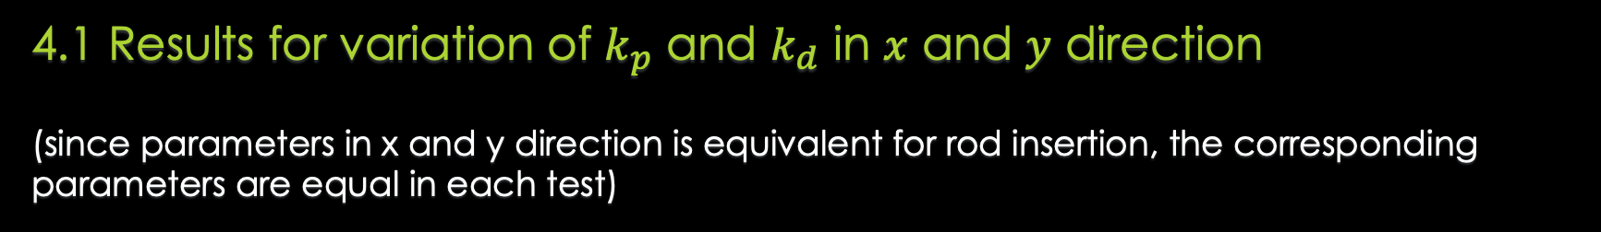
———————————————
Part 4: Algorithm
4.1 Results for variation of $k_{p}$ and $k_{d}$ in $x$ and $y$ direction
(since parameters in x and y direction is equivalent for rod insertion, the corresponding parameters are equal in each test)

Slide 8
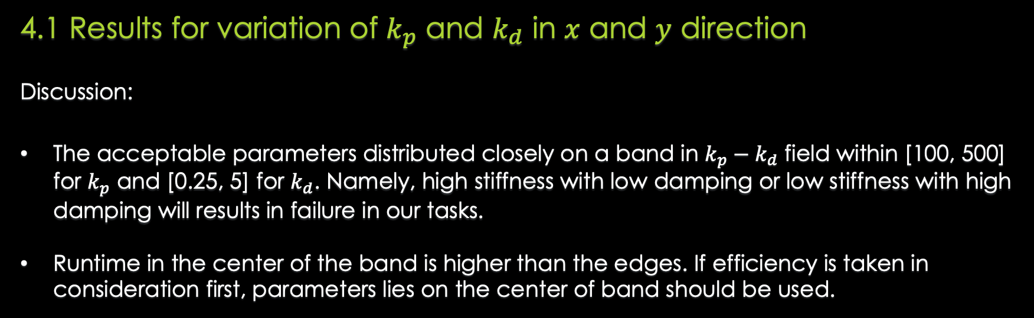
———————————————
Part 4: Algorithm
4.1 Results for variation of $k_{p}$ and $k_{d}$ in $x$ and $y$ direction
Discussion:
The acceptable parameters distributed closely on a band in $k_{p}−k_{d}$ field within [100, 500] for $k_{p}$ and [0.25, 5] for $k_{d}$. Namely, high stiffness with low damping or low stiffness with high damping will results in failure in our tasks.
Runtime in the center of the band is higher than the edges. If efficiency is taken in consideration first, parameters lies on the center of band should be used.

Slide 9
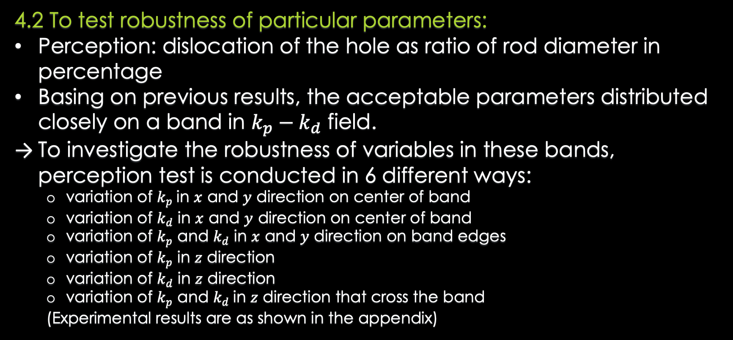
———————————————
Part 4: Algorithm
4.2 To test robustness of particular parameters:
Perception: dislocation of the hole as ratio of rod diameter in percentage
Basing on previous results, the acceptable parameters distributed closely on a band in $k_{p}−k_{d}$ field.
To investigate the robustness of variables in these bands, perception test is conducted in 6 different ways:
variation of $k_{p}$in $x$ and $y$ direction on center of band
variation of $k_{d}$ in $x$ and $y$ direction on center of band
variation of $k_{p}$ and $k_{d}$ in $x$ and $y$ direction on band edges
variation of $k_{p}$ in $z$ direction
variation of $k_{d}$ in $z$ direction
variation of $k_{p}$ and $k_{d}$in $z$ direction that cross the band
(Experimental results are as shown in the appendix)

Slide 10
———————————————
Part 5: Performance under assumed best parameters
$k_{p}$: [,,,,,]
$k_{d}$: [,,,,,]

Slide 11
———————————————
Part 6: Discussion and Future Development

Slide 12
COP Determination of Refrigeration System
Using Elasto-caloric Effect
Questions
_____________________

Slide 13
COP Determination of Refrigeration System
Using Elasto-caloric Effect
Thank You!
_____________________

Slide 14
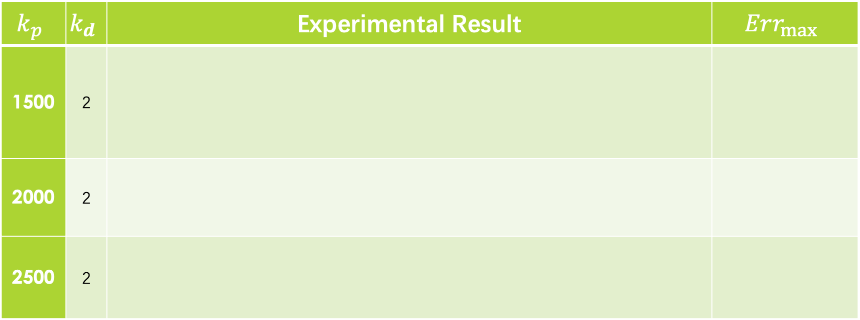
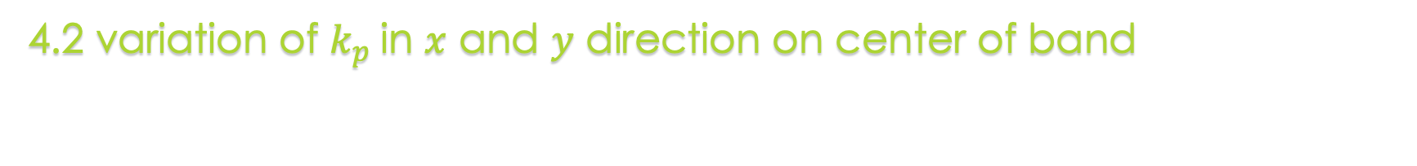
———————————————
Part 4: Algorithm – Appendix
4.2 variation of $k_{p}$in $x$ and $y$ direction on center of band
$$k_{p}$$ | $$k_{d}$$ | Experimental Result | $$Err_{max}$$
1500 | 2
2000 | 2
2500 | 2

Slide 15

———————————————
Part 4: Algorithm – Appendix
4.2 variation of $k_{d}$ in $x$ and $y$ direction on center of band
$$k_{p}$$ | $$k_{d}$$ | Experimental Result | $$Err_{max}$$
1500 | 2
2000 | 2
2500 | 2

Slide 16
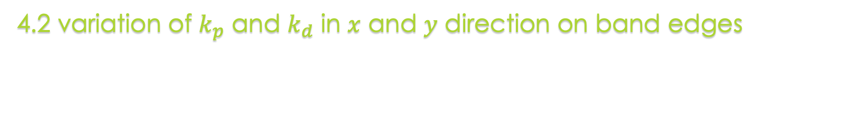
———————————————
Part 4: Algorithm – Appendix
4.2 variation of $k_{p}$ and $k_{d}$ in $x$ and $y$ direction on band edges
$$k_{p}$$ | $$k_{d}$$ | Experimental Result | $$Err_{max}$$
1500 | 2
2000 | 2
2500 | 2

Slide 17
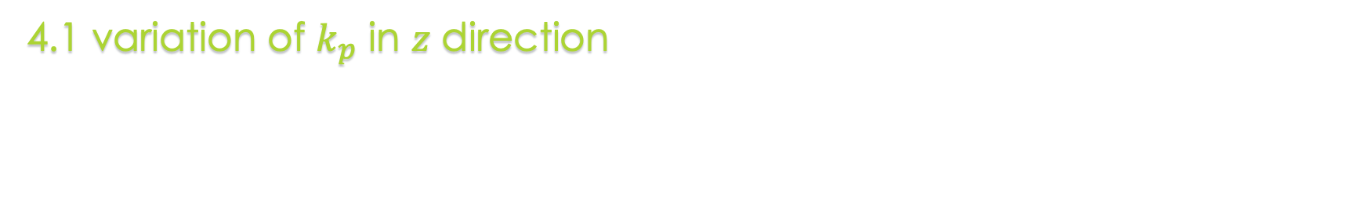
———————————————
Part 4: Algorithm – Appendix
4.1 variation of $k_{p}$ in $z$ direction
$$k_{p}$$ | $$k_{d}$$ | Experimental Result | $$Err_{max}$$
1500 | 2
2000 | 2
2500 | 2

Slide 18

———————————————
Part 4: Algorithm – Appendix
4.1 variation of $k_{d}$ in $z$ direction
$$k_{p}$$ | $$k_{d}$$ | Experimental Result | $$Err_{max}$$
1500 | 2
2000 | 2
2500 | 2

Slide 19

———————————————
Part 4: Algorithm – Appendix
4.1 variation of $k_{p}$ and $k_{d}$in $z$ direction that cross the band
$$k_{p}$$ | $$k_{d}$$ | Experimental Result | $$Err_{max}$$
1500 | 2
2000 | 2
2500 | 2

