Slide 1
Coworker Presentation
Joy Garnett

Slide 2
Outline
Problem Statement
Dataset Overview
Dataset size and data types present
Packages used
Identify and remove uninformative features
Data Cleaning / Feature Transformations
Statistical Learning Models
Overview
Results
Recommendations

Slide 3
Problem Statement
Client:
Tax firm looking to sell tax preparation software
Data:
Two years of customer information
Record whether they were able to sell successfully to each customer.
Goal:
They want to understand this data and build a model to predict if they will be able to successfully sell their software to a given individual.
This is a classification problem to identify a ‘yes’ or ‘no’ successful sale.
Approach:
Exploratory data analysis to identify features that contribute to a successful sale
Two classification models to predict whether a sale would be successful or not

Slide 4
Dataset overview
Filename: project_data.csv
Two years of customer information
41,188 customers
Successful sale rate: 11.2%
No: 36548
Yes: 4640
21 features for each customer
15 Identifiable features
6 Unidentifiable features excluding successful sale
No duplicate records found
Present datatypes
6 float columns
5 integer columns
11 string object columns
Uninformative features removed:
c8: (35,563/41,188) 86.3% of data is missing
n4: (39, 673/41,188) 96.3% of data is the same value of 999
Reduces 21 features to 19 features per record

Slide 5
Packages Used
Data handling / feature transformation
Pandas
Groupby to aggregate data
Numpy
Modeling
Scikit-learn
Random Forest
Logistic Regression
Visualization
Seaborn
Matplotlib

Slide 6
Pandas.Groupby Data Aggregation
'Successful_sell’ column was mapped to integers to make the aggregations simpler
Aggregations with pandas.groupby on the ‘successful_sell’ column were performed on the following columns:
Employment status
Marriage-status
Day of the week (dow)
School
n4 (found to be uninformative)
Month

Slide 7
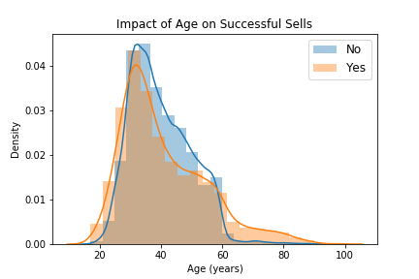
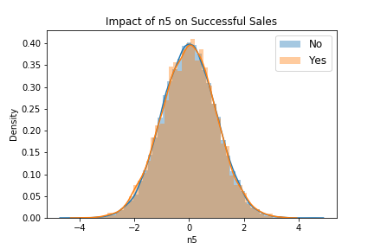
successful sale Distribution plots
Distribution plots to compare successful and unsuccessful sales
Age column: Major differences in Groups A and C
A (17 – 31): more likely to buy
B (31 – 60): less likely to buy
C (60+): more likely to buy
n5 column
No differences found between successful and unsuccessful sales

Slide 8
Data cleaning and Feature transformations
String values converted to numerical values
Reason: scikit-learn models require numerical value inputs
Null values were converted to either ‘unknown’ and one-hot encoded or -1, depending on the column
One-hot encoding expanded total features from 19 to 35 (excluding successful_sell)
Two types of numerical conversion
Unordered
One-hot encoding with pandas.get_dummies
Marriage-status
Employment
Ordered
Direct mapping to values
b1, b2, c10, c3, c4, dow, month, schools

Slide 9
Map implementation for ordered string columns
b1: yes = 1, no = 0
b2: yes = 1, no = 0, NaN = -1
c10: yes = 1, no = 0
c3: True = 1, False = 0, unknown = -1
c4: new = 1, old = 0
dow (day of the week): mon = 0, tues = 1, wed = 2, thurs = 3, fri = 4
month: jan = 0, feb = 1, ... nov = 10, dec = 12
school: 5 - a decent amount = 5, 5 - a lot = 5, 2 - a little bit = 2, 4 - average amount = 4, 3 - a bit more = 3, 1 - almost none = 1, 0 - none = 0, NaN = -1

Slide 10
Data Prep for Models
Data split for model training and testing
Training/Test/Validation split: 60/20/20
Training: 24712
Test: 8238 samples
Validation dataset: 8238 samples
Data was then scaled to zero mean and unit variance
Scaler was first fit to the training data
Transformation applied
Training data
Test data
Validation data
This data was then fit to two models
Default scikit-learn parameters were included in this first iteration.

Slide 11
Model results
Two models were employed to predict whether a customer would buy.
Random Forest Classifier (Model 1)
Adv: Gini Feature Importance
Which factors contribute to successful sales?
Logistic Regression (Model 2)
Adv: Faster implementation
Results:
For both models, the accuracy, precision, recall, and AUC values were 1.0
All successful sales were classified correctly
No unsuccessful sales were mistaken for successful ones (no false positives)
No successful sales were missed by the model (no false negatives)
I found one factor that contributes the most to the Random Forest classifier.

Slide 12
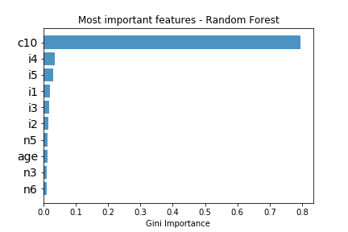
Major Contributions to Successful Sales
The c10 feature was the greatest contributor to successful sales.
It is uninterpretable so it’s hard to directly advise business strategies on this factor alone.
c10 | Counts | Sell %
no | 36548 | 0
yes | 4640 | 1

Slide 13
What was given to the client
Three deliverables were given to the client.
Customer segmentation based on several identifiable features:
Age
Marriage
Education
Month of attempted sale
Source code for customer segmentation and two machine learning models with full documentation.

Slide 14
What was given to the client
There were three deliverables given to the client.
Five business strategies based on the customer segmentation analysis of multiple identifiable features as well as the models.
Expand marketing and sales efforts to currently underserved but high-likelihood age groups:17-31 and 60+
Expand marketing and sales efforts to single people
Expand targeting to those who identify as having occupations of students, none, and leisure
Expand marketing and sales efforts to months before tax day (March, December, September, October) and expand operations to January and February
Use c10 to your full advantage as it is the greatest predictor of a successful sale

Slide 15

Thank you

