Slide 1
GOOD TUTOR goodtutor.infinityfreeapp.com
GARNET CAMERON
AREEBA HASSAN
SON DANG
AMULYA MURUDUDDI

Slide 2
INTRODUCTION
Subject specific 1-hour session(s) purchasing.
User registration and login.
Multiple Payment Gateways.
AI Assistant.

Slide 3


Architecture
Two Tiered and Three Layers
request
1
2
Client
HTTPS
Web Server
Apache
DB
MySQL
response

Slide 4
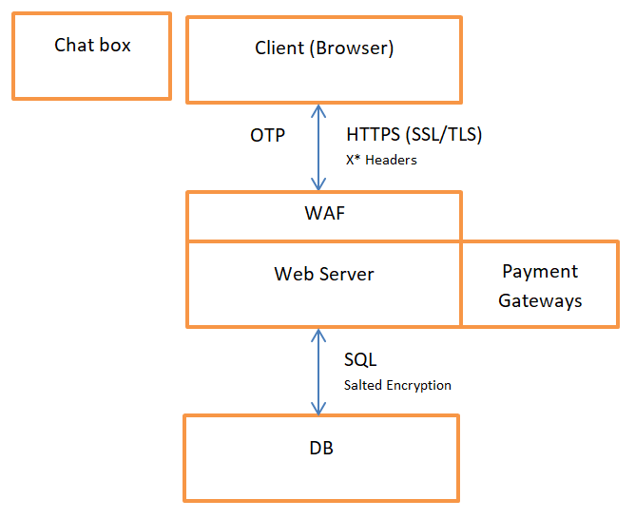
Architecture cont'd

Slide 5
Results & Analysis
Tools:
WordPress and plug-ins (construction)
Woo Commerce, OTP, Redirect, "AIOS", etc.
OWASP ZAP (Vulnerabilities / Testing)
Results (needed):
Server: response security headers – XSS, X-Frame, Cache
Browser: security headers – X-Content

Slide 6
Summary and Takeaways
Summary:
Designed a secure e-commerce platform with robust authentication and payment systems
Key Takeaways:
User trust, robust security measures, continuous testing.
Future Scope:
Install and configure AIOS
Connect and secure Chat Box
Expanding services, enhancing AI-based tutor recommendations and additional features.

Slide 7
REFERENCES
American Express. (2022, December 19). E-Commerce Security Threats and Their Solutions. American Express. Retrieved September 8, 2024, from https://www.americanexpress.com/en-ca/business/trends-and insights/articles/ecommerce-security-threats-and-their-solutions/
Bader, S. (2023, April 19). Common Risks with E-commerce | How to Avoid Them | Rewind. Rewind Backups. Retrieved September 7, 2024, from https://rewind.com/blog/common-risks-with-ecommerce-and-how-to-avoid them/
Gusain, S. (2024, September 2). Ecommerce Security - Key Threats And How To Prevent Them. Binmile. Retrieved September 8, 2024, from https://binmile.com/blog/ecommerce-security/ NIST. (2022, January 10). Multi-Factor Authentication |
NIST. National Institute of Standards and Technology. Retrieved September 8, 2024, from https://www.nist.gov/itl/smallbusinesscyber/guidance-topic/multi-factor authentication
TigerLab AI. (2024, January 10). Top 10 Security Vulnerabilities in LLMs and Chatbots. Top 10 Security Vulnerabilities in LLMs and Chatbots | medium.com. Retrieved November 29, 2024, from https://medium.com/@tigerlab.ai/top-10-security-vulnerabilities-in-llms-and-chatbots-f89453ebc499

