Slide 1
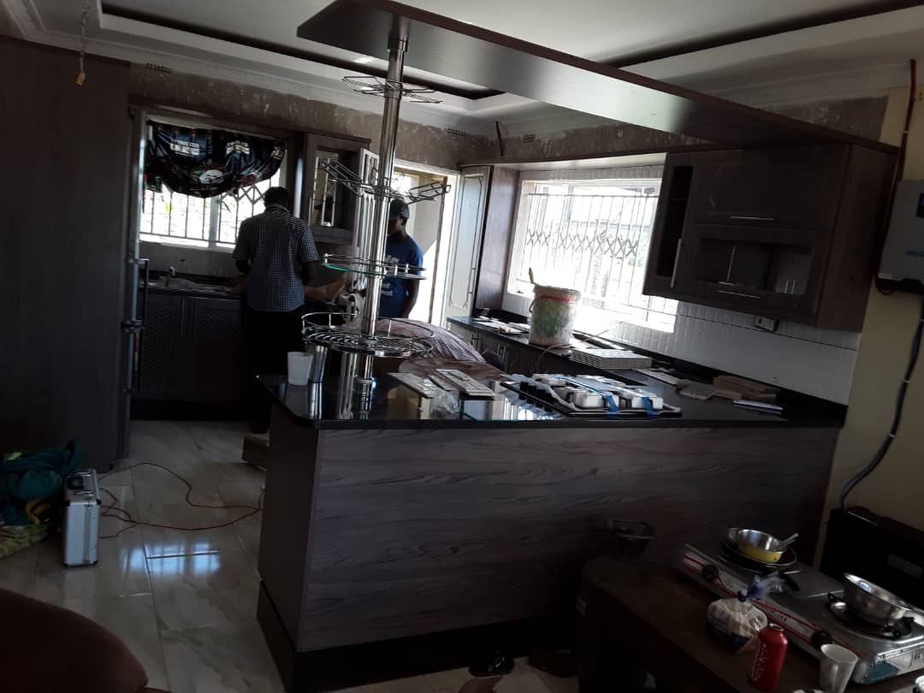

Customised
Kitchen
Douglas
Phone : +263 772 885 007
Phone : +263 772 885 007
E-mail : dmanzungu@gmail.com

Slide 2
Call
+263 772 885 007
Visit us @ Stand No. 3 Enterprise Centre,
Cnr. 1st St & 3rd Ave, Exhibition Park, Harare
Fitted Kitchens
Built in Wardrobes
Ceilings
Wall Partitions & Panels
Aluminium Works
Counters
Customized Joinery

Slide 3
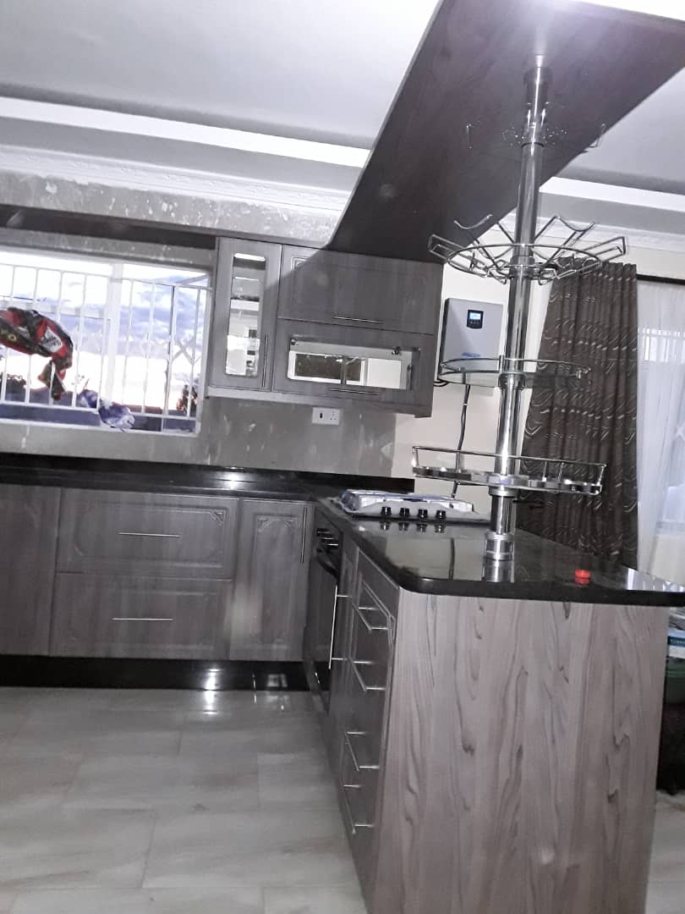
Call
+263 772 885 007
Visit us @ Stand No. 3 Enterprise Centre,
Cnr. 1st St & 3rd Ave, Exhibition Park, Harare
Fitted Kitchens
Built in Wardrobes
Ceilings
Wall Partitions & Panels
Aluminium Works
Counters
Customized Joinery

Slide 4
Call
+263 772 885 007
Visit us @ Stand No. 3 Enterprise Centre,
Cnr. 1st St & 3rd Ave, Exhibition Park, Harare
Fitted Kitchens
Built in Wardrobes
Ceilings
Wall Partitions & Panels
Aluminium Works
Counters
Customized Joinery

Slide 5


KITCHENS
WADROBES
CEILINGS
PARTITIONS
ALUMINIUM
COUNTERS
Visit us @ Stand No. 3 Enterprise Centre,
Cnr. 1st St & 3rd Ave, Exhibition Park, Harare

Slide 6
KITCHENS
What is it that you
dream about your
KITCHEN?
- Building the KITCHEN
from the ground up?
- Upgrading your current
KITCHEN?
We, at Rootpeg, are here
to partner with you
to saw, carve, joint your
Your dream into reality.
VISIT – CALL – WHATSAPP
TODAY
WADROBES
CEILINGS
PARTITIONS
ALUMINIUM
COUNTERS
Visit us @ Stand No. 3 Enterprise Centre,
Cnr. 1st St & 3rd Ave, Exhibition Park, Harare

Slide 7
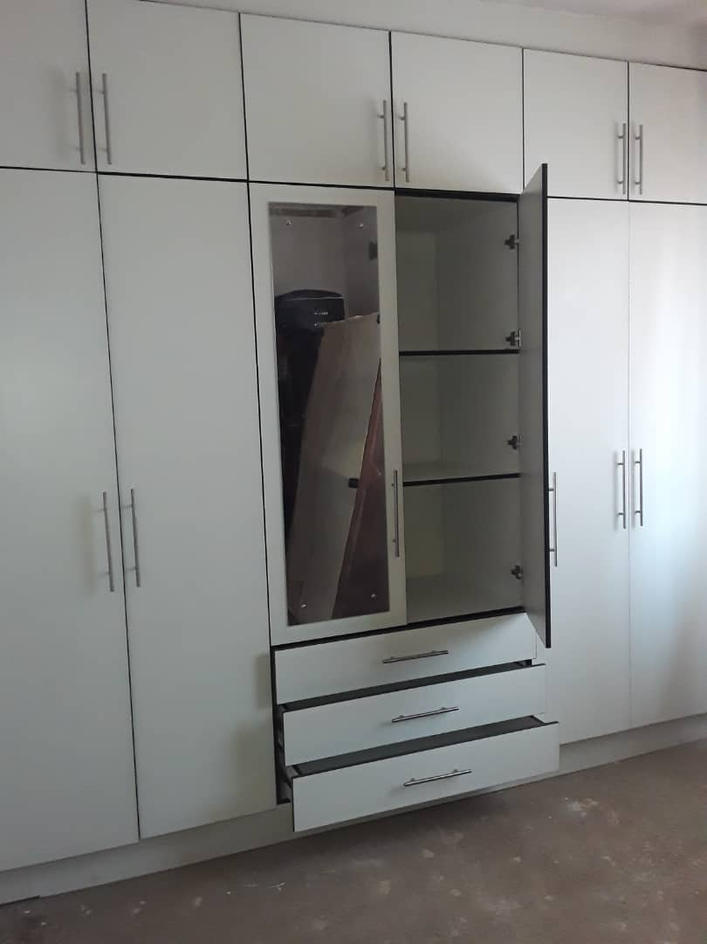
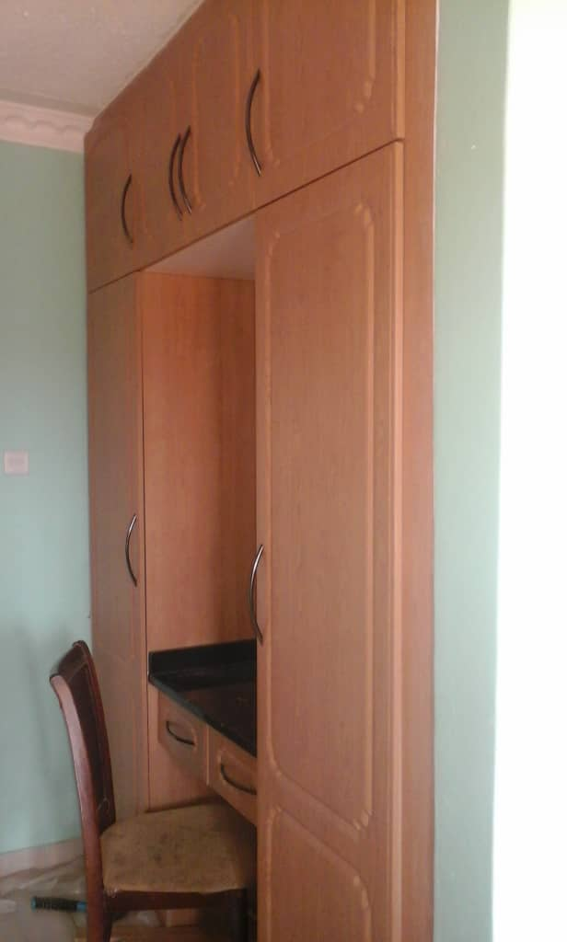
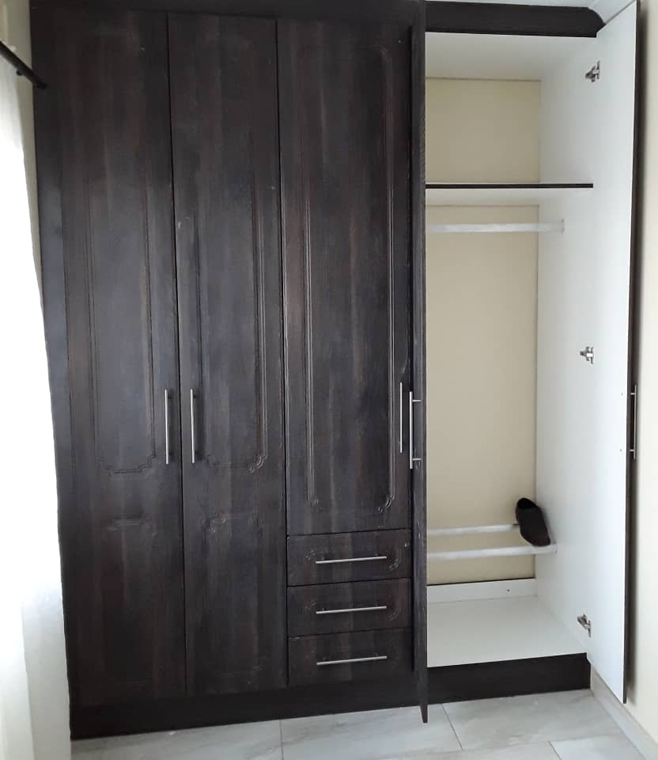
KITCHENS
WARDROBES
CEILINGS
PARTITIONS
ALUMINIUM
COUNTERS
Visit us @ Stand No. 3 Enterprise Centre,
Cnr. 1st St & 3rd Ave, Exhibition Park, Harare

Slide 8
KITCHENS
WADROBES
CEILINGS
PARTITIONS
ALUMINIUM
COUNTERS
Visit us @ Stand No. 3 Enterprise Centre,
Cnr. 1st St & 3rd Ave, Exhibition Park, Harare

Slide 9
KITCHENS
WADROBES
CEILINGS
PARTITIONS
ALUMINIUM
COUNTERS
Visit us @ Stand No. 3 Enterprise Centre,
Cnr. 1st St & 3rd Ave, Exhibition Park, Harare

Slide 10
KITCHENS
WADROBES
CEILINGS
PARTITIONS
ALUMINIUM
COUNTERS
Visit us @ Stand No. 3 Enterprise Centre,
Cnr. 1st St & 3rd Ave, Exhibition Park, Harare

Slide 11
KITCHENS
WADROBES
CEILINGS
PARTITIONS
ALUMINIUM
COUNTERS
Visit us @ Stand No. 3 Enterprise Centre,
Cnr. 1st St & 3rd Ave, Exhibition Park, Harare

