Slide 1





ROOTPEG SHOPFITTERS SERVICES
COUNTERS
KITCHENS
6
1
♗
ALUMINIUM
5
WADROBES
2
PowerUP
With
POWERPOINT
PARTITIONS
4
3
CEILINGS
♔

Slide 2
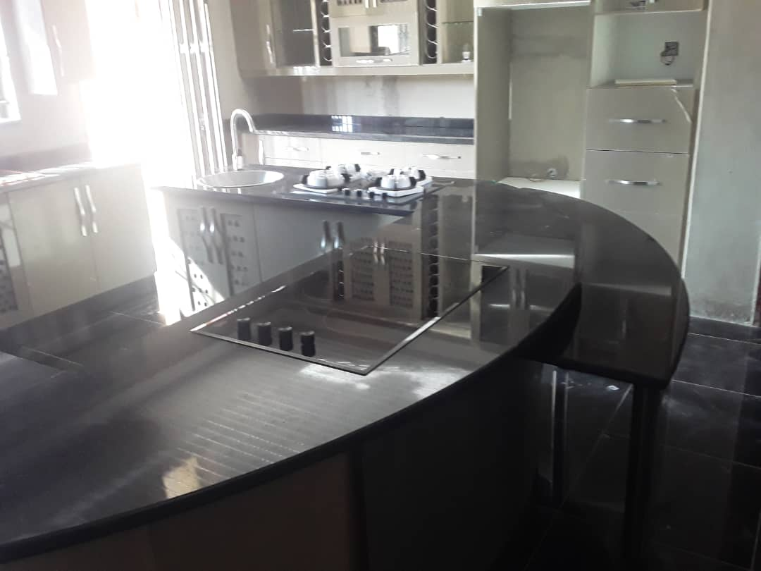
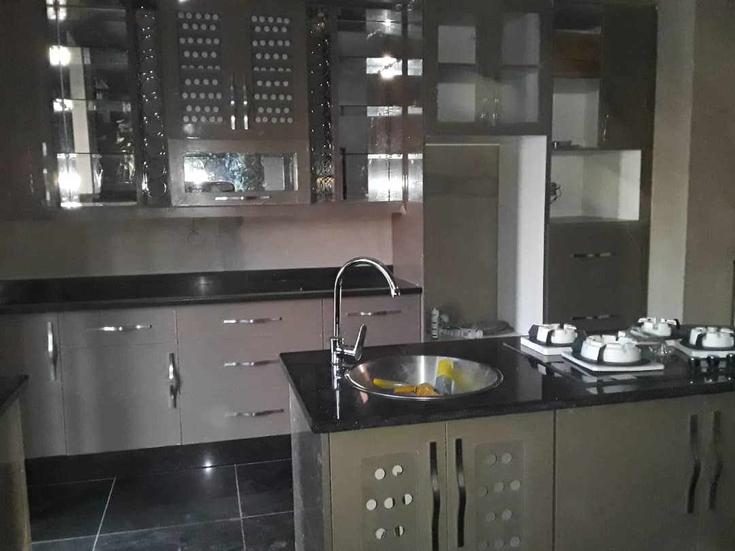
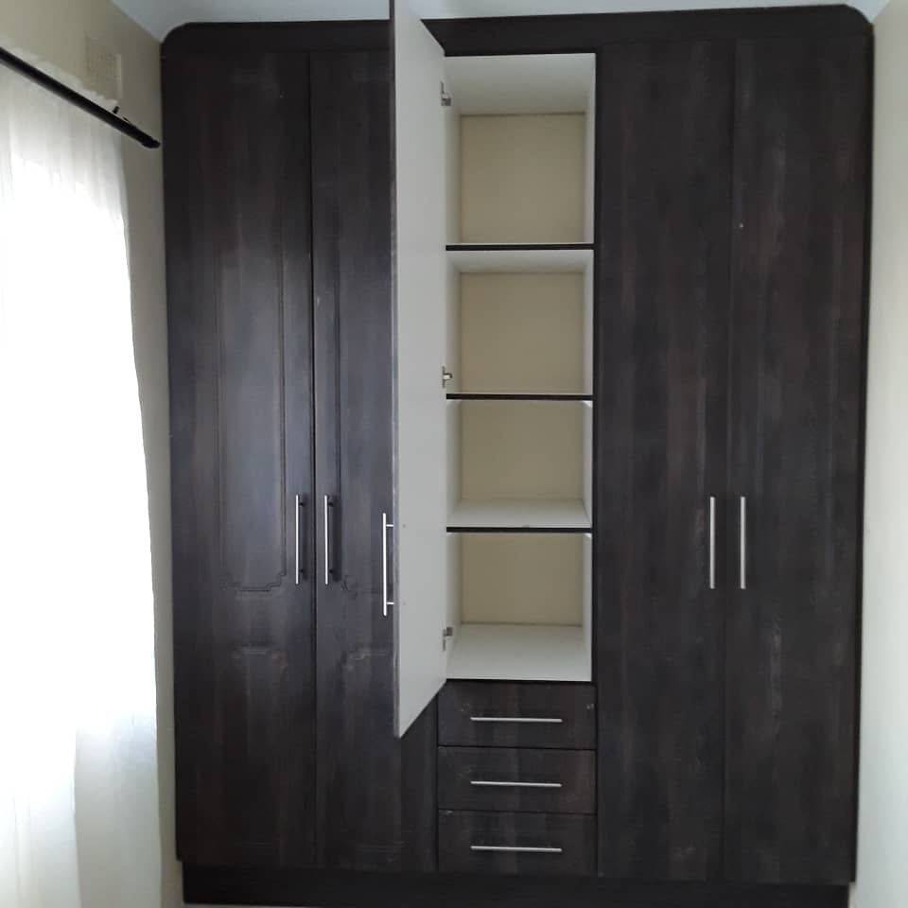
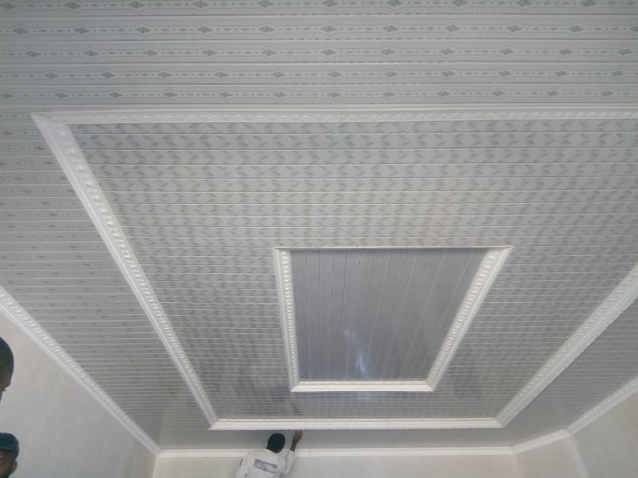
ROOTPEG SHOPFITTERS SERVICES
COUNTERS
KITCHENS
6
1
ALUMINIUM
5
WADROBES
2
PowerUP
With
POWERPOINT
PARTITIONS
4
3
CEILINGS
♔

