Slide 1
Gaurav Kumar Arora Twitter - @g_arora
Gaurav is an enthusiast Technologist. He is an author of
http://c-sharpcorner.com , having more than 15yrs experience in the industry

Slide 2
Asp.Net MVC – series for Beginers: Part-1

Slide 3
Attention
This is a first session of our Beginners series. We will discuss very basic topics in this session.
I would like to make this session more interactive, do participate and make this session more presentable.
Compile your views, which you want to add and send me I will publish all with your name.

Slide 4
Agenda
Introduction to MVC
Why MVC?
Reason to choose MVC against asp.net web forms
Overview of Model View Controller
Overview working of MVC
Overview of routes collection
Revisiting session
Question / Answer / Suggestion

Slide 5
Introduction to MVC
A background to Asp.Net MVC:
Is based on Asp.Net
A framework for RAD (rapid application development), used to develop Web application
Is a composition of Model, View Controller
Is an open source and code is available at CodePlex [In 2009 – released under Microsoft Public License and in 2012 – released under Apache License 2.0]

Slide 6
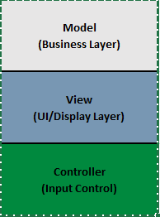
Why MVC?
Take a moment and think about a valuable Software Pattern Model-view-controller. We can also predicts from the image that MVC pattern divides a software application into a three interconnected parts/components. Basically, it’s a concept of separation (here just separation of internal representation of information from ways/logics/techniques how it is being represented to the end-user)

Slide 7
Why MVC?
Controller can send commands/directions to the model to update its state as well as commands over to view.
Associated views and controller get notified by Model as per changes of its state.
Model provides specific result as a output upon the request of View to represent.

Slide 8
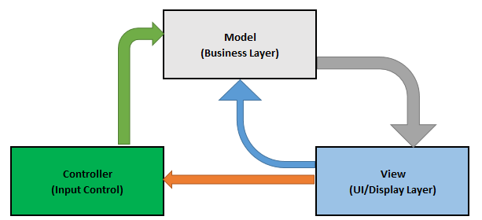
Why MVC?
Lets understand this from associated image
In simple words, we can say that MVC is providing a facility to make our layers separate which are separated and interacting with each-other.

Slide 9
Asp.net mvc over asp.net webforms
There are numerous reasons to choose Asp.Net for web development over Asp.Net WebForms:
Asp.Net MVC is a web framework and is based on MVC pattern
No viewstate (performance is better in asp.net mvc)
Completely testable
Integration with client side (easily handshake with client side scripting like Jquery etc.)
Flexibility (provides various views engines, which renders HTML – Razor View Engine is most famous)

Slide 10
Overview of Model View Controller
Devs we have already covered this in previous slides, lets discuss it again.

Slide 11
Overview of Model View Controller
Conclusion - what we discussed (for asp.net mvc framework)
What is a Model?
MVC model is typically a class (of C# or VB.NET).
Both controller and view can access model.
A model can be used to pass data from Controller to view
Main purpose of a view is to display data in page with the use of model.

Slide 12
Overview of Model View Controller
Conclusion - what we discussed (for asp.net mvc framework)
What is a View?
View is nothing but a page you can say a web page and it is not having any code-behind
All page specific HTML generation and formatting can be done inside view
A request to view can be made only from a controller’s action method

Slide 13
Overview of Model View Controller
Conclusion - what we discussed (for asp.net mvc framework)
What is a Controller?
Controller is typically a class (of C# or VB.Net) and inherits "system.mvc.controller"
Within this class methods can be implemented and called as action methods. These are responsible for responding to browser and/or calling views.
Controller class can access and use model class to pass data to views

Slide 14
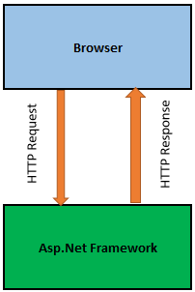
Overview working of MVC
In this session we are not going to cover only basic things:
High level overview says – browser sends request to Asp.Net MVC and it returns response back to browser [request is HTTP Request and response is HTTP response].
Lets discuss shown image:

Slide 15
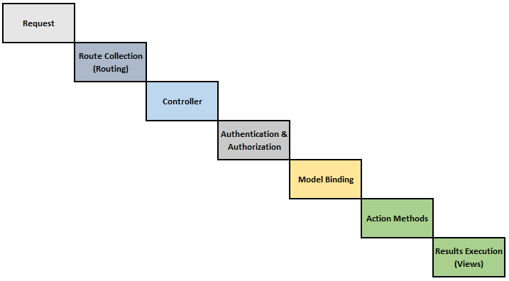
Overview working of MVC
In broader way – First request comes to Route Tables then passes to specific controller before interaction with Model Binding it goes through Authentication & Authorization and afterwards Fires a specific Action Method and execute the results to View.
Lets take an example to discuss more.

Slide 16
Overview of routes collection
In simple words, routes collection (also can say Route table) is nothing but a collection of different routes.
What is route?
A system works on pattern matching mechanism. A route match incoming request to meet a specific pattern and allows once matched else denied.
What happened at runtime?
At runtime, routing engine uses route table (contains different routes) to match incoming urls with the defined route patterns (url patterns).

Slide 17
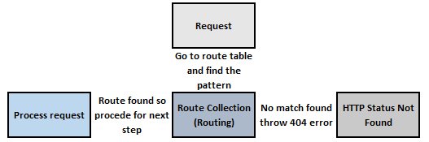
Overview of routes collection
In above image, url will be processed if any match found else it will throw the HTTP Status code Not Found (404 error).

Slide 18
Revisit Session
In this very first session we covered:
Basics of MVC
Discussed MVC pattern
Discussed basics of MVC architecture
Discussed basics of route collection / route table
Read here: ASP.Net MVC Series For Beginners: Part 1

Slide 19
Question/answer
Surely, you should have questions, it is hard to discuss all the questions, please compile your questions and shoot me an email.

Slide 20
Feedback
This is a series of sessions, today we covered very basics of asp.net mvc part.
In coming session we will cover new and some advanced topics.
Your feedback is very important. Provide your feedback so, I can share more worthful things with you.

Slide 21
Continues…
Lets meet in next session …

