Slide 1
Gaurav Kumar Arora
twitter - @g_arora
A technology enthusiast, having more than 15yrs of experience in the industry.
An author of CSharpCorner.

Slide 2
ASP.Net MVC series for beginers-Part 2

Slide 3
Agenda of the day
01 Revisiting Previous Session | 05 Looking into advanced Model concepts
02 Getting started with a simple app | 06 Learn with a demo
03 Defining Models | 07 What comes next?
04 Lets create a Model | 08 Closing notes

Slide 4
Revisiting Previous Session

Slide 5
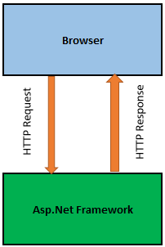
Request/Response in an ASP.NET application
High level overview

Slide 6
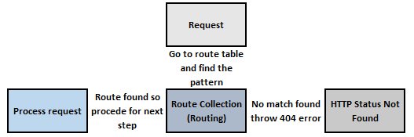
Request processing
High level overview – how request processed

Slide 7
Pictorial representation of Models, Views and Controllers
Request
Controller
Processed
Model
Response
Request comes to Controller, it retrieves the Model to perform certain stuff which processed as a Response to View just to visually represent the model
View
High level overview of MVC

Slide 8
Getting started with a simple app - Demo
Notes:
Create a default asp.net mvc web application and discuss the different parts of application (folder structure)

Slide 9
Lets create a Model
Notes:
Create a default asp.net mvc web application and discuss the different parts of application (folder structure)

Slide 10
What is a Model?
MVC model is typically a class
Both Controller and View can access Model
A Model can be used to pass data from Controller to view

Slide 11
Demo
Getting started by adding a Model

Slide 12
Defining Models
Notes:
Create a default asp.net mvc web application and discuss the different parts of application (folder structure)

Slide 13
Creating a Model?
Adding Properties
Adding attributes to Properties
A Model can be used to pass data from Controller to view

Slide 14
Attributes at a glance
Main available attributes
Attributes to check DataTypes
Attributes to Display
Attributes for validation
Required
Length
Comparison
RegularExpression

Slide 15
Looking into advanced Model concepts
Notes:
Create a default asp.net mvc web application and discuss the different parts of application (folder structure)

Slide 16
Client side vs. Server side validations
Server side
ModelState.IsValid
Client side
JQuery validation

Slide 17
Models are awesome
Can create automatic UI

Slide 18
Demo
Running demo app

Slide 19
What comes next
Notes:
Create a default asp.net mvc web application and discuss the different parts of application (folder structure)

Slide 20
Q & A
Few moments for handling queries

Slide 21
Closing notes
Notes:
Create a default asp.net mvc web application and discuss the different parts of application (folder structure)

