Slide 1
Why Do We Want C#9?
An incremental improvement or a step change?

Slide 2
Why Do We Want C#9?
An incremental improvement or a step change?
Just when you though it couldn't get any better, C# v9 arrives bringing new features to Visual Studio. Each of these will be demonstrated in a practical example.

Slide 3
Visual Studio History and Naming
Visual Studio 7
Visual Studio .NET 2002
C# 1
Visual Studio 7.1
Visual Studio .NET 2003
C# 2
Visual Studio 8
Visual Studio 2005
Visual Studio 9
Visual Studio 2008
C# 3
Visual Studio 10
Visual Studio 2010
C# 4
Visual Studio 11
Visual Studio 2012
C# 5
Visual Studio 12
Visual Studio 2013
Visual Studio 14
Visual Studio 2015
C# 6
Visual Studio 15
Visual Studio 2017
C# 7
Visual Studio 16
Visual Studio 2019
C# 8, 9

Slide 4
What's new in .NET 5
.NET 5 IS
.NET 5 IS NOT
Next major release of .NET Core
Skipped version 4 (confusing)
Dropped “Core” from the .NET name
Going forward: .NET 5
Required for C# 9
Does not replace .NET Framework
Does not replace .NET Standard
Drops Web Forms
Drops WF
Developers writing .NET 5 apps will have access to the latest C# version and features.
.NET 5 is paired with C# 9, which brings many new features to the language.
https://docs.microsoft.com/en-us/dotnet/core/dotnet-five#c-updates

Slide 5
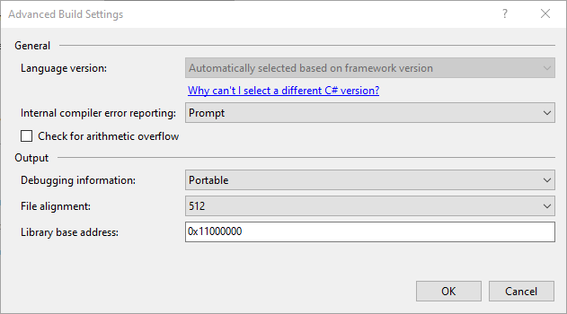
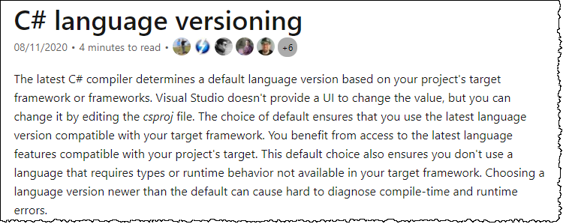
The C# 7 language selector no longer used
https://docs.microsoft.com/en-us/dotnet/csharp/language-reference/configure-language-version

Slide 6
.NET Defaults - The compiler determines the default
Target framework | version | C# language version default
.NET | 5.x | C# 9.0
.NET Core | 3.x | C# 8.0
.NET Core | 2.x | C# 7.3
.NET Standard | 2.1 | C# 8.0
.NET Standard | 2.0 | C# 7.3
.NET Standard | 1.x | C# 7.3
.NET Framework | all | C# 7.3
https://docs.microsoft.com/en-us/dotnet/csharp/language-reference/configure-language-version

Slide 7
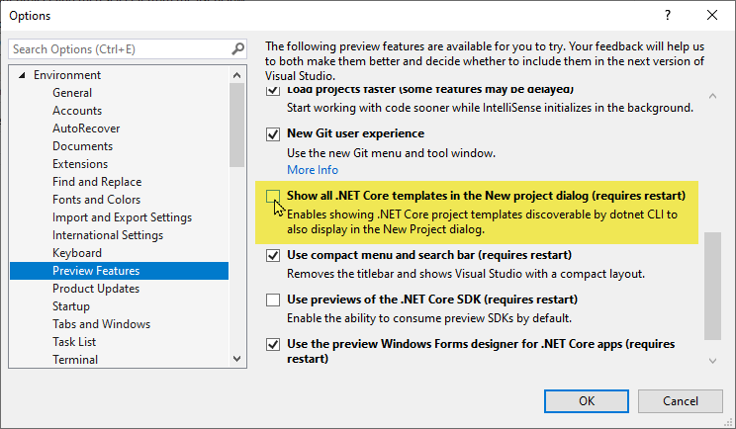
VS 2019 Will Not Default, But Will Give Option

Slide 8
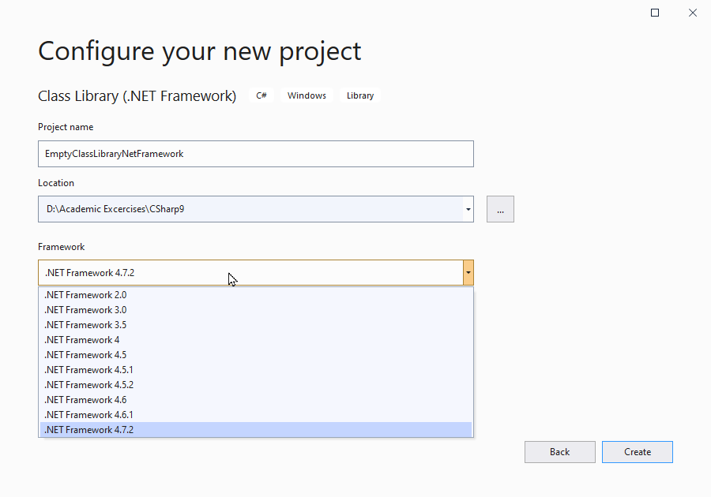
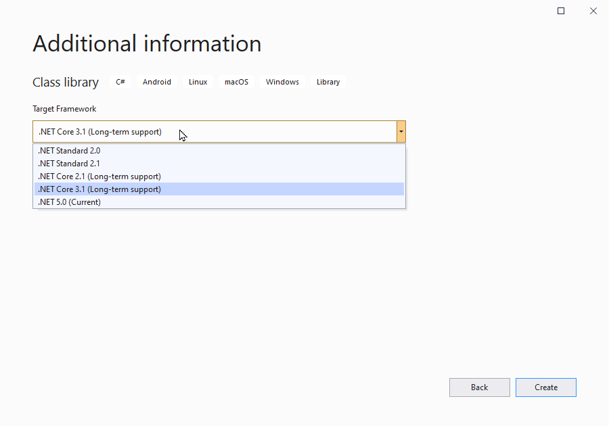
After “Show All .NET Core Templates”

Slide 9
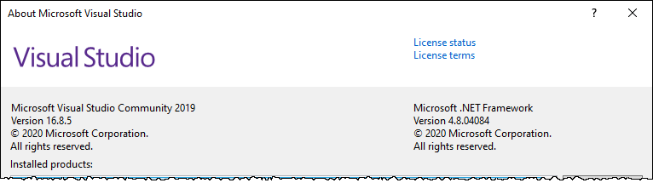
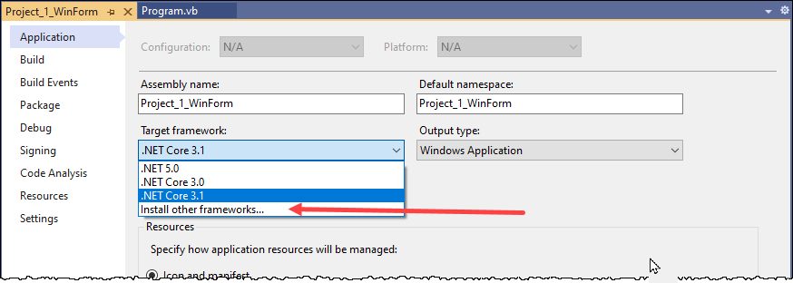
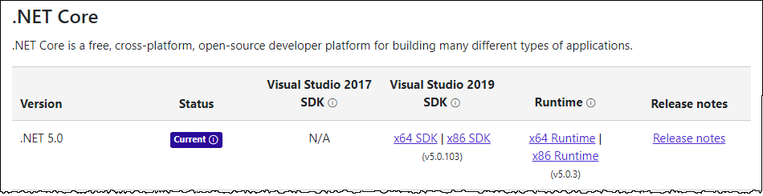
Installing .NET 5 (the way I did it - redundantly)

Slide 10
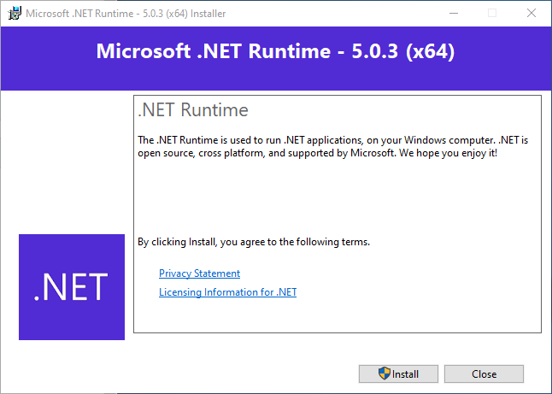
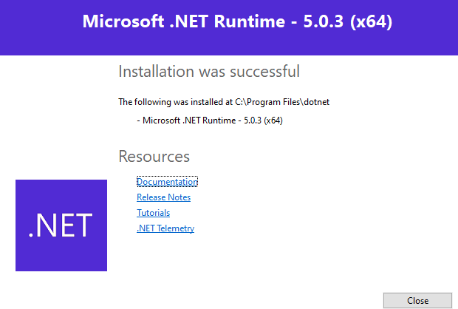
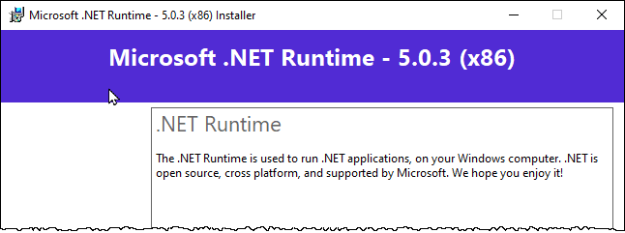
Installing .NET (the way I did it – redundantly, part 2)
Seconds later…

Slide 11
History in Review C# 1-5
C# 1.0 VS 2002
C# 4.0 VS 2010
Async Features
C# 2.0 VS 2005
C# 3.0 VS 2005
C# 5.0 VS 2012
Caller Information
Dynamic (late) Binding
Generic Variance
Embedded Interop Types
Anonymous Types
Extension Methods
Query Methods
Lambda Expressions
Expression Trees
Partial Methods
Partial Types
Anonymous Methods
Iterators
Nullable Types
Private Setters
Delegates
Variance
Static Classes
Basic Features
Generics
Implicit Variable
Object Initializer
Auto Properties
Named\optional parameters

Slide 12
History in Review C# 6 IN vs2015
String Interpolation
Auto Property Features
Expression Bodied Members
Null Conditional Operators
nameof() operator
Extension Add Methods in Collection Initializers
Using Static
Exception Filter
await in catch\finally block
The Elvis operator – one of the coolest enhancements ever
Nice for one-line methods and properties
Why did it take so long to figure get this one?
Some call this Razor context; I call it fabulous
Notes:
String Interpolation
For example: $”Page {page.number} of {Page.count}”
Auto Property Features
For example: public string MyProperty { get; set; }
Null Conditional Operators
For example: anObject?.aProperty ?? defaultValue
Expression Bodied Members
nameof() operator
Extension Add Methods in Collection Initializers
Using Static
Exception Filter
await in catch\finally block

Slide 13
New Features in C# 7.0, 7.1, 7.2, 7.3
C# 7.0 VS2017 v15.2
Binary Literals
Digit Separators
Local Functions
Out Variables
Tuples (enhancement)
Deconstruction
Discards
Ref Returns & Locals
Pattern Matching
Expression Bodied Members
Throw Expression
C# 7.1 VS2017 v15.3
Language version selection
Async main
Default literal expressions
Inferred tuple element names
Reference assembly generation
C# 7.2 VS2017 v15.5
Techniques for writing safe code
Reference semantics with value types
Non-trailing named arguments
Leading underscores in numeric literals
private protected access modifier
Conditional ref expressions
C# 7.3 VS2017 v15.7
Better performance for safe code
Reassign ref
Generic constraints
etc
Other enhancements
Testing tuples
Expression variables
Backing fields
etc
https://docs.microsoft.com/en-us/dotnet/csharp/whats-new/csharp-7
Notes:
There are blogs indicasting a version 7.3 is looming

Slide 14
New Features in C# 8
Readonly members
Default interface methods
Pattern matching enhancements:
Switch expressions
Property patterns
Tuple patterns
Positional patterns
Using declarations
Static local functions
Disposable ref structs
Nullable reference types
Asynchronous streams
Asynchronous disposable
Indices and ranges
Null-coalescing assignment
Unmanaged constructed types
Stackalloc in nested expressions
Enhancement of interpolated verbatim strings
https://docs.microsoft.com/en-us/dotnet/csharp/whats-new/csharp-8
Notes:
There are blogs indicasting a version 7.3 is looming

Slide 15
New Features in C# 9
Hot new features
Some other features
Init only setters (in properties)
Target-typed new expressions
Records
Pattern matching enhancements
Top-level statements
Target-typed conditional expressions
Covariant return types
Native sized integers
Function pointers
Suppress emitting localsinit flag
static anonymous functions
Extension GetEnumerator support for foreach loops
Lambda discard parameters
Attributes on local functions
Module initializers
New features for partial methods
Keep asking yourself:
Is it more readable?
Is it testable?
Is it more maintainable?
Is it more robust?
Where would I have used it?
(for me) Is it teachable? To whom?
https://docs.microsoft.com/en-us/dotnet/csharp/whats-new/csharp-9
Notes:
There are blogs indicasting a version 7.3 is looming

Slide 16
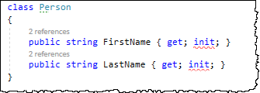
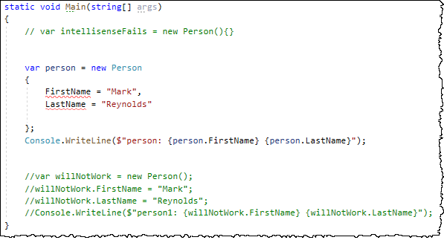

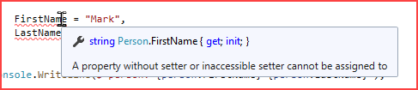
Init only setters (in properties)
Intellisense wants a setter, Compiler is happy,
Presentation is messy
No help from IDE B-(

Slide 17
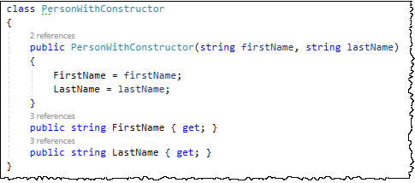
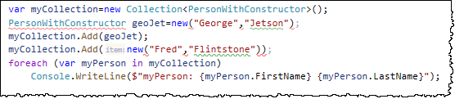
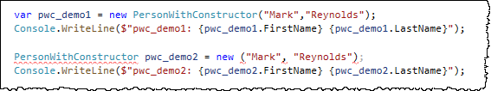
Target-typed new expressions
Nothing to see here
Nothing to see here either
OK, now you just messing with me!
What? tuples?
https://www.thomasclaudiushuber.com/2020/09/08/c-9-0-target-typed-new-expressions/
https://docs.microsoft.com/en-us/dotnet/csharp/language-reference/proposals/csharp-9.0/target-typed-conditional-expression

Slide 18
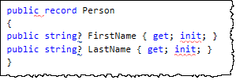
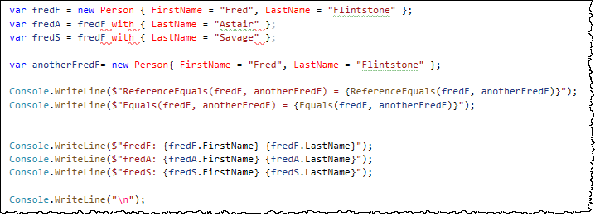
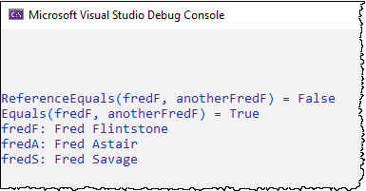
Records part 1
C# 9 Introduces a new keyword: record keyword. record keyword makes an object immutable and behave like a value type.
https://anthonygiretti.com/2020/06/17/introducing-c-9-records/
https://devblogs.microsoft.com/dotnet/c-9-0-on-the-record/

Slide 19
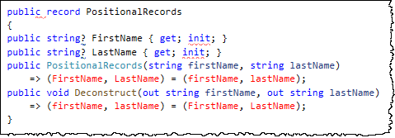
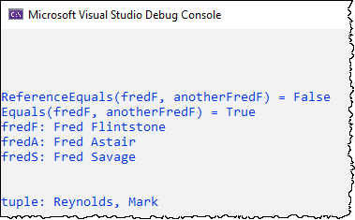

Records part 2
If you find yourself wanting the whole object to be immutable and behave like a value, then you should consider declaring it as a record.
OK, you’re messing with me again!
https://devblogs.microsoft.com/dotnet/c-9-0-on-the-record/

Slide 20
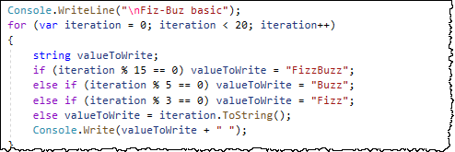
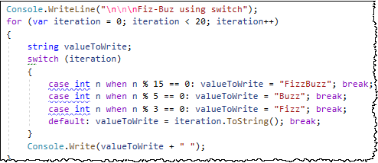
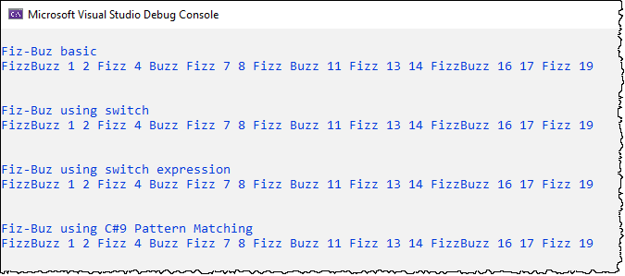
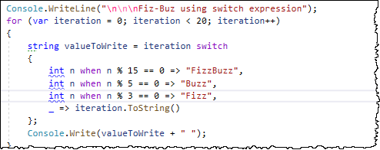
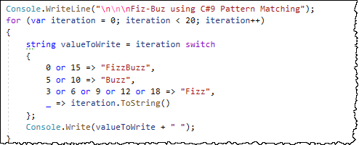
Pattern matching enhancements

Slide 21

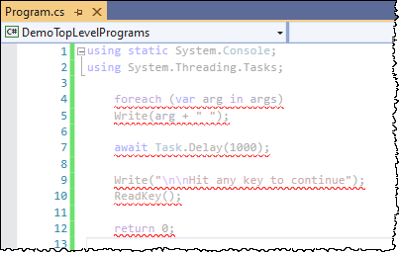
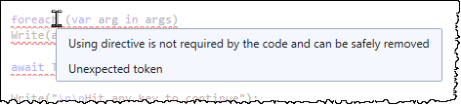
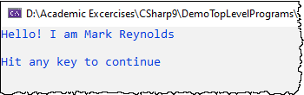
Top-level statements
This is not only overwhelming for language beginners, but clutters up the code and adds levels of indentation. In C# 9.0 you can just write your main program at the top level.
Any statement is allowed. The program has to occur after the usings and before any type or namespace declarations in the file, and you can only do this in one file, just as you can have only one Main method today.
(lie)
I think we have jumped the shark
https://devblogs.microsoft.com/dotnet/c-9-0-on-the-record/

Slide 22
Target-typed conditional expressions
For a conditional expression c ? e1 : e2, when
there is no common type for e1 and e2, or
for which a common type exists but one of the expressions e1 or e2 has no implicit conversion to that type
we define a new implicit conditional expression conversion
This one scares me
https://docs.microsoft.com/en-us/dotnet/csharp/language-reference/proposals/csharp-9.0/target-typed-conditional-expression

Slide 23
Covariant return types
Support covariant return types. Specifically, permit the override of a method to declare a more derived return type than the method it overrides, and similarly to permit the override of a read-only property to declare a more derived type. Override declarations appearing in more derived types would be required to provide a return type at least as specific as that appearing in overrides in its base types. Callers of the method or property would statically receive the more refined return type from an invocation.
Motivation:
It is a common pattern in code that different method names have to be invented to work around the language constraint that overrides must return the same type as the overridden method.
class Compilation ...
{
public virtual Compilation WithOptions(Options options)...
}
class CSharpCompilation : Compilation
{
public override CSharpCompilation WithOptions(Options options)...
}
https://docs.microsoft.com/en-us/dotnet/csharp/language-reference/proposals/csharp-9.0/covariant-returns

Slide 24
Native sized integers
Language support for a native-sized signed and unsigned integer types.
Motivation:
For interop scenarios and for low-level libraries.
The types nint and nuint are represented by the underlying types System.IntPtr and System.UIntPtr with compiler surfacing additional conversions and operations for those types as native ints.
https://docs.microsoft.com/en-us/dotnet/csharp/language-reference/proposals/csharp-9.0/native-integers

Slide 25
Function pointers
This proposal provides language constructs that expose IL opcodes that cannot currently be accessed efficiently, or at all, in C# today: ldftn and calli. These IL opcodes can be important in high performance code and developers need an efficient way to access them.
Motivation:
The motivations and background for this feature are described in the following issue (as is a potential implementation of the feature):
https://docs.microsoft.com/en-us/dotnet/csharp/language-reference/proposals/csharp-9.0/function-pointers

Slide 26
Suppress emitting localsinit flag
Allow suppressing emit of localsinit flag via SkipLocalsInitAttribute attribute.
Motivation:
In high-performance application the cost of forced zero-initialization could be noticeable. It is particularly noticeable when stackalloc is used.
In some cases JIT can elide initial zero-initialization of individual locals when such initialization is "killed" by subsequent assignments. Not all JITs do this and such optimization has limits. It does not help with stackalloc.
https://docs.microsoft.com/en-us/dotnet/csharp/language-reference/proposals/csharp-9.0/skip-localsinit

Slide 27
static anonymous functions
Allow a 'static' modifier on lambdas and anonymous methods, which disallows capture of locals or instance state from containing scopes.
Motivation:
Avoid unintentionally capturing state from the enclosing context, which can result in unexpected retention of captured objects or unexpected additional allocations.
https://docs.microsoft.com/en-us/dotnet/csharp/language-reference/proposals/csharp-9.0/static-anonymous-functions

Slide 28
Extension GetEnumerator support for foreach loops
Allow foreach loops to recognize an extension method GetEnumerator method that otherwise satisfies the foreach pattern, and loop over the expression when it would otherwise be an error.
Motivation:
This will bring foreach inline with how other features in C# are implemented, including async and pattern-based deconstruction.
https://docs.microsoft.com/en-us/dotnet/csharp/language-reference/proposals/csharp-9.0/extension-getenumerator

Slide 29
Lambda discard parameters
Allow discards (_) to be used as parameters of lambdas and anonymous methods. For example:
lambdas: (_, _) => 0, (int _, int _) => 0
anonymous methods: delegate(int _, int _) { return 0; }
Motivation:
Unused parameters do not need to be named. The intent of discards is clear, i.e. they are unused/discarded.
https://docs.microsoft.com/en-us/dotnet/csharp/language-reference/proposals/csharp-9.0/lambda-discard-parameters

Slide 30
Attributes on local functions
Local function declarations are now permitted to have attributes. Parameters and type parameters on local functions are also allowed to have attributes.
Attributes with a specified meaning when applied to a method, its parameters, or its type parameters will have the same meaning when applied to a local function, its parameters, or its type parameters, respectively.
https://docs.microsoft.com/en-us/dotnet/csharp/language-reference/proposals/csharp-9.0/local-function-attributes

Slide 31
Module initializers
Although the .NET platform has a feature that directly supports writing initialization code for the assembly (technically, the module), it is not exposed in C#. This is a rather niche scenario, but once you run into it the solutions appear to be pretty painful. There are reports of a number of customers (inside and outside Microsoft) struggling with the problem, and there are no doubt more undocumented cases.
Motivation:
Enable libraries to do eager, one-time initialization when loaded, with minimal overhead and without the user needing to explicitly call anything
One particular pain point of current static constructor approaches is that the runtime must do additional checks on usage of a type with a static constructor, in order to decide whether the static constructor needs to be run or not. This adds measurable overhead.
Enable source generators to run some global initialization logic without the user needing to explicitly call anything
https://docs.microsoft.com/en-us/dotnet/csharp/language-reference/proposals/csharp-9.0/module-initializers

Slide 32
New features for partial methods
Remove all restrictions around the signatures of partial methods in C#. The goal being to expand the set of scenarios in which these methods can work with source generators as well as being a more general declaration form for C# methods.
https://docs.microsoft.com/en-us/dotnet/csharp/language-reference/proposals/csharp-9.0/module-initializers

Slide 33

Mark Reynolds
Mark Reynolds Vitae
Ready for a new adventure
Southwestern Energy
Lone Star College
Intent Driven Designs
Scan Systems
Sikorsky Aircraft
General Dynamics
Personal Email: mark@IntentDriven.com
Linkedin: www.linkedin.com/in/ProfReynolds
http://ProfReynolds.com

