Slide 1
Real Estate Model for Oxford/Cincinnati Area
Robert Garrett, Mary Yu and Weishen Zou

Slide 2
Problem to Address
Our Model takes in various factors to predict housing cost
Only for the Oxford/Cincinnati areas
Fills a business world need
Here are the processes and considerations we utilized in creating our model:

Slide 3
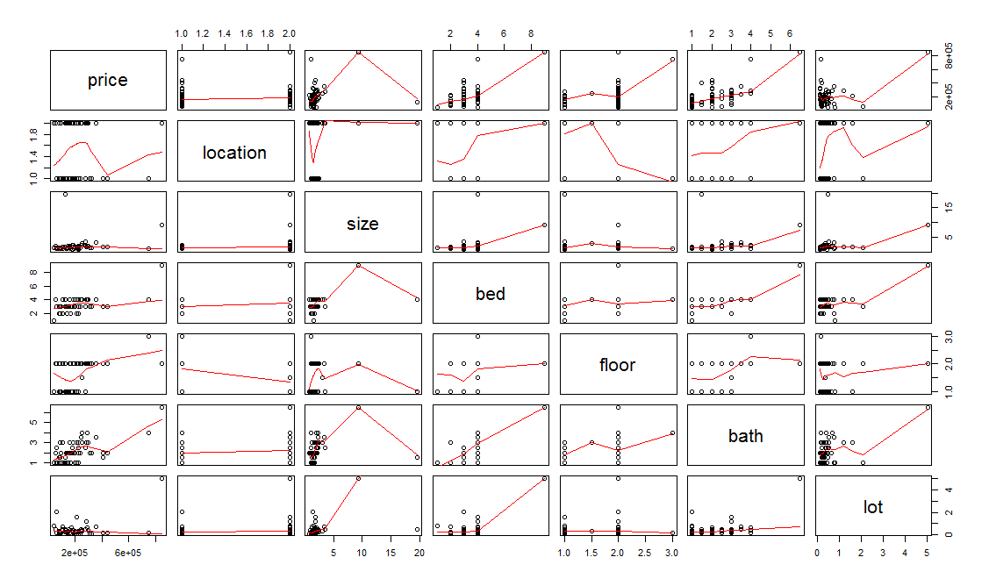
Analysis of data
First, we run the pairwise plot to visualize the bivariate association.
The price which is the response variable, has a relative strong relationship with bedrooms numbers and bathrooms numbers.
However, there are not many relationships between predictors.

Slide 4
Analysis of data
Then, we run the codes in Rstudio in order to obtain the full model. The full model contains all variables so it is complicated. We need to further clean it in probably next few steps. But at this point, we would do:
Determine the usefulness of the model
Check model assumptions
As the result shown in the R, the p value of F test is 0.002832 which <0.05 significance level, we reject the null hypothesis and we say at least one of the beta is not equal to 0. We further conclude that the model is useful to predict the price.

Slide 5
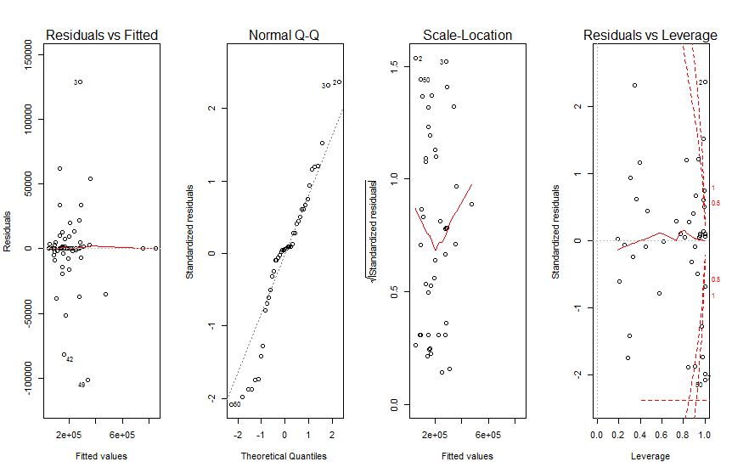
Analysis of data
Normality assumption is violated (based on the normal QQ plot; The points are not rough lay straight on the line toward upper right)
Equal variance assumption is met (based on the residual vs. fitted plot, there is no megaphone effect)
Linear assumption is met (based on the residual vs. fitted plot; there is no curvature)
the observations 2 and 3 are considered as outliers. These observations will impact the accuracy of the model.
We further found that all six variables including location, size, bed, floor, bath, and lot are all significant in explaining y(price).

Slide 6
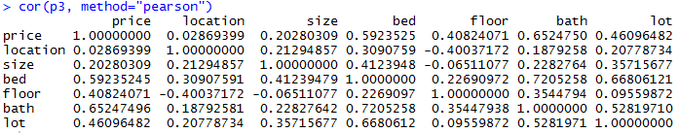
Analysis of Covariance
High correlation between bedrooms and bathrooms
How do we move forward?

Slide 7
Model Selection
Moving forward, we select best model with backwards elimination
This builds on our other refinement processes of our model
We end up selecting the model with the lowest AIC
It is still larger than desired, but provides slightly tighter prediction intervals

Slide 8
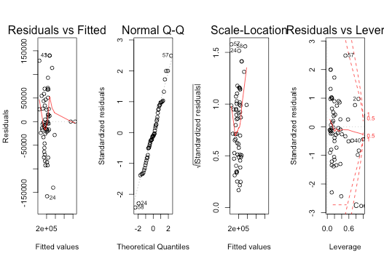
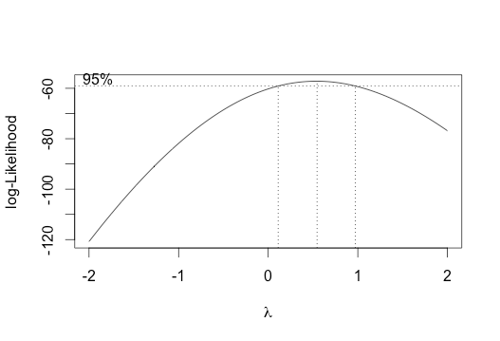
Transformation

Slide 9
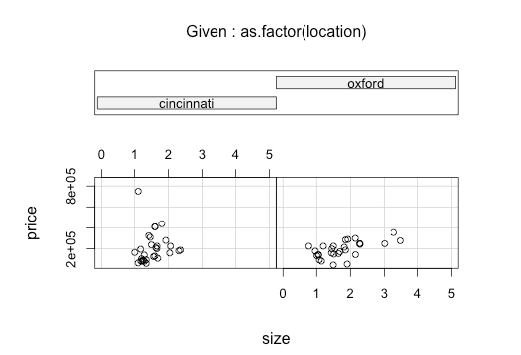
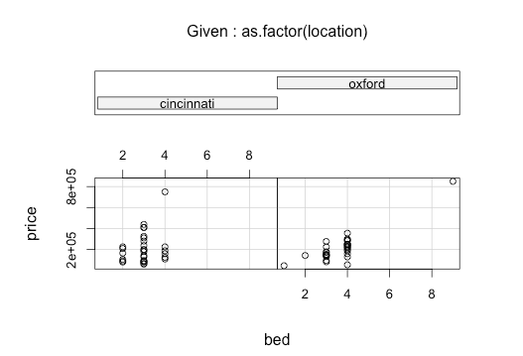
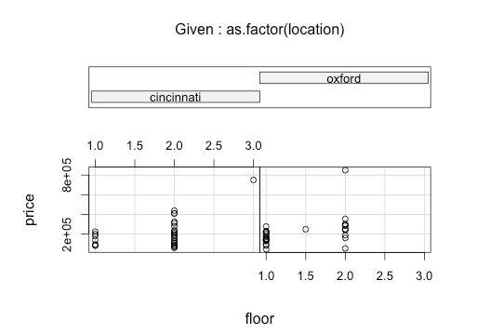
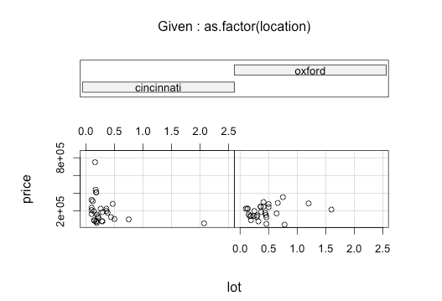
Coplots
We wished to see more comparisons between the houses in the two area, therefore we constructed multiple coplots, using location as a factor, price in the y-axis and different variables in the x-axis.

Slide 10
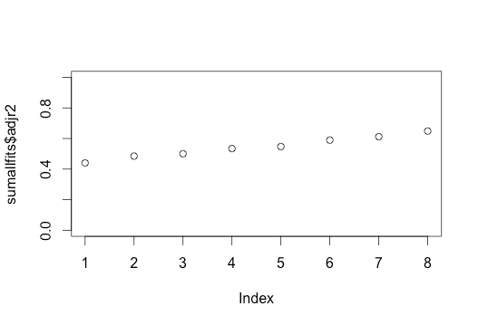
R-Squared Adjusted plot
We ran an R-squared adjusted plot to compare the R-squared values of all of the models we are comparing.
Our largest model that was being compared rises a little over 0.7, which is our best model.

Slide 11
Prediction Intervals
After confirming that our model does not need transformation, we ran the prediction intervals and found the following:
All of our values falls inside our interval
The intervals are very large, which can result from outliers.
fit lwr upr
1 110574.83 -63217.8462 284367.5
2 34270.46 -168747.8722 237288.8
3 270085.76 114726.7763 425444.8
4 96696.51 -71999.1476 265392.2
5 140802.56 -22007.7030 303612.8

Slide 12
Conclusion
Our model assigns realistic prediction values for houses
Potential applications include:
  User adjustable website estimations
  Advantage for real estate investors
  More complex model could do things like analyze housing cost over varying levels of urban development or economic prosperity

