Slide 1
Big Mountain Resort:
Ticket Pricing Model
Garrett Heinke

Slide 2
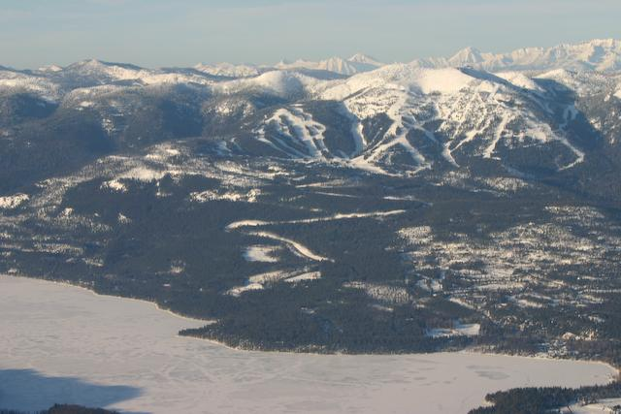
Big Mountain Resort
MBR has excellent facilities
Glacier National Park
Flathead National Forest
Runs: 105
Longest run: 3.3 miles
11 lifts, 2 t-bars, and a magic carpet
350,000 skiers and snowboarders per season
Notes:
*The image of Whitefish Mountain Resort is taken from the creative commons.

Slide 3
Problem Identification
Problem: New ski lift costs by $1,540,000 this season
Solution: Increase revenue to cover increased costs
Strategy 1: Cut operating costs while improving facilities
Observation: Current prices likely undervalue our facilities
Current pricing strategy: Charge a premium on the market average
Consequences:
Missing out on potential revenue and profits
Future investment and returns on investment
Out-competed by competition
Strategy 2: Find a new pricing model for skiing tickets in our market segment

Slide 4
Recommendation and key findings
Current price: $81.00
Estimated market supported price (MSP): $96.84
Mean absolute error: $10.35
Increase in revenue: $27,720,000
± ~$18,112,500
Or $9,607,500 - $45,832,500
Closing up to 10 runs
Closing one run: MSP does not change
Closing 10 runs: MSP increases by $1.63
Increasing vertical drop and install a new chair lift
Increased market supported price: $1.99
Increased revenue: $3,482,500

Slide 5
Overview: Modeling results and analysis
Target feature was the ‘adult weekend ticket price’.
Market segments was the entire market.
Market supported price
Random forest regression

Slide 6
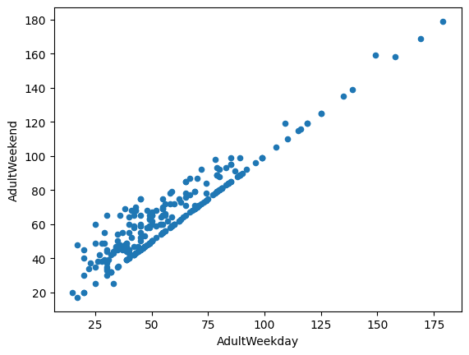
Data set
329 observations
Columns
Resort name, state, and region
Lift facilities: 8 columns
Skiing facilities: 11 columns
Weekend and weekday adult ticket prices
State area and population
Target feature: Adult weekend ticket prices
Fewer missing values
Observations:
Strong price correlation
Weekday price usually less

Slide 7
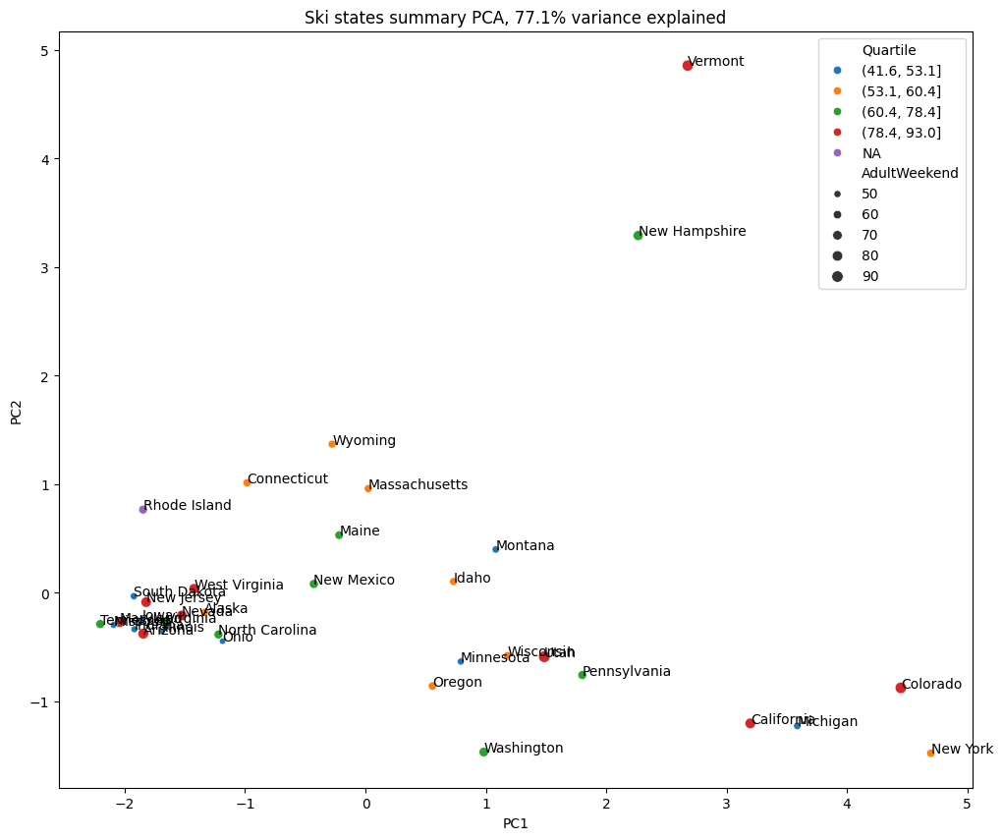
Market segment
PCA indicates no regional market segments
MSP model will include the entire market

Slide 8
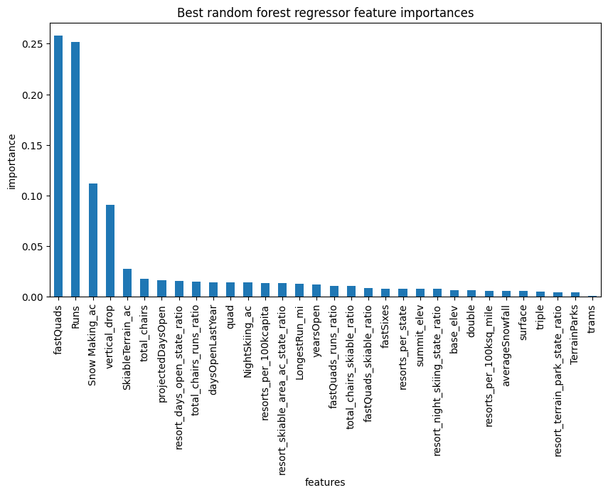
Model selection
Linear regression model vs. random forest regress
Random forest regress had a lower mean absolute error using cross-validation on training data
RFR indicated four important features
fastQuads
Runs
Snow Making_ac
vertical_drop
Impact: guides facility improvements

Slide 9
Summary and conclusion
Motive for increasing revenue
Identified two strategies for increasing revenue
Implemented the second strategy
Impacts on the first strategy
Actionable pricing model
Confirmed the suspicion that BMR is undervaluing its facilities

