Slide 1
Toward a theory of timing effects in self-organizing sentence processing
Garrett Smith & Whitney Tabor
<Uconn & Haskins logos>
Notes:
LC & agr. attr. suggest we need ungramm. in reps.
SOSP-TH provides theory of those states and embeds them in a math. framework that affords preds about proc. times and rates of building different types of structures
Stick w/ dependency formalism.

Slide 2
NComp
Det
Subj
PObj
Det
The
coach
smiled
at
the
player
Notes:
Visually step through parsing process under grammar-controlled theory, e.g., surprisal but with dep. grammar
Show how it works for simple sentence
Explain that proc. cost comes from having to make big changes to your beliefs about sent. struct.

Slide 3
A challenge for grammar-supervised theories
The coach smiled at the player (who was) tossed the frisbee
The coach smiled at the player (who was) thrown the frisbee
…the player tossed… is locally coherent, but should be ruled out in this context because prepositions can’t take whole clauses as complements
Tabor et al. (2004) observed slowed processing at tossed but not at thrown, suggesting people are entertaining the ungrammatical parse
Grammar-supervised theories struggle because they cannot entertain ungrammatical structures
Notes:
Start w/ materials
Show how grammar-controlled would proc. LC: it fails to predict a difference between tossed/thrown
Show Tabor et al. (2004) results
Seems to require entertaining ungramm. structures (Konieczny 2005)

Slide 4
NComp
PObj
Det
RelCl
…smiled
at
the
player
thrown
NComp
PObj
Det
RelCl
…smiled
at
the
player
tossed
Notes:
Visually step through parsing process under grammar-controlled theory, e.g., surprisal but with dep. grammar
Show how it works for simple sentence
Explain that proc. cost comes from having to make big changes to your beliefs about sent. struct.

Slide 5
Self-organized sentence processing
Many frameworks, but unified by basic assumption: sentence structures form via local interactions between small pieces of syntactic structure (e.g., Kempen & Vosse, 1989; Stevenson, 1994; Tabor & Hutchins, 2004; van der Velde & de Kamps, 2006)
Treelets compete with each other based on how well their features mesh
SOSP-TH: lexically anchored dependency treelets with feature vectors specifying head and dependent features

Slide 6
NComp
Subj
PObj
Det
RelCl
…smiled
at
the
player
thrown
NComp
Subj
PObj
Det
RelCl
…smiled
at
the
player
tossed
Notes:
Visually step through parsing process under grammar-controlled theory, e.g., surprisal but with dep. grammar
Show how it works for simple sentence
Explain that proc. cost comes from having to make big changes to your beliefs about sent. struct.

Slide 7
Notes:
Highlight: feature vectors, fact that all possible interactions are entertained

Slide 8
Goal
Self-organizing theories can account for local coherence effects by allowing the system to entertain the ungrammatical parse
Prev. SOSP models acct. for lots of important parse-formation phenomena, but few results on timing
Our goal: sent. proc. framework that incorporates ungrammatical states (integrated w/ well-motivated theory of ungrammaticality) and from which we can derive both parse-formation rates and timing predictions

Slide 9
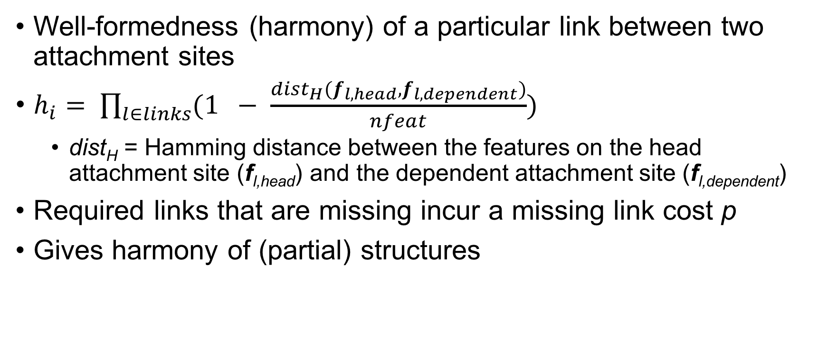
Determining local harmony
Well-formedness (harmony) of a particular link between two attachment sites
$h_{i}= \prod_{l∈links}{(1 − \frac{dist_{H}(f_{l, head}, f_{l,dependent})}{nfeat})}$
dist_{H} = Hamming distance between the features on the head attachment site (f_{l,head}) and the dependent attachment site (f_{l,dependent})
Required links that are missing incur a missing link cost p
Gives harmony of (partial) structures

Slide 10
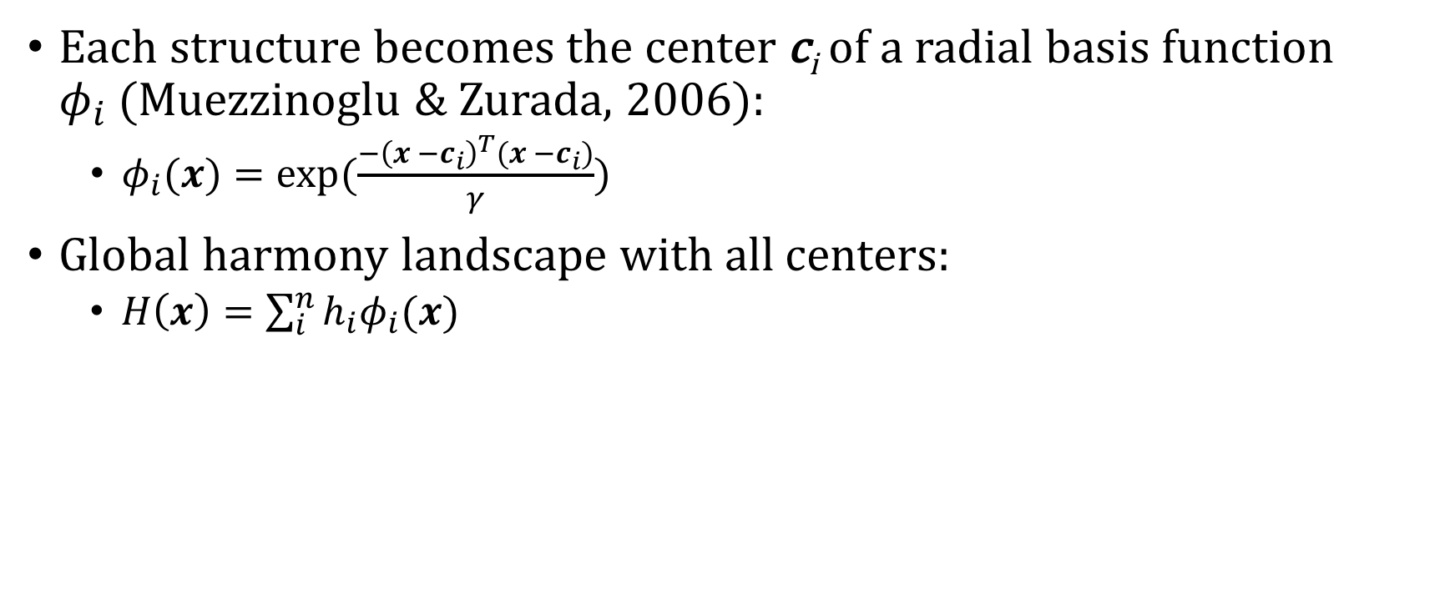
Harmony landscape
Each structure becomes the center c_{i} of a radial basis function $φ_{i}$(Muezzinoglu & Zurada, 2006):
$φ_{i}(x)=exp⁡(\frac{−{\left(x −c_{i}\right)}^{T}(x −c_{i})}{γ})$
Global harmony landscape with all centers:
$H\left(x\right)=\sum_{i}^{n}{h_{i}φ_{i}(x)}$

Slide 11
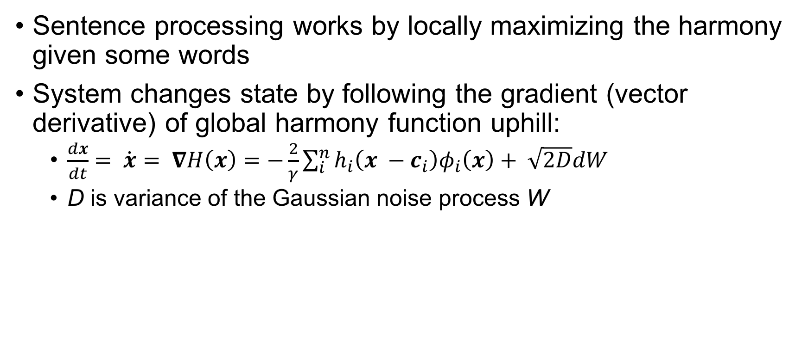
Dynamics I
Sentence processing works by locally maximizing the harmony given some words
System changes state by following the gradient (vector derivative) of global harmony function uphill:
$\frac{dx}{dt}= \dot{x}= ∇H\left(x\right)=−\frac{2}{γ}\sum_{i}^{n}{h_{i}\left(x −c_{i}\right)φ_{i}\left(x\right)}+ \sqrt{2D}dW$
D is variance of the Gaussian noise process W

Slide 12
Dynamics II
Harmony maxima of H are attractors of the dynamics, points to which the system returns after a small perturbation (Strogatz, 1994; Smith, 2018)
Given some initial condition, the system will settle toward a harmony maximum (modulo the effects of the noise)
In the implementation, the system settles until it is within some distance tol of an attractor

Slide 13
Processing
Reading/producing a word turns on its features, displacing the system away from an attractor
Noisy dynamics drive uphill until close enough to an attractor
Then, next word is processed
Notes:
Reading or producing a word turns on its features at a particular point in the sentence
This initial condition is not within tol to an attractor, so the harmony is low
The noisy dynamics push the system uphill to make a more well-formed structure
Once the system is within tol of an attractor, the next word is produced or read

Slide 14
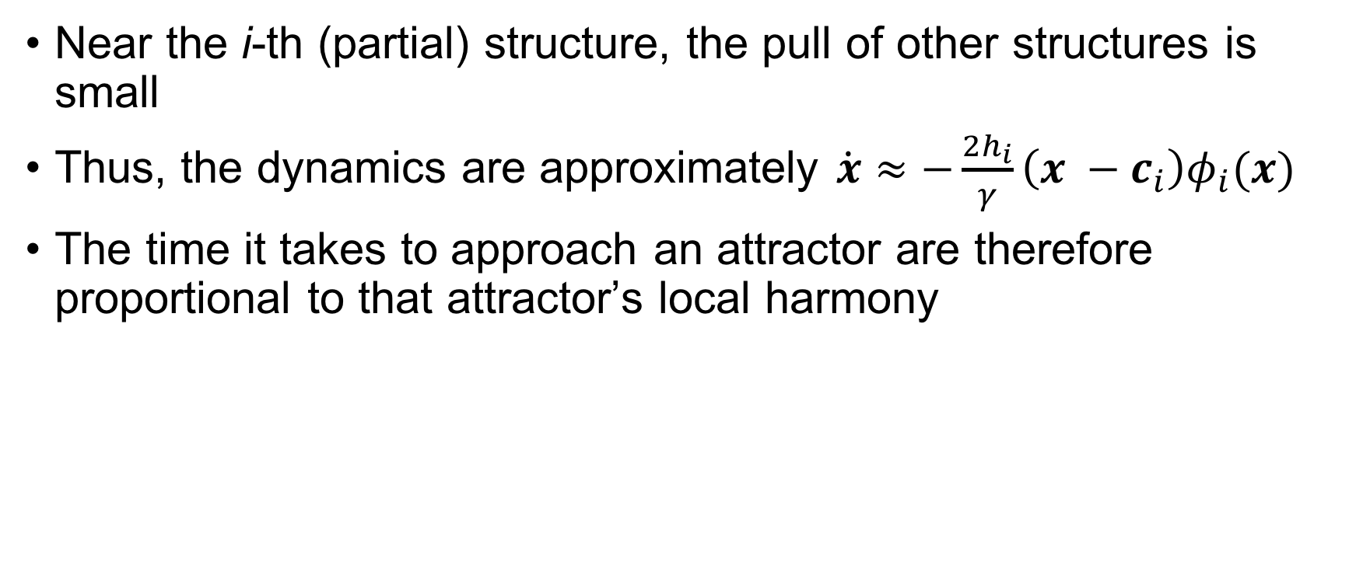
Processing times: Individual trials
Near the i-th (partial) structure, the pull of other structures is small
Thus, the dynamics are approximately $\dot{x}≈−\frac{2h_{i}}{γ}\left(x −c_{i}\right)φ_{i}(x)$
The time it takes to approach an attractor are therefore proportional to that attractor’s local harmony

Slide 15
Processing times: Many trials
Over many trials, the system will choose different attractors due to the noise
In general, the attractors will have different harmonies, so the average processing time will be the average of processing times to each attractor weighted by how often that attractor is chosen

Slide 16
Processing times: the whole picture
The time to build a structure is proportional to its harmony
Average processing time is weighted average of settling times to different attractors
Final effect on times: soft deflection
Trajectories get bowed toward high-harmony structures, even if the system eventually settles on some other attractor
<FIGURE>

Slide 17
Applying the model to local coherence
Simplifying assumptions:
System has already read The coach smiled at the player tossed/thrown
Now it has to settle on a structure (which link forms)
Most relevant structures (and the only two attractors): attach player as subject of tossed/thrown or attach tossed/thrown as modifier of player

Slide 18
Results
Processing times
Tossed condition: M = 159.073, SD = 27.692
Thrown condition: M = 149.794, SD = 24.698
Parse distributions
Tossed condition: 14% of runs → locally coherent parse
Thrown condition: < 1% of runs → locally coherent parse
Parameter settings chosen by hand (extra slides)
Notes:
(Dotlacil, 2018; Brasoveanu & Dotlacil, 2018) → undesireable
First published model of local coherence effects
Somehow quickly discuss how we might account for the interaction…

Slide 19
Discussion
In SOSP-TH, local coherence effects arise because a relatively good but still ill-formed competitor slows processing more than a very bad competitor (the former is built more often, driving average processing times up)
Grammar-supervised theories (e.g., Levy et al. 2009) can explain the Tabor et al. (2004) effects by assuming the input is noisy (the coach smiled at the player tossed… → the coach smiled and the player tossed…), however this fails for other cases of local coherence (Paape & Vasishth, 2015; see discussion in Kukona et al., 2014)

Slide 20
Exploring parameter space
For low- and very high-harmony competitors, processing times are fast
Determined by proportion of runs settling to the lower-harmony parse
Notes:
Plotted are means from 100 runs/point

Slide 21
An application: the ambiguity advantage
The son of the driver with the mustache was pretty cool read faster than the car of the driver with the mustache and the driver of the car with the mustache (Traxler et al., 1998)
→ Ambiguous sometimes faster than unambiguous
A challenge for competition-based models like SOSP-TH
But SOSP-TH’s nonlinear relationship between processing times and competitor strength might offer an explanation

Slide 22
Conclusion
SOSP-TH offers a transparent relationship between parse harmony and processing times (in contrast to previous self-organizing models)
It makes ungrammatical structures attractors, allowing them to handle phenomena that grammar-controlled theories struggle with (local coherence, agreement attraction, and encoding interference effects; see extra slides)
This work provides a flexible framework for further theoretical (e.g., mean first passage time analyses; Gardiner, 1985) and empirical (ambiguity advantage, garden path effects)

Slide 23
Extra slides

Slide 24
Params for local coherence simulations
Discretization time step = 0.01
Noise magnitude D = 0.001
Gamma = 0.25
Local harmony of grammatical structure h₀ = 1.0
Local harmony of locally coherent structure h₁ = 0.8 (tossed), h₁ = 0.5
2000 runs initiated from (0, 0)

Slide 25
Simple agreement attraction in production
Fill in from dissertation

Slide 26
Number agreement with pseudopartitives
Fill in from dissertation

Slide 27
Processing times under encoding interference
Fill in from dissertation

